Slide 1







DS5020
Mini Project
Customer Analysis
PCA or SVD
Aditya Vishwanath

Slide 2

Better suggestions, built in seconds, stored in MB
40%
3.5 s
3.7 MB
vs 27%
full nightly job
vs 161 MB
of customers get a correct suggestion in their top 10, vs a best-seller list
patterns + 'also bought' for 3,687 products + lists for 5,473 customers
stored model compared with the full customer × product table
Plus six named customer groups for marketing, with no customer IDs anywhere.
2

Slide 3
From 1.07M invoice lines to a leak-free matrix
1,067,371
776,577
9 Oct 2011
5,473 × 3,687
Raw lines
Clean lines
Time split
sparse matrix
2 Excel sheets, Dec 2009 – Dec 2011
Removed:
  Cancellation
  Guests
  Fees
  Duplicates
Last 2 months held out; model never sees them
97.95% empty · 5 MB sparse vs 161 MB dense
A hidden data issue I caught
'47503J' and '47503J ' (trailing space) were stored as two products. Stripping spaces merged them and stopped real rows being dropped.
Reproducible in one command
build_matrix.py rebuilds everything from the raw file, and its matrix is identical to the notebook's. Every decision is in the decision log.
3

Slide 4
PCA vs SVD: a tie, so I chose the faster one
Measure (k = 50) | PCA | Truncated SVD
Hit rate at 10 | 40.4% | 40.0%
Fit time | 3.3 s | 1.1 s
Works on the sparse table | Only with special solvers | Yes, natively
Needs the full 161 MB table to score | Yes (centred data) | No
Component 1 means | Buying volume (r = 0.98) | Buying volume (r = 0.98)
Why it's a tie
In purchase data, the biggest way any customer differs from the average is buying more or less. So centring (PCA) finds the same first pattern as SVD.
SVD wins on speed and on staying small.
4

Slide 5
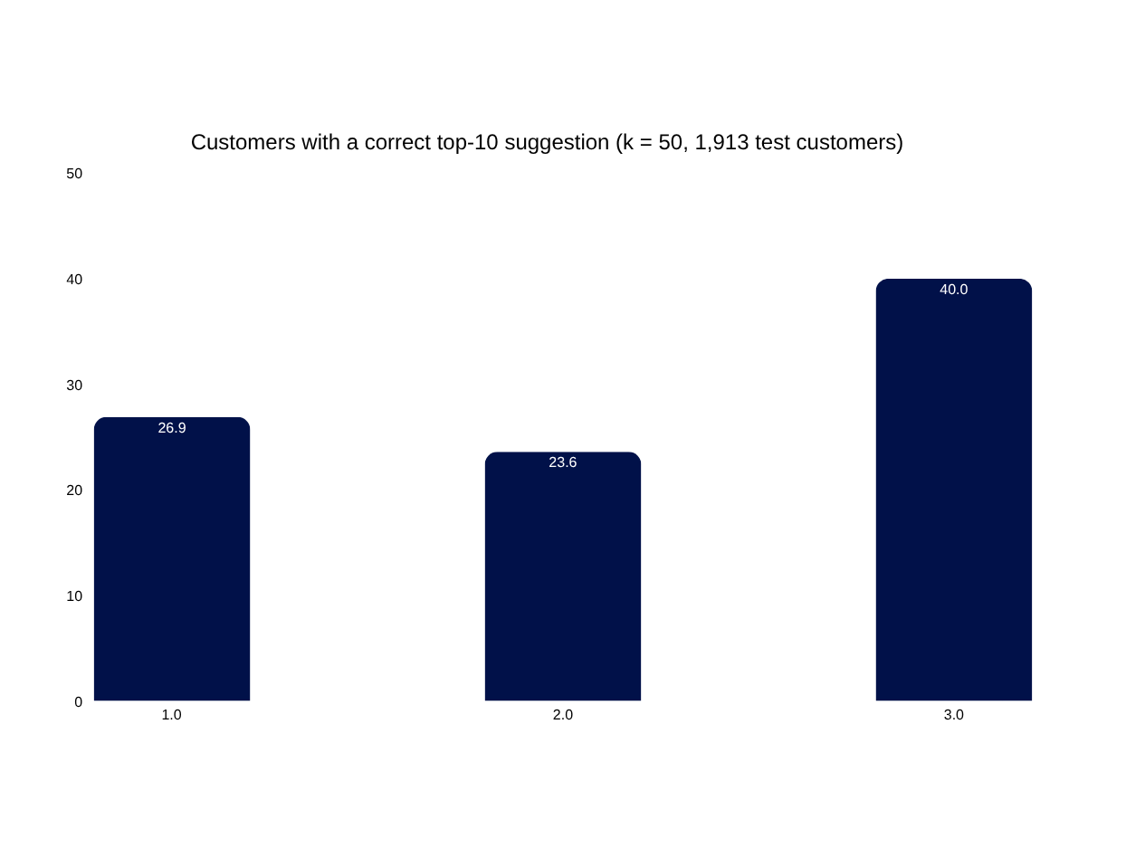
Cosine lost to best sellers; Dot product won
1
Cosine ignores popularity
A niche item bought by 12 shops counted as much as a hit bought by 2,000.
2
Dot product keeps it
Scoring with the rebuilt table puts popular, fitting items first.
3
k = 50, 1/0 values
k = 100 gave 40.3%, within noise, at twice the size.
5

Slide 6
6 customer groups marketing can name
23%
22%
19%
Cosy Comfort Gifts
Romantic Home Décor
Kids' Crafts & Games
Hot water bottles, chocolate-themed gifts · smallest orders
Heart decorations, lanterns, trellis · 98% UK
Crayons, paint sets, Ludo, coloured pencils
15%
14%
8%
Bags & Storage Bulk Buyers
Party Supplies
Vintage Tea Party
Jumbo bags in many designs · largest orders
Paper plates, cups, cake cases · most international
Regency teacups, plates, milk jugs
Groups overlap (silhouette ≈ 0.05): read each as a customer's main interest. Country barely separates them.
6

Slide 7




What could go wrong
New customers have no history; they see best sellers
Tested on Oct-Dec; may be weaker in quieter months
List repeats variants of same item
Settings chosen on the test months; slightly optimistic
7

Slide 8




What to do next
Live A/B test against best sellers
Max 2 items per product family
Retrain monthly: confirm on seperate months
Best sellers for new customers until first order
Recommendation: launch the box on a share of product pages and measure it against best sellers.
7

