Slide 1
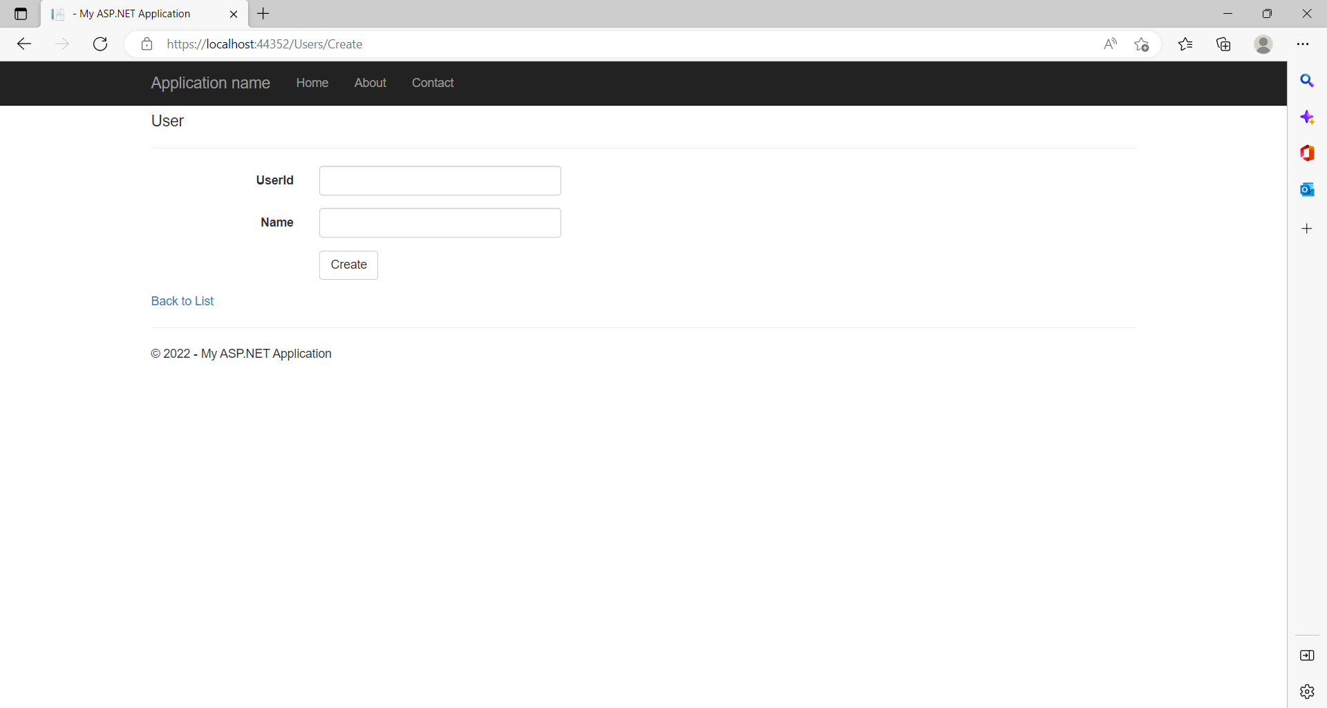
This is the Admin user page used for creating Users.
The Admin user can create the users of Doctors, Nurses and Patients.

Slide 2
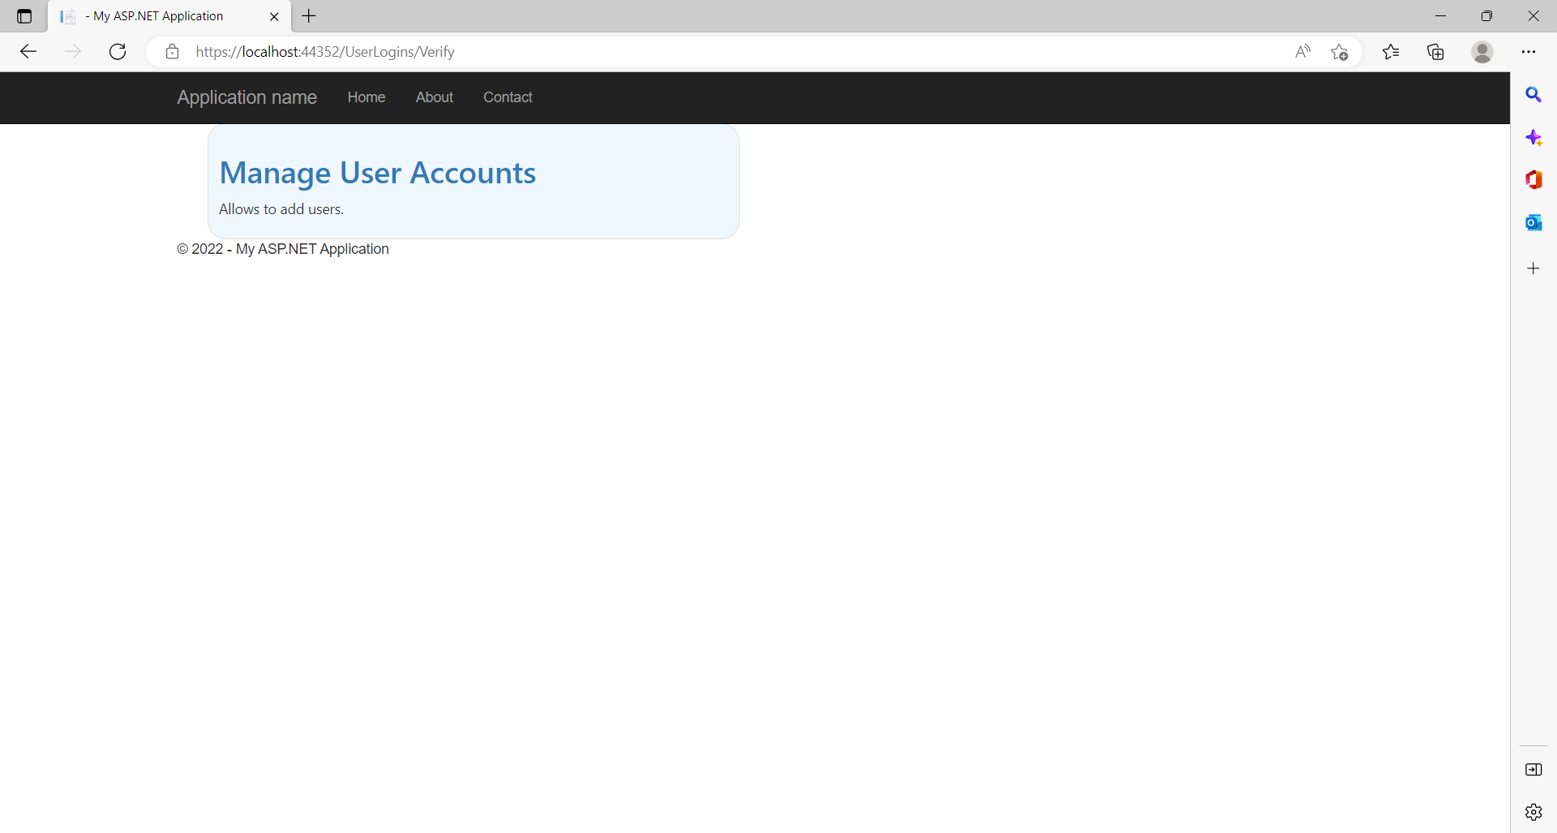
In this page we can manage the users; we can view the details of the users, add the users, edit the users and delete the users in the “Manage User Accounts” tab.

Slide 3
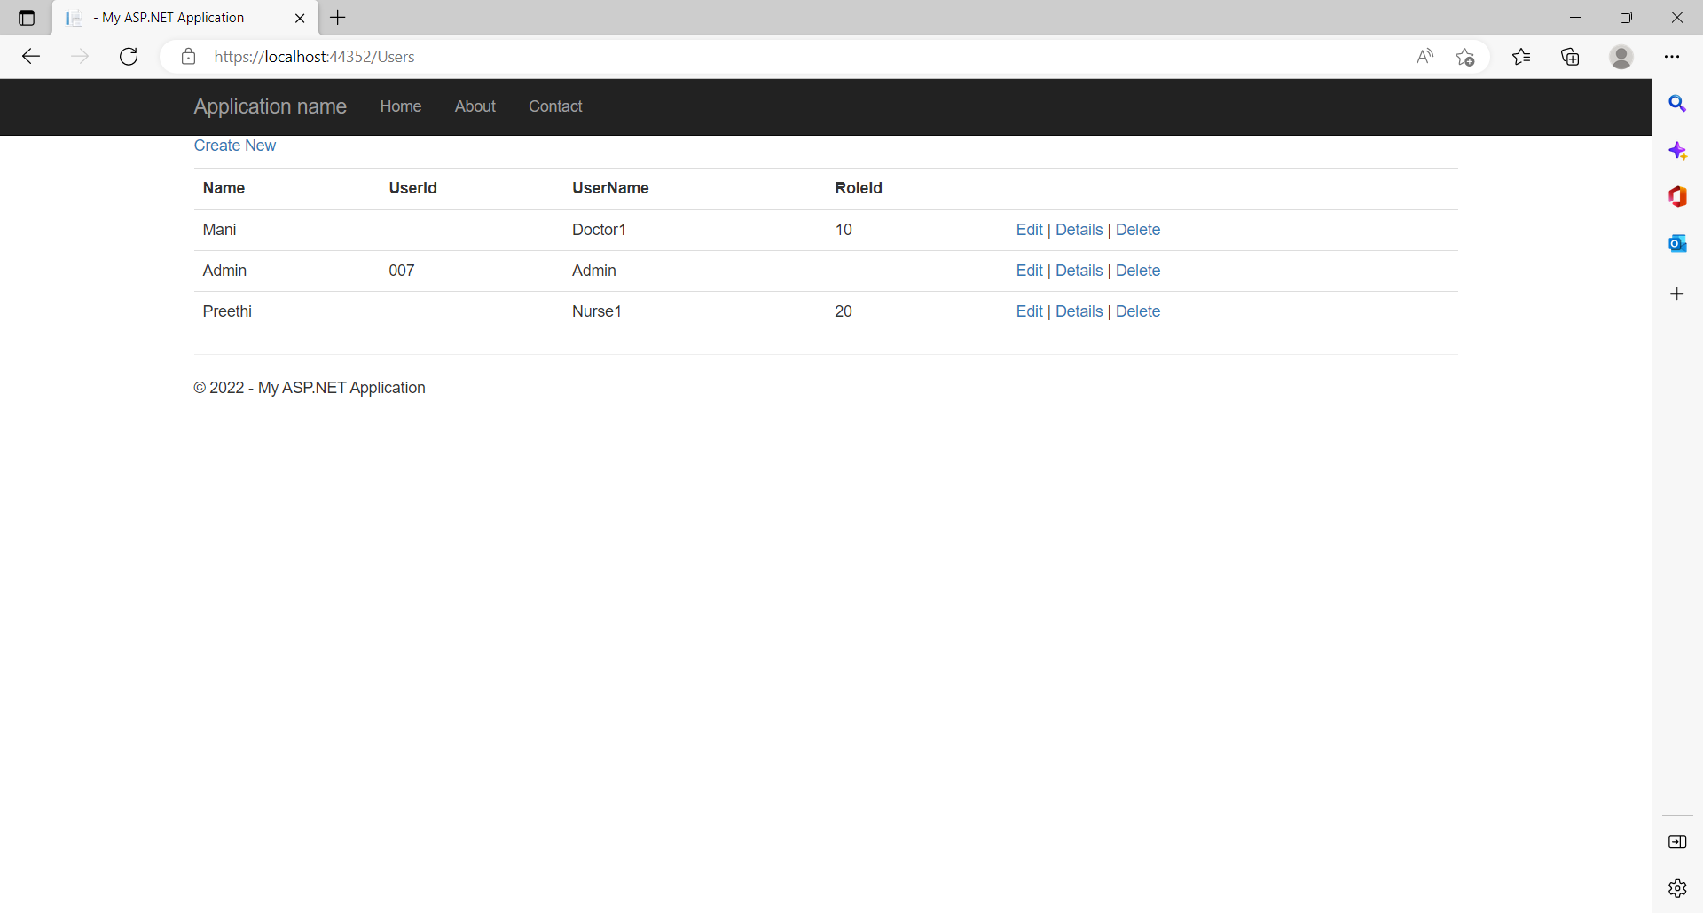
As mentioned in the previous slide above managing the users; this is the next page of it.
Here we can view the details, edit, delete and add the users of the Doctor, Nurse and the admin too.

Slide 4
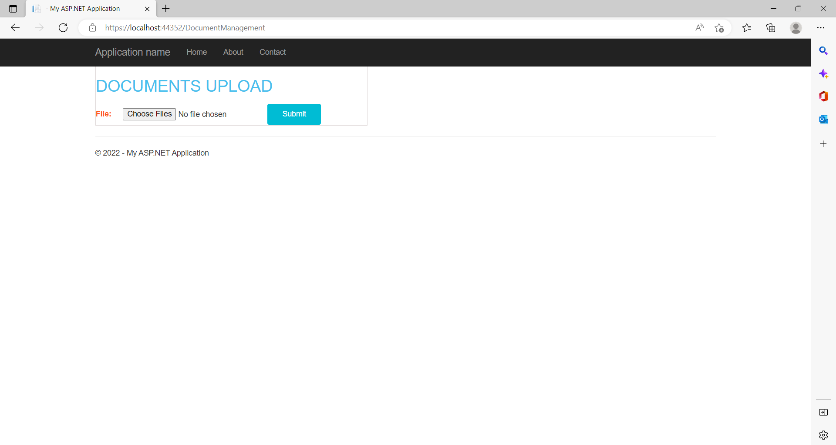
In this section we can upload all the patient related records (his/her complete medical history).
We can upload his previous health related documents, previous prescriptions and previous CT-Scans reports if any.
Based on these records the Doctors can have a clear idea and can easily diagnose a patient medical history and his medical problems and can suggest for any advance tests or scans if necessary based on the patient condition.

Slide 5
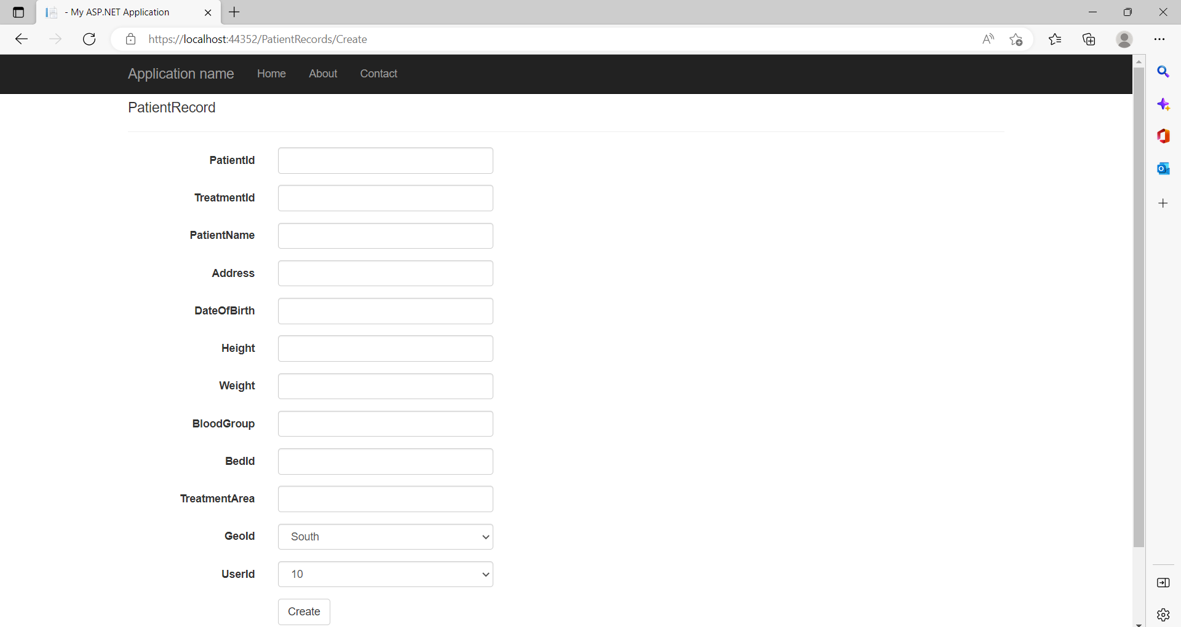
Here the admin or the nurse can create the user of the patient by adding his details and the user Id would be provided to the particular patient for future medical purposes if he wants to go with the same hospital.
Each patient will have a unique USER_ID. User ID will be in the format of the numbers only.

Slide 6
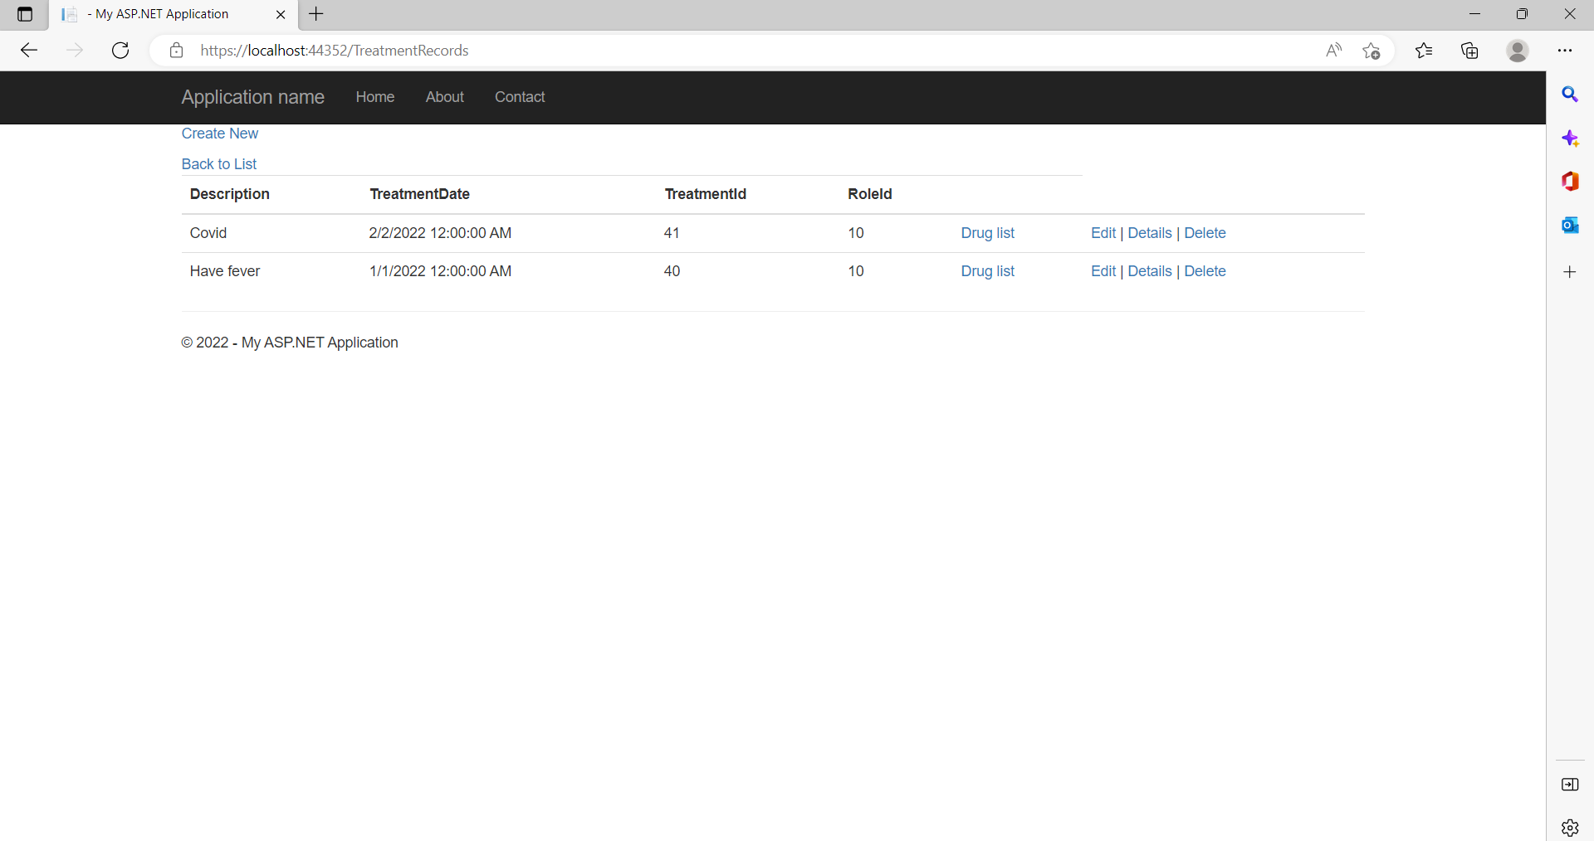
Herer the nurse will upload the documents of the patient as the tests are given.
There is also an option for the nurse to upload all the other documents of the patient Medical history.

Slide 7
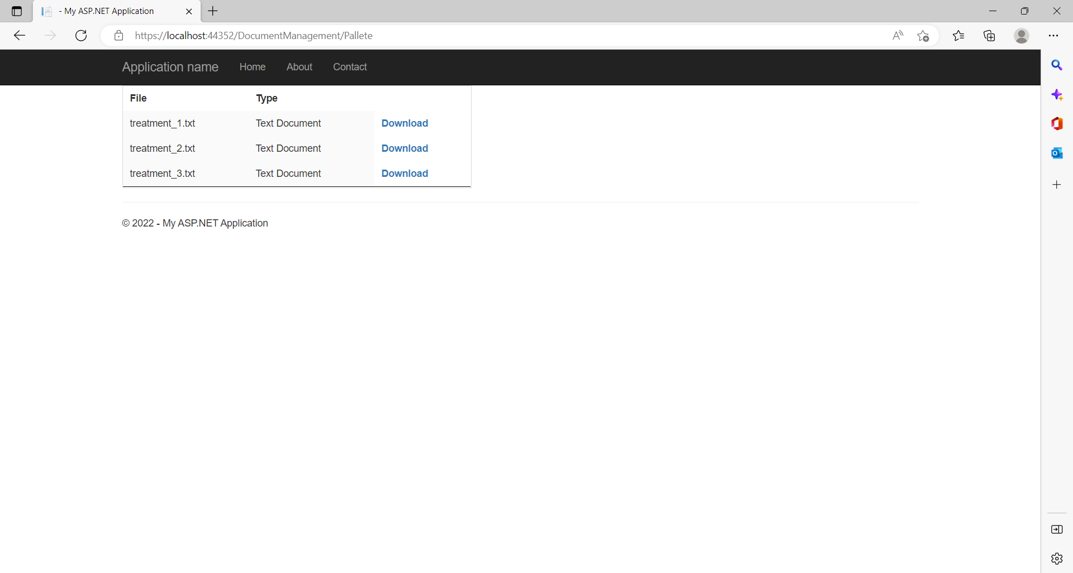
Here we can view the patient reports uploaded by the Nurse or the User Admins.

Slide 8
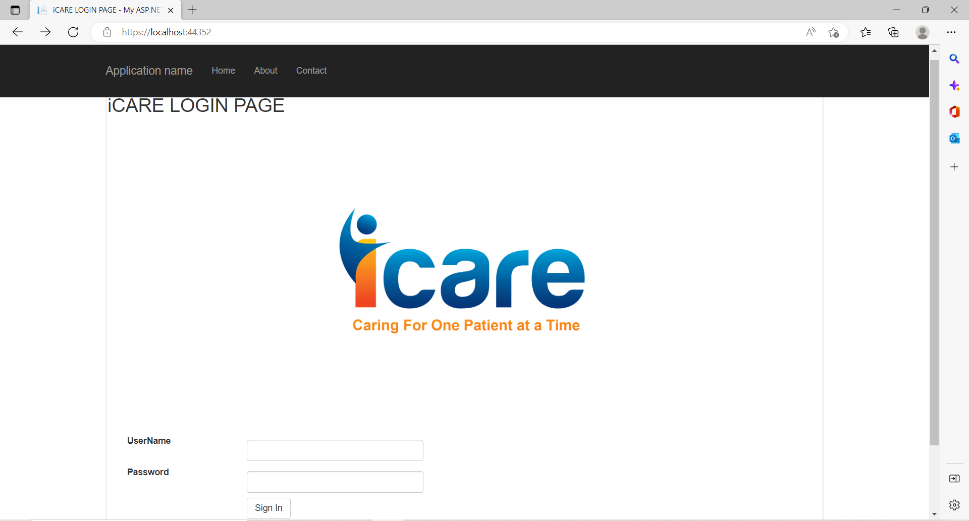
Finally this is the Login page for the the Doctor and Nurse.
Anyone can login here but the they can only view the options given by the “Admin”.

Slide 9
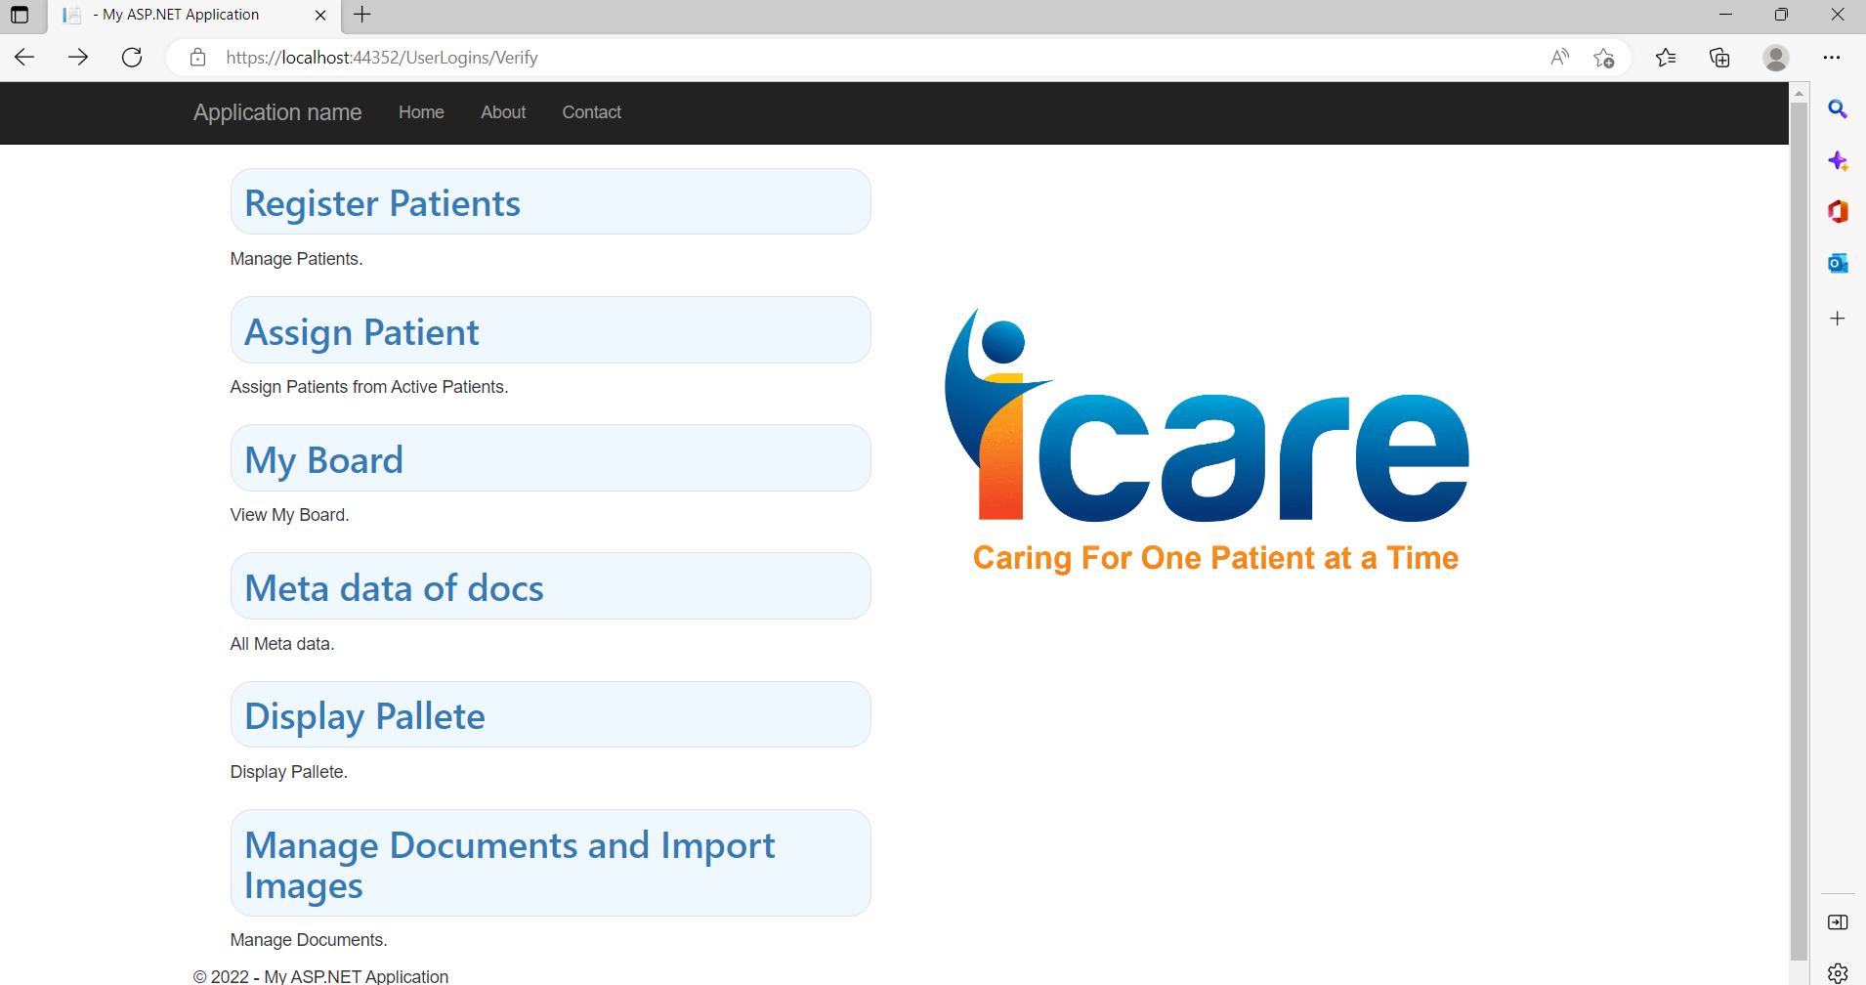
As discussed in the above image this is the screen after “ Signing-In “ by the Admin, Doctor or a Nurse.
Here we can select an option as per the drive path we wanted to go with.

