Slide 1
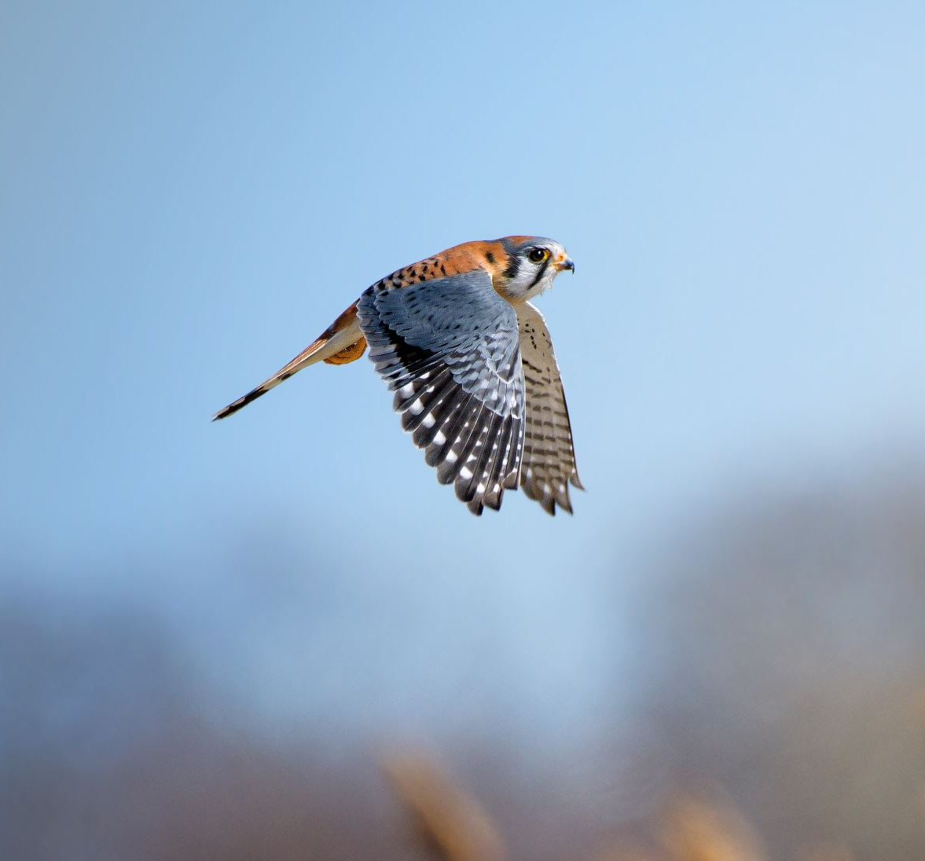
Bird Biodiversity Monitoring Mobile App (BBMMA)
Aditya Vashist
MSc Computer Science

Slide 2
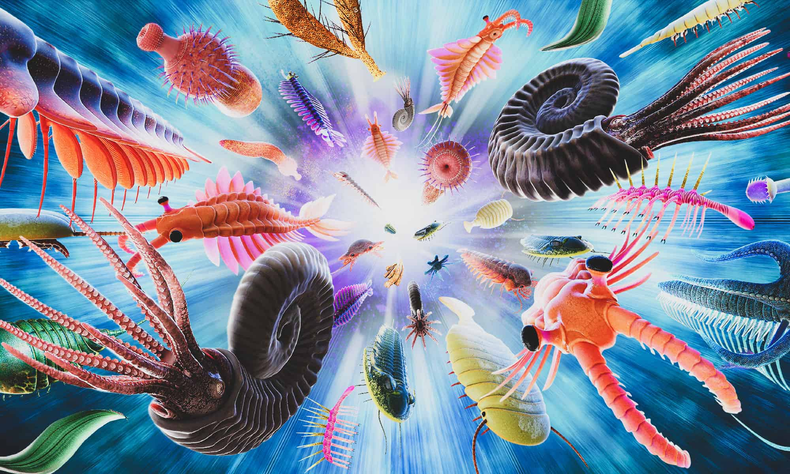
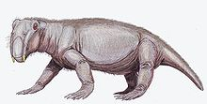
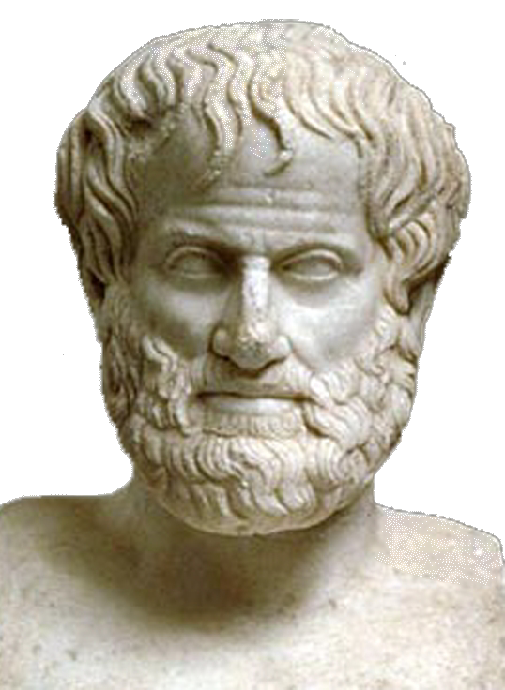
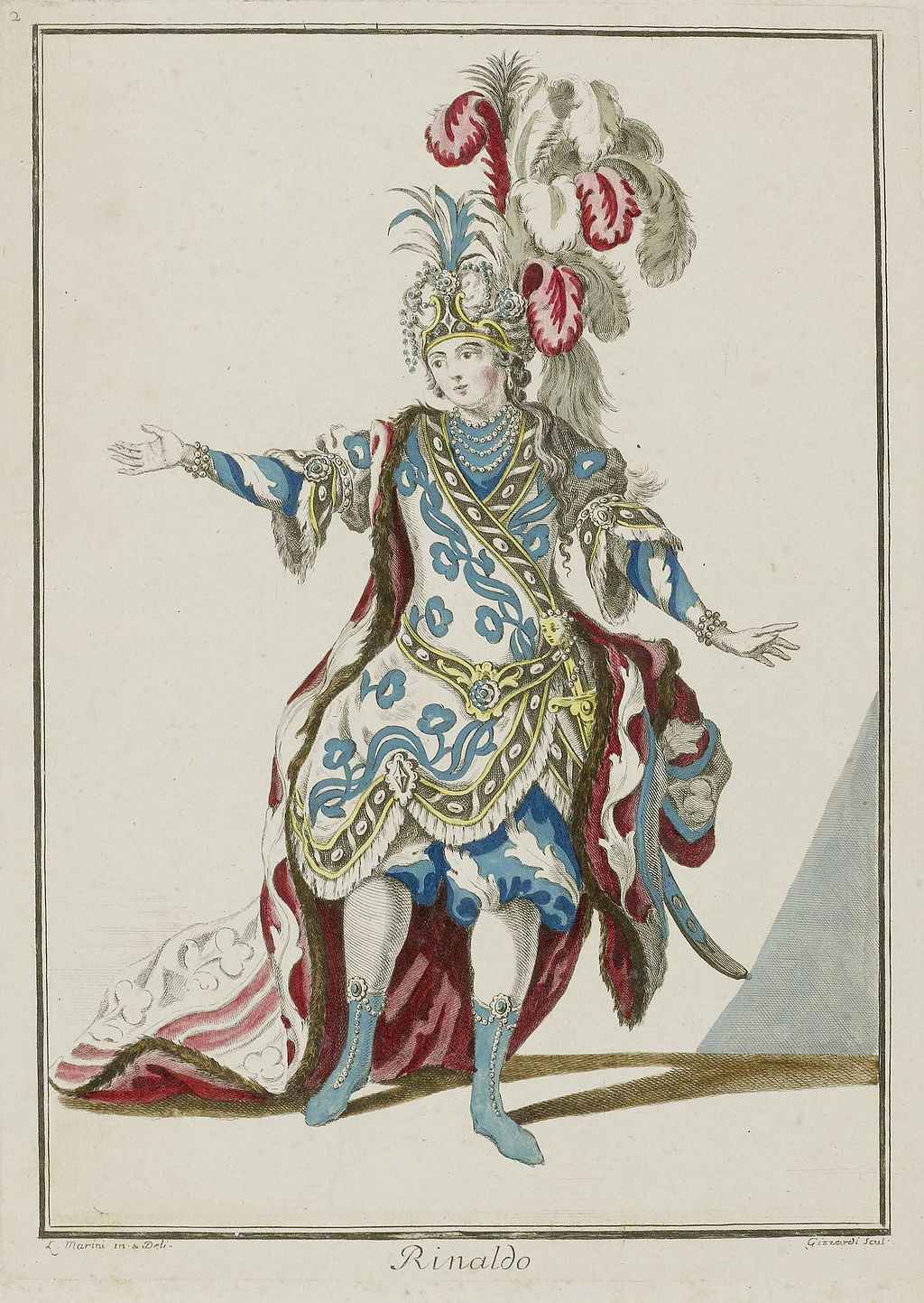
History of Biodiversity
~ 540 million years – Cambrian Explosion
~ 250 million years - Permian-Triassic
~ 350 BCE - Aristotle’s Classification System
17th century – Fixed Biodiversity Belief
Notes:
1- Cambrian Explosion
A- life on rapidly increased during this period,
B- multicellular organisms appeared in large numbers – shaping the early forms of biodiversity
------------------------------------------------------------------------------------------------------------------------------------
2- Permian-Triassic
A- Also commonly known as Great DYING - the most severe extinction event in Earth’s history
B- 96% of marine species and 70% of land species
C- Took 4-6 million years to recover
------------------------------------------------------------------------------------------------------------------------------------
3- Aristotle Classification System
A- Was the first philosopher to classify animals systematically
B- Based on physical traits, behaviours, and habitats
C- His system was influenced for over 2,000 years
------------------------------------------------------------------------------------------------------------------------------------
4- Fixed Biodiversity Beliefs
A- many believed that species had always existed and it never changed
B- Extinction was not recognised as a natural process
C- Influence by religious beliefs of the time

Slide 3
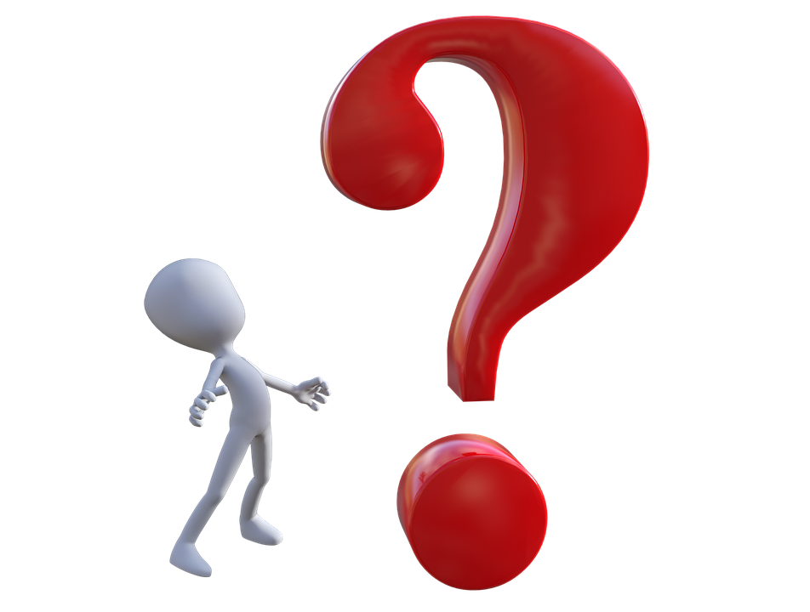
Answering the big question --- WHY?
Observe, Record and Monitor
Notes:
Biodiversity monitoring has been around for a long time; by creating this project, it encourages the contribution of citizen science – the study in which ordinary people can contribute to the enhancement of knowledge that scientists possess. BBMAP was established to allow citizens to monitor diversity within their area, explore, and document any encounters they may have. Users will be able to use photo identification, sound identification, and geotagging for their findings to help them learn about what exists in the natural world. Unique features like geotagging enable users to record their findings and display them on an interactive map; users can see all their conclusions, and with the educational tool, they can look up standard descriptions of what a bird may look like and sound like to assist them in identifying what they found during their explorations.

Slide 4

Aims and Objectives
1- Evaluate similar platforms
2 – Research suitable Technologies
3 – Develop and Build BBMAP
4 – Evaluate Feature
Notes:
Explain what these aims were
1- Evaluate Similar Platforms
Talk about:
A- BirdNet
B- BIOPHONE,
C- DEVELOPMENT ASIA (MOBILE APPS, DRONES, Remote Sensing,
E- Machine Learning And AI
------------------------------------------------------------------------------------------------------------------------------------
2- Research Suitable Technologies
A- Existing people who haved – (Convolutional Neural Networks) - in Image and Sound - Importance
------------------------------------------------------------------------------------------------------------------------------------
3- Develop and Build
A- Talk about the Dataset – CUB-200-2011 and Bird of Pray – what you did with them - train and test – data augmentation
B- Built my own CNN model
------------------------------------------------------------------------------------------------------------------------------------
4- Evaluate Functionality and Feature
A- Talk about the uniqueness of BBMAP – Markers – Cheat Sheet – Reverse Geo Coding

Slide 5


Platforms – React Native – Expo
It lets users build mobile applications and allows hot reloading for instant updates
An open-source framework, where uses can find pre-built libraries
Notes:
Reason for choosing React Native
------------------------------------------------------------------------------------------------------------------------------------
A- React Native allows it to be both in Android and iOS
B- It uses JavaScript and React, making this easy-to-learn
C- Allows hot reloading, helping with quick and instant updates and no need to start to restart the app
------------------------------------------------------------------------------------------------------------------------------------
Reason for choosing Expo
A- An opensource framework that allows the creation react native
A.1 – Things like Camera Location is pre-built libraries, users can test and deploy, making it perfect for mobile application

Slide 6
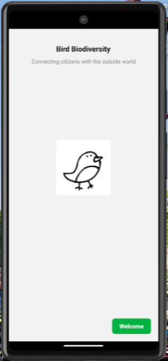
Welcome
Providing the user with the welcome screen when they open the app so they can start their biodiversity adventures.
Notes:
Explain the minimalist approach, the same UI throughout the whole app to avoid confusion to the user, one theme for smooth UX

Slide 7
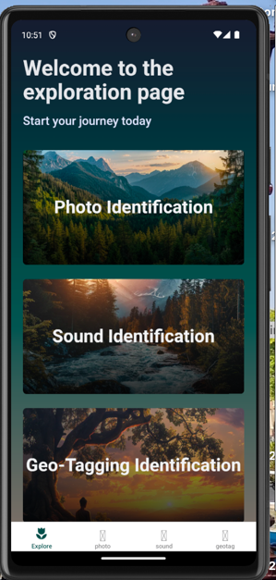
Landing Page
A place where users can go to each section of the application.
Notes:
A user can go to the explore screen (where they can decide whether they want to identify a bird through a photo or sound or even use the interactive map feature (geotagging) to display their findings in real-time

Slide 8
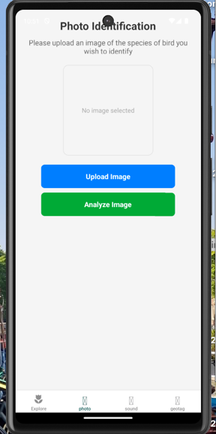
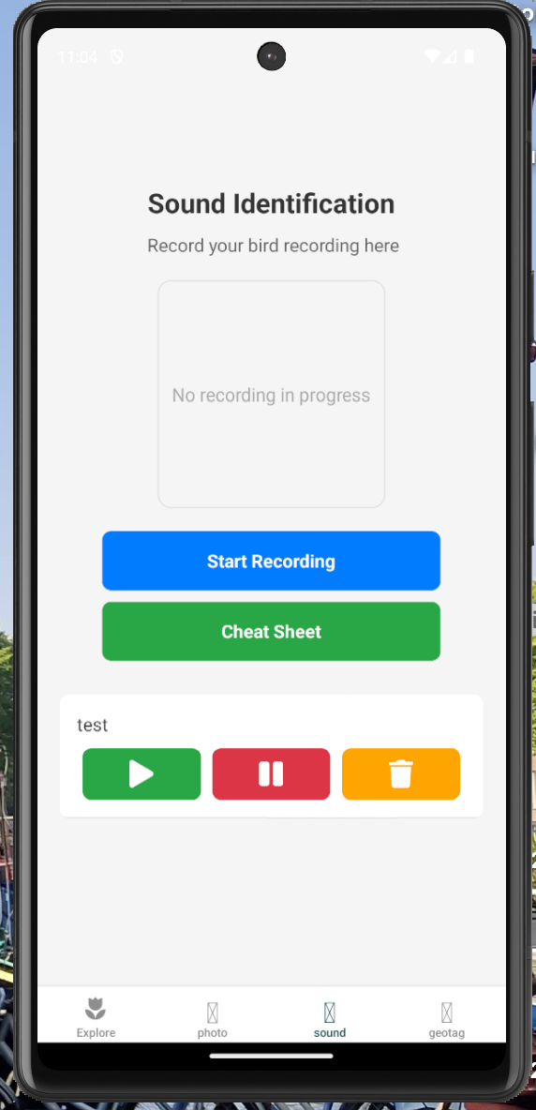
Photo Identification and Sound Identification
Users can upload photos from their galleries. When clicked on, the analysis will tell them what bird it is.
Users can start a recording of their surroundings and get analyse of the bird they discovered.
Notes:
Users can upload a photo from their gallery through the photo identification feature, and when clicking on the analysed image, it will inform the user what bird it is.
Users can start a recording of their surroundings, and once stopped, they can save their findings with a unique name (shown in slide 10), if the sound identification recognises an existing name, an alert appears telling users to try again, and users then can also listen to their recordings, resume it where they left off and delete if needed. Plus, if the user leaves any section empty or clicks a button that’s not filled in same as geo-tagging, the application will let the user know)

Slide 9
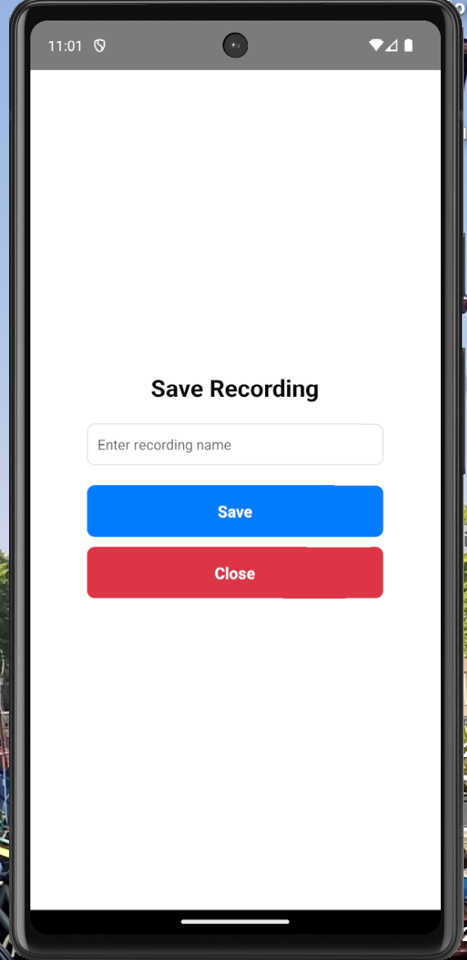
Save
Users can save their findings with audio
Notes:
Explain this saving feature - Once the user has stopped their recording, they can save their findings with a unique name. If the existing names or even sections are left, the device will let the user know – the same as geotagging.

Slide 10
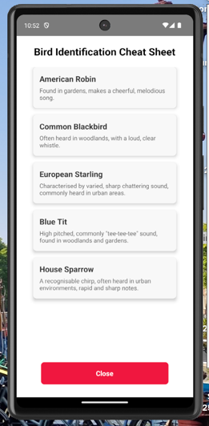
Educational Guide – “Cheat Sheet”
A reference guide
Notes:
An educational tool to help users name their recordings and fill information at the geotagging side with some common birds, and used to educate, linking to the aim of raising awareness of biodiversity.

Slide 11
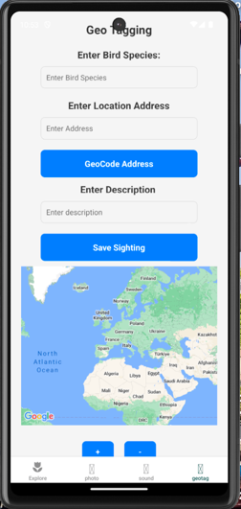
Geotagging
A place to see user findings of birds
Notes:
This section allows users to put in the name of their bird, the exaxct location (used reverse geocoding) and the description of the bird of what they saw and then with that information a physically marker is placed on the map to show the user that this is what they found out while exploring. When clicking on the marker, the user can see all their information with they inputted in and the longitude and latitude also, this linking with the record, observe and monitor.

Slide 12
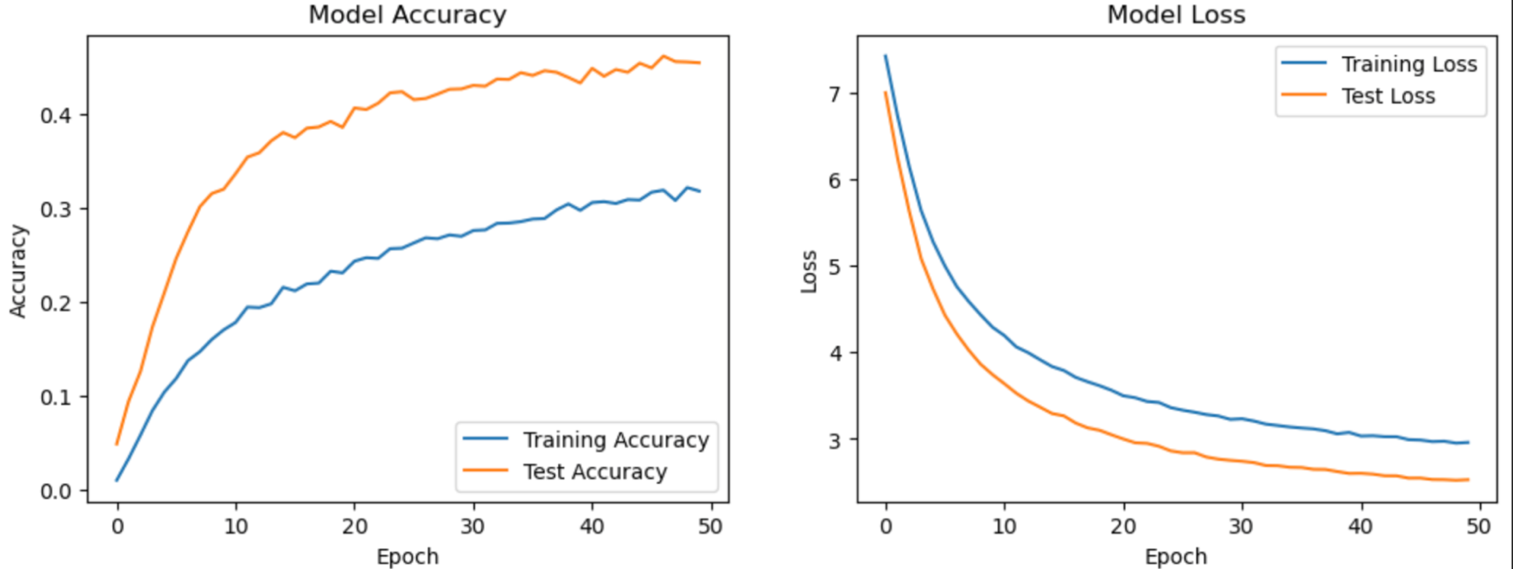
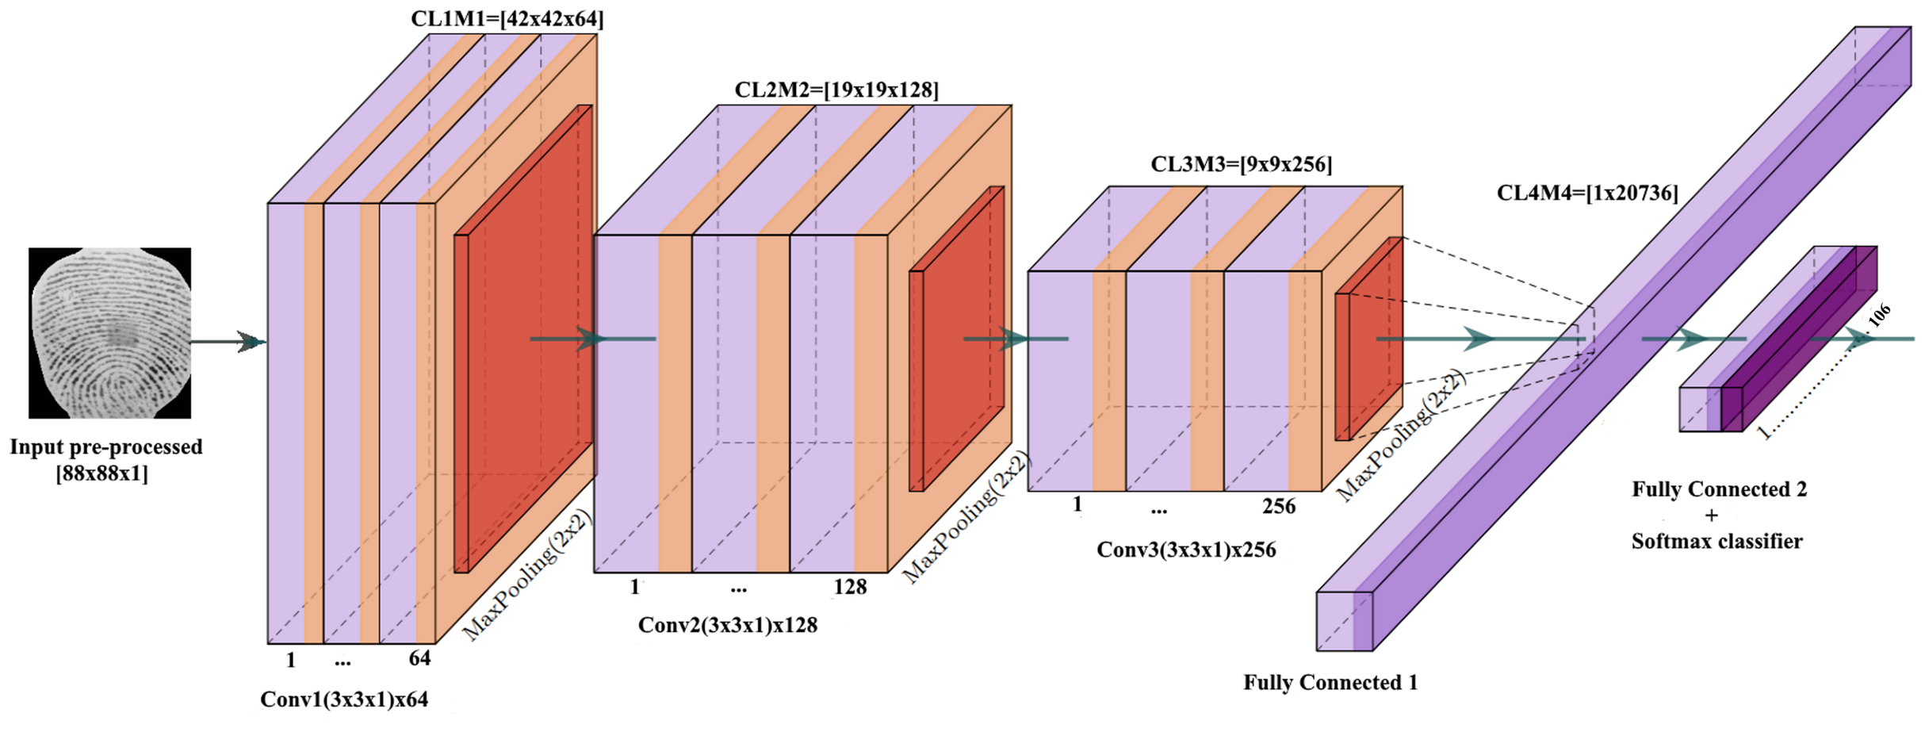
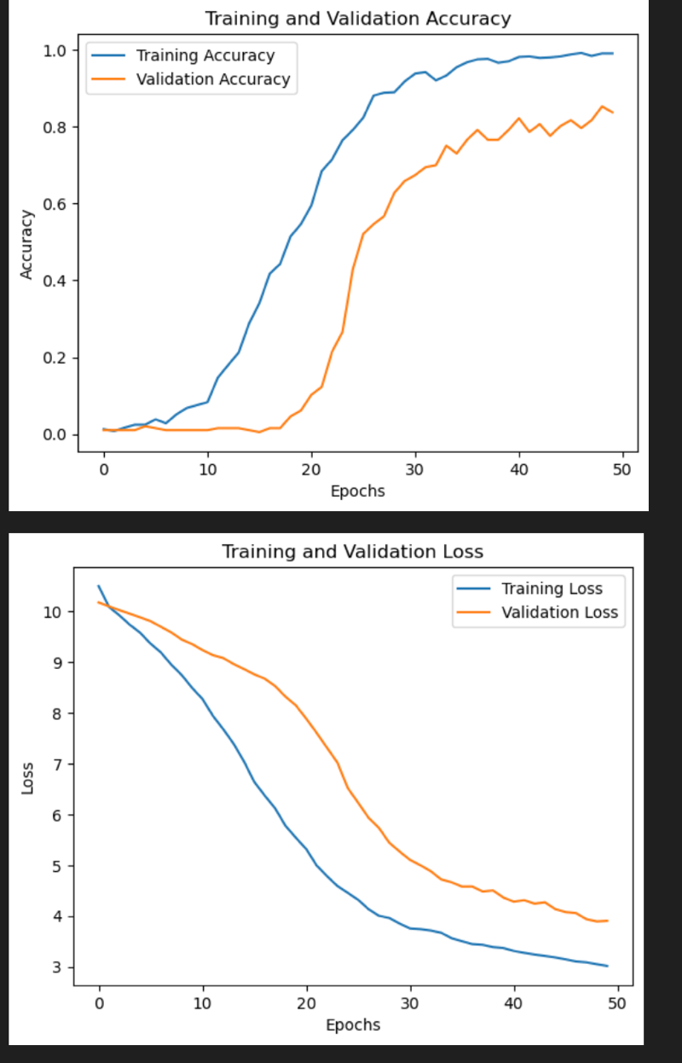
Deep Learning Model
Result of Image and Sound CNN model
Notes:
Users can add related images through the image identification feature. Using CNN, the image learns key features and displays the user with an output of the information it learns.
The same is true for Sound identification, but first, the user records audio. That audio file is then saved and resized into a spectrogram, and the same process begins for sound classification. Both use CNN to learn and display to the user what the model thinks the outcome is. Data augmentation, such as fine-tuning and dropout, ReLU allows the system to focus only on relevant parts to achieve results and explain (what epochs mean)

Slide 13
Demo
Let's see how it works

Slide 14
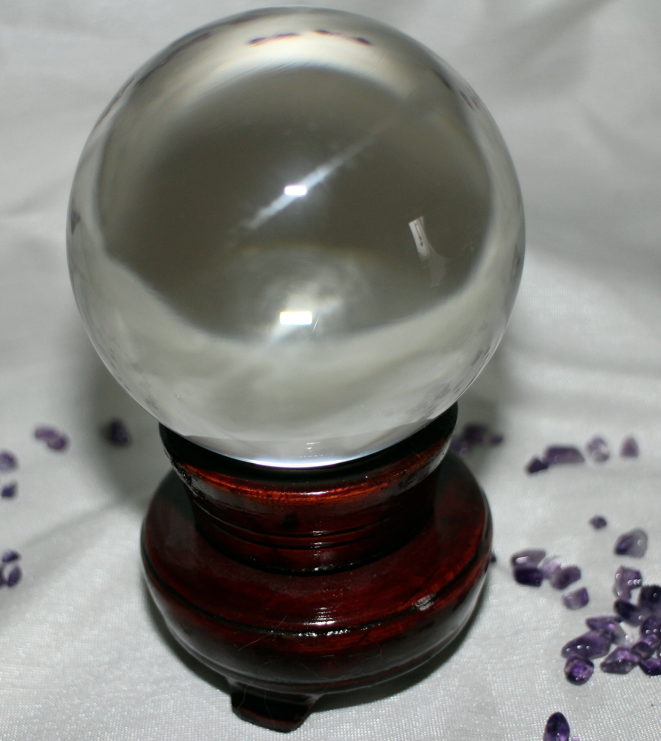
Future Works
Augmented Reality
Real-Time Camera Identification
Refining the educational tool
Notes:
The user can use AR to see the markers that were by them in real time and expand to bigger communities where they can see others' findings, creating a sense of community and expanding.
Users can use their phone, and simply by using their phone, real-time detection will be made of what bird it is and key information it is – helping it to become an educational tool for users to use.
By refining the educational tool, users will have more of an option to filter through large varieties of birds to help them narrow down the search and help them name their bird findings and even learn from it the use of filtering, for example, by location, colour and you will be a starting point for this future engagement.

Slide 15
Thank You

