Slide 1
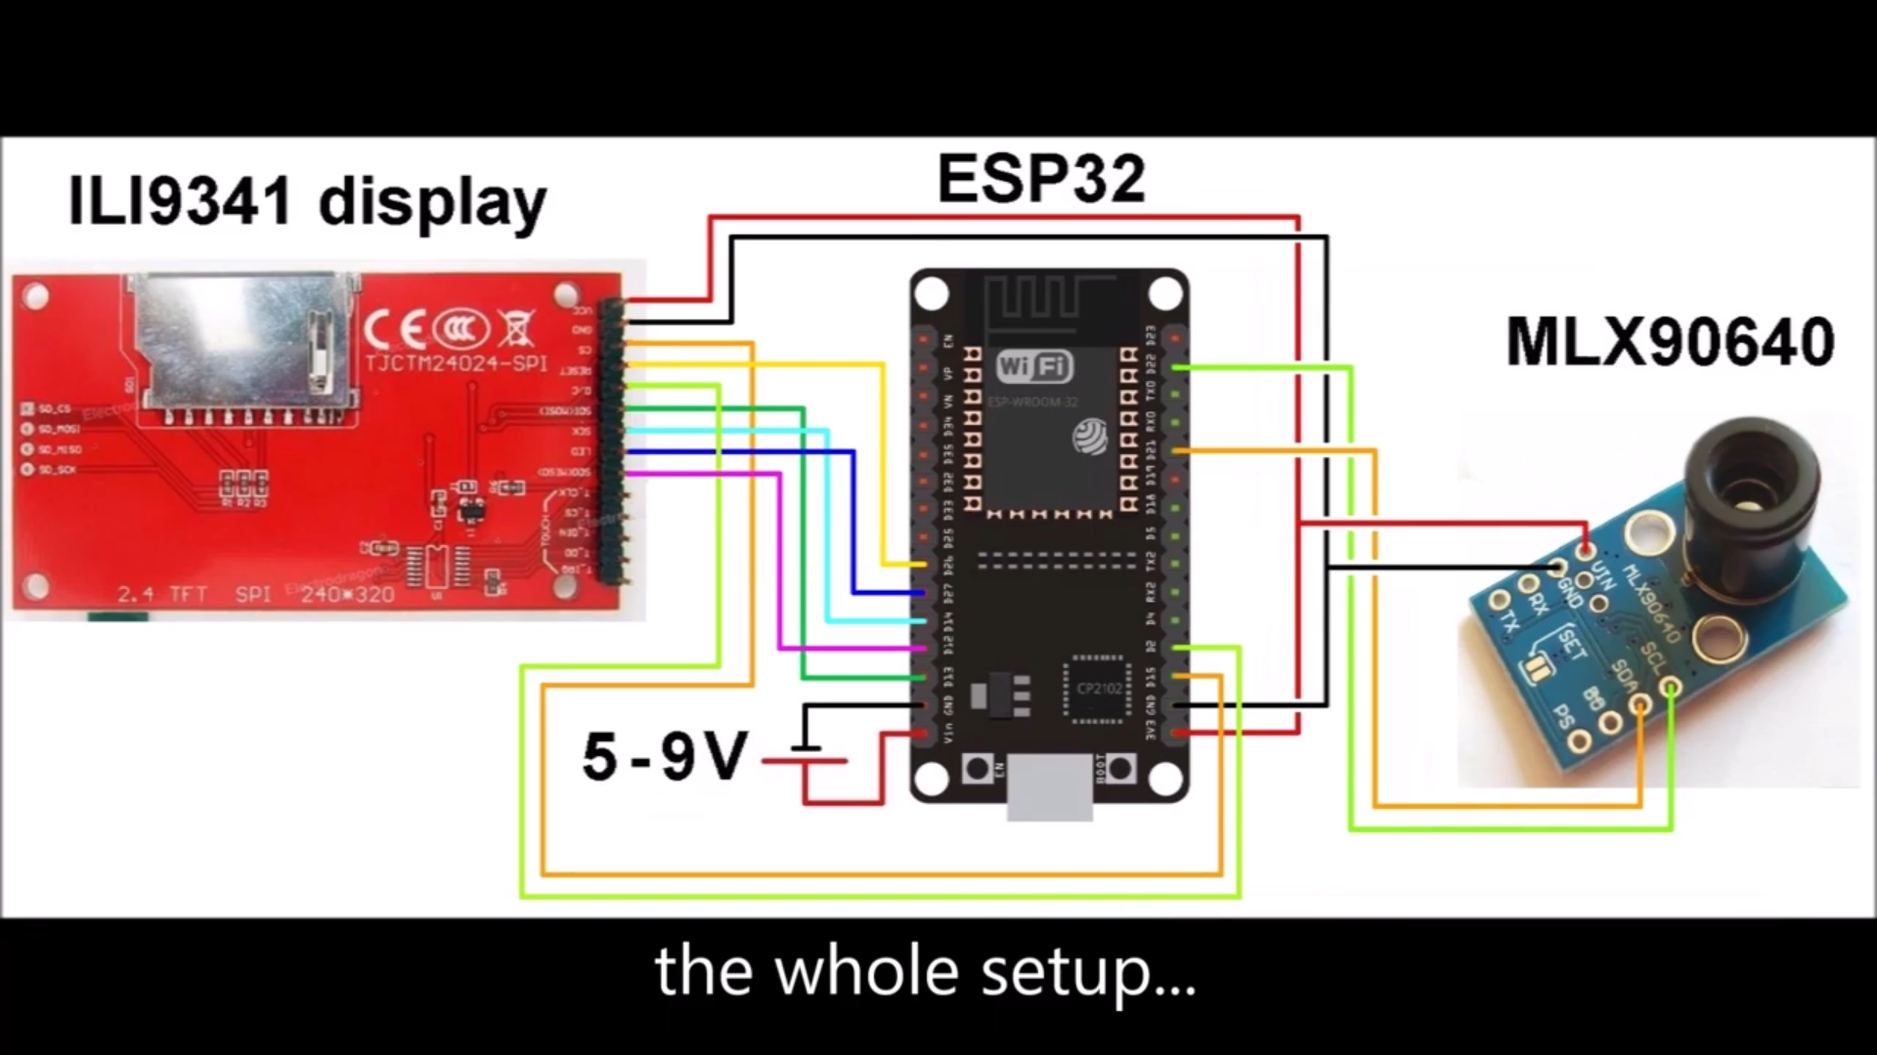
https://www.instructables.com/Infrared-Thermal-Imaging-Camera-With-MLX90640-and-/
Techtonics Thermal Imaging Camera – MLX90641 16×12 IR
Array with 110° FO

Slide 2
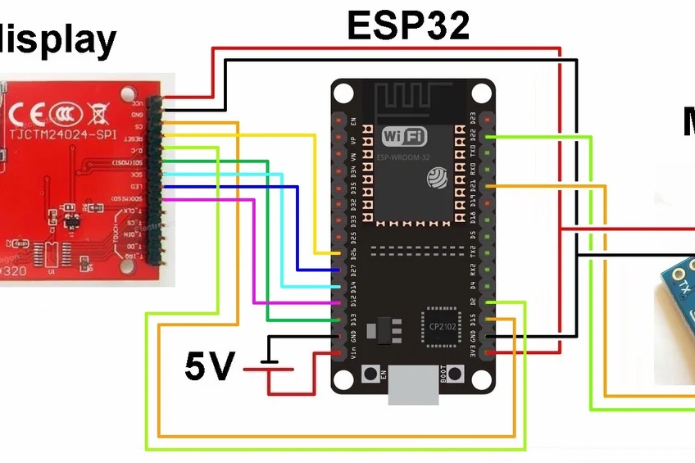

Slide 3
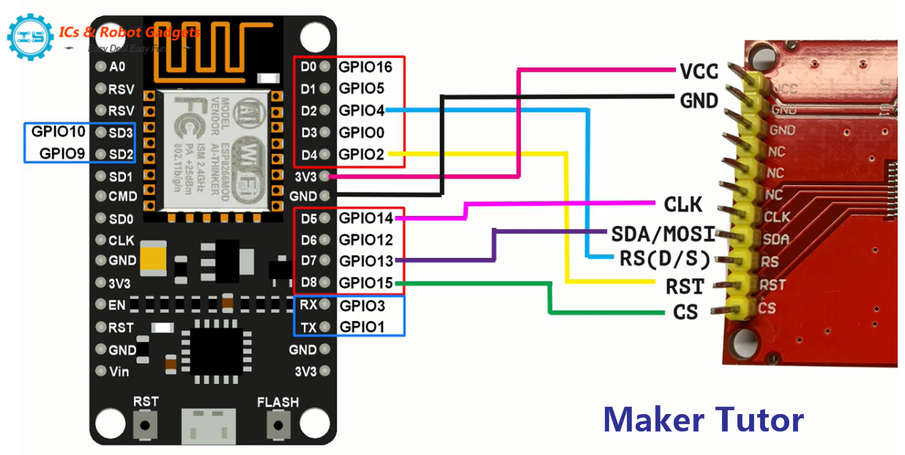

Slide 4
#define TFT_CS 33
#define TFT_DC 18 //pin in the range 0-31
#define TFT_RST 32 // Reset pin, toggles on startup
#define TFT_WR 19 //must use a pin in the range 0-31
#define TFT_RD 23 // Read strobe control pin
#define TFT_D0 13 // Must use pins in the range 0-31
#define TFT_D1 12
#define TFT_D2 14
#define TFT_D3 27
#define TFT_D4 26
#define TFT_D5 15
#define TFT_D6 2
#define TFT_D7 4

