Slide 1
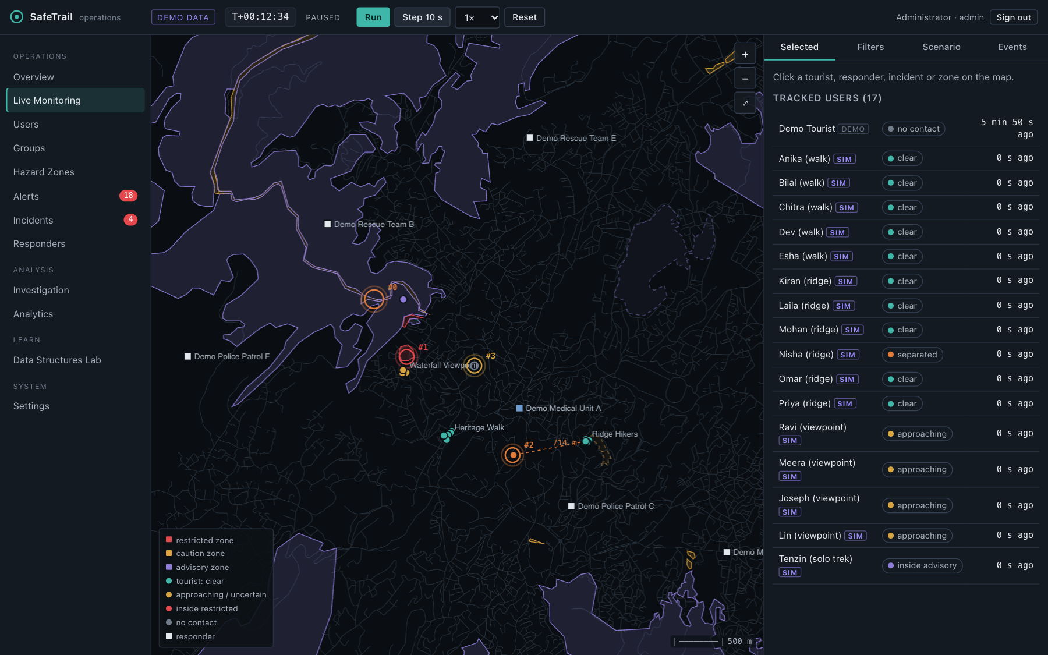
SafeTrail
Geofencing and incident response for tourist safety, built on hand-written data structures in C++17
Live Monitoring: simulated tourists (SIM) over real OpenStreetMap hazard zones and roads around Shillong
Data Structures course project · github.com/adivishall/safetrail
Notes:
SafeTrail is a geofencing and incident-response system for tourist safety in low-connectivity regions, built on hand-written data structures in C++17.

Slide 2
Where people get hurt, phones lose signal
Remote treks in Meghalaya: cliffs, rivers, closed roads
Help arrives late when nobody knows who is where
GPS is noisy: a fix is a disc of ±5–35 m, not a point
Every fix must be checked against every zone that could contain it
O(n) per fix
a linear scan of every hazard zone, for every person, every second
100,000 zones
the scale the indexes are measured at
Offline
the phones that need it most have no network
Notes:
In the hills around Shillong, cliffs, rivers and closed roads are where people get hurt, and phones lose signal exactly there. Help is late when nobody knows who is where. Checking every position against every hazard zone is O(n) per GPS fix — the cost the whole design is about.

Slide 3
What SafeTrail does, end to end
1
2
3
4
Opt-in tracking
Geofence
Alerts
Incidents
consent + session, per user
inside / outside / uncertain
enter, approach, dwell, SOS
related alerts → one card
5
6
7
8
Dispatch
Groups
Offline
History
nearest responder, A* route
separated members detected
phone evaluates, syncs later
past state + Merkle evidence
Notes:
People opt in. Every fix is checked against hazard zones, with GPS uncertainty treated as a disc, not a point. Transitions become alerts, related alerts become incidents, the nearest responder is routed along roads, groups that split are noticed, phones that go offline keep working and sync later, and everything is kept in a tamper-evident history.

Slide 4
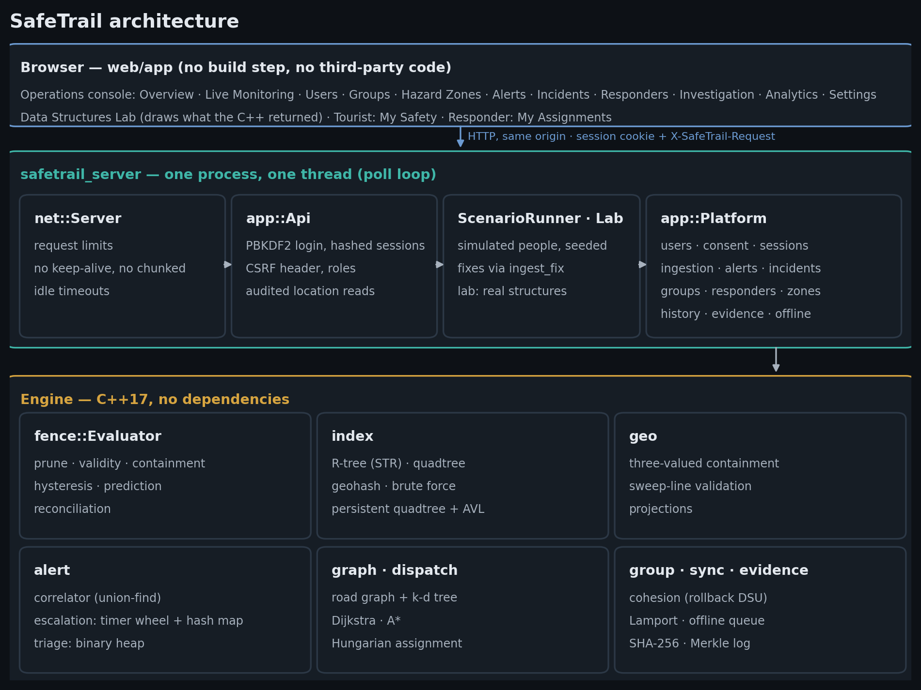
Three layers, one process, no dependencies
Engine
indexes, geometry, the 9-step evaluator
Platform
users, consent, alerts, incidents, groups, responders, history, offline sync
Server + console
one thread: every update in one total order, no locks
Notes:
Three layers: the engine — indexes, geometry, the evaluator; the platform — users, consent, sessions, alerts, incidents, groups, responders, history, offline sync; and a single-threaded HTTP server with a web console. No database, no map service, no dependencies.

Slide 5
Five core structures answer the geofencing questions
Structure | Answers | Bound
Brute force | the oracle: which zone boxes meet this box? | Θ(n)
Quadtree | same, by splitting space into quadrants | O(log n + k) expected
R-tree + STR packing | same, by grouping items into envelopes | O(log n + k) expected
AVL interval tree | which rules were in force at time t? | O(log n) per update
Persistent quadtree | what did the zone set look like at 14:32? | O(depth) nodes per change
k = number of results. No spatial library, no std::map / set / unordered_map / priority_queue.
Notes:
Brute force as the oracle; a quadtree that splits space; an R-tree that groups items, bulk-loaded with STR; an AVL interval tree for validity windows; a persistent quadtree for every past version.

Slide 6
Every supporting structure has a job in the product
Binary heap
Union-find + rollback
Dijkstra / A* frontier, alert triage
group split, alert → incident
Hash table (probing)
Timer wheel
users, sessions, sync de-duplication
unacknowledged alerts escalate
Ring buffer
k-d tree
last 64 fixes: speed, stillness
snap to 144,090 road junctions
Adjacency list graph
Merkle tree
Dijkstra, A*, Hungarian dispatch
provably unedited event log
Notes:
A binary heap for Dijkstra, A* and alert triage; union-find with rollback for groups and incidents; an open-addressing hash table for users, sessions and sync; a timer wheel for escalation; a ring buffer for recent fixes; a k-d tree for snapping to the road network; a Merkle tree for evidence.

Slide 7
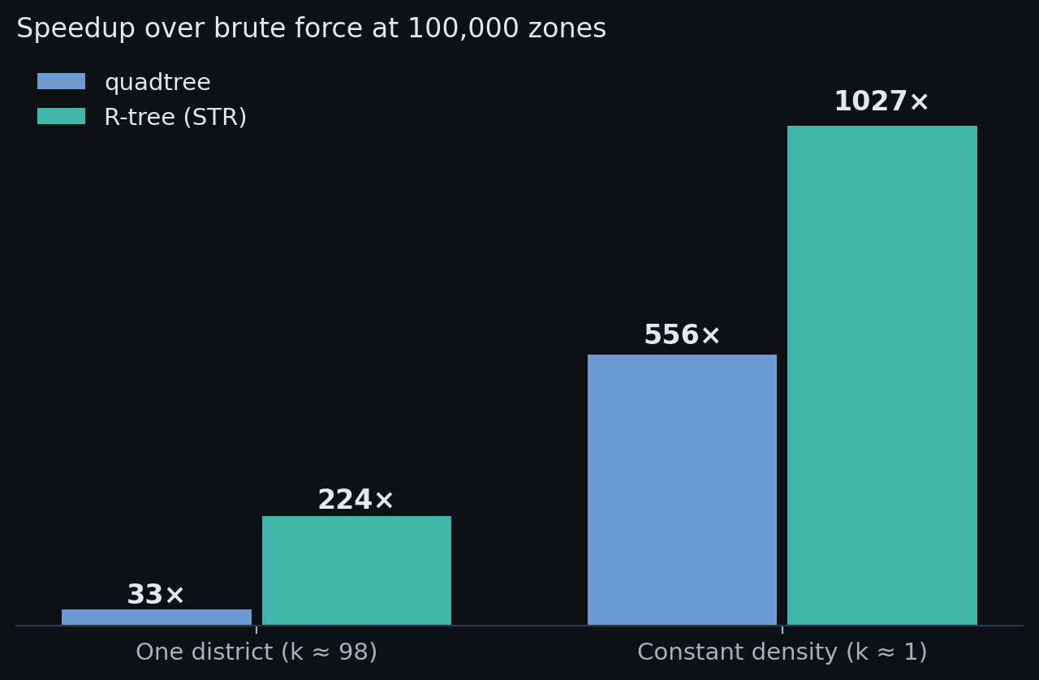
Indexes make it hundreds of times faster, never different
0 mismatches
every index returns exactly the brute-force answer
6.3× faster
STR-packed vs insertion-built R-tree queries
≈ 75 % fewer
junctions settled by A* than by Dijkstra
Apple M4, medians of 11 interleaved rounds, paired ratios — bench/results/*.csv, regenerated by make bench
Notes:
At 100,000 zones in one district the R-tree answers 224 times faster than a scan, the quadtree 33 times — identical answers. At constant density the speedups keep growing, because the answer size k is what bounds them.

Slide 8
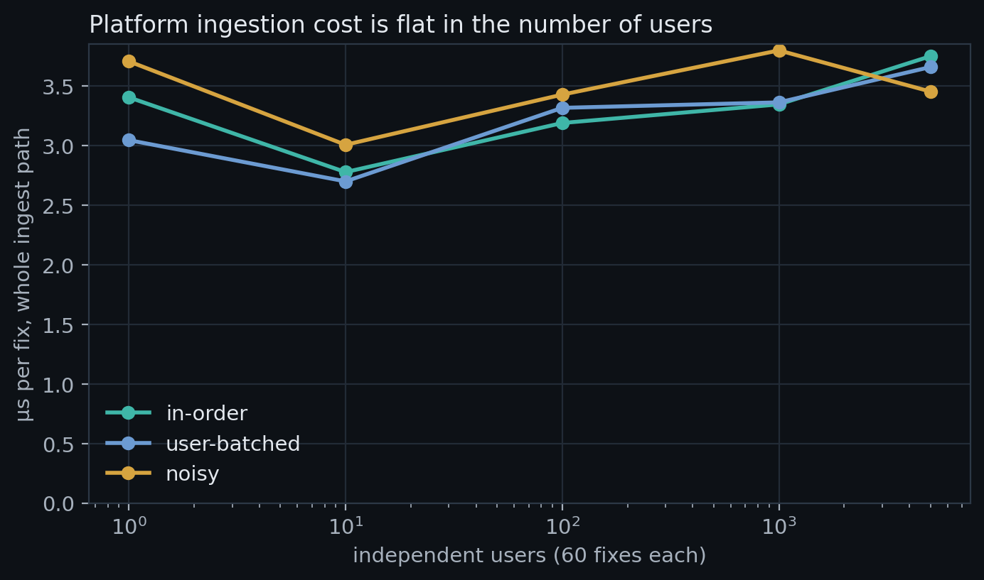
Thousands of independent users, the same cost per fix
≈ 300,000
fixes per second on one core
≈ 6.9 KB
of state per tracked user
Exact
duplicate and late-fix counters in the noisy stream
Notes:
The platform ingests a fix — validation, ordering checks, trail, evaluation, alerting — in about 3 microseconds, flat from 10 to 5,000 users. That benchmark also found a real bug: alert bookkeeping was quadratic until alerts were indexed per user.

Slide 9

Correctness is tested, not assumed
51
12,066
test files
checks, 0 failed
28 / 28
29
injected bugs caught
end-to-end HTTP checks
Oracles for every fast structure
Invariant audit after every operation
Same events under all four indexes
Same bytes on macOS and Linux (CI)
Data Structures Lab: the real quadtree's visited (teal) and pruned (red) nodes; every index vs brute force
Notes:
Every fast structure has an oracle; invariants are checked after every operation; 51 test files, 12,066 checks; 28 injected bugs, all caught; byte-identical output on macOS and Linux.

Slide 10
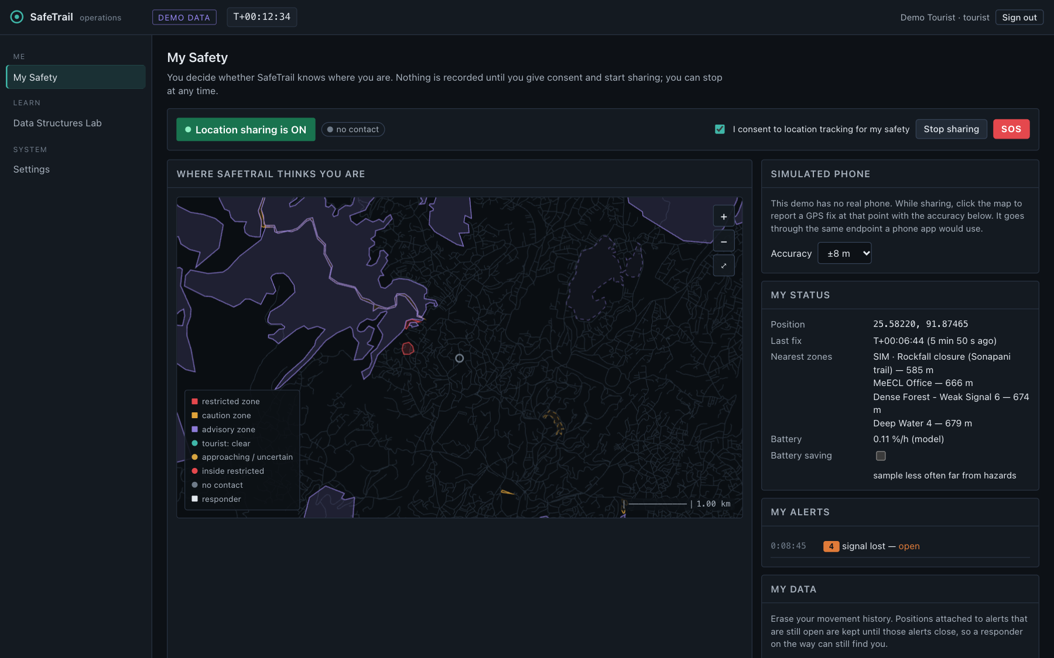
A safety system, not a surveillance tool
Opt-in
only the person can consent and start sharing
Stop any time
zone state discarded, no invented exit
Retention + erasure
trails expire; the person can erase theirs
Audited access
every look at a location goes in a Merkle log
Need to know
responders see a person only while assigned
My Safety: the tourist's own consent switch, sharing state, SOS and erasure
Honest demo data
simulated people marked SIM, fixtures DEMO
Notes:
Opt-in only, nobody else can switch it on, stop any time, history expires and can be erased, every look at someone's location is audited, responders see a person only while assigned.

Slide 11
Live demo
Simulated tourists over real OpenStreetMap zones and roads
Restricted-zone entry → alert → incident → A* dispatch
Group separation, and a phone that goes offline and syncs
What the system knew at a past time; Merkle proof checked in the browser
Data Structures Lab: the real quadtree, R-tree, AVL tree, Dijkstra and A*
Notes:
Switch to the browser: docs/final/LIVE_DEMO_SCRIPT.md has the exact steps and fallbacks.

Slide 12
Syllabus topics, each in working code
Syllabus concept | Where SafeTrail uses it
Arrays, ring buffer | zone store; last 64 fixes
Trees, recursion, traversal | quadtree and R-tree queries
BST, AVL rotations, augmentation | interval tree for validity windows
Hashing, collision handling | users, sessions, sync de-duplication
Heap, priority queue | Dijkstra, A*, alert triage
Graphs, adjacency list, shortest paths | road network, responder routing
Union-find | group cohesion, incident correlation
Binary search | position at a past time
Beyond the syllabus
Persistent data structures
Merkle proofs, SHA-256
Lamport clocks, offline sync
Computational geometry
Hysteresis, state machines
Notes:
Arrays and ring buffers, stacks, trees and recursion, BSTs and AVL rotations, augmented trees, hashing with collision handling, heaps and priority queues, graphs and adjacency lists, Dijkstra and A*, union-find, binary search, complexity and measurement. Beyond: persistence, Merkle proofs, Lamport clocks, computational geometry.

Slide 13
What it does not claim, and what comes next
Limitations
Next
People are simulated; no field trial
Server state is in memory, one thread
OSM hazard polygons are thin: 'uncertain' is often the honest answer
Benchmarks from one laptop; ratios move between sessions
Battery figure is a model, not a measurement
Durable event log, signed Merkle roots
Evaluation on real GPS traces
Phone app running the same offline evaluator
O(log n) index removal; travel-time routing
TLS, Argon2id, external security review
Notes:
Simulated people; an in-memory server; the OSM hazard polygons are thin, so 'uncertain' is often the honest answer; benchmarks from one laptop. Next: persistence, real GPS traces, a phone app running the same offline evaluator, TLS and Argon2.

Slide 14
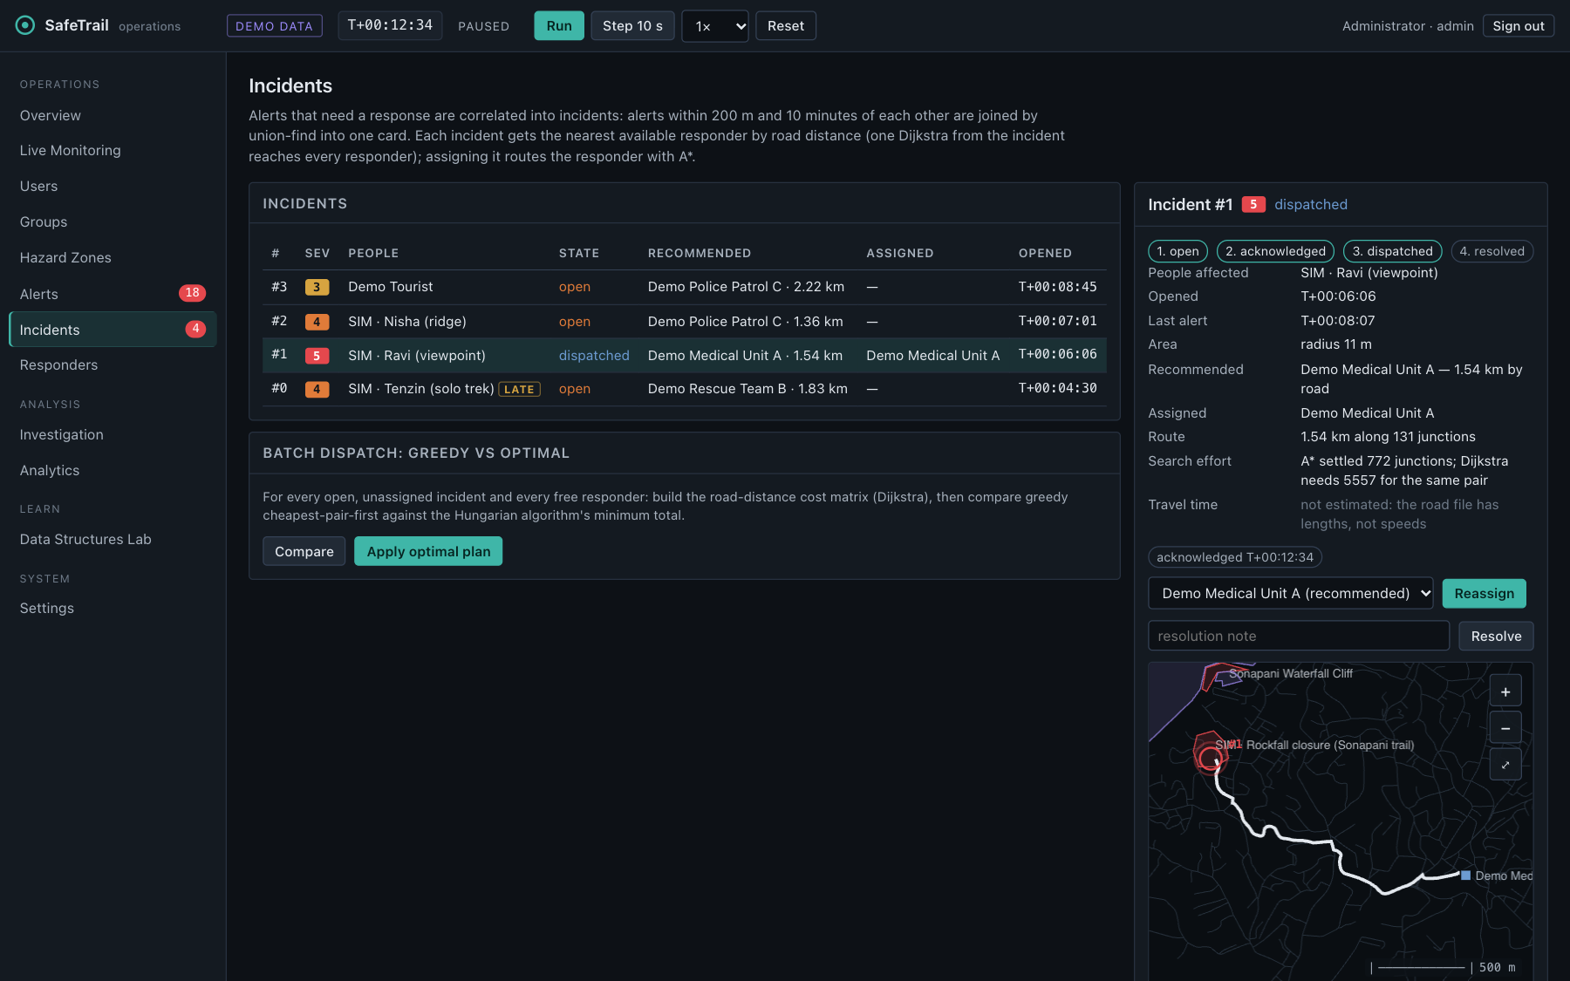
Thank you
Code, tests, benchmarks, report and this deck: github.com/adivishall/safetrail. Every number here is regenerated by make bench.
An incident assigned: the responder's route is A* over the OpenStreetMap road graph
Notes:
Thank you — the code, tests, benchmarks and this deck are in the repository, and every number on these slides is regenerated by make bench.

