Slide 1
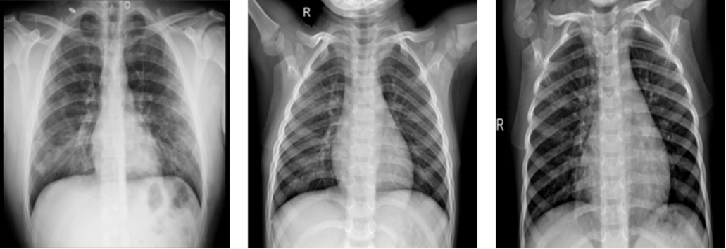
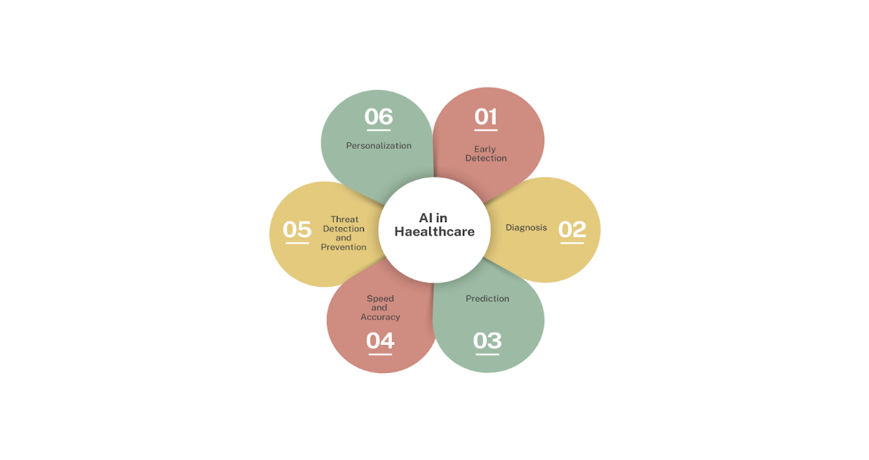
A CNN FRAMEWORK FOR COVID IDENTIFICATION USING RADIOGRAPHIC IMAGES
By Adivya & Drishti
0901AD211004 & 0901AD211014

Slide 2
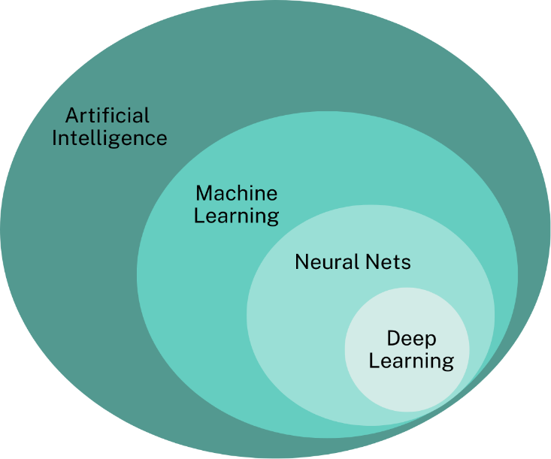
WHY DEEP LEARNING CNN??
Exponentially Growing Data
Identification of Patterns
Deep Learning Architecture
Scientists and researchers face a significant challenge due to the rapid exponential growth of vast amounts of data every day. This data is gathered through various methods such as RTP-CR, CT scans, and Chest X-Ray images, creating complexity in the handling and analysis process. Fortunately, cutting-edge AI technology offers a solution.
CNNs excel at recognizing spatial patterns in images, making them ideal for medical image analysis.
CNNs are a type of deep learning model specifically designed for processing and classifying images.

Slide 3
Importance of Image Classification in Medical Diagnosis
1
Accurate Disease Identification
2
Early Disease Detection
3
Enhanced Diagnostic Speed
Image classification ensures precise and reliable identification of diseases using medical images.
It aids in the early detection of diseases, leading to timely intervention and treatment.
Automated image classification speeds up the diagnostic process, enabling faster decision-making.

Slide 4
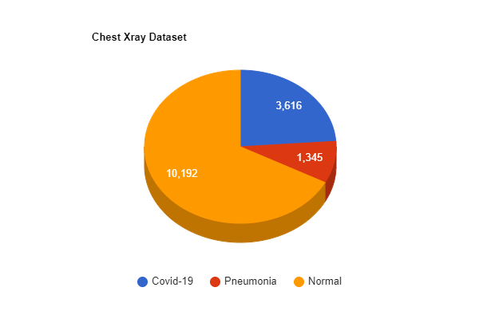
Dataset Used for COVID X-ray Classification
Large-Scale Repository
Quality and Diversity
Our dataset, obtained freely from Kaggle's COVID-19 Radiography Database (recipient of the COVID-19 Database Award by the Kaggle Community), presents a collection of chest X-ray images showcasing Covid-19 positive cases, as well as Normal and Viral Pneumonia images.
It contains diverse X-ray images capturing variations in COVID manifestations, ensuring robust model training. The dataset features 3616 COVID-19 positive cases, together with 10,192 Normal, and 1345 Viral Pneumonia images

Slide 5
Architecture of the CNN Model Used for Classification
3
3
3 FC
Convolutional Layers
Pooling Layers
Fully Connected Layers
Multiple layers for feature extraction and abstraction.
Downsampling layers to reduce dimensionality and extract key features.
Layers for making decisions based on the features extracted.

Slide 6
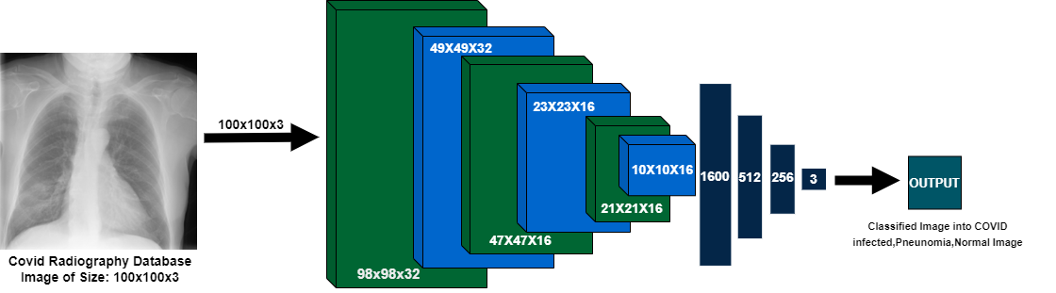

Slide 7
EXISTING AND PROPOSED CNN MODEL
Existing DL model | Accuracy
VGG-16 | 73.65%
AlexNet | 67.5%
LeNet-5 | 66.16%
ResNet | 77.59%
The Proposed CNN Model | 95.80%

Slide 8
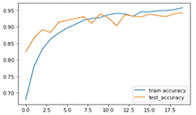
Accuracy/ Valid_Accuracy
ACTIVATION FUNCTION: | ReLu |  | ELu
DROPOUT | 0.5 | 0.8 | 0.5 | 0.8
ADAM OPTIMIZER | 89.30/ 89.15 | 69.62/ 71.42 | 95.80/ 94.27 | 74.22/81.89
SGD OPTIMIZER | 67.02/ 67.99 | 67.02/ 67.99 | 67.02/ 67.99 | 74.22/81.89
Results Analysis
The custom model proposed achieved an accuracy of 95.80% surpassing other predefined existing deep learning CNN architectures using the chest radiography dataset which accomplish the main aim to assist medical professionals, researchers and scientist and speeds up mass testing. Being such high accuracy can not only increase the testing and detection of infected patients also can be more cost efficient then other COVID detection approaches like RT-PCR. This model can efficiently classify X-Ray images into three types: Normal, COVID and Pneumonia.

Slide 9
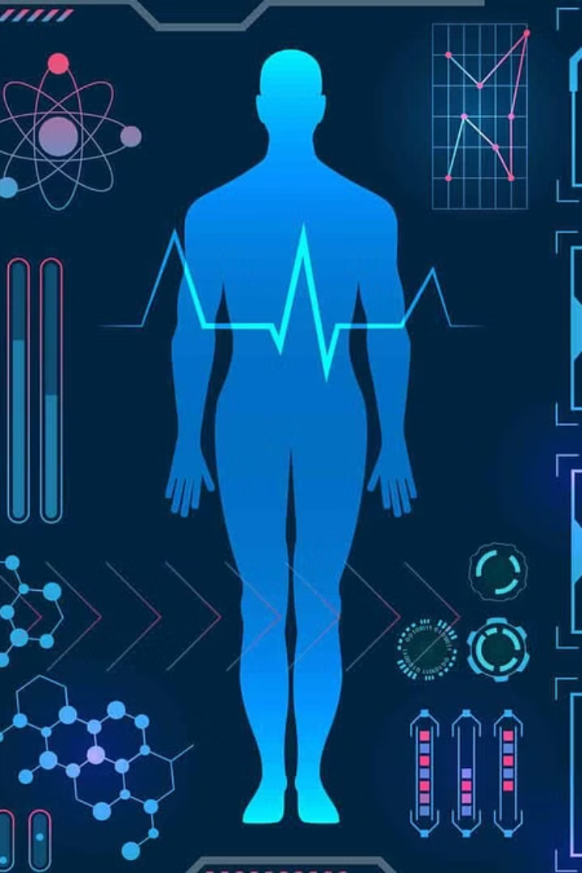
Conclusion
In conclusion, our project "A CNN framework for COVID identification using Radiographic Images" represents a significant advancement in leveraging deep learning for early detection of COVID-19. Through interdisciplinary collaboration and technological innovation, we developed a custom CNN model achieving an impressive accuracy of 95.80%, surpassing existing deep learning architectures. This model offers a quicker, more efficient means of diagnosis, aiding medical professionals in mass testing efforts. Further validation and consultation with medical specialists are recommended for real-world implementation.

