Slide 1
ISO Developer’s Toolkit - mdJSON & mdTools 2015 CDI Workshop
May 11, 2015
Josh Bradley, Arctic LCC

Slide 2
mdJSON{}
Version{}
Contacts[]
Metadata{}
Data Dictionary[]
Individual{}
Organization{}
Citation{}
Distribution[]
Associated Resources[]
Keywords[]
Extents[]
Resource Info{}
Metadata Info{}
Additional Docs[]
...
Notes:
Contacts is an array that contains a list of all contacts found in the mdJSON document. Each contact is assigned a unique id, which is used to reference the contact throughout the document. This avoids the need to store the entire contact multiple times.

Slide 3
Contacts
{
"version": {
"name": "mdJson",
"version": "1.0.0"
},
"contact": [
{
"contactId": "1",
"organizationName": "US Geological Survey - Alaska Science Center"
}
],
"metadata": {
"resourceInfo": {
"resourceType": "project",
"citation": {
"title": "Real-Time Permafrost and Climate Monitoring Network - Arctic Alaska",
"date": [
{
"date": "2012-12-21",
"dateType": "revision"
}
]
},
"pointOfContact": [
{
"contactId": "1",
"role": "pointOfContact"
}
],
"abstract": "DOI is developing a long-term permafrost monitoring network.",
"status": "onGoing",
"language": ["eng; USA", "esp; MEX"]
}
}
}

Slide 4
Developing with mdJSON
What’s needed:
Understanding of JSON structure and syntax
Basic knowledge of JSON Schema specification
Ability to use mdJSON-schemas to validate

Slide 5
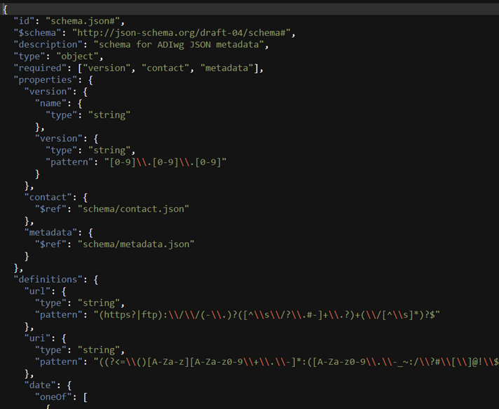
JSON Schema
Complete structural validation of JSON
Latest IETF draft: version 4
Validation engines available in many languages, see http://json-schema.org/

Slide 6
JSON Schema Keywords: $ref
The value of $ref is a JSON Pointer.
$ref is replaced with the value it points to.
JSON Pointer identifies a specific value within a JSON document.
Can point to location in another file
{"$ref": “doc.json#/location/in/doc“}
http://spacetelescope.github.io/understanding-json-schema/
Notes:
The use of $ref allows the schemas to be split into multiple files.
JSON Pointer is similar to Xpath in XML, but it is much simpler.

Slide 7
JSON Schema Keywords
allOf: Must be valid against all of the subschemas
anyOf: Must be valid against any of the subschemas
oneOf: Must be valid against exactly one of the subschemas
http://spacetelescope.github.io/understanding-json-schema/

Slide 8
mdJSON-schemas
Can be used independent of mdTranslator for validation
Include descriptions and pointers to examples
Mapping to other standards(19115-2, FGDC)
https://github.com/adiwg/mdJson-schemas

Slide 9



An interface for ADIwg metadata tools
The purpose of these tools is to assist with the production of metadata
For now, primarily useful for learning and development
www.adiwg.org/mdTools
d3.js
Notes:
Objectives, to make it easier:
To learn about mdJSON and the schema
To use the schemas to validate mdJSON
To use the mdTranslator

