Slide 1
ISO Developer’s Toolkit - Installing on Windows 2015 CDI Workshop
May 11, 2015
Stan Smith, USGS
Notes:
-- presentation covers all the steps to install and validate Ruby and Ruby on Rails installations on Windows 7
-- and I think 8 as well
-- will not discuss every step, take too long
-- all steps are on the slides for those who want to do this latter, or even try and keep up in the workshop
-- try to walk you around the pitfalls and recover from the install issues

Slide 2
Do I need to install Ruby?
I will need to install Ruby if …
… I want to participate in extending the ISO Metadata Toolkit
… I want to customize the mdTranslator for my own purpose
… I want to integrate the adiwg-mdTranslator gem into local systems (either by code or CLI)
… I want to host the mdTranslator as a local web service
I do not need to install Ruby if …
… I will use the publicly hosted mdTranslator API

Slide 3
Why Ruby?
Ruby is a dynamic, Object Oriented, cross-platform, open-source, general-purpose programming language written in C (not to be confused with ‘Ruby on Rails’)
Initial development in mid 1990s by Yukihiro Matsumoto
Gained wide acceptance and popularity
Ruby has more than 100,000 Gems available for specialized tasks
Interpretive language
The MinGW compiler is used for Windows installations
Ruby project on GitHub - https://github.com/ruby
Notes:
-- why choose the Ruby language (points on the slide)
-- Ruby runs on Linux, Windows, and iOS
-- developed on both Windows and Linux to be sure our software worked properly in both environments

Slide 4
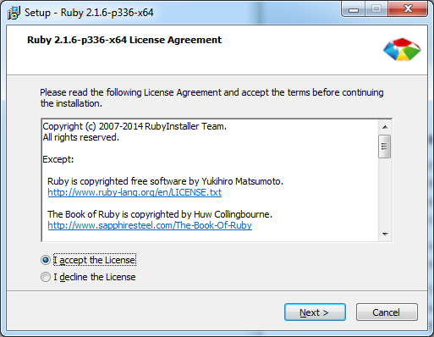
Ruby on Windows 1
Download the appropriate Windows installer from http://rubyinstaller.org/ . In this example we use Ruby 2.1.6 x64. Version for 2.2.2 is available but I like to give time for RubyGem providers to test against new versions.
Navigate to the download directory and double-click the self-extracting 7z file.
Accept the license …
Notes:
-- next 7 slides step a Ruby installation on Windows 7 x64
-- the steps also cover validating the installation

Slide 5
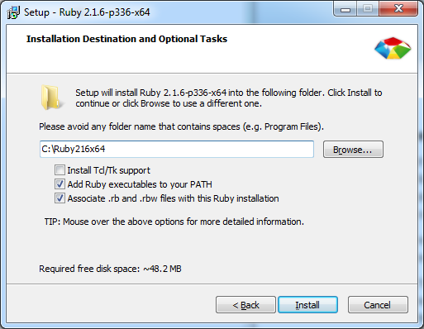
Ruby on Windows 2
Provide a location for the installation. I use the root of the C:\ drive to be sure the binaries are easy for all Ruby programs to find. I also name the folder with the version of Ruby being installed so I can install and test newer releases as they become available.
Be sure to choose to add Ruby to your PATH and make the association with .rb and .rbw file types.
Click ‘Install’ and the process will complete.
Notes:
-- Ruby does not use the Windows registry other than for the installer (so you can uninstall)
-- Ruby can downloaded and unzipped in directory,
---- manually add the PATH to your environment variable
---- and you are ready to go

Slide 6
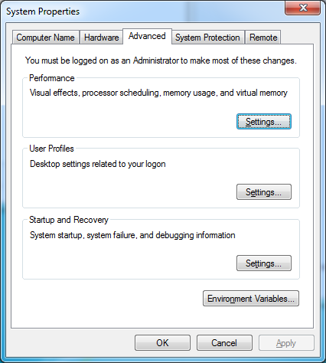
Ruby on Windows 3
The installations is complete. So let’s verify it. Check that the path was added to the Windows Environment Variables. The PATH can be viewed and edited from the ‘Advanced’ tab of ‘System Properties’. Click the ‘Environment Variables …’ button.

Slide 7
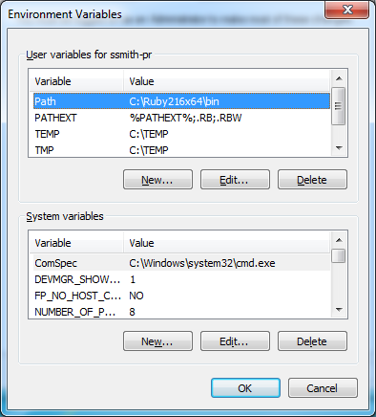
Ruby on Windows 4
Be sure you see the path to the folder you installed Ruby in.
Notes:
-- must be running with administrator privilege to have install add PATH
-- still must have admin to add it later

Slide 8
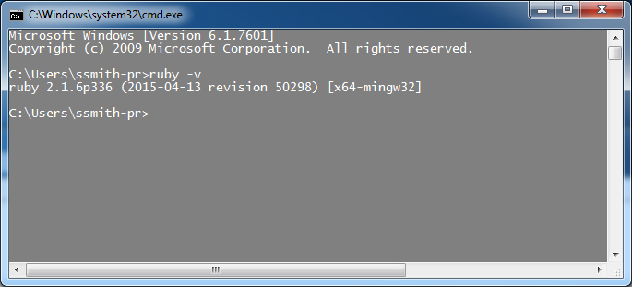
Ruby on Windows 5
With Ruby installed, test that Ruby works properly in your environment. Start a command window (launch cmd.exe from the start menu).
From the prompt check the version of Ruby installed: > ruby –v

Slide 9
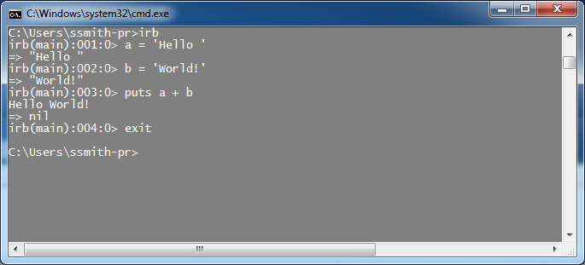
Ruby on Windows 6
You can also start the ‘Interactive Ruby’ console and write a few lines of Ruby code just to see that all works properly. > irb > a = ‘Hello ‘ > b = ‘World!’ > puts a + b Hello World!

Slide 10
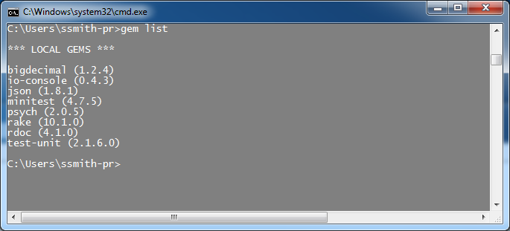
Ruby on Windows 7
Ruby gets much of its power from the rich repository of RubyGems or code libraries. These are written to easily plug into and be consumed by Ruby programs. Check the gems installed with the Ruby installation: > gem list
Note that the RubyGem ‘gem’ was also installed although not listed.

Slide 11
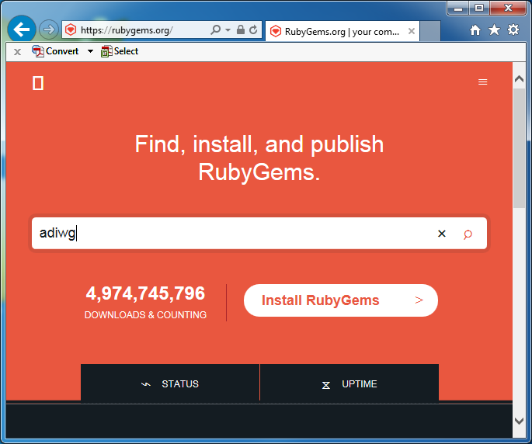
adiwg-mdtranslator gem
Thousands of RubyGems are available for download at http://rubygems.org/ including those written by ADIwg. Enter ‘adiwg’ and press ‘Enter’.

Slide 12
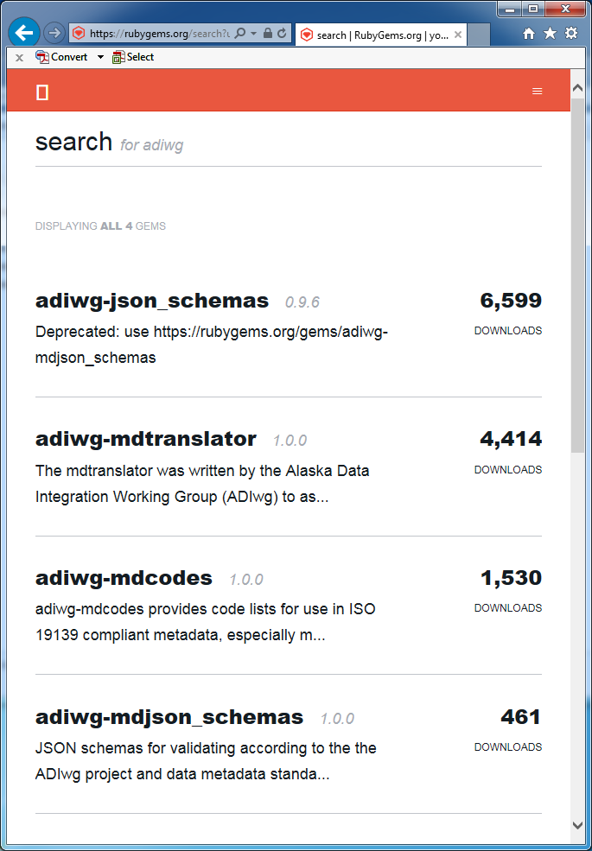
adiwg-mdtranslator gem
The ADIwg gems available are listed along with their current download counts.
In this case we want to install the ‘adiwg-mdtranslator’ gem. From the command line type: > gem install adiwg-mdtranslator
Notes:
-- old screenshot, versions are now 1.1.

Slide 13
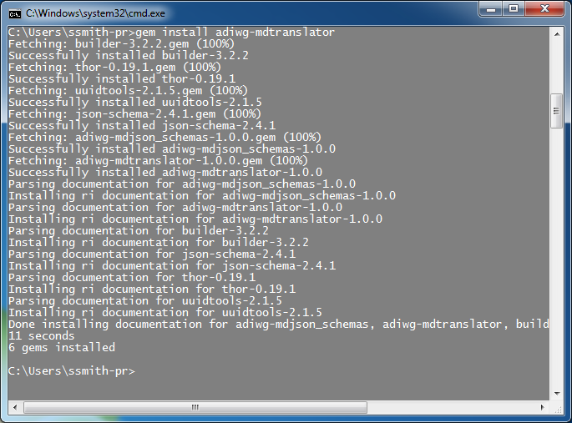
adiwg-mdtranslator gem
The adiwg-mdtranslator gem will install along with all its other RubyGem dependencies. Notice 6 gems were installed.

Slide 14
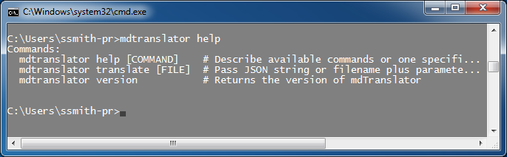
adiwg-mdtranslator gem
Since the adiwg-mdtranslator gem provides a Command Line Interface (CLI) we can check its installation by typing: > mdtranslator help

Slide 15
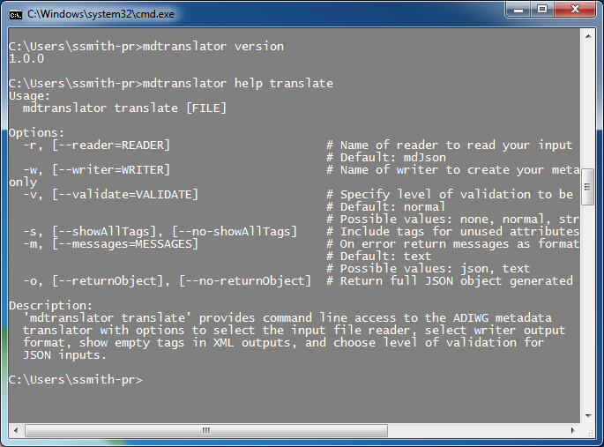
adiwg-mdtranslator gem
We can check the version and get more help on commands such as ‘translate’.
Installation of Ruby and the mdTranslator are complete. We could use mdTranslator from the command line and pipe the result to a file.
Notes:
-- took 8 minutes to here

Slide 16
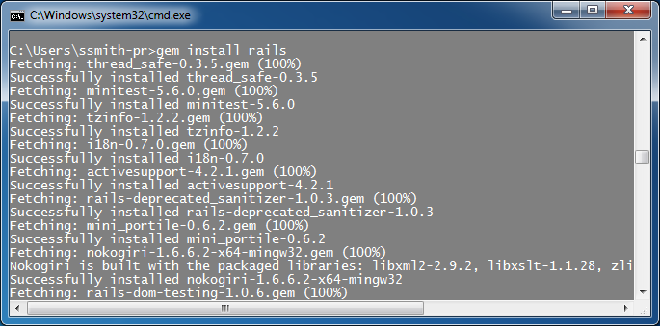
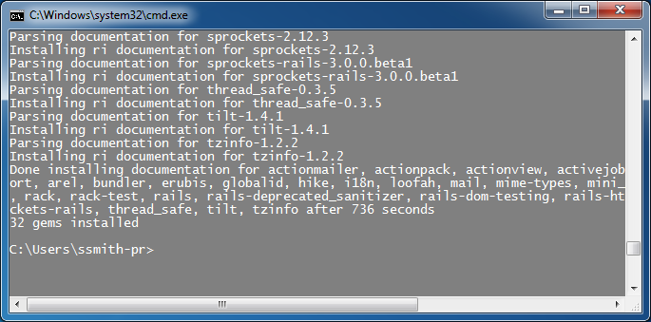
Rails on Windows 1
If we wish to use mdTranslator within a local web service we need to install Ruby on Rails (Rails).
With Ruby install, use Gem to do the work for us. > gem install rails.
Notice Rails installed another 32 gems.

Slide 17
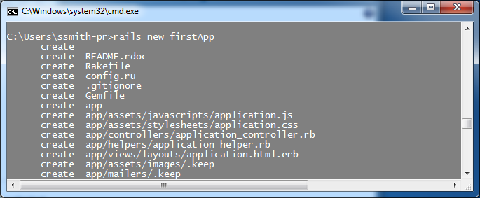
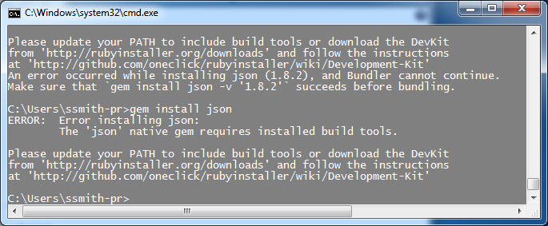
Rails on Windows 2
To test the Rails installation, ask rails to create a new website for us.
Navigate to the folder to hold your new website.
From the command line type: > rails new firstApp.
Rails will create a new directory named ‘firstApp’ and install all the code for a new website

Slide 18
Rails on Windows 3
After many lines are reported back the web site failed to complete because the ‘json’ gem version 1.8.2 did not provided a version compiled for Windows. Unfortunately, glitches are common on Windows installations and the installation of DevKit will generally be required at some point. Best do it now!
Download the appropriate version of DevKit from http://rubyinstaller.org/downloads/ .
I also install DevKit at the root of the C:\ directory. More information about installing DevKit can be found at https://github.com/OneClick/RubyInstaller/wiki/Development-Kit .

Slide 19
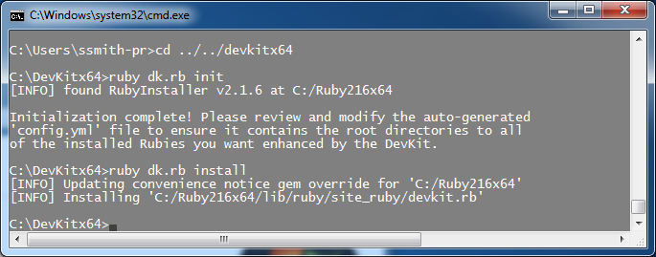
Rails on Windows 4
To connect DevKit to the Ruby installation, navigate to the directory where DevKit installed.
From the command line type: > ruby dk.rb init
Next type: > ruby dk.rb install

Slide 20
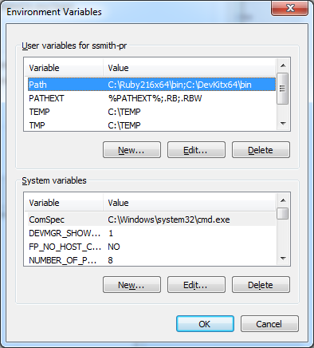
Rails on Windows 5
With DevKit installed, check that the PATH variable was properly updated.
Notes:
-- must be running with administrator privilege to have install add PATH
-- still must have admin to add it later

Slide 21
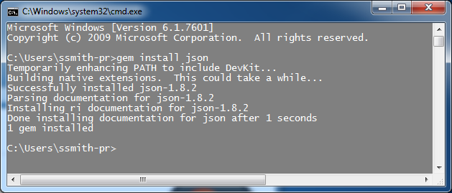
Rails on Windows 6
With the DevKit PATH now defined to Ruby, try for a properly installed version of the json gem. From the command line type: > gem install json
And this time it works!

Slide 22
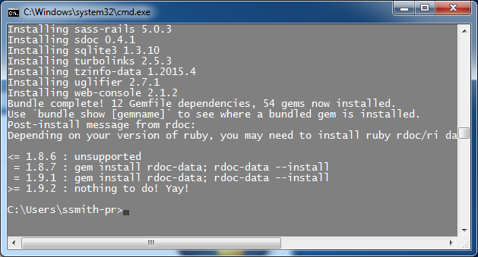
Rails on Windows 7
Try again to have Rails build a new web site. From the command line: > rails new firstApp
After many lines you should see a successful completion.

Slide 23
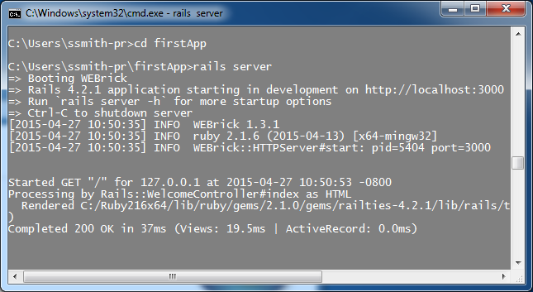
Rails on Windows 8
To test our new web site, navigate to its directory and start the rails server. From the command line type: > rails server
Rails will start its default web server ‘WEBrick’ on localhost port 3000.

Slide 24
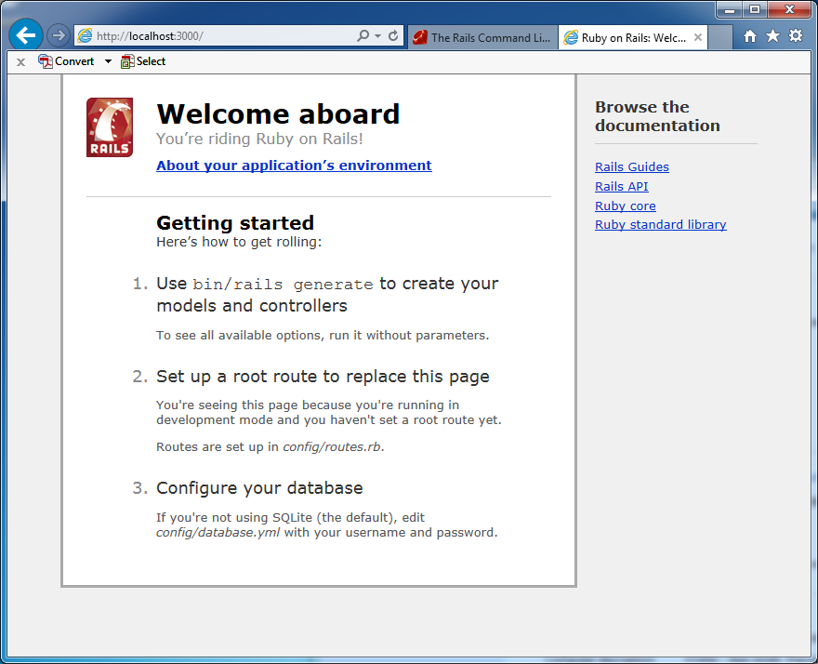
Rails on Windows 9
Open you browser and navigate to http://localhost:3000. You should see the Rails ‘Welcome aboard’ page.

Slide 25
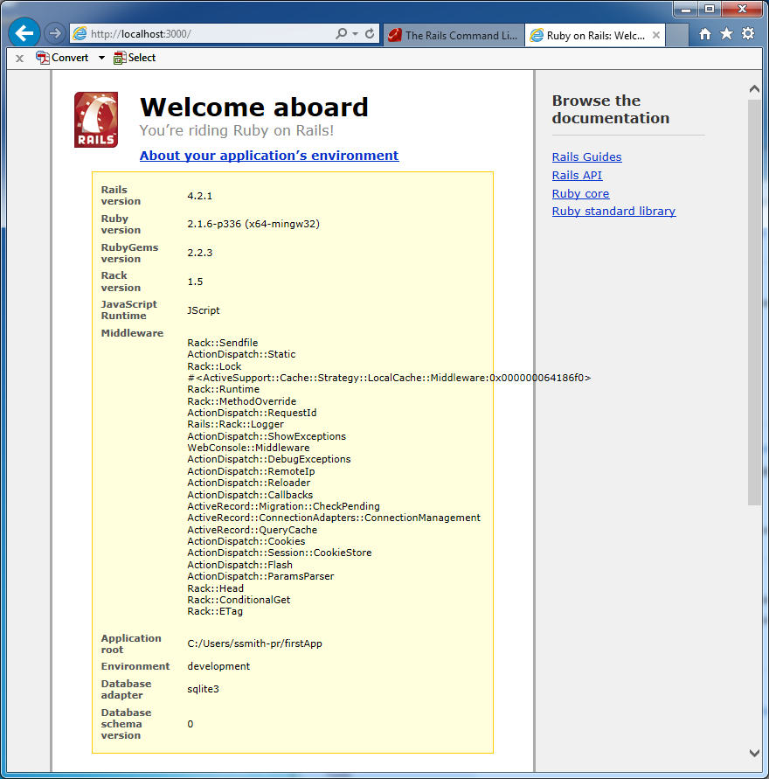
Rails on Windows 10
For more information about the installation click the ‘About your application’s environment’ and Rails will display information about the software and version used.
Time to start developing! -- Almost --
Notes:
-- took 31 minutes to here

Slide 26
Rails on Windows 11
Another common problem with Rails on Windows x64 is the gem ‘tzinfo’. Windows does not include a time-zone table with the operating system so one needs to be downloaded. tzinfo will automatically set one up for Windows x32 but not x64. Find the ‘Gemfile’ line …
gem 'tzinfo-data', platforms: [:mingw, :mswin]
edit to tell tzinfo to include support for Windows x64
gem 'tzinfo-data', platforms: [:mingw, :mswin, :x64_mingw]
Run another gem installed with Rails, ‘bundler’. Bundler tell Rails the gems and their versions to use with your Rails web site. From the terminal prompt to update the web site’s gem files. Type: > bundle update.
Now you are ready. Really…

Slide 27
Questions?
Discussion?

