Slide 1
ISO Developer’s Toolkit - mdTranslator in Rails 2015 CDI Workshop
May 11, 2015
Stan Smith, USGS
Notes:
-- not too complex, but more to do than building a Ruby application
-- Rails is a web application development platform
-- tries to make programming web applications simpler by making many assumptions about what the developer needs to get done
-- that can also drive you nuts!

Slide 2
mdTranslator on Rails 1
From the command line, navigate to the directory to hold your new Rails application. This will become the parent directory of the new Rails application.
Generate the new rails application. > rails new translator
A new directory named ‘translator’ will be created and filled with the new Rails application modules.
Test the new ‘translator’ rails application.
Change the directory to the Rails application just created > cd translator
Start the Rails server. > rails server
From a browser type http://localhost:3000
You should see the ‘Welcome aboard’ page.

Slide 3
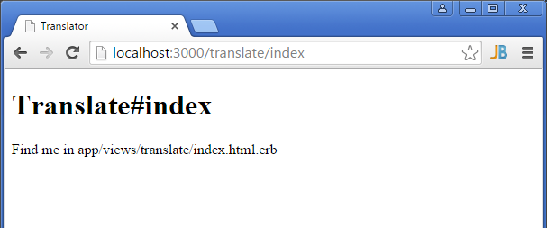
mdTranslator on Rails 2
Generate a home page using a Rails helper. > rails generate controller translate index
Test the new index page that Rails generated for you … http://localhost:3000/translate/index

Slide 4
or maybe not!
Found trouble on some Windows installations – not sure of cause
In file …/app/views/layouts/application.html.erb comment out the line calling the javascript_include_tag so it looks like this:
This feature preserves head JavaScript from page to page as a means of saving load and compile time. Not need in this application anyway.
<head> <title>mdTranslator API</title> <%= stylesheet_link_tag 'application', media: 'all', 'data-turbolinks-track' => true %> <!-- javascript_include_tag 'application', 'data-turbolinks-track' => true --> <%= csrf_meta_tags %> </head>

Slide 5
mdTranslator on Rails 3
Next set the ‘index’ page as the default page for the website. In the .../config/routes.rb file set the root to ‘translate#index’.
Rails.application.routes.draw do get 'translate/index' root 'translate#index'
Notes:
-- Rails.application.routes.draw tells Rails to build a route map of accepted routes.
-- the get was added by Rails when we generated the ‘index’ page.

Slide 6
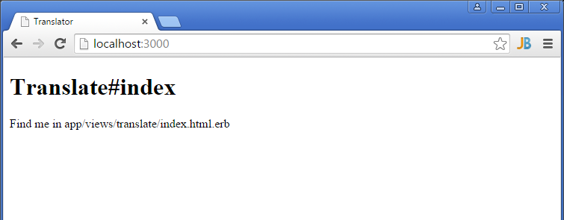
mdTranslator on Rails 4
Now the index page will display at root rather than ‘Welcome aboard’.

Slide 7
mdTranslator on Rails 5
Code a simple HTML form in the file …/app/views/translate/index.html.erb replacing all the Rails generated code.

Slide 8
<!-- # Alaska Data Integration working group - ADIwg # REST endpoint controller for demonstration of mdTranslator --> <h2> mdTranslator Rails example</h2> <div id="form_container"> <%= form_tag('/translate') do %> <div> <h3>Submit JSON</h3> <p> Paste or type JSON, choose options, and click Submit. Valid ISO 19115-2 XML should be generated. <br> </p> <div> <textarea name="file">Place mdJson here</textarea> </div> </div> <div class="buttons"> <input type="hidden" name="form_id" value="759352"/> <input id="saveForm" class="button_text" type="submit" name="submit" value="Submit"/> </div> <div> <p> For more info visit the <a href="http://www.adiwg.org/mdTranslator">mdTranslator website</a>. </p> </div> <% end %> </div>
Notes:
-- building a HTML form
-- clicking the submit button will POST the contents of the form to ‘/translate/’

Slide 9
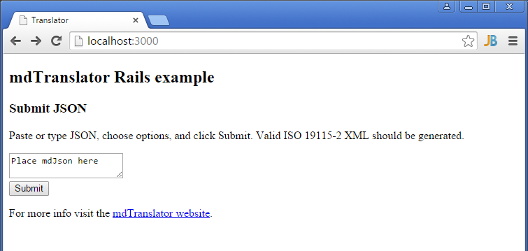
mdTranslator on Rails 6
The updated index page now looks like this …

Slide 10
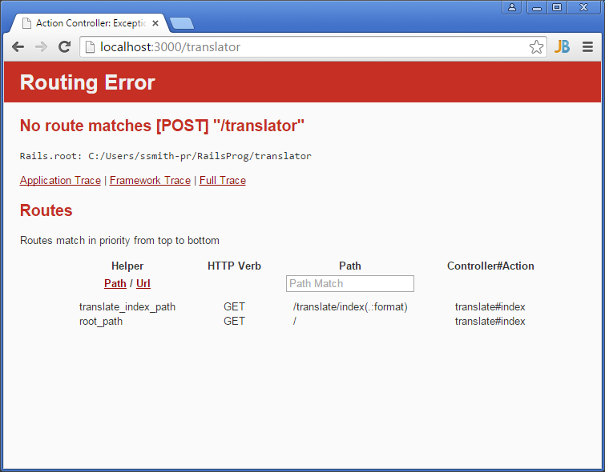
mdTranslator on Rails 7
Click ‘Submit’ and Rails shows a ‘Routing Error’. We have not handled the HTTP POST in our routing or controller.
Notes:
-- notice in the Routes map there is no
---- POST /translate/

Slide 11
mdTranslator on Rails 8
Rails only generated code in the router and controller to process the HTTP GET verb. Add a ‘resources’ statement to …/config/routes.rb to have Rails automatically handle all HTTP verbs, including POST.
Rails.application.routes.draw do get 'translate/index' root 'translate#index' resources :translate

Slide 12
mdTranslator on Rails 9
Add code in the …/app/controllers/translate_controller.rb file intercept and process the HTTP POST request.
class TranslateController < ApplicationController # process GETs def index end # process POSTs def create render inline: '<h2>This is the HTTP POST</h2>' end end
Notes:
-- the code to process the GETs is already in the file
-- def create intercepts POSTs
---- render inline: returns the HTML in quotes as the web page, ok for testing.

Slide 13
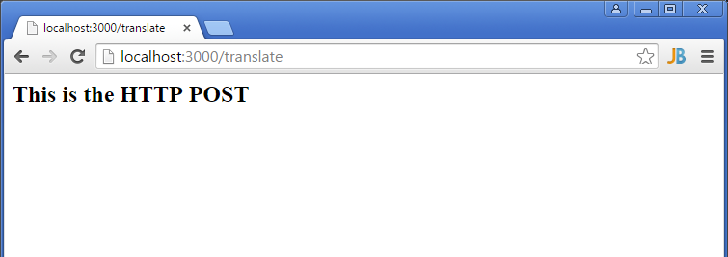
mdTranslator on Rails 10
Now the HTTP POST is properly intercepted. When the ‘Submit’ button is pressed we see...

Slide 14
mdTranslator on Rails 11
With the basic structure of the website complete connect the mdTranslator gem to the website. Add the adiwg-mdtranslator gem request to the .../Gemfile.
Update the website’s gems. From the command line type: > bundle update. The adiwg-mdtranslator gem and all its dependencies will be loaded to your Rails website.
Remember to restart the Rails server after adding new gems.
# Alaska Data Integration working group metadata translator gem 'adiwg-mdtranslator', '~> 1.0'
Notes:
-- ~> 1.0 asks to load version 1.0 or higher
-- the most recent version should load
-- bundler is a gem installed with Rails

Slide 15
mdTranslator on Rails 12
Now we need to write a simple script to process the HTTP POST. In the ../app/controllers/translate_controller.rb file replace the ‘render inline:’ statement we entered to test the connection and routing with something like this…
# process POSTs def create # load file and parameter from POST fileObj = params[:file] # call the ADIwg metadata translator @mdReturn = ADIWG::Mdtranslator.translate( file: fileObj, reader: 'mdJson', validate: 'normal', writer: 'iso19115_2', showAllTags: false) render xml: @mdReturn[:writerOutput] end
Notes:
-- grab the input file from the parameter list
-- pass the file and other parameters to the mdTranslator gem
-- accept the returned hash
-- render the metadata output as XML

Slide 16
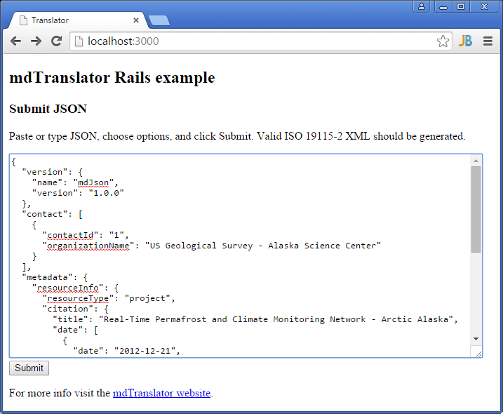
mdTranslator on Rails 13
After the server restarts, navigate to the website root and enter some valid mdJson.

Slide 17
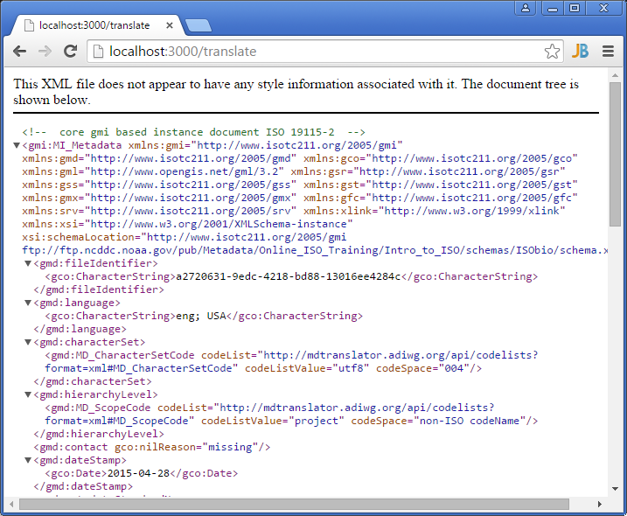
mdTranslator on Rails 14
Click submit and you should see ISO 19115_2 returned from you locally hosted web service.
Notes:
-- time 25 minutes to here

Slide 18
mdTranslator on Rails 15
This ‘non-award winning’ website only demonstrates the simplicity of building a website that can interface with the ADIWG ISO Metadata Toolkit. A real website would need to be more robust checking for errors, handling all mdTranslator options, and handling all response types returned from the mdTranslator (XML. JSON, JSONp, text, plain). But it’s a start.

Slide 19
Questions?
Discussion?

