Slide 1
Introduction to ADIwg ISO Metadata Toolkit 2015 CDI Conference Training Session
May 11, 2015
Stan Smith, USGS ASC;
Josh Bradley, Arctic LCC;
Dennis Walworth, USGS ASC

Slide 2
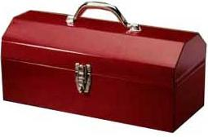
Workshop Outline
Project overview and toolkit introduction
Generating metadata using the toolkit
Toolkit integration with systems

Slide 3

Overview
Project introduction
Development background
Toolkit introduction
Documentation

Slide 4


About ADIwg
The Alaska Data Integration Working Group (ADIwg)
Mission: to examine and address the technical barriers to efficiently integrate and share data within and among participating organizations
Steering Committee: Alaska Climate Change Executive Roundtable (ACCER)
ADIwg technical work group implements objectives
Notes:
Recognition of need to exchange research knowledge in terms of data and metadata

Slide 5
Who is ADIwg?
Federal
BLM, BOEM, NPS, USFWS, USFS, USGS
State of Alaska
University of Alaska (UAF, UAS)
Geographic Information Network of Alaska (GINA)
International Arctic Research Center (IARC)
Non-Governmental Organizations (NGOs)
Arctic Ocean Observing System (AOOS)
Arctic Research Mapping Application (ARMAP) - Nunatech Consulting
North Pacific Research Board (NPRB)
North Slope Science Initiative (NSSI)
Cooperatives/Joint-Ventures
Arctic LCC

Slide 6
ADIwg ISO Metadata Requirements
Adoption of ISO 19115-2 as standard for ADIwg
Share high investment cost for comprehension and implementation
Support diversity of requirements and implementation skills across ADIwg membership
Transition existing project metadata standard to ISO

Slide 7

Project Objectives
Eliminate necessity to learn ISO 19115 family of standards
Make it easier for organizations to:
Achieve ISO compliance
Integrate ISO support into local applications and services
Implement custom web services with ISO metadata capability
Host a public web service for generation of ISO metadata records
Support both project and data metadata in ISO
Host a public web app for PIs to enter and edit metadata

Slide 8
Project Scope
Support creation of original metadata records
Portable, open source code library for developers
Create a user-friendly metadata preparation tools
Accommodate diverse needs and technical abilities
Extensible (create metadata in multiple standards)

Slide 9
Out of Scope
Metadata clearinghouse
Translation between XML metadata standards (e.g. FGDC->ISO)
Provide metadata snippets to other metadata tools

Slide 10
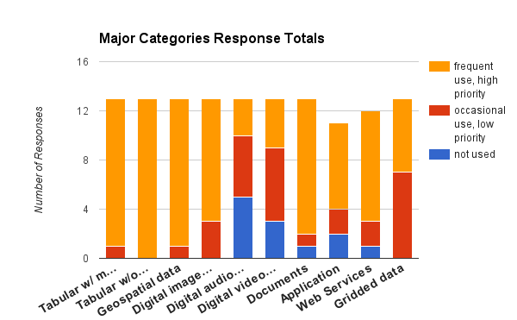
Choosing a Standard
Polled members for types of data produced

Slide 11
Choosing a Standard
Defined metadata content requirements
Analyzed common standards for best solution
FGDC, Dublin Core, EMI, ISO
Selected ISO standard

Slide 12
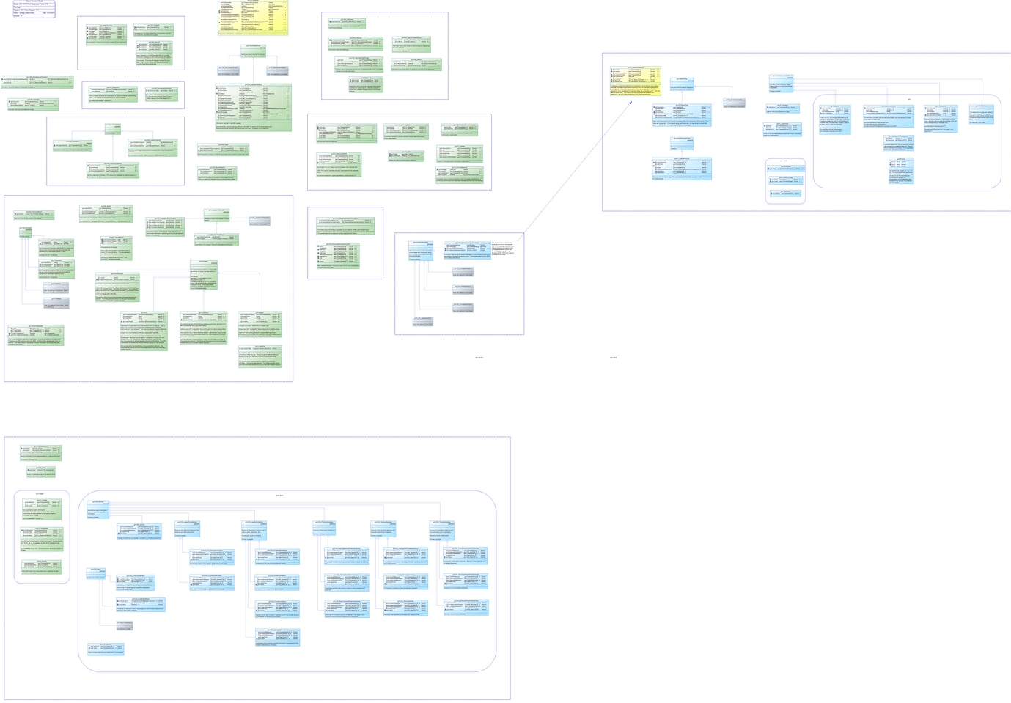
Supported ISO Fields
ADIwg supported fields
110+ classes
350+ attributes
70% of full standard
3 ‘E’ size diagrams
Notes:
The full ISO standard is very large – but little is mandatory
Limit the number of ISO fields to support in first iteration
Anticipate this field set will cover about 80%+ of our data resources.
Still not small, (see stats)
The model is also an excellent tool to learn ISO, much easier than ISO docs
Yellow – starting point
Green – implemented
Blue – implementation on hold
Gray – subtypes not implemented

Slide 13
ISO Metadata Toolkit
Transition to branded open source project
Core Alaska group from ADIwg
Growing participation from interested parties
Sponsorship from CDI and NCCWSC

