Slide 1
ISO Developer’s Toolkit - Using mdTranslator API 2015 CDI Workshop
May 11, 2015
Stan Smith, USGS
Notes:
-- mdTranslator is hosted as a public web service on Heroku
-- Heroku is a cloud platform as a service (PaaS) supporting several languages
-- Ruby, Node.js, Python, PHP, Perl
-- We did not develop on this platform, but are using it to host the mdTranslator API until a permanent home is found

Slide 2


mdTranslator as web service
Web Application
POST
Public hosted web service
Ruby code
Ruby Gem
mdTranslator-rails
http://mdtranslator.adiwg.org/
Notes:
-- back to were we left off in the Into to ISO Toolkit segment
-- hosted on Heroku at http://mdtranslator.adiwg.org/
-- the web service has an embedded mdTranslator gem
-- the web service provides a RESTful API to interact with the mdTranslator
---- REST (Representational State Transfer)
------ Architectural style for scalable web services
------ All functionality is available via unique URLs

Slide 3
mdTranslator as web service
Web Application
mdCodes
Ruby Gem
GET/POST
Public hosted web service
Ruby code
Ruby Gem
mdTranslator-rails
http://mdtranslator.adiwg.org/
Notes:
-- another ISO Toolkit component is also hosted in the API – mdCodes
-- mdCodes is designed to supply ISO codelists via REST endpoints to metadata editor application
-- covered later in this segment

Slide 4
mdTranslator ‘Welcome’
Welcome page - http://mdtranslator.adiwg.org/
Root for mdTranslator API
Overview
Background
Including description of the six ISO Metadata Developer’s Toolkit components
Links
mdTranslator resources
API .../api/v1
Readers .../api/readers
Writers .../api/writers
Related external resources
mdTranslator Home page http://www.adiwg.org/mdTranslator/
mdTools http://www.adiwg.org/mdTools/
GitHub repository https://github.com/adiwg
RubyGems libraries https://rubygems.org/
Notes:
-- talk from slide

Slide 5
mdTranslator API
API V1 documentation .../api/v1/api or .../api/v1
API is versioned to support legacy versions of API
API only supports GET and POST verbs
PUTs (updates) and DELETEs not accepted
Cross domain requests handled by CORS (Cross-Origin Resource Sharing)
Documentation and Lists
GET
Informational web pages
API version 1 options .../api/v1/options
Interacting with codelists
Translator method
GET
Limited application due to URI size limits (2K)
POST
mdTranslator parameters .../api/v1/demo
Notes:
-- talk from slide
-- demonstrate mdTranslator parameters from demo

Slide 6
mdCodes
mdCodes is also a GitHub repo and RubyGem
Designed for metadata content editors (mdEditor) to load codelist values
Contains all ISO codelists needed by mdTranslator
Current with 19115-2, 19115-1, including some ADIwg extensions
Each codelist is a maintained in a separate YAML file
“Yet Another Markup Language” or “YAML Ain’t Markup Language”
Suited for text editing structured data
Supported in Ruby, Python, Perl, grep
Only static codelists are supported at this time
We might extend to provide a consistent API for externally maintained hierarchical code lists such as:
GCMD Global Change Master Directory of Earth Science Keywords (NASA), ITIS, Several candidates from NOAA
Notes:
-- talk from slide

Slide 7
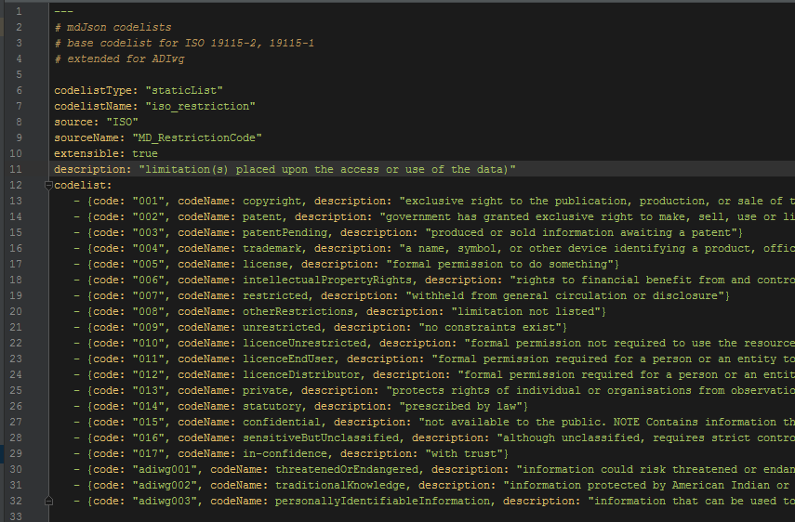
mdCodes YAML file
Static codelist example
Notes:
-- type of list => static
-- name => iso_restriction
-- official source name => MD_RestrictionCode
-- extensible => T/F
-- description
-- list of codes
---- unique code
---- code name
---- description

Slide 8
mdCodes API
.../api/codelists – use chrome w/ JSON formatter plugin
All codelists and values .../api/codelists
All codelists and values .../api/codelists?format=json
ISO CT_CodelistCatalogue .../api/codelists?format=xml
All codes with definitions .../api/codelists?definitions=true
Add a JSONp wrapper .../api/codelists?callback=myCall
Single codelist .../api/codelists/iso_restriction
Single codelist with definitions .../api/codelists/iso_mediumName?definitions=true

Slide 9
Questions?
Discussion?

