Slide 1
Introduction to ADIwg ISO Metadata Toolkit 2015 CDI Conference Training Session
May 11, 2015
Stan Smith, USGS ASC;
Josh Bradley, Arctic LCC;
Dennis Walworth, USGS ASC

Slide 2
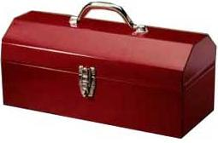
Workshop Outline
Project overview and toolkit introduction
Generating metadata using the toolkit
Toolkit integration with systems

Slide 3

Overview
Project introduction
Development background
Toolkit introduction
Documentation

Slide 4


About ADIwg
The Alaska Data Integration Working Group (ADIwg)
Mission: to examine and address the technical barriers to efficiently integrate and share data within and among participating organizations
Steering Committee: Alaska Climate Change Executive Roundtable (ACCER)
ADIwg technical work group implements objectives
Notes:
Recognition of need to exchange research knowledge in terms of data and metadata

Slide 5
Who is ADIwg?
Federal
BLM, BOEM, NPS, USFWS, USFS, USGS
State of Alaska
University of Alaska (UAF, UAS)
Geographic Information Network of Alaska (GINA)
International Arctic Research Center (IARC)
Non-Governmental Organizations (NGOs)
Arctic Ocean Observing System (AOOS)
Arctic Research Mapping Application (ARMAP) - Nunatech Consulting
North Pacific Research Board (NPRB)
North Slope Science Initiative (NSSI)
Cooperatives/Joint-Ventures
Arctic LCC

Slide 6
ADIwg ISO Metadata Requirements
Adoption of ISO 19115-2 as standard for ADIwg
Share high investment cost for comprehension and implementation
Support diversity of requirements and implementation skills across ADIwg membership
Transition existing project metadata standard to ISO

Slide 7

Project Objectives
Eliminate necessity to learn ISO 19115 family of standards
Make it easier for organizations to:
Achieve ISO compliance
Integrate ISO support into local applications and services
Implement custom web services with ISO metadata capability
Host a public web service for generation of ISO metadata records
Support both project and data metadata in ISO
Host a public web app for PIs to enter and edit metadata

Slide 8
Project Scope
Support creation of original metadata records
Portable, open source code library for developers
Create a user-friendly metadata preparation tools
Accommodate diverse needs and technical abilities
Extensible (create metadata in multiple standards)

Slide 9
Out of Scope
Metadata clearinghouse
Translation between XML metadata standards (e.g. FGDC->ISO)
Provide metadata snippets to other metadata tools

Slide 10
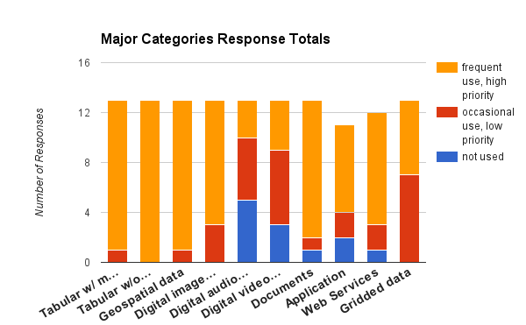
Choosing a Standard
Polled members for types of data produced

Slide 11
Choosing a Standard
Defined metadata content requirements
Analyzed common standards for best solution
FGDC, Dublin Core, EMI, ISO
Selected ISO standard

Slide 12
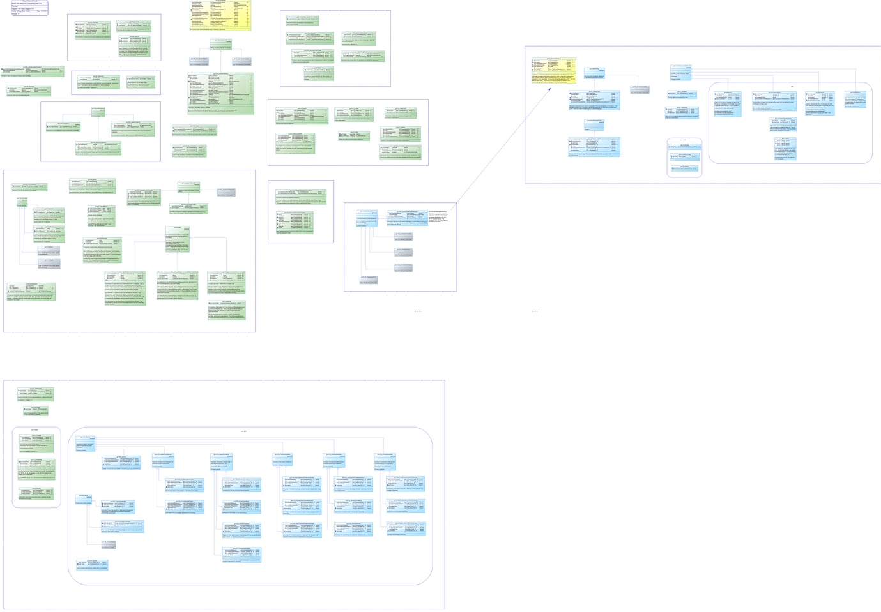
Supported ISO Fields
ADIwg supported fields
110+ classes
350+ attributes
70% of full standard
3 ‘E’ size diagrams
Notes:
The full ISO standard is very large – but little is mandatory
Limit the number of ISO fields to support in first iteration
Anticipate this field set will cover about 80%+ of our data resources.
Still not small, (see stats)
The model is also an excellent tool to learn ISO, much easier than ISO docs
Yellow – starting point
Green – implemented
Blue – implementation on hold
Gray – subtypes not implemented

Slide 13
ISO Metadata Toolkit
Transition to branded open source project
Core Alaska group from ADIwg
Growing participation from interested parties
Sponsorship from CDI and NCCWSC

Slide 14
Metadata Developer’s Toolkit - Toolkit Development 2015 CDI Workshop
May 11, 2015
Josh Bradley, Arctic LCC
Notes:
This presentation is about the team’s development philosophy and design process.

Slide 15
Project Objectives
Share metadata easily and efficiently among organizations
Support both project and data metadata
Eliminate necessity to learn ISO 19115 family of standards
Make it easier for organizations to:
Achieve ISO compliance
Integrate ISO support into local applications and services
Implement custom web services with ISO metadata capability
Host a public web service for generation of ISO metadata records
Host a public web app for PIs to enter and edit metadata
Notes:
Primary focus is on top three bullets

Slide 16
Traditional Process
Review Standards
Adopt
Learning Curve
Adapt/Build Tools
Output Metadata
Number of Supported Standards
Notes:
This is the approach we started from.
Examples of tool are databases, editors, web applications.
Typically, this process results in tools and workflows that support a single primary standard or format.
Secondary standards typically don’t get first class treatment.

Slide 17
Choices
Which Standard?
FGDC CSDGM, Dublin Core, EML, ISO/TC 211, ...
Which Version?
19115, 19115-2, 19115-1, …
Which Profile?
Based on ISO 19115: North American Profile, WMO Core, INSPIRE, Polar Metadata Profile, …
Notes:
First step is choosing a “standard”
ISO 19115 can be written many ways with varying degrees of support for the full standard, hence “profiles”.
ISO/TC 211 - Geographic information/Geomatics: http://www.iso.org/iso/home/store/catalogue_tc/catalogue_tc_browse.htm?commid=54904

Slide 18
ISO (19115-2) Metadata
Comprehensive, a great starting point
Learning curve is steep!
Too heavy & complex for common data-interchange
Rigid, not easily extended (and still validate)
Another profile???
Notes:
ISO standards must be purchased, NOAA produces the XSDs.
To really work efficiently with XSDs, proprietary software is needed.
ADIwg decided to focus on 19115-2, with a plan to eventually support 19115-1.
ADIwg(mostly Stan) spent several months reviewing the ISO standard(s).
A class diagram and data dictionary were created.

Slide 19
ADIwg Concept
Adopt Single Standard
Learning Curve
Adapt/ Build Tools
Translate to Supported Standards
Output Metadata
Notes:
Goal is to support a single standard that can be translated to other standards.
Organizations may build or adopt internal tools to support the adopted standard, but translation tools are jointly developed.

Slide 20
Solution
Create a new, independent standard that is flexible, adaptable, lightweight, and capable of being translated into other standards and formats, including ISO 19115.
Notes:
New standard allows efficient communication among supporting organizations, translation allows for communication with external entities.

Slide 21
JavaScript Object Notation
{
"firstName": "John",
"lastName": "Smith",
"age": 25,
“active”: true,
"address": {
"streetAddress": "21 2nd Street",
"city": "New York",
"state": "NY",
"postalCode": "10021"
},
"phoneNumber": [
{
"type": "home",
"number": "212 555-1234"
},
{
"type": "fax",
"number": "646 555-4567"
}
]
}
Notes:
Needed to pick a format to encode the metadata.
Looked at multiple options: XML, JSON, yaml.
JSON was the winner.

Slide 22
Why JSON?
Easy Input/Output for both humans and machines
Focus is on the data, not markup
Wide support by programming languages
Excellent for data-interchange
JSON Schema for validation
Notes:
Easy to serialize, compact, ignores whitespace.
Good basic IDE support, but not for JSON schema (no equivalent to XML Schema support in Oxygen and XML Spy).

Slide 23
{ “JSON” : “KISS” }
Two basic (nestable) structures:
A collection of name/value pairs, i.e. object
An ordered list of values, i.e. array
Values are: a “string”, or a number, or true or false or null (or an object or an array)
Simple but powerful - can represent complex OO data structures
Notes:
KISS philosophy applies.

Slide 24
GeoJSON
Drop-in support for spatial extents
Widely supported in common frameworks and APIs: OpenLayers, Leaflet, MapServer, GDAL, Google, ESRI, etc…
Easy to extract

Slide 25
mdJSON Design
Influenced by ISO 19115-2/19110
Mapped to FGDC CSDGM
Define and validate via JSON Schemas
Support both project and data metadata
Notes:
The developing standard was named mdJSON(metadata JSON).
While some naming conventions and structures were inherited, mdJSON freely deviates from ISO in the interest of clarity and efficiency.
Mapped to FGDC to ensure similar compatibility.

Slide 26
mdJSON
Version
Contacts
Metadata
Data Dictionary
Individual
Organization
Citation
Distribution
Associated Resources
Keywords
Extents
Resource Info
Metadata Info
Additional Docs
...
Notes:
High-level overview of mdJSON hierarchical structure.

Slide 27
Tools Needed
Needed to develop schemas
Major focus on documentation
Traditional reference docs
Interactive, Graphical
At a minimum, support ISO 19115-2
Make everything easily available
Lay groundwork for developing a mdJSON editor
Notes:
Tools needed to be developed to support the standard.
Tools assist with both education and development, making adoption easier.

Slide 28
Questions?
github.com/adiwg/mdWorkshop
www.adiwg.org/mdTools
mdtranslator.adiwg.org
mdbook.adiwg.org

Slide 29
ISO Developer’s Toolkit - Intro to ISO Toolkit 2015 CDI Workshop
May 11, 2015
Stan Smith, USGS
Notes:
-- Into to ISO Developer’s Toolkit in pictures
-- Talk about all the tools in the Toolkit and how they relate
-- Some will be discussed in more detail in later segments

Slide 30




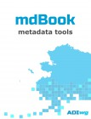
ISO Toolkit Components
mdJson
Standard for encoding project and data metadata
mdTranslator
Provides translation to established metadata standards
mdTools
Groups documentation, validation, and translator interface tools
mdEditor
Online preparation and editing of mdJson files
mdBook
Online documentation for all tools in the ISO Metadata Developer’s Toolkit
mdCodes
Standard ISO codelists for populating metadata editors
mdJson-schemas
Schema definition for mdJson for validating mdJson file structure and content
mdTranslator-rails
Ruby on Rails website for public access to hosted mdTranslator
Code available on GitHub:
https://github.com/adiwg/
Notes:
-- 8 components of the ISO Developer’s Toolkit
-- each has its own GitHub repository
-- all are open source
-- those with public exposure get nice icons
-- all components will be covered during the workshop to varying degrees
-- mention each tool
-- also mdWorkshop repository has all our workshop presentation materials

Slide 31
Core: mdTranslator
ADIwg mdTranslator
mdJson
mdJson
Validator
ISO 19115-2
Writer
19110
HTML
none
ISO
19115-2
mdJson
Reader
19115-1
SQL
Internal Data Store
Future readers:
Future writers:
sbJson
FGDC
FGDC
Notes:
-- mdTranslator is the core of the ISO Developer’s Toolkit
-- accepts input in any supported format (mdJson for now)
-- input is validated using the toolkit component ‘mdJson-schemas’
-- if passes validation, sent to mdJson reader to write the metadata content to the ‘internal data store’
-- if the write succeeds, control passes to the requested writer (ISO 19115-2 in example)
-- other supported metadata writer standards in blue
-- planned metadata writer standards in aqua
-- newly structured metadata passed back to requestor

Slide 32
Core: mdTranslator
mdJson
mdJson-schemas
ADIwg mdTranslator
mdJson
mdJson
Validator
ISO 19115-2
Writer
19110
HTML
none
ISO
19115-2
mdJson
Reader
19115-1
SQL
Internal Data Store
Future readers:
Future writers:
sbJson
FGDC
FGDC
mdTranslator
Notes:
-- mdTranslator is the core of the ISO Developer’s Toolkit
-- accepts input in any supported format (mdJson for now)
-- input is validated using the toolkit component ‘mdJson-schemas’
-- if passes validation, sent to mdJson reader to write the metadata content to the ‘internal data store’
-- if the write succeeds, control passes to the requested writer (ISO 19115-2 in example)
-- other supported metadata writer standards in blue
-- planned metadata writer standards in aqua
-- newly structured metadata passed back to requestor

Slide 33

mdTranslator as code
Ruby install
+ program
Method call or CLI
Ruby code
Notes:
-- Install a local Ruby environment
-- download mdTranslator code repository from GitHub
-- write a program or use the mdTranslator CLI to pass your mdJson to the Ruby code and catch the result
-- using the GitHub repository code means:
---- you can modify the mdTranslator behavior
---- all the maintenance is yours
---- updates to the repository will have to carefully merged into your code

Slide 34
mdTranslator as gem
Ruby install
+ program
Method call or CLI
Ruby code
Ruby Gem
Notes:
-- Install a local Ruby environment
-- install ‘adiwg-mdtranslator’ gem from rubygems.org
-- write program to pass your mdJson to the Ruby code and catch the result
-- using the RubyGem means:
---- write a simpler program to interface with mdTranslator
---- all dependent code is automatically installed by the gem installer
---- all updates and enhancements to adiwg-mdtranslator are merged by a single command

Slide 35
mdTranslator as web service
Web Application
POST
Public hosted web service
Ruby code
Ruby Gem
mdTranslator-rails
Notes:
-- No local Ruby environment needed
-- mdTranslator is hosted at http://mdtranslator.adiwg.org/
-- write simple web application to POST your mdJson to the Ruby code and catch the result
-- use POST to avoid the limitations browsers place on GET (2K)
-- using the hosted web service means:
---- write a simple web application to interface with mdTranslator API
---- no local dev environment
---- always current

Slide 36
mdTranslator as web service
Web Application
POST
Public hosted web service
Ruby code
Ruby Gem
mdTranslator-rails
mdTranslator-rails
Notes:
-- No local Ruby environment needed
-- mdTranslator is hosted at http://mdtranslator.adiwg.org/
-- write simple web application to POST your mdJson to the Ruby code and catch the result
-- use POST to avoid the limitations browsers place on GET (2K)
-- using the hosted web service means:
---- write a simple web application to interface with mdTranslator API
---- no local dev environment
---- always current

Slide 37

mdTranslator in mdTools
Browser
Public hosted web service
Copy
Ruby code
Ruby Gem
Document mdJson
mdTranslator-rails
Validate mdJson
POST
Submit & Capture
Notes:
-- No local Ruby or web application environment needed
-- mdTranslator is hosted at http://mdtranslator.adiwg.org/
-- mdTools is hosted at http://www.adiwg.org/mdTools/#viewer-page
-- use mdTools to validate and POST to mdTranslator and catch result
-- using mdTools means:
---- no local dev environment
---- no code to write
---- always current

Slide 38
mdTranslator in mdTools
Browser
Public hosted web service
Copy
Ruby code
Ruby Gem
Document mdJson
mdTranslator-rails
Validate mdJson
POST
Submit & Capture
mdTools
Notes:
-- No local Ruby or web application environment needed
-- mdTranslator is hosted at http://mdtranslator.adiwg.org/
-- mdTools is hosted at http://www.adiwg.org/mdTools/#viewer-page
-- use mdTools to validate and POST to mdTranslator and catch result
-- using mdTools means:
---- no local dev environment
---- no code to write
---- always current

Slide 39
mdTranslator with mdEditor
Browser
POST
Public hosted web service
Ruby code
Ruby Gem
mdTranslator-rails
Notes:
-- No local Ruby or web application environment needed
-- mdTranslator is hosted at http://mdtranslator.adiwg.org/
-- mdTools is hosted at ???
-- using mdEditor means:
---- no local dev environment
---- no code to write
---- always current
---- assembly and editing of mdJson metadata content file

Slide 40
mdTranslator with mdEditor
mdEditor
Browser
POST
Public hosted web service
Ruby code
Ruby Gem
mdCodes
mdTranslator-rails
Notes:
-- No local Ruby or web application environment needed
-- mdTranslator is hosted at http://mdtranslator.adiwg.org/
-- mdTools is hosted at ???
-- using mdEditor means:
---- no local dev environment
---- no code to write
---- always current
---- assembly and editing of mdJson metadata content file

Slide 41
mdTranslator with mdEditor
Browser
POST
Public hosted web service
Ruby code
Ruby Gem
mdTranslator-rails
mdBook
Notes:
-- No local Ruby or web application environment needed
-- mdTranslator is hosted at http://mdtranslator.adiwg.org/
-- mdTools is hosted at ???
-- using mdEditor means:
---- no local dev environment
---- no code to write
---- always current
---- assembly and editing of mdJson metadata content file

Slide 42
mdJson file?
???
Notes:
-- Why mdJson? Is this just another standard?
---- yes.
---- JSON is simple to read and write
---- supported by most computer languages
---- native to moving data to and from browsers
---- native to JavaScript, the language of browsers
-- How do we get our metadata content into mdJson?
---- no Toolkit component to build mdJson yet
---- mdTools support documentation and validation of mdJson

Slide 43
mdJson from mdEditor
Notes:
-- Addition of mdEditor will complete version 1 of the ISO Developer’s Toolkit
-- hosted online mdJson creator and editor
-- ambitious JavaScript application running local
-- all file storage will be local
-- will interface with mdTranslator
-- nothing to install and no development needed start to finish
-- prototype due fall 2015

Slide 44
mdJson from system
system
Write
metadata
Write
Query
To
mdJson
Notes:
-- If your metadata content is already collected in a database
---- write queries to gather content and format in mdJson

Slide 45
mdJson from template
empty
mdJson
template
Edit in md content
Notes:
-- Start with the mdJson template
-- use JSON editor to edit in metadata content
---- notepad++ with JSON plugins
---- most any IDE will support JSON

Slide 46
Distributing mdJson
mdJson-schemas
Send
Receive
Notes:
-- when exchanging mdJson files with partners
-- the mdJson-schemas tool can be helpful to validate the mdJson file received
-- available as adiwg-mdjson-schemas RubyGem

Slide 47
Questions?
github.com/adiwg/mdWorkshop
www.adiwg.org/mdTools
mdtranslator.adiwg.org
mdbook.adiwg.org

Slide 48
Documentation
mdBook

Slide 49

mdBook
GitBook
Metadata Toolkit documentation
mdbook.adiwg.org

Slide 50
Questions?
github.com/adiwg/mdWorkshop
www.adiwg.org/mdTools
mdtranslator.adiwg.org
mdbook.adiwg.org

