Slide 1
ISO Developer’s Toolkit - mdJSON & mdTools 2015 CDI Workshop
May 11, 2015
Josh Bradley, Arctic LCC

Slide 2
mdJSON{}
Version{}
Contacts[]
Metadata{}
Data Dictionary[]
Individual{}
Organization{}
Citation{}
Distribution[]
Associated Resources[]
Keywords[]
Extents[]
Resource Info{}
Metadata Info{}
Additional Docs[]
...
Notes:
Contacts is an array that contains a list of all contacts found in the mdJSON document. Each contact is assigned a unique id, which is used to reference the contact throughout the document. This avoids the need to store the entire contact multiple times.

Slide 3
Contacts
{
"version": {
"name": "mdJson",
"version": "1.0.0"
},
"contact": [
{
"contactId": "1",
"organizationName": "US Geological Survey - Alaska Science Center"
}
],
"metadata": {
"resourceInfo": {
"resourceType": "project",
"citation": {
"title": "Real-Time Permafrost and Climate Monitoring Network - Arctic Alaska",
"date": [
{
"date": "2012-12-21",
"dateType": "revision"
}
]
},
"pointOfContact": [
{
"contactId": "1",
"role": "pointOfContact"
}
],
"abstract": "DOI is developing a long-term permafrost monitoring network.",
"status": "onGoing",
"language": ["eng; USA", "esp; MEX"]
}
}
}

Slide 4
Developing with mdJSON
What’s needed:
Understanding of JSON structure and syntax
Basic knowledge of JSON Schema specification
Ability to use mdJSON-schemas to validate

Slide 5
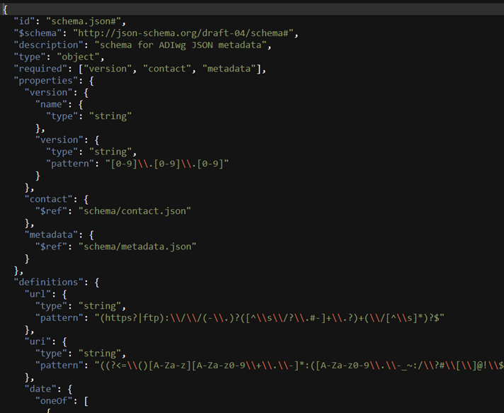
JSON Schema
Complete structural validation of JSON
Latest IETF draft: version 4
Validation engines available in many languages, see http://json-schema.org/

Slide 6
JSON Schema Keywords: $ref
The value of $ref is a JSON Pointer.
$ref is replaced with the value it points to.
JSON Pointer identifies a specific value within a JSON document.
Can point to location in another file
{"$ref": “doc.json#/location/in/doc“}
http://spacetelescope.github.io/understanding-json-schema/
Notes:
The use of $ref allows the schemas to be split into multiple files.
JSON Pointer is similar to Xpath in XML, but it is much simpler.

Slide 7
JSON Schema Keywords
allOf: Must be valid against all of the subschemas
anyOf: Must be valid against any of the subschemas
oneOf: Must be valid against exactly one of the subschemas
http://spacetelescope.github.io/understanding-json-schema/

Slide 8
mdJSON-schemas
Can be used independent of mdTranslator for validation
Include descriptions and pointers to examples
Mapping to other standards(19115-2, FGDC)
https://github.com/adiwg/mdJson-schemas

Slide 9



An interface for ADIwg metadata tools
The purpose of these tools is to assist with the production of metadata
For now, primarily useful for learning and development
www.adiwg.org/mdTools
d3.js
Notes:
Objectives, to make it easier:
To learn about mdJSON and the schema
To use the schemas to validate mdJSON
To use the mdTranslator

Slide 10
Questions?
github.com/adiwg/mdWorkshop
www.adiwg.org/mdTools
mdtranslator.adiwg.org
mdbook.adiwg.org

Slide 11
mdJSON Example

Slide 12

mdJSON Example
Only write blocks for which content exists
Must provide mandatory elements
Must be valid syntax
Must use ISO code lists for domain values
Describe contacts once, use many times
mdJSON Example

Slide 13
ISO Developer’s Toolkit - Using mdTranslator API 2015 CDI Workshop
May 11, 2015
Stan Smith, USGS
Notes:
-- mdTranslator is hosted as a public web service on Heroku
-- Heroku is a cloud platform as a service (PaaS) supporting several languages
-- Ruby, Node.js, Python, PHP, Perl
-- We did not develop on this platform, but are using it to host the mdTranslator API until a permanent home is found

Slide 14


mdTranslator as web service
Web Application
POST
Public hosted web service
Ruby code
Ruby Gem
mdTranslator-rails
http://mdtranslator.adiwg.org/
Notes:
-- back to were we left off in the Into to ISO Toolkit segment
-- hosted on Heroku at http://mdtranslator.adiwg.org/
-- the web service has an embedded mdTranslator gem
-- the web service provides a RESTful API to interact with the mdTranslator
---- REST (Representational State Transfer)
------ Architectural style for scalable web services
------ All functionality is available via unique URLs

Slide 15
mdTranslator as web service
Web Application
mdCodes
Ruby Gem
GET/POST
Public hosted web service
Ruby code
Ruby Gem
mdTranslator-rails
http://mdtranslator.adiwg.org/
Notes:
-- another ISO Toolkit component is also hosted in the API – mdCodes
-- mdCodes is designed to supply ISO codelists via REST endpoints to metadata editor application
-- covered later in this segment

Slide 16
mdTranslator ‘Welcome’
Welcome page - http://mdtranslator.adiwg.org/
Root for mdTranslator API
Overview
Background
Including description of the six ISO Metadata Developer’s Toolkit components
Links
mdTranslator resources
API .../api/v1
Readers .../api/readers
Writers .../api/writers
Related external resources
mdTranslator Home page http://www.adiwg.org/mdTranslator/
mdTools http://www.adiwg.org/mdTools/
GitHub repository https://github.com/adiwg
RubyGems libraries https://rubygems.org/
Notes:
-- talk from slide

Slide 17
mdTranslator API
API V1 documentation .../api/v1/api or .../api/v1
API is versioned to support legacy versions of API
API only supports GET and POST verbs
PUTs (updates) and DELETEs not accepted
Cross domain requests handled by CORS (Cross-Origin Resource Sharing)
Documentation and Lists
GET
Informational web pages
API version 1 options .../api/v1/options
Interacting with codelists
Translator method
GET
Limited application due to URI size limits (2K)
POST
mdTranslator parameters .../api/v1/demo
Notes:
-- talk from slide
-- demonstrate mdTranslator parameters from demo

Slide 18
mdCodes
mdCodes is also a GitHub repo and RubyGem
Designed for metadata content editors (mdEditor) to load codelist values
Contains all ISO codelists needed by mdTranslator
Current with 19115-2, 19115-1, including some ADIwg extensions
Each codelist is a maintained in a separate YAML file
“Yet Another Markup Language” or “YAML Ain’t Markup Language”
Suited for text editing structured data
Supported in Ruby, Python, Perl, grep
Only static codelists are supported at this time
We might extend to provide a consistent API for externally maintained hierarchical code lists such as:
GCMD Global Change Master Directory of Earth Science Keywords (NASA), ITIS, Several candidates from NOAA
Notes:
-- talk from slide

Slide 19
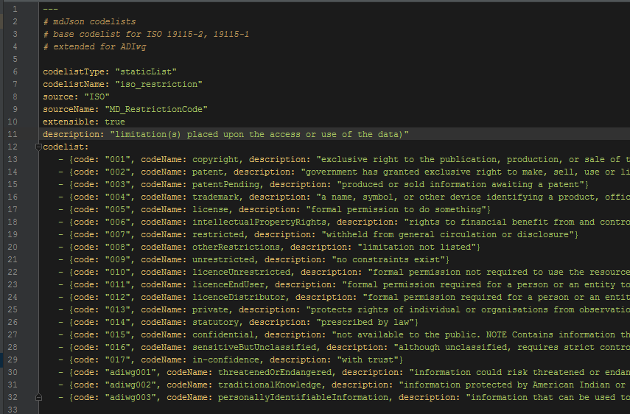
mdCodes YAML file
Static codelist example
Notes:
-- type of list => static
-- name => iso_restriction
-- official source name => MD_RestrictionCode
-- extensible => T/F
-- description
-- list of codes
---- unique code
---- code name
---- description

Slide 20
mdCodes API
.../api/codelists – use chrome w/ JSON formatter plugin
All codelists and values .../api/codelists
All codelists and values .../api/codelists?format=json
ISO CT_CodelistCatalogue .../api/codelists?format=xml
All codes with definitions .../api/codelists?definitions=true
Add a JSONp wrapper .../api/codelists?callback=myCall
Single codelist .../api/codelists/iso_restriction
Single codelist with definitions .../api/codelists/iso_mediumName?definitions=true

Slide 21
Questions?
github.com/adiwg/mdWorkshop
www.adiwg.org/mdTools
mdtranslator.adiwg.org
mdbook.adiwg.org

