Slide 1
ISO Developer’s Toolkit - Installing on Windows 2015 CDI Workshop
May 11, 2015
Stan Smith, USGS
Notes:
-- presentation covers all the steps to install and validate Ruby and Ruby on Rails installations on Windows 7
-- and I think 8 as well
-- will not discuss every step, take too long
-- all steps are on the slides for those who want to do this latter, or even try and keep up in the workshop
-- try to walk you around the pitfalls and recover from the install issues

Slide 2
Do I need to install Ruby?
I will need to install Ruby if …
… I want to participate in extending the ISO Metadata Toolkit
… I want to customize the mdTranslator for my own purpose
… I want to integrate the adiwg-mdTranslator gem into local systems (either by code or CLI)
… I want to host the mdTranslator as a local web service
I do not need to install Ruby if …
… I will use the publicly hosted mdTranslator API

Slide 3
Why Ruby?
Ruby is a dynamic, Object Oriented, cross-platform, open-source, general-purpose programming language written in C (not to be confused with ‘Ruby on Rails’)
Initial development in mid 1990s by Yukihiro Matsumoto
Gained wide acceptance and popularity
Ruby has more than 100,000 Gems available for specialized tasks
Interpretive language
The MinGW compiler is used for Windows installations
Ruby project on GitHub - https://github.com/ruby
Notes:
-- why choose the Ruby language (points on the slide)
-- Ruby runs on Linux, Windows, and iOS
-- developed on both Windows and Linux to be sure our software worked properly in both environments

Slide 4
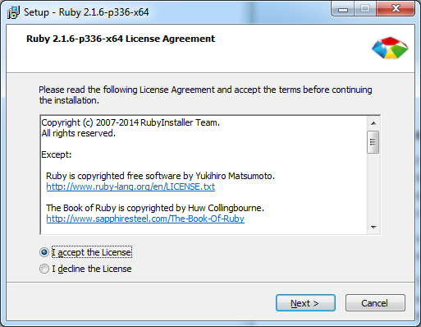
Ruby on Windows 1
Download the appropriate Windows installer from http://rubyinstaller.org/ . In this example we use Ruby 2.1.6 x64. Version for 2.2.2 is available but I like to give time for RubyGem providers to test against new versions.
Navigate to the download directory and double-click the self-extracting 7z file.
Accept the license …
Notes:
-- next 7 slides step a Ruby installation on Windows 7 x64
-- the steps also cover validating the installation

Slide 5
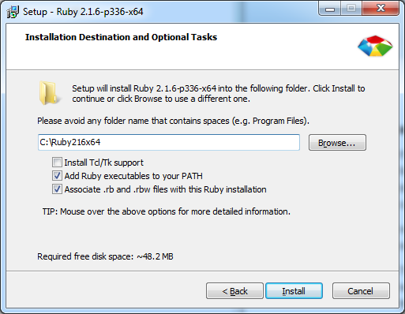
Ruby on Windows 2
Provide a location for the installation. I use the root of the C:\ drive to be sure the binaries are easy for all Ruby programs to find. I also name the folder with the version of Ruby being installed so I can install and test newer releases as they become available.
Be sure to choose to add Ruby to your PATH and make the association with .rb and .rbw file types.
Click ‘Install’ and the process will complete.
Notes:
-- Ruby does not use the Windows registry other than for the installer (so you can uninstall)
-- Ruby can downloaded and unzipped in directory,
---- manually add the PATH to your environment variable
---- and you are ready to go

Slide 6
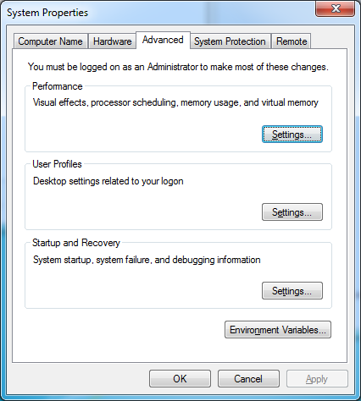
Ruby on Windows 3
The installations is complete. So let’s verify it. Check that the path was added to the Windows Environment Variables. The PATH can be viewed and edited from the ‘Advanced’ tab of ‘System Properties’. Click the ‘Environment Variables …’ button.

Slide 7
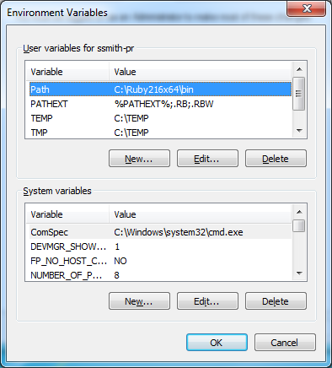
Ruby on Windows 4
Be sure you see the path to the folder you installed Ruby in.
Notes:
-- must be running with administrator privilege to have install add PATH
-- still must have admin to add it later

Slide 8
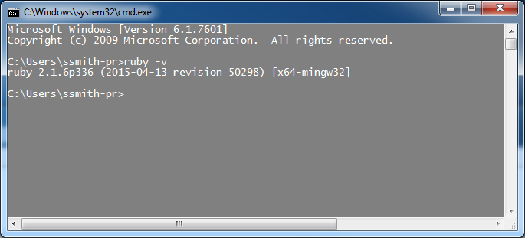
Ruby on Windows 5
With Ruby installed, test that Ruby works properly in your environment. Start a command window (launch cmd.exe from the start menu).
From the prompt check the version of Ruby installed: > ruby –v

Slide 9
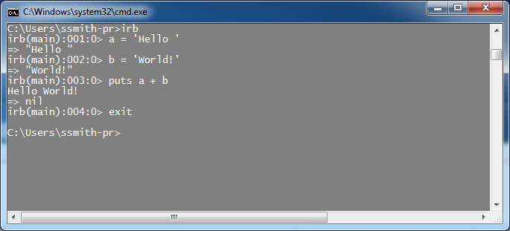
Ruby on Windows 6
You can also start the ‘Interactive Ruby’ console and write a few lines of Ruby code just to see that all works properly. > irb > a = ‘Hello ‘ > b = ‘World!’ > puts a + b Hello World!

Slide 10
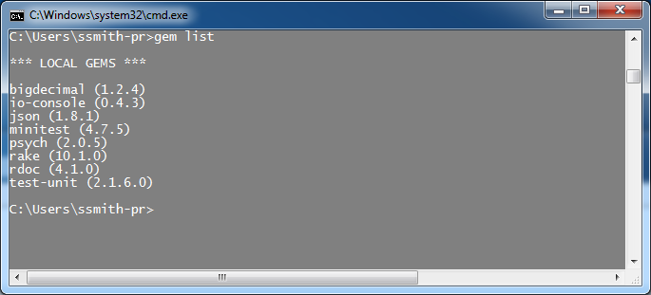
Ruby on Windows 7
Ruby gets much of its power from the rich repository of RubyGems or code libraries. These are written to easily plug into and be consumed by Ruby programs. Check the gems installed with the Ruby installation: > gem list
Note that the RubyGem ‘gem’ was also installed although not listed.

Slide 11
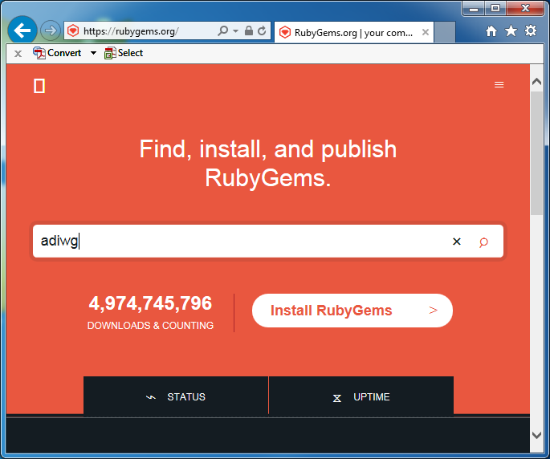
adiwg-mdtranslator gem
Thousands of RubyGems are available for download at http://rubygems.org/ including those written by ADIwg. Enter ‘adiwg’ and press ‘Enter’.

Slide 12
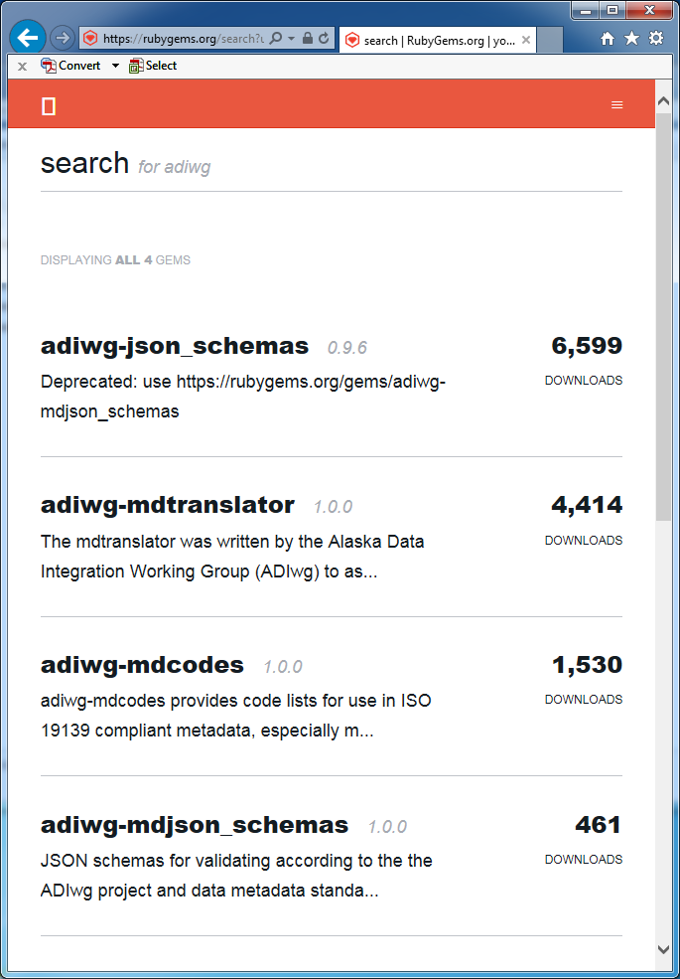
adiwg-mdtranslator gem
The ADIwg gems available are listed along with their current download counts.
In this case we want to install the ‘adiwg-mdtranslator’ gem. From the command line type: > gem install adiwg-mdtranslator
Notes:
-- old screenshot, versions are now 1.1.

Slide 13
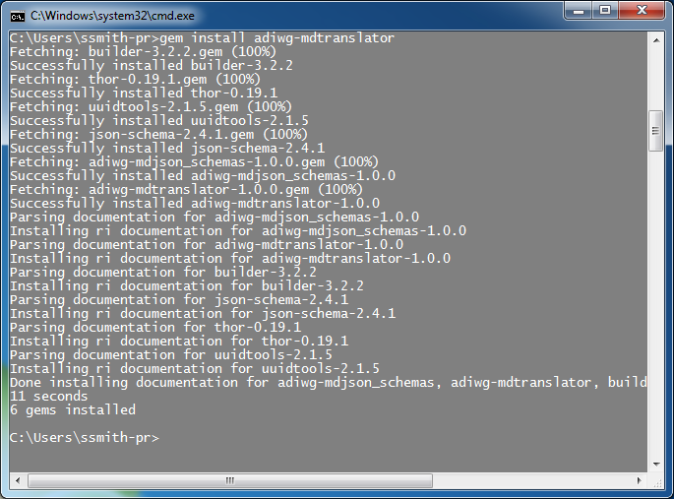
adiwg-mdtranslator gem
The adiwg-mdtranslator gem will install along with all its other RubyGem dependencies. Notice 6 gems were installed.

Slide 14
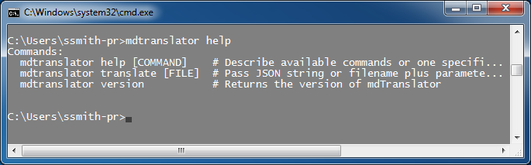
adiwg-mdtranslator gem
Since the adiwg-mdtranslator gem provides a Command Line Interface (CLI) we can check its installation by typing: > mdtranslator help

Slide 15
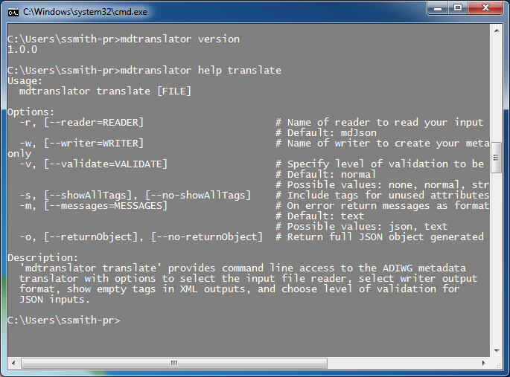
adiwg-mdtranslator gem
We can check the version and get more help on commands such as ‘translate’.
Installation of Ruby and the mdTranslator are complete. We could use mdTranslator from the command line and pipe the result to a file.
Notes:
-- took 8 minutes to here

Slide 16
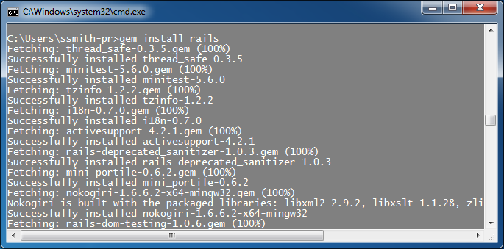
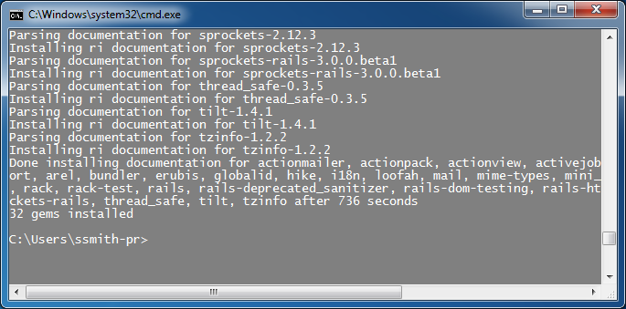
Rails on Windows 1
If we wish to use mdTranslator within a local web service we need to install Ruby on Rails (Rails).
With Ruby install, use Gem to do the work for us. > gem install rails.
Notice Rails installed another 32 gems.

Slide 17
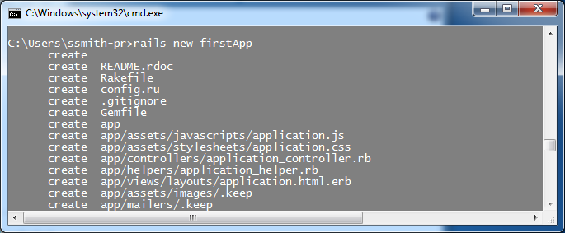
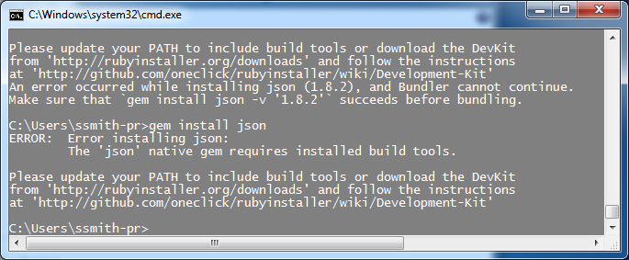
Rails on Windows 2
To test the Rails installation, ask rails to create a new website for us.
Navigate to the folder to hold your new website.
From the command line type: > rails new firstApp.
Rails will create a new directory named ‘firstApp’ and install all the code for a new website

Slide 18
Rails on Windows 3
After many lines are reported back the web site failed to complete because the ‘json’ gem version 1.8.2 did not provided a version compiled for Windows. Unfortunately, glitches are common on Windows installations and the installation of DevKit will generally be required at some point. Best do it now!
Download the appropriate version of DevKit from http://rubyinstaller.org/downloads/ .
I also install DevKit at the root of the C:\ directory. More information about installing DevKit can be found at https://github.com/OneClick/RubyInstaller/wiki/Development-Kit .

Slide 19
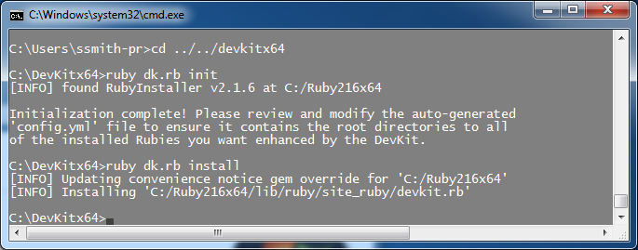
Rails on Windows 4
To connect DevKit to the Ruby installation, navigate to the directory where DevKit installed.
From the command line type: > ruby dk.rb init
Next type: > ruby dk.rb install

Slide 20
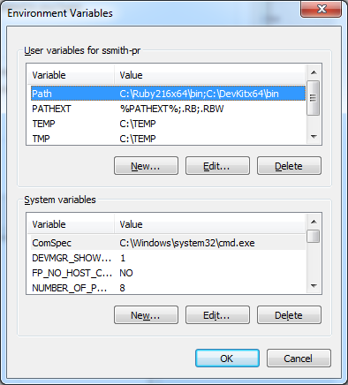
Rails on Windows 5
With DevKit installed, check that the PATH variable was properly updated.
Notes:
-- must be running with administrator privilege to have install add PATH
-- still must have admin to add it later

Slide 21
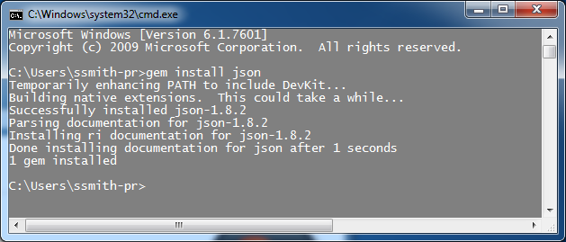
Rails on Windows 6
With the DevKit PATH now defined to Ruby, try for a properly installed version of the json gem. From the command line type: > gem install json
And this time it works!

Slide 22
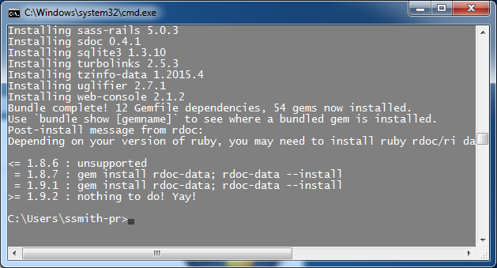
Rails on Windows 7
Try again to have Rails build a new web site. From the command line: > rails new firstApp
After many lines you should see a successful completion.

Slide 23
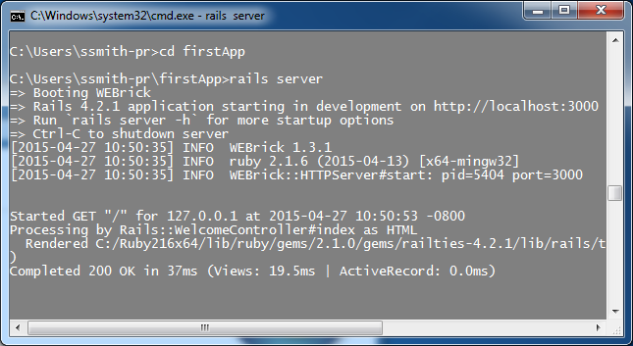
Rails on Windows 8
To test our new web site, navigate to its directory and start the rails server. From the command line type: > rails server
Rails will start its default web server ‘WEBrick’ on localhost port 3000.

Slide 24
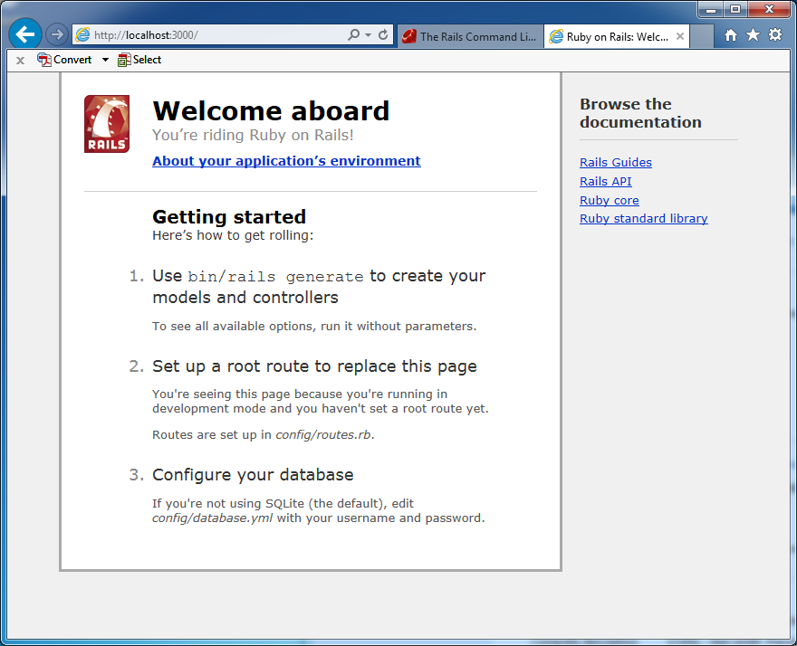
Rails on Windows 9
Open you browser and navigate to http://localhost:3000. You should see the Rails ‘Welcome aboard’ page.

Slide 25
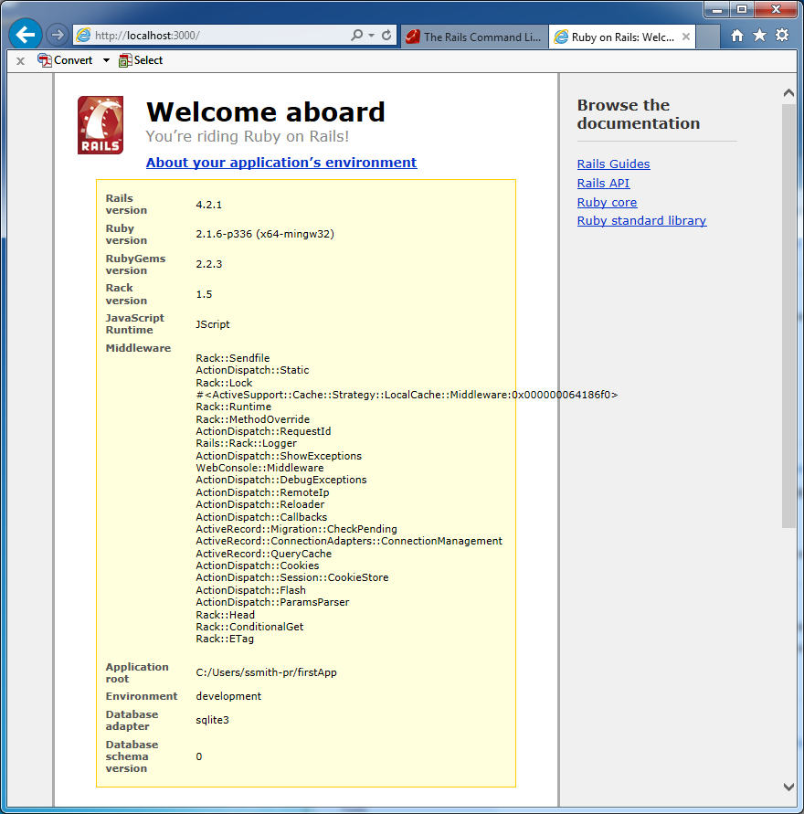
Rails on Windows 10
For more information about the installation click the ‘About your application’s environment’ and Rails will display information about the software and version used.
Time to start developing! -- Almost --
Notes:
-- took 31 minutes to here

Slide 26
Rails on Windows 11
Another common problem with Rails on Windows x64 is the gem ‘tzinfo’. Windows does not include a time-zone table with the operating system so one needs to be downloaded. tzinfo will automatically set one up for Windows x32 but not x64. Find the ‘Gemfile’ line …
gem 'tzinfo-data', platforms: [:mingw, :mswin]
edit to tell tzinfo to include support for Windows x64
gem 'tzinfo-data', platforms: [:mingw, :mswin, :x64_mingw]
Run another gem installed with Rails, ‘bundler’. Bundler tell Rails the gems and their versions to use with your Rails web site. From the terminal prompt to update the web site’s gem files. Type: > bundle update.
Now you are ready. Really…

Slide 27
ISO Developer’s Toolkit - Linux Installation 2015 CDI Workshop
May 11, 2015
Presenter Here, USGS

Slide 28
Ruby Version Manager
Options:
RVM: https://rvm.io/
rbenv: https://github.com/sstephenson/rbenv
chruby: https://github.com/postmodern/chruby
Easily switch between Ruby versions
mdTranslator requires Ruby >= 2.1
mdTranslator-rails requires 2.1.5
Notes:
Can always add via distro packaging system, but need to be aware of version requirements.
Ubuntu alternative: https://www.brightbox.com/docs/ruby/ubuntu/

Slide 29
Install mdTranslator (RVM)
#install rvm and ruby
gpg --keyserver hkp://pgp.mit.edu --recv-keys 409B6B1796C275462A1703113804BB82D39DC0E3
\curl -sSL https://get.rvm.io | bash -s stable –ruby
source ~/.rvm/scripts/rvm
gem install adiwg-mdtranslator
mdtranslator help translate
Notes:
Tested on Ubuntu 14.04

Slide 30
Install mdTranslator-rails (RVM)
#install mdTranslator-rails
# if necessary, source rvm
source ~/.rvm/scripts/rvm
rvm install 2.1.5 #about 25MB download
rvm use 2.1.5
gem install bundler
git clone https://github.com/adiwg/mdTranslator-rails.git #or git@github.com:adiwg/mdTranslator-rails.git
cd mdTranslator-rails/
bundle update #will install rails
rails server #or ‘unicorn’
Notes:
Tested on Ubuntu 14.04
You may have to install postgresql-server-dev-9.x package (for PostgreSQL dev headers).

Slide 31
Questions?
github.com/adiwg/mdWorkshop
www.adiwg.org/mdTools
mdtranslator.adiwg.org
mdbook.adiwg.org

Slide 32
ISO Developer’s Toolkit - CLI Integration 2015 CDI Workshop
May 11, 2015
Josh Bradley, USGS
Notes:
This presentation introduces the mdTranslator command-line interface(CLI) and options for integration into non-Ruby systems.

Slide 33
mdTranslator CLI
Command-line interface is provided with gem
Supports all options available via API
Allows simple integration with non-Ruby applications
Notes:
If application language can execute system commands, it can interact with the CLI.

Slide 34
mdTranslator CLI
> mdtranslator help translate
Usage:
mdtranslator translate [FILE]
Options:
-r, [--reader=READER] # Name of reader to read your input
# Default: mdJson
-w, [--writer=WRITER] # Name of writer to create your metadata, or leave blank to validate input only
-v, [--validate=VALIDATE] # Specify level of validation to be performed
# Default: normal
# Possible values: none, normal, strict
-s, [--showAllTags], [--no-showAllTags] # Include tags for unused attributes
-m, [--messages=MESSAGES] # On error return messages as formatted text or json object
# Default: text
# Possible values: json, text
-o, [--returnObject], [--no-returnObject] # Return full JSON object generated by translator

Slide 35
CLI: -o, [--returnObject]
> mdtranslator translate –o –w html file.json
{
"readerFormat" : "json",
"readerStructurePass" : true,
"readerStructureMessages" : [],
"readerRequested" : "mdJson",
"readerFound" : "mdJson",
"readerVersionFound" : "1.0.0",
"readerVersionUsed" : "1.0",
"readerValidationLevel" : "normal",
"readerValidationPass" : true,
"readerValidationMessages" : [],
"readerExecutionPass" : true,
"readerExecutionMessages" : [],
"writerName" : "html",
"writerVersion" : "1.1.1",
"writerFormat" : "html",
"writerPass" : true,
"writerMessages" : [],
"writerOutput" : "<!DOCTYPE html>\n<html lang=\"en\">\n..."
}

Slide 36
PHP Example
<?php
function translate($json, $format='iso19115_2') {
//write to temp file to support cross-platform
$temp = tmpfile();
fwrite($temp, $json);
fseek($temp, 0);
$meta = stream_get_meta_data($temp);
exec("mdtranslator translate -o -w $format " . $meta['uri'], $out, $code);
fclose($temp);
$xml = empty($out) ? FALSE : json_decode($out[0]);
if ($code > 0) {
throw new \Exception("mdTranslator error.");
} elseif (!is_object($xml) || !$xml->writerPass) {
throw new \Exception("JSON did not validate.");
}
return $xml->writerOutput;
}
?>
Notes:
Line 2 The function accepts a JSON string and format to output as parameters.
Lines 4-7 take the json input and create a temp file
Line 8 calls the mdTranslator CLI and passes options and input file location.
Line 11 decodes the output from the CLI
Line 13-17 check for output errors. Line 13 is checking the CLI exit code.
Line 19 returns the translated output.

Slide 37
Application Example
ALCC Project Tracking System
mdJSON
mdTranslator
metadata. arcticlcc.org
ISO XML, mdJSON Webservice
Notes:
The Arctic LCC has integrated the mdTranslator into it’s Project Tracking System.
The goal is to host a webservice providing access to multiple metadata formats using the output from the mdTranslator.

Slide 38
Questions?
github.com/adiwg/mdWorkshop
www.adiwg.org/mdTools
mdtranslator.adiwg.org
mdbook.adiwg.org

Slide 39
ISO Developer’s Toolkit - mdTranslator in Ruby 2015 CDI Workshop
May 11, 2015
Stan Smith, USGS
Notes:
-- this is really easy

Slide 40
mdTranslator in Ruby 1
Complete the installation of Ruby and the adiwg-mdtranslator RubyGem if this is not already done.
Using your favorite code editor create a new file named ‘translate.rb’.
Start by including the RubyGem ‘adiwg-mdtranslator’.
# simple mdTranslator Ruby application # include the adiwg-mdtranslator RubyGem in the application require 'adiwg-mdtranslator'

Slide 41
mdTranslator in Ruby 2
Read in the file with your metadata content in mdJson format.
Call the mdTranslator.
# read file in the mdJson file my_file = File.open('C:\Users\...\full_example.json', 'r') jsonObj = my_file.read my_file.close
# call mdtranslator with desired parameters # mdtranslator uses a 'named' parameter list metadata = ADIWG::Mdtranslator.translate( file: jsonObj, reader: 'mdJson', validate: 'normal', writer: 'iso19115_2', showAllTags: true)
Notes:
4 – Ruby code to read a file and assign the content to a variable
5 – call to the mdTranslator
5 – the parameter list is ‘named’ position of the parameters in the list is not important.

Slide 42
mdTranslator in Ruby 3
Extract the output from the return.
Save the formatted metadata record.
All done!
# extract the metadata output from the returned metadata hash if !metadata[:writerOutput].nil? writerOut = metadata[:writerOutput] metadata[:writerOutput] = 'Extracted' end
# send the metadata output to a file File.open('C:\Users\...\mdOutput.xml', 'w') { |file| file.write(writerOut) }
Notes:
6 – a Ruby hash is returned from the mdTranslator.translate method
6 – extract the output from metadata[:writerOutput]
7 – write the metadata output to a file

Slide 43
mdTranslator in Ruby 4
Other things to do …
Examine other elements of the ‘return hash’
Check return values for errors
Handle error reporting
Handle different writers
Support mdTranslator.translate options
Blah, blah, blah …
# show metadata returned hash require 'pp' pp metadata
Notes:
-- took 12 minutes to here

Slide 44
Questions?
github.com/adiwg/mdWorkshop
www.adiwg.org/mdTools
mdtranslator.adiwg.org
mdbook.adiwg.org

Slide 45
ISO Developer’s Toolkit - mdTranslator in Rails 2015 CDI Workshop
May 11, 2015
Stan Smith, USGS
Notes:
-- not too complex, but more to do than building a Ruby application
-- Rails is a web application development platform
-- tries to make programming web applications simpler by making many assumptions about what the developer needs to get done
-- that can also drive you nuts!

Slide 46
mdTranslator on Rails 1
From the command line, navigate to the directory to hold your new Rails application. This will become the parent directory of the new Rails application.
Generate the new rails application. > rails new translator
A new directory named ‘translator’ will be created and filled with the new Rails application modules.
Test the new ‘translator’ rails application.
Change the directory to the Rails application just created > cd translator
Start the Rails server. > rails server
From a browser type http://localhost:3000
You should see the ‘Welcome aboard’ page.

Slide 47
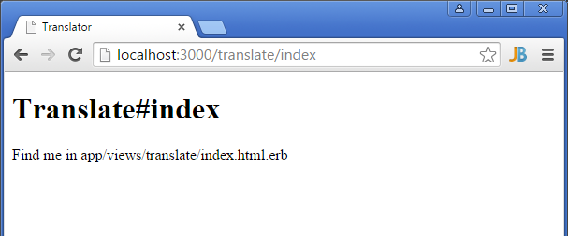
mdTranslator on Rails 2
Generate a home page using a Rails helper. > rails generate controller translate index
Test the new index page that Rails generated for you … http://localhost:3000/translate/index

Slide 48
or maybe not!
Found trouble on some Windows installations – not sure of cause
In file …/app/views/layouts/application.html.erb comment out the line calling the javascript_include_tag so it looks like this:
This feature preserves head JavaScript from page to page as a means of saving load and compile time. Not need in this application anyway.
<head> <title>mdTranslator API</title> <%= stylesheet_link_tag 'application', media: 'all', 'data-turbolinks-track' => true %> <!-- javascript_include_tag 'application', 'data-turbolinks-track' => true --> <%= csrf_meta_tags %> </head>

Slide 49
mdTranslator on Rails 3
Next set the ‘index’ page as the default page for the website. In the .../config/routes.rb file set the root to ‘translate#index’.
Rails.application.routes.draw do get 'translate/index' root 'translate#index'
Notes:
-- Rails.application.routes.draw tells Rails to build a route map of accepted routes.
-- the get was added by Rails when we generated the ‘index’ page.

Slide 50
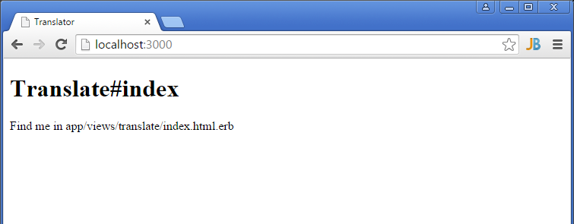
mdTranslator on Rails 4
Now the index page will display at root rather than ‘Welcome aboard’.

Slide 51
mdTranslator on Rails 5
Code a simple HTML form in the file …/app/views/translate/index.html.erb replacing all the Rails generated code.

Slide 52
<!-- # Alaska Data Integration working group - ADIwg # REST endpoint controller for demonstration of mdTranslator --> <h2> mdTranslator Rails example</h2> <div id="form_container"> <%= form_tag('/translate') do %> <div> <h3>Submit JSON</h3> <p> Paste or type JSON, choose options, and click Submit. Valid ISO 19115-2 XML should be generated. <br> </p> <div> <textarea name="file">Place mdJson here</textarea> </div> </div> <div class="buttons"> <input type="hidden" name="form_id" value="759352"/> <input id="saveForm" class="button_text" type="submit" name="submit" value="Submit"/> </div> <div> <p> For more info visit the <a href="http://www.adiwg.org/mdTranslator">mdTranslator website</a>. </p> </div> <% end %> </div>
Notes:
-- building a HTML form
-- clicking the submit button will POST the contents of the form to ‘/translate/’

Slide 53
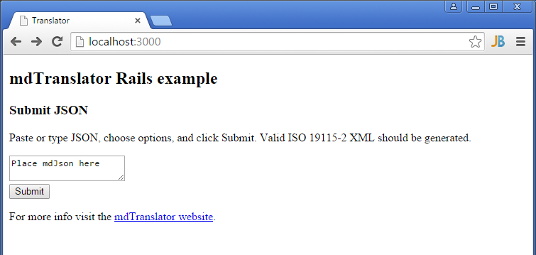
mdTranslator on Rails 6
The updated index page now looks like this …

Slide 54
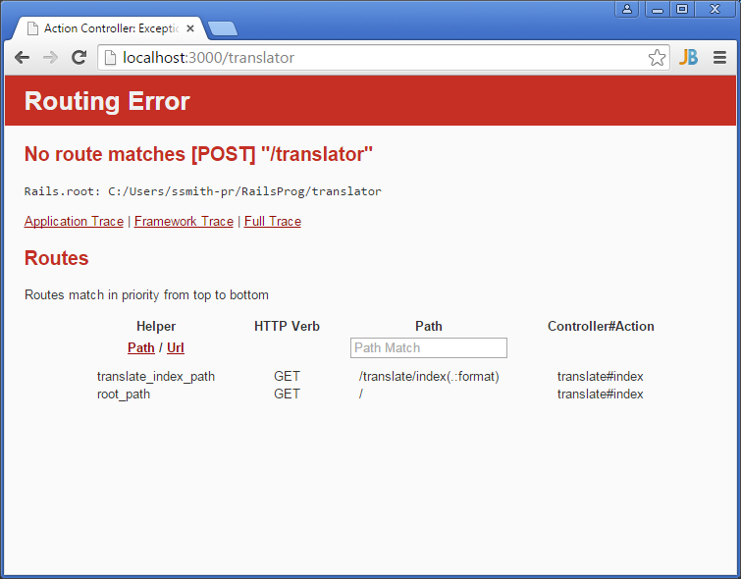
mdTranslator on Rails 7
Click ‘Submit’ and Rails shows a ‘Routing Error’. We have not handled the HTTP POST in our routing or controller.
Notes:
-- notice in the Routes map there is no
---- POST /translate/

Slide 55
mdTranslator on Rails 8
Rails only generated code in the router and controller to process the HTTP GET verb. Add a ‘resources’ statement to …/config/routes.rb to have Rails automatically handle all HTTP verbs, including POST.
Rails.application.routes.draw do get 'translate/index' root 'translate#index' resources :translate

Slide 56
mdTranslator on Rails 9
Add code in the …/app/controllers/translate_controller.rb file intercept and process the HTTP POST request.
class TranslateController < ApplicationController # process GETs def index end # process POSTs def create render inline: '<h2>This is the HTTP POST</h2>' end end
Notes:
-- the code to process the GETs is already in the file
-- def create intercepts POSTs
---- render inline: returns the HTML in quotes as the web page, ok for testing.

Slide 57
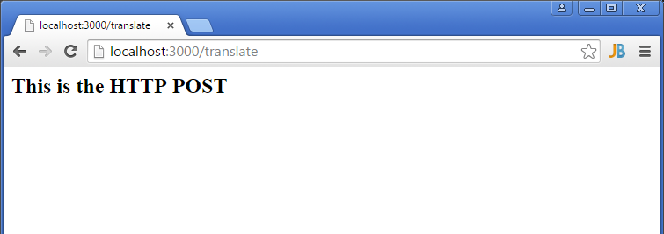
mdTranslator on Rails 10
Now the HTTP POST is properly intercepted. When the ‘Submit’ button is pressed we see...

Slide 58
mdTranslator on Rails 11
With the basic structure of the website complete connect the mdTranslator gem to the website. Add the adiwg-mdtranslator gem request to the .../Gemfile.
Update the website’s gems. From the command line type: > bundle update. The adiwg-mdtranslator gem and all its dependencies will be loaded to your Rails website.
Remember to restart the Rails server after adding new gems.
# Alaska Data Integration working group metadata translator gem 'adiwg-mdtranslator', '~> 1.0'
Notes:
-- ~> 1.0 asks to load version 1.0 or higher
-- the most recent version should load
-- bundler is a gem installed with Rails

Slide 59
mdTranslator on Rails 12
Now we need to write a simple script to process the HTTP POST. In the ../app/controllers/translate_controller.rb file replace the ‘render inline:’ statement we entered to test the connection and routing with something like this…
# process POSTs def create # load file and parameter from POST fileObj = params[:file] # call the ADIwg metadata translator @mdReturn = ADIWG::Mdtranslator.translate( file: fileObj, reader: 'mdJson', validate: 'normal', writer: 'iso19115_2', showAllTags: false) render xml: @mdReturn[:writerOutput] end
Notes:
-- grab the input file from the parameter list
-- pass the file and other parameters to the mdTranslator gem
-- accept the returned hash
-- render the metadata output as XML

Slide 60
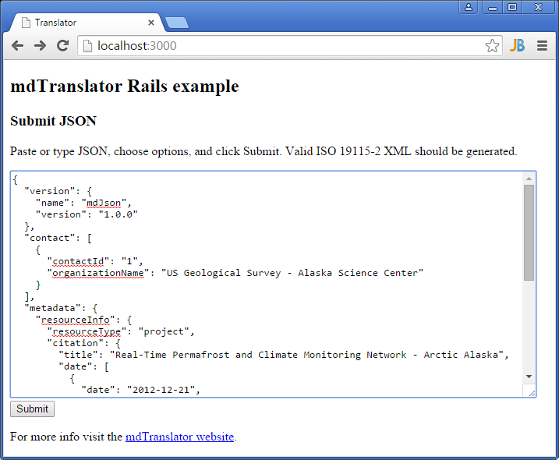
mdTranslator on Rails 13
After the server restarts, navigate to the website root and enter some valid mdJson.

Slide 61
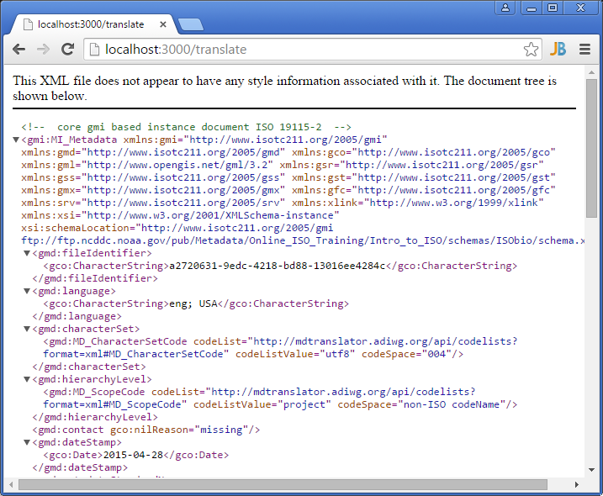
mdTranslator on Rails 14
Click submit and you should see ISO 19115_2 returned from you locally hosted web service.
Notes:
-- time 25 minutes to here

Slide 62
mdTranslator on Rails 15
This ‘non-award winning’ website only demonstrates the simplicity of building a website that can interface with the ADIWG ISO Metadata Toolkit. A real website would need to be more robust checking for errors, handling all mdTranslator options, and handling all response types returned from the mdTranslator (XML. JSON, JSONp, text, plain). But it’s a start.

Slide 63
Questions?
github.com/adiwg/mdWorkshop
www.adiwg.org/mdTools
mdtranslator.adiwg.org
mdbook.adiwg.org

