Slide 1
Introduction to ADIwg ISO Metadata Toolkit 2015 CDI Conference Training Session
May 11, 2015
Stan Smith, USGS ASC;
Josh Bradley, Arctic LCC;
Dennis Walworth, USGS ASC

Slide 2
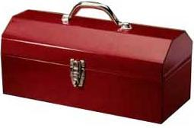
Workshop Outline
Project overview and toolkit introduction
Generating metadata using the toolkit
Toolkit integration with systems

Slide 3

Overview
Project introduction
Development background
Toolkit introduction
Documentation

Slide 4


About ADIwg
The Alaska Data Integration Working Group (ADIwg)
Mission: to examine and address the technical barriers to efficiently integrate and share data within and among participating organizations
Steering Committee: Alaska Climate Change Executive Roundtable (ACCER)
ADIwg technical work group implements objectives
Notes:
Recognition of need to exchange research knowledge in terms of data and metadata

Slide 5
Who is ADIwg?
Federal
BLM, BOEM, NPS, USFWS, USFS, USGS
State of Alaska
University of Alaska (UAF, UAS)
Geographic Information Network of Alaska (GINA)
International Arctic Research Center (IARC)
Non-Governmental Organizations (NGOs)
Arctic Ocean Observing System (AOOS)
Arctic Research Mapping Application (ARMAP) - Nunatech Consulting
North Pacific Research Board (NPRB)
North Slope Science Initiative (NSSI)
Cooperatives/Joint-Ventures
Arctic LCC

Slide 6
ADIwg ISO Metadata Requirements
Adoption of ISO 19115-2 as standard for ADIwg
Share high investment cost for comprehension and implementation
Support diversity of requirements and implementation skills across ADIwg membership
Transition existing project metadata standard to ISO

Slide 7

Project Objectives
Eliminate necessity to learn ISO 19115 family of standards
Make it easier for organizations to:
Achieve ISO compliance
Integrate ISO support into local applications and services
Implement custom web services with ISO metadata capability
Host a public web service for generation of ISO metadata records
Support both project and data metadata in ISO
Host a public web app for PIs to enter and edit metadata

Slide 8
Project Scope
Support creation of original metadata records
Portable, open source code library for developers
Create a user-friendly metadata preparation tools
Accommodate diverse needs and technical abilities
Extensible (create metadata in multiple standards)

Slide 9
Out of Scope
Metadata clearinghouse
Translation between XML metadata standards (e.g. FGDC->ISO)
Provide metadata snippets to other metadata tools

Slide 10
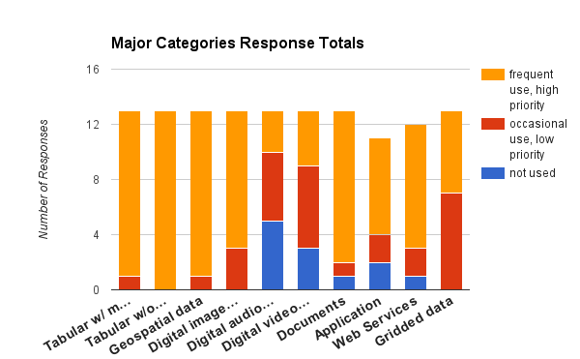
Choosing a Standard
Polled members for types of data produced

Slide 11
Choosing a Standard
Defined metadata content requirements
Analyzed common standards for best solution
FGDC, Dublin Core, EMI, ISO
Selected ISO standard

Slide 12
“data about data”
Which Standard?
FGDC CSDGM, Dublin Core, EML, ISO/TC 211, ...
Which Version?
19115, 19115-2, 19115-1, …
Which Profile?
Based on ISO 19115: North American Profile, WMO Core, INSPIRE, Polar Metadata Profile, …
Notes:
ISO/TC 211 - Geographic information/Geomatics: http://www.iso.org/iso/home/store/catalogue_tc/catalogue_tc_browse.htm?commid=54904

Slide 13
“human vs machine”
What’s it for?
Human eyes?
Machine-to-machine?
To discover, communicate, document, archive?
Resource type?
Geospatial
Non-spatial (reports, images, tabular, …)
Project level
Collection

Slide 14
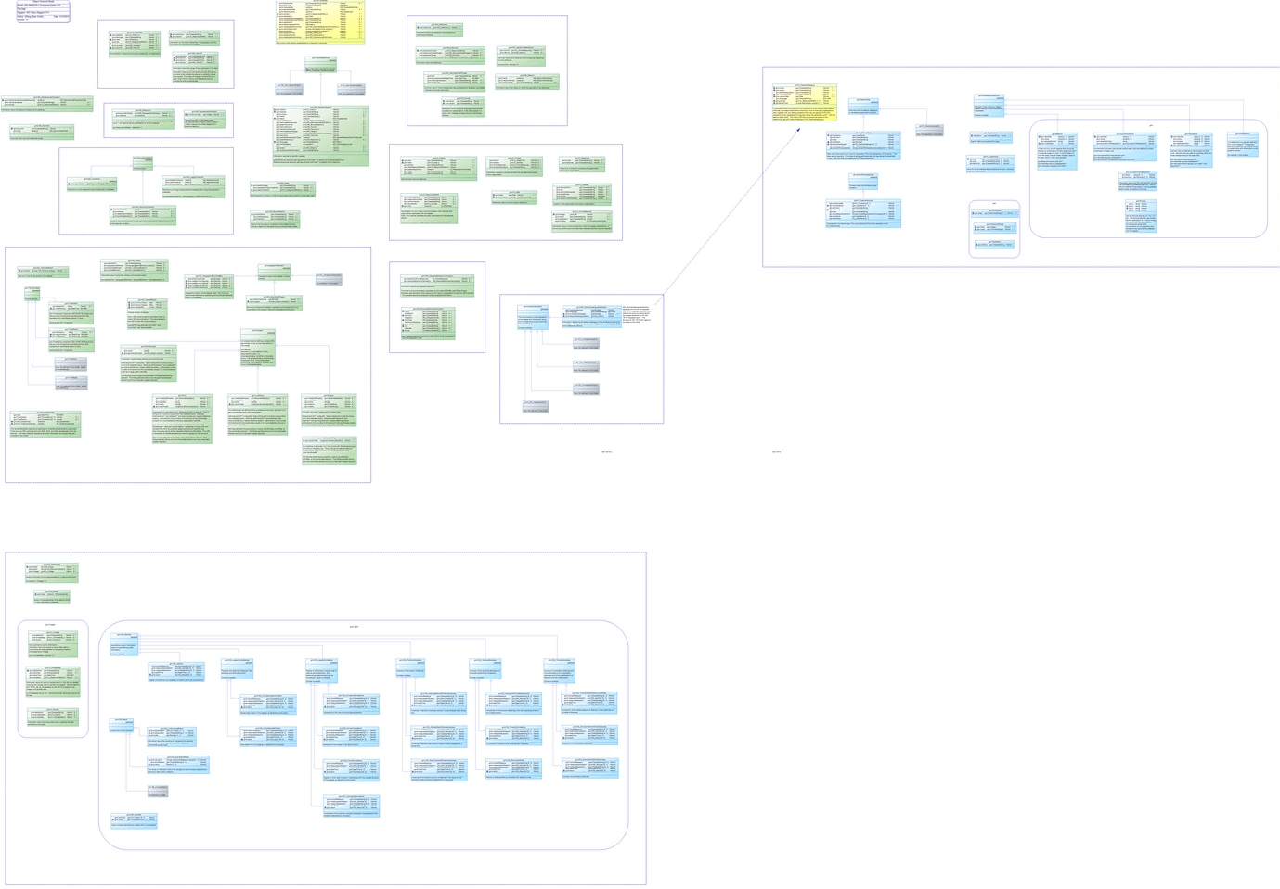
Supported ISO Fields
ADIwg supported fields
110+ classes
350+ attributes
70% of full standard
3 ‘E’ size diagrams
Notes:
The full ISO standard is very large – but little is mandatory
Limit the number of ISO fields to support in first iteration
Anticipate this field set will cover about 80%+ of our data resources.
Still not small, (see stats)
The model is also an excellent tool to learn ISO, much easier than ISO docs
Yellow – starting point
Green – implemented
Blue – implementation on hold
Gray – subtypes not implemented

Slide 15
ISO Metadata Toolkit
Transition to branded open source project
Core Alaska group from ADIwg
Growing participation from interested parties
Sponsorship from CDI and NCCWSC

Slide 16
Development Background

Slide 17
Documentation

Slide 18

mdBook
GitBook
Metadata Toolkit documentation
mdbook.adiwg.org

Slide 19
Generating Metadata Using the Toolkit

Slide 20
Generating Metadata Using mdTools
mdJSON Standard
mdJSON Example
Using mdTools Web Services
Using mdTranslator API

Slide 21

mdJSON Example
Only write blocks for which content exists
Must provide mandatory elements
Must be valid syntax
Must use ISO code lists for domain values
Describe contacts once, use many times
mdJSON Example

Slide 22
Integrating mdTools into Systems

Slide 23
Integrating mdTools into Systems
GitHub
Installation
Command Line Interface
Integration with existing system
Ruby Gem
Rails
Forking ADIwg repos

Slide 24
Questions?
Discussion?

