Slide 1
ISO Developer’s Toolkit - mdJSON & mdTools 2015 CDI Workshop
May 11, 2015
Josh Bradley, Arctic LCC

Slide 2
mdJSON{}
Version{}
Contacts[]
Metadata{}
Data Dictionary[]
Individual{}
Organization{}
Citation{}
Distribution[]
Associated Resources[]
Keywords[]
Extents[]
Resource Info{}
Metadata Info{}
Additional Docs[]
...

Slide 3
Developing with mdJSON
What’s needed:
Understanding of JSON structure and syntax
Basic knowledge of JSON Schema specification
Ability to use mdJSON-schemas to validate

Slide 4
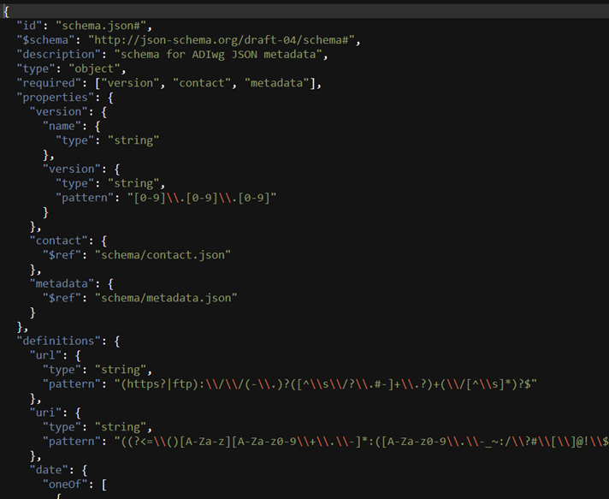
JSON Schema
Complete structural validation of JSON
Latest IETF draft: version 4
Validation engines available in many languages, see http://json-schema.org/

Slide 5
JSON Schema Keywords: $ref
The value of $ref is a JSON Pointer.
$ref is replaced with the value it points to.
JSON Pointer identifies a specific value within a JSON document.
{"$ref": “doc.json#/location/in/doc“}
Can point to location in another file
http://spacetelescope.github.io/understanding-json-schema/
Notes:
The use of $ref allows the schemas to be split into multiple files.
JSON Pointer is similar to Xpath in XML, but it is much simpler.

Slide 6
JSON Schema Keywords
allOf: Must be valid against all of the subschemas
anyOf: Must be valid against any of the subschemas
oneOf: Must be valid against exactly one of the subschemas
http://spacetelescope.github.io/understanding-json-schema/

Slide 7
mdJSON-schemas
Can be used independent of mdTranslator for validation
Include descriptions and pointers to examples
Mapping to other standards(19115-2, FGDC)
https://github.com/adiwg/mdJson-schemas

Slide 8



An interface for ADIwg metadata tools
The purpose of these tools is to assist with the production of metadata
For now, primarily useful for learning and development
www.adiwg.org/mdTools
d3.js

