Slide 1
Twitter Boost App
Advanced Software Services
Students:
Livia Moroianu
Adrian-Nicolae Zamfirescu

Slide 2
Context
Social media today
A second reality
Keeps people in touch with online news and information of personal interest
Downside:
Use is overwhelmed by the extremely large flow on information
Objective:
Allow users to keep track of particular pieces of information

Slide 3
Proposal: Twitter Boost App
Web application
Integrates Twitter API
No Twitter account required
Advanced filtering of tweets
Allows saving filter groups for ulterior easy retrieval of tweets

Slide 4
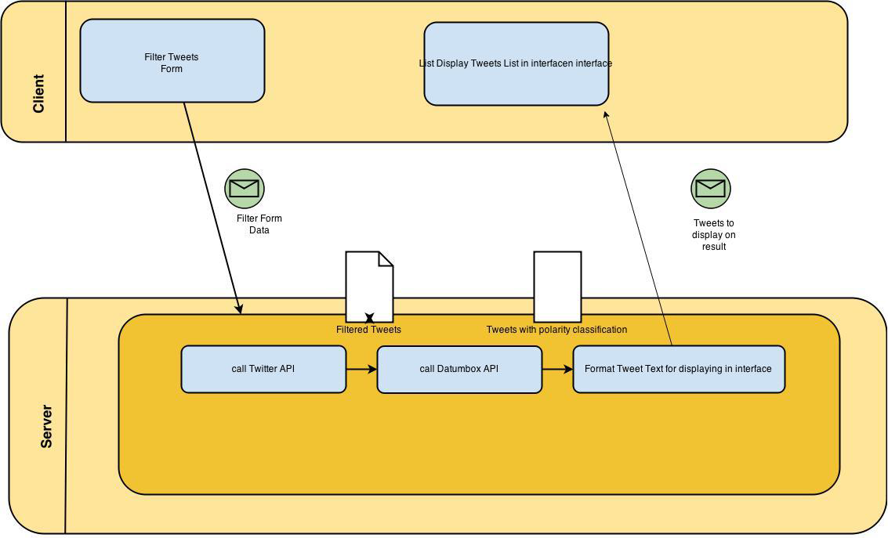
Architecture
Backend
Spring
Hibernate
Liquibase
Twitter4J
Datumbox
Frontend
AngularJS
HTML, CSS
Bootstrap

Slide 5
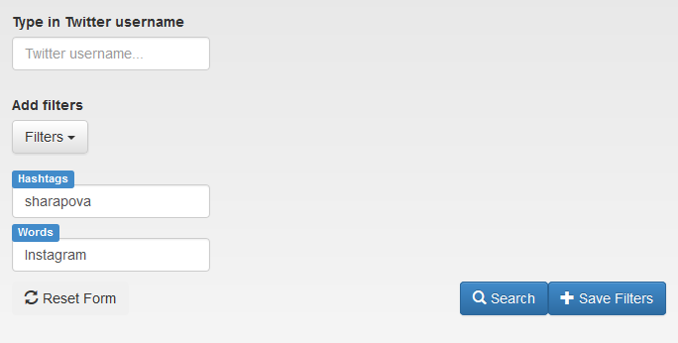
Architecture – Tweet Filtering
Filters available in the interface
HASHTAGS
REFERENCES
WORDS
TWITTER USER

Slide 6
Architecture – Sentiment Analysis
~ Opinion mining
Def: Extract subjective information from text or oral communication
Goal: determine the attitude of a speaker of a writer regarding some topic or in general
Result:
Assign a polarity to a piece of writing.
A possible classification for text is the following: positive, negative, neutral
The application uses sentiment analysis on tweets and classifies content as positive, negative or neutral

Slide 7



Technologies
Spring
Framework that offers rich high-level Java development environment that allows a large area of server issues to be handled
Root of the backend architecture and configuration of the application through use of Spring MVC, Spring security, Object Relational Mapping framework Hibernate (ORM) integration.

Slide 8

Technologies
Angular
JavaScript framework
Provides ways for extending HTML vocabulary
Quick to develop
Expressive and readable environment
Daynamic generation of the DOM given the logic in code
Single-Page application

Slide 9

Technologies
Liquibase
Database-independent library
In-memory database
Easier tracking of database changes
XML Config file for changes (each change has an id and author)

Slide 10
Implementation
Authentication and authorization
Spring Security
Access allowed only to registered users
Unique username restriction at registration
User data is stored in the database
Application’s core page is protected from unauthenticated access attempts

Slide 11
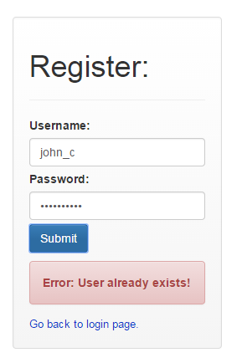
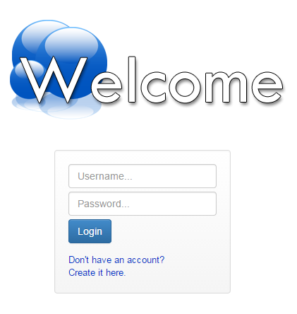
Implementation
Authentication and authorization
Login and register forms available in the application

Slide 12
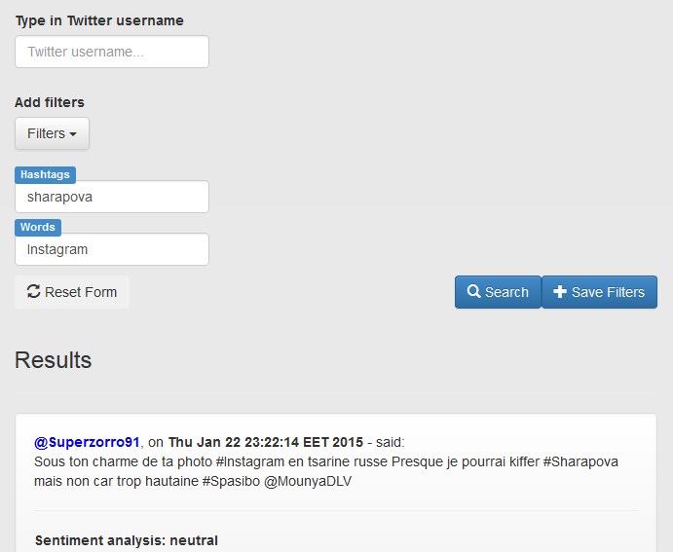

Implementation
Tweets Search
Twitter4j
Unofficial Java library for the Twitter API
Provides easy integration with Twitter service
Used for handling tweet search requests with custom filters

Slide 13
Implementation
Save Filter Groups
Groups of filters are persisted in the database along with a short description
Database schema:
FILTER GROUP PREFERENCES with columns:
USER ID and FILTER GROUP DESCRIPTION
SAVED FILTERS with columns FILTER GROUP ID,
FILTER CATEGORY, FILTER CONTENT

Slide 14
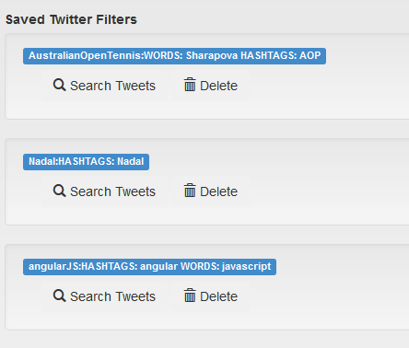
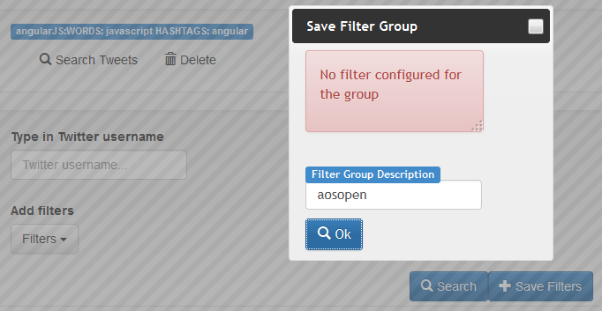
Implementation
Save Filter Groups
Each saved filter group can be used for later easier tweet retrieval based on preffered filters
User can delete a saved filter group

Slide 15

Sentiment Analysis
Sentiment Analysis
Datumbox API
Public service performing text analysis based in machine learning algorithms
REST API
Request URL: http://api.datumbox.com/1.0/TwitterSentimentAnalysis.json
Result: JSON with classification result
Requires singing up for API key

Slide 16
Conclusions
Growing interest of developers in integrating theTwitter API
Many applications require the user to actually have a Twitter account and login with it.
Our application bypasses this restriction and allows user to get access to public tweets in the absence of a Twitter account.
The user creates a new account, managed by our application, and then enjoys a personalized interrogation of tweets based on saved favorite groups of filters.

Slide 17

Questions?

