Slide 1
SESSION 10
Support Vector
Machines (SVM)
Find the boundary with the widest margin — and use kernels to bend it around non-linear data. Built on the Wine dataset.
Tulika Sharma
Machine Learning · Classification
Assistant Professor | Dept. of Computer Science | PSIT Kanpur

Slide 2
SESSION 10
What we'll cover today
The idea of the maximum-margin boundary
Support vectors — the points that matter
The kernel trick for non-linear data
Key knobs: C and gamma
Building & evaluating on Wine
The widest street
Many lines separate two classes. SVM picks the one that leaves the widest 'street' between them — the maximum margin. A wider margin means the boundary is more confident and generalises better to new points.
1

Slide 3
PART 1
The maximum margin
Of all boundaries that separate the classes, SVM chooses the one furthest from the nearest points of each class.
2

Slide 4
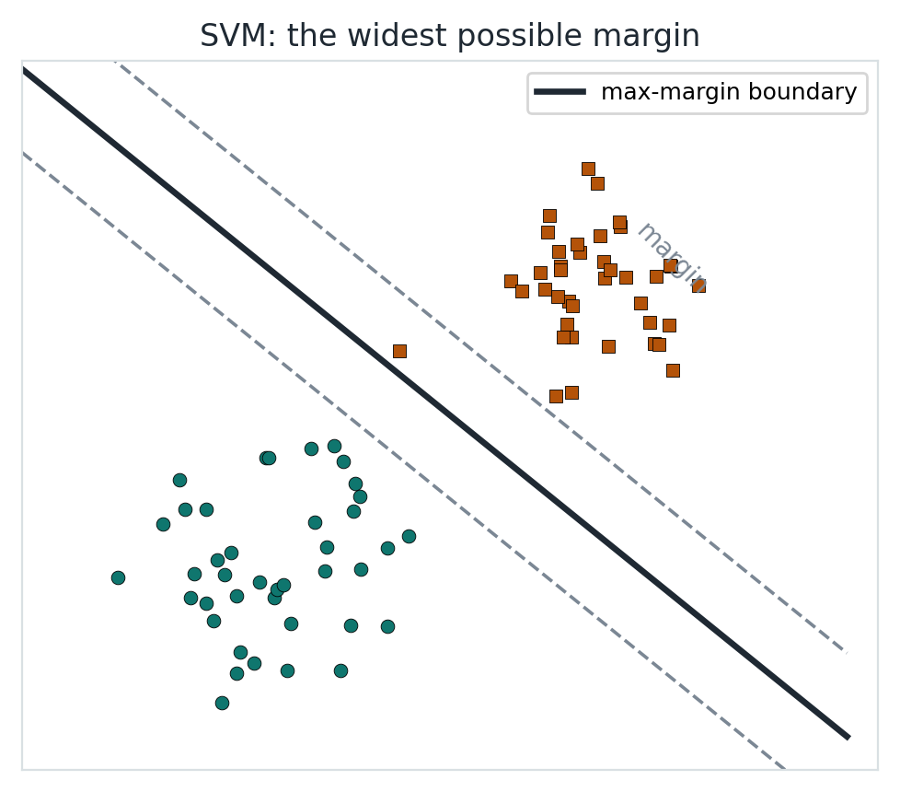
MAXIMUM MARGIN
The widest possible gap
SVM finds the boundary that maximises the margin — the distance to the closest points of either class.
Those closest points are the support vectors. They alone define the boundary; moving any other point doesn't change it.
A wide margin makes the classifier robust: it has the most 'room' before it starts making mistakes.
The solid line is the boundary; dashed lines mark the margin.
Key idea SVM = the boundary with the widest margin, fixed by a few support vectors.
3

Slide 5
PART 2
Kernels & knobs
Real data is rarely separable by a straight line. Kernels let SVM draw curved boundaries.
4

Slide 6
THE KERNEL TRICK
Curved boundaries without the cost
When classes can't be split by a line, a kernel maps the data into a higher dimension where they CAN be separated — then the boundary looks curved back in the original space.
Common kernels: linear (straight boundary), RBF / Gaussian (smooth curves — the default), polynomial.
The RBF kernel is the go-to for most tabular problems.
Two key knobs
C — regularization: low C = wider margin, more tolerant; high C = fits training data harder
gamma — RBF reach: low = smooth/broad; high = wiggly, can overfit
Tune both together (grid search).
5

Slide 7
BUILDING IT
SVM on the Wine dataset
from sklearn.svm import SVC
model = SVC(kernel='rbf', C=1, gamma='scale',
probability=True, random_state=42)
model.fit(X_train, y_train) # X scaled first!
Must scale first
SVM uses distances
Unscaled features distort the margin
Always StandardScaler before SVM
We predict the wine cultivar (3 classes) from 13 chemical features, then evaluate with the confusion matrix and macro precision/recall/F1 — the same scorecard as every classifier in this block.
Key idea SVM needs scaled features. RBF + moderate C is a strong default.
6

Slide 8
WRAP-UP
What you now know
SVM finds the maximum-margin boundary, defined by support vectors.
Kernels (RBF, polynomial) let it draw non-linear boundaries.
C controls margin width; gamma controls RBF flexibility.
Always scale features — SVM is distance-based.
Now: open the notebook
Load & scale the Wine data
Train an RBF SVM
Confusion matrix + classification report
ROC curve and AUC
Key idea Next: Naïve Bayes — a fast, probabilistic classifier built on Bayes' theorem.
7

