Slide 1
Adjacent Link LLC
Preliminary
DLEP Layer Design
Joseph Giovatto
jgiovatto@adjacentlink.com

Slide 2
Overview
Objective
EMANE R2RI Metrics
Peer Discovery
DLEP Modem / DLEP Layer Messages
DLEP Layer Interaction
Flow Diagrams
EMANE DLEP Stack

Slide 3
Objective
Develop EMANE DLEP components to allow radio model implementations to directly support DLEP using MIT-LL DLEP Modem API:
  Boundary interface for MIT-LL DLEP Modem API that encapsulates any messaging required for peer communication.
  Over-the-Air Controller implementing a DLEP destination dynamic discovery protocol.
Develop EMANE DLEP Layer that provides DLEP support for any NEM instantiated with a radio model supporting EMANE R2RI.
  DLEP Layer performs R2RI to DLEP metric translation and uses EMANE DLEP components for peer and OTA messaging.

Slide 4
R2RI Neighbor Metrics
Metrics pertaining to each Neighbor via EMANE Neighbor R2RI:
  NumRxFrames Number of frames received from the neighbor
  NumTxFrames Number of frames sent to the neighbor
  NumMissedFrames Number of frames missed from the neighbor
  BandwidthConsumption Bandwidth consumption in microseconds
  SINRAvg Average SINR from neighbor in dBm
  SINRStd Standard deviation SINR from neighbor
  NoiseFloorAvg Average noise floor from neighbor in dBm
  NoiseFloorStd Standard deviation noise floor from neighbor
  RxAvgDataRate Average Rx datarate from neighbor bps
  TxAvgDataRate Average Tx datarate to neighbor bps

Slide 5
R2RI Self Metrics
Metrics pertaining to the local radio via EMANE Self R2RI:
  BroadcastDataRate Broadcast datarate in bps
  MaxDataDataRate Max datarate in bps
Metrics pertaining to local radio queue(s) via EMANE Queue R2RI:
  MaxQueueSize Max Queue size in bytes
  CurrentDepth Current Queue depth in bytes
  NumDiscards Num packet discards
  AvgDelay Average queue delay in microseconds

Slide 6
DLEP Destination Discovery
Problem
  DLEP Destinations are defined by an Ethernet MAC Address. In a DLEP Session the MAC Address of the DLEP Router is used in all DLEP Destination related signals. Unfortunately remote nodes have no way of knowing these MAC Address(es) and/or the DLEP Session Up/Down Status at any given time.
Solution
  The DLEP Layer tracks the MAC Address of the DLEP Router for all Sessions via the PEER_UP/ PEER_DOWN message. These MAC Address(es) are advertised to all remote destinations via a lossy OTA message at some periodic rate. Upon receipt of these advertisements each DLEP Layer is able to detect new or deleted Destinations and respond with a Destination Up or Destination Down message accordingly.

Slide 7
Messages sent from DLEP Layer to DLEP Modem
Triggered by Destination Status Messages:
  DEST_UP indicates detection of a remote DLEP session
    Required: macAddress
  DEST_DOWN indicates termination of a remote DLEP session
    Required: macAddress
Triggered by Peer Events:
  REQUEST_STATUS in response to request (peer update, link info, etc)
    Required RequestId, status

Slide 8
Messages sent from DLEP Layer to DLEP Modem cont'd
Triggered by R2RI Messages:
  DEST_UPDATE
    Required: macAddress
    Optional: IPv4/6 address, MDR, CDR, Latency, Resources and RLQ
  PEER_UPDATE
    Optional: IPv4/6 address, MDR, CDR, Latency, Resources, RLQ
Triggered by Radio Model:
  PEER_TERM indicates radio model termination
    Required: macAddress
Optional for Radio Models supporting credits
  CREDIT_REQUEST
    Required: macAddress
  CREDIT_STATUS in response to a credit grant
    Required: macAddress, creditStatus
  CREDIT_GRANT in response to a credit request
    Required macAddress, creditAmount

Slide 9
Messages sent from DLEP Modem to DLEP Layer
Triggered by Modem/Router Peer activity
  PEER_UP indicates a new local DLEP session
    Required: macAddress
  PEER_DOWN indicates termination of a local DLEP session
    Required: macAddress
  PEER_UPDATE indicates peer metric changes
    Required: macAddress
    Optional: IPv4/6 address, MDR, CDR, Latency, Resources and RLQ
  PEER_FAIL indicates local session failure
    Required: macAddress, errorCode
Triggered by Peer request
  LINK_CHAR_REQ peer requests specific link characteristics per dest
    Required: macAddress
    Optional: CDR, Latency
  REQUEST_STATUS in response to a request (peer update, link char req)
    Required: MessageId, status

Slide 10
Messages sent from DLEP Modem to DLEP Layer cont'd
Optional for Radio Models supporting credits
  CREDIT_STATUS in response to a credit grant
    Required: macAddress, creditStatus
  CREDIT_GRANT in response to a credit request
    Required: macAddress, creditAmount
  CREDIT_REQUEST request credits per destination
    Required: macAddress

Slide 11
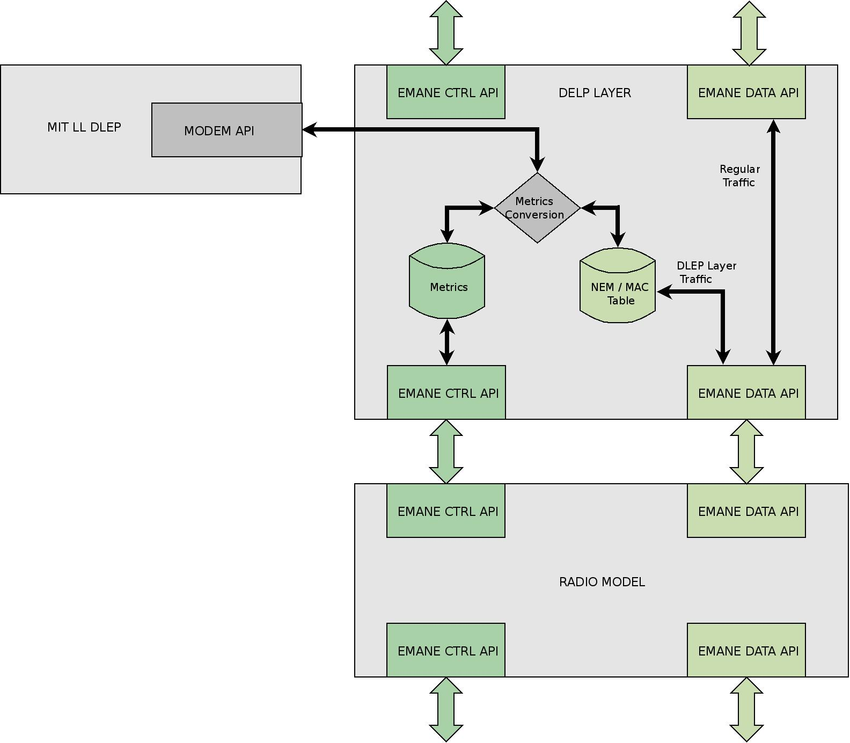
DLEP Layer Interaction

Slide 12
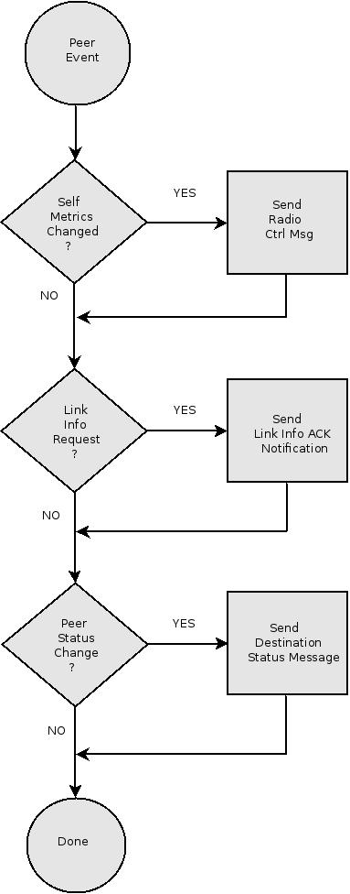
DLEP Peer Event Flow

Slide 13
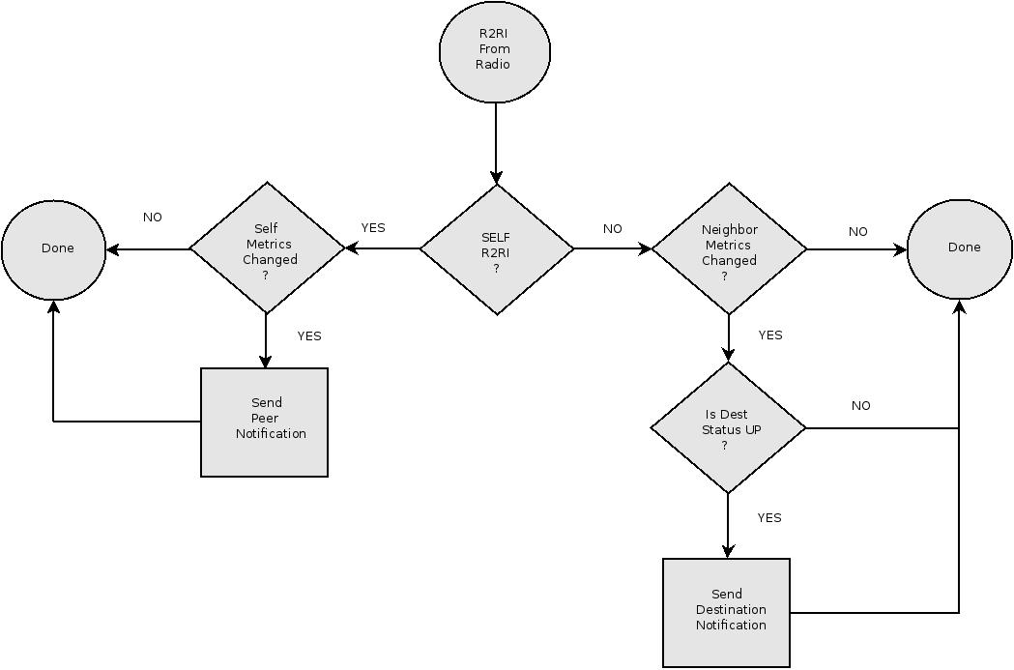
DLEP R2RI Flow

Slide 14
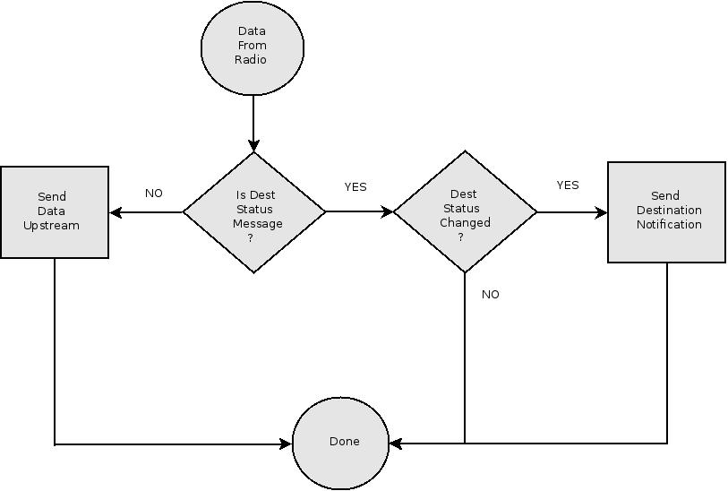
DLEP Destination Status Flow

Slide 15
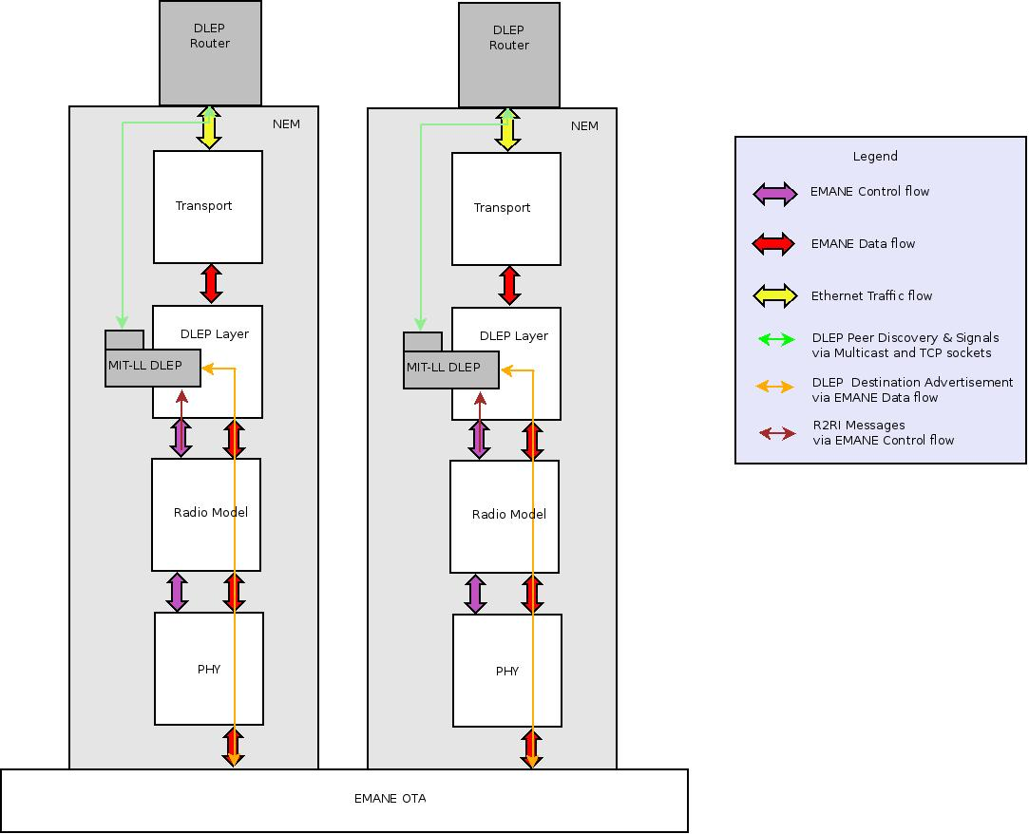
DELP/EMANE Component Stack

