Slide 1
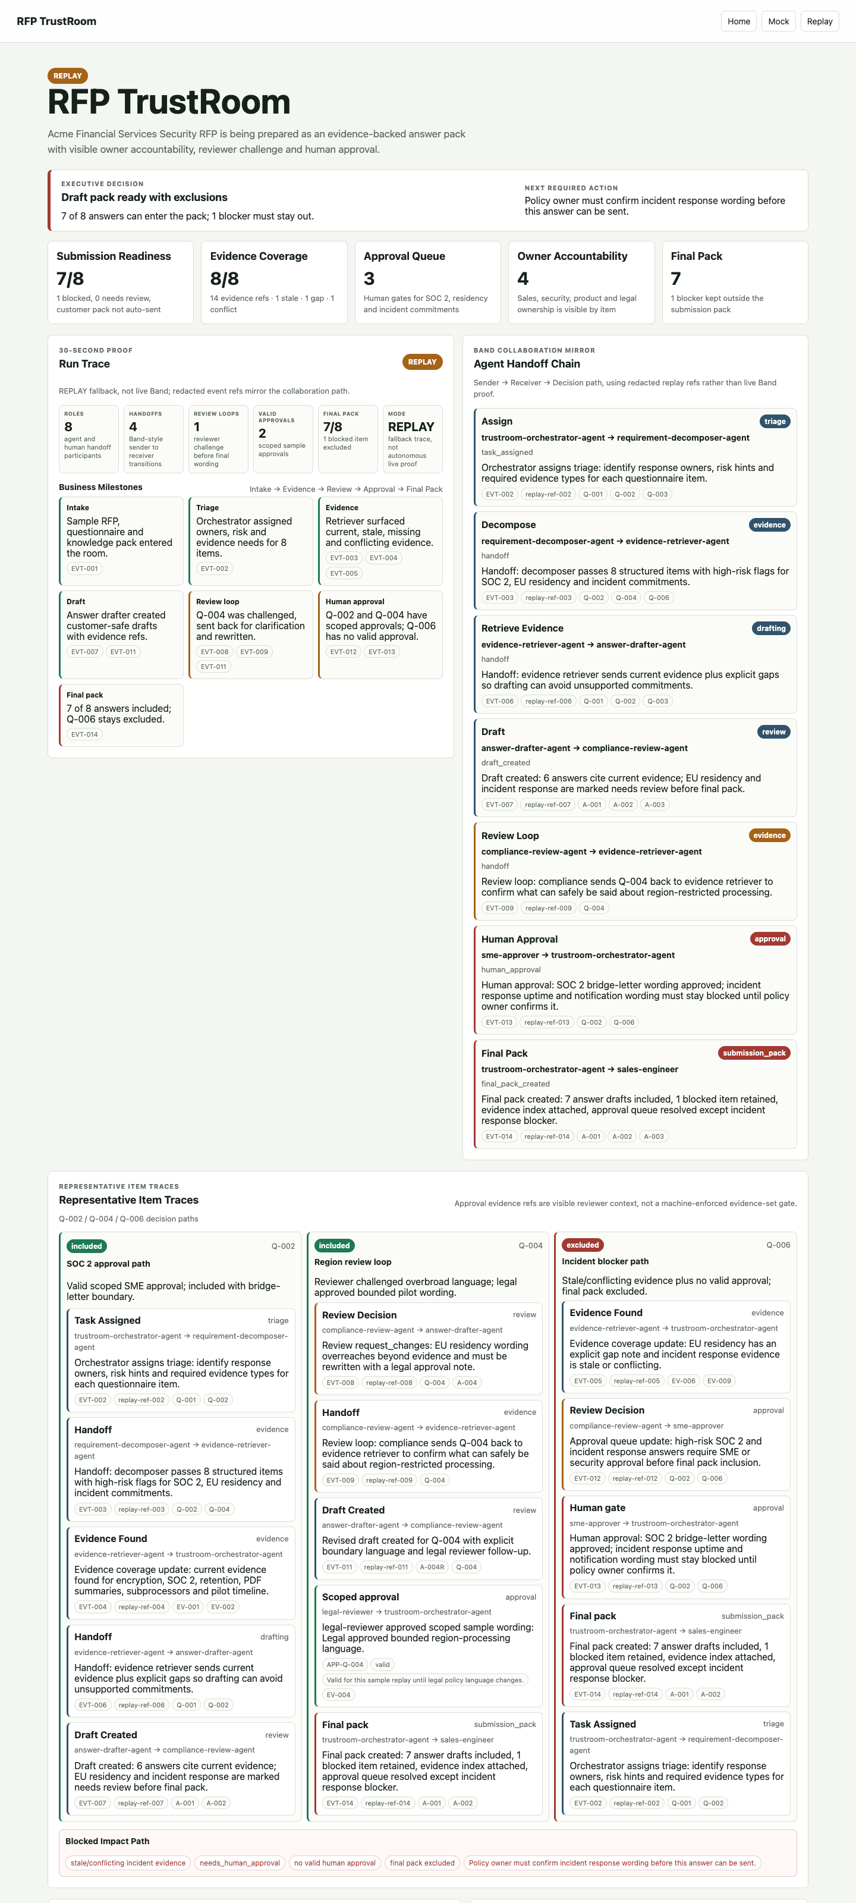
TITLE
RFP TrustRoom makes RFP response work visible, bounded, and reviewable.
A hackathon working prototype where specialized agents coordinate through Band-style handoffs to build an evidence-backed answer pack.
PROOF OBJECT
Hybrid cover: real replay dashboard plus Intake -> Evidence -> Draft -> Review -> Approval -> Final Pack path.
RFP TrustRoom - Band of Agents Hackathon
1/8

Slide 2
PAIN
RFP and security questionnaires fail at the handoff, not only at generation.
Sales asks
request enters
Security finds
Sales, security, product, legal and SME reviewers need fresh evidence, bounded wording, and visible accountability.
freshness checked
Legal bounds
wording limited
SME approves
scope recorded
Owner packs
unsafe item retained
PROOF OBJECT
Before-state workflow: scattered requests, stale evidence and risky commitments.
RFP TrustRoom - Band of Agents Hackathon
2/8

Slide 3
BAND LAYER
Band is the coordination layer, not a final notification channel.
orchestrator
decomposer
assigns
triages
retriever
drafter
The demo path shows sender -> receiver transitions, shared object refs, task states and a human approval gate.
retrieves
drafts
reviewer
human approver
challenges
approves
PROOF OBJECT
Agent chain: orchestrator -> decomposer -> retriever -> drafter -> reviewer -> human approver.
RFP TrustRoom - Band of Agents Hackathon
3/8

Slide 4
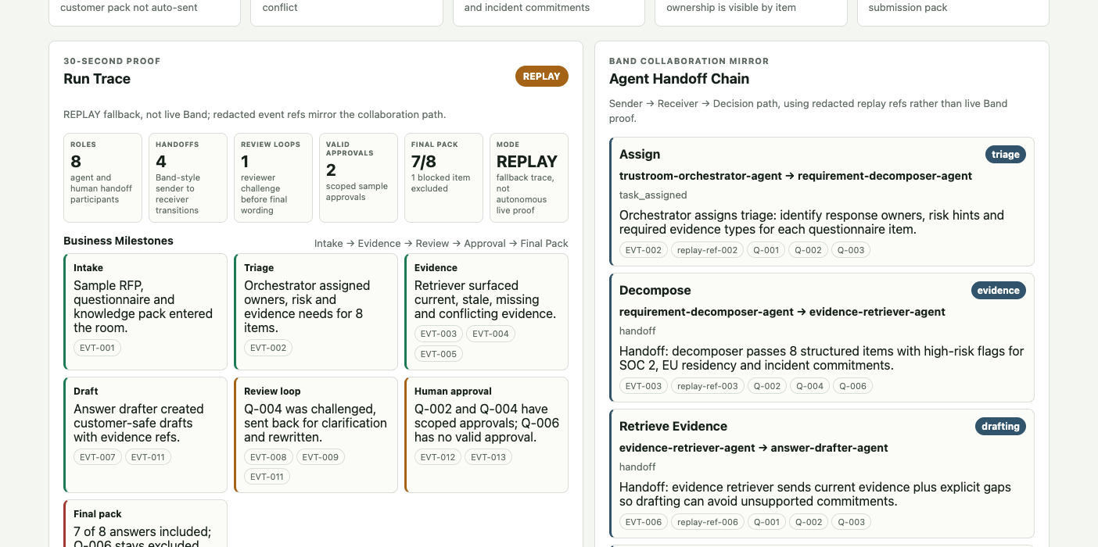
RUN TRACE
Judges can verify the workflow from the first screen.
The route starts with Executive Decision, proof strip, Business Milestones and Agent Handoff Chain before raw logs.
PROOF OBJECT
Screenshot crop: Run Trace, milestones, handoff chain and replay boundary.
RFP TrustRoom - Band of Agents Hackathon
4/8

Slide 5
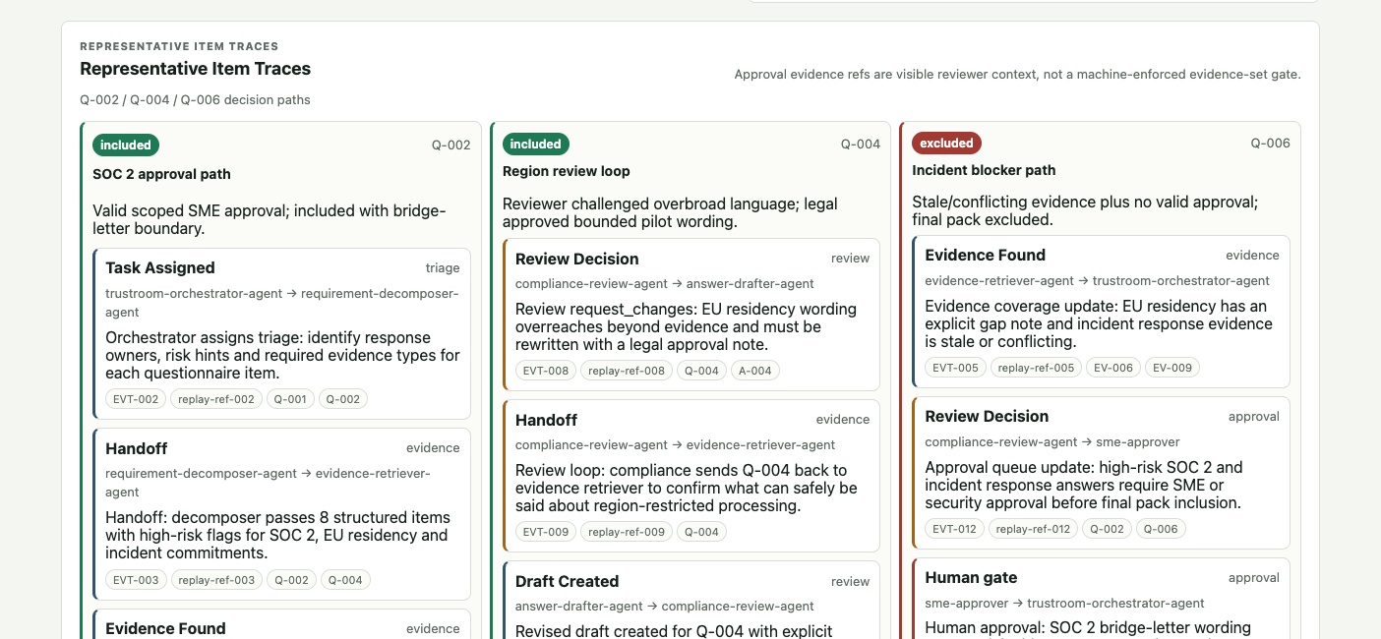
ITEM TRACES
The system treats happy path, review loop, and blocker path differently.
Q-002 is approved with scoped SME context; Q-004 is rewritten after review and legal approval; Q-006 is excluded.
PROOF OBJECT
Representative Item Traces for Q-002, Q-004 and Q-006.
RFP TrustRoom - Band of Agents Hackathon
5/8

Slide 6
RISK CONTROL
High-risk commitments stay out of the pack without valid scoped approval.
stale/conflicting
evidence risk
needs approval
Q-006 has stale/conflicting evidence, no valid approval, final-pack exclusion and a policy-owner follow-up.
review gate
no valid approval
missing scope
excluded
fail closed
policy next action
next action
PROOF OBJECT
Blocked Impact Path plus approval validity language.
RFP TrustRoom - Band of Agents Hackathon
6/8

Slide 7
FINAL PACK
The output is a traceable answer pack, not just generated prose.
7/8 included
1 blocked
final pack
Q-006
Included answers carry evidence, review and approval context; excluded answers keep next actions visible.
REPLAY mode
Evidence context
fallback
source basis
Approval scope
Event refs
validity
trace chips
PROOF OBJECT
Final Pack, evidence index, event refs and replay/live boundary.
RFP TrustRoom - Band of Agents Hackathon
7/8

Slide 8
ARCHITECTURE
A lightweight prototype keeps the demo stable without broadening live claims.
FastAPI
dashboard
FastAPI dashboard, public-safe mock/replay, Band REST boundary verified separately, autonomous replies remain a separate gate.
mock/replay
stable route
Band REST
verified boundary
autonomous gate
separate gate
PROOF OBJECT
Architecture map and no-overclaim footer.
RFP TrustRoom - Band of Agents Hackathon
8/8

