Slide 1








Big Data Technology -- Final Project
by
Elias Adjei
Md Shahjahan Rasel

Slide 2
Overview
We took Twitter API as our data source and streamed data from there
Create a stream of tweets that will be sent to a Kafka queue
Pull the tweets from the Kafka cluster using Spark Streaming
Save this data to a Hive table using SparkContext and SparkSQL configuration
Visualize the Hive data with Plotly and Matplotlib

Slide 3







Workflow
Call to twitter API
Twitter API
Producer
Send data to Kafka Queue
Textblob
ML
Spark Stream
Service
+
Spark SQL
Send request
Kafka Server
or
Broker
Hive
Get data

Slide 4

Environment Setup
To do this, we had to set up an environment that includes
Ubuntu as OS
a Single-node Kafka cluster
a Single-node Hadoop cluster
Hive
Spark
Python & python packages

Slide 5
Producer
We created a Kafka producer by setting up a Kafka broker on port 9092 on localhost.
We then created a few tweet topics that we wanted to get from the twitter API.
We connected to the Twitter API by registering for a developer account and using as a python module tweepy.
After getting the tweets, we filtered by passing our tweet topics and sent the tweets to queue using the Kafka producer to consume later and save into our hive datastore with spark SQL.

Slide 6
Consumer
On spark consumer we create a spark context using the PySpark module.
We then create a streaming context and pass our spark context and time interval where our streaming data will be divided into batches
We are doing real-time batch processing after all.

Slide 7
Consumer
We then initialize a spark session with the configuration of the location of our hive warehouse, to tell spark where to save our data and SparkSQL configuration also to tell spark how to write our data. We also enable hive support to enable our spark session to be able to connect to hive.
We also import a Kafka Utils library to create a direct stream from the port 9092 where our Kafka producer keeps our incoming data from twitter
Finally, we transform this data and create an RDD from it and save it to our hive datastore so we can retrieve it later to perform further analysis.

Slide 8
For setting up the stream, Run the following script to create the zookeeper server:
~/kafka/bin/zookeeper-server-start.sh ~/kafka/config/zookeeper.properties
Then setup the kafka server/broker with this shell command:
~/kafka/bin/kafka-server-start.sh ~/kafka/config/server.properties
Create the topic, use the following commands
~/kafka/bin/kafka-topics.sh --create --zookeeper localhost:2181 --topic tweets --replication-factor 1 --partitions 1
Stream data from Twitter API:
python3 ~/tweet_stream.py
Start the consumer:
spark-submit --jars ~/spark-streaming-kafka-0-8-assembly_2.11-2.4.8.jar ~/transformer.py
Integration

Slide 9
// create a spark context
sc = SparkContext(appName=”StreamingProject")
// create a streaming context with our spark context and time interval to process streaming batches
ssc = StreamingContext(sc, 5)
// Initialize a spark session by specifying the location of our hive warehouse and for spark to use sparkSQL to save our data to hive
ss=SparkSession.builder.appName("Something").config("spark.sql.warehouse.dir", "/user/hive/warehouse").config("hive.metastore.uris", "thrift://localhost:9083").enableHiveSupport().getOrCreate()
// set spark logging to warn
ss.sparkContext.setLogLevel('WARN’)
// connect our spark streaming context to our kafka broker by creating a direct stream
ks = KafkaUtils.createDirectStream(ssc, ['tweets'], {​​​​​​'metadata.broker.list': 'localhost:9092'}​​​​​​)

Slide 10

scala> spark.sql("CREATE TABLE tweets (text STRING, words INT, length INT) ROW FORMAT DELIMITED FIELDS TERMINATED BY '\\|' STORED AS TEXTFILE");
scala> spark.sql("show tables").show(); +------------+-------------------+-------------------+ |database | tableName. | isTemporary | +------------+-------------------+-------------------+ | default | test. | false. | | default | tweets. | false | | default. | tweets_test. | false | +------------+-------------------+-------------------+

Slide 11
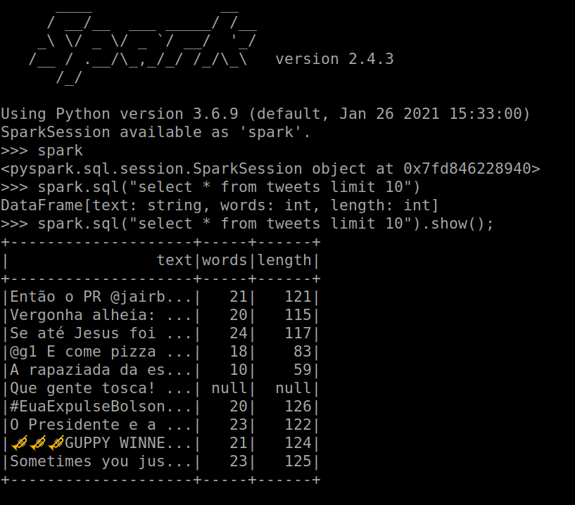

Slide 12
After streaming our data into hive, the data in our warehouse isn't useful until we can do something with it. We make our data useful by exporting it from our warehouse using spark SQL depending on the topics we assigned in our Kafka producer. For the purpose of our exercise, we selected tweets about Programming and the Olympics.
Our data is not if a format we can directly represent visually, so we run some data pre-processing to convert the data into a format that will be acceptable by our visualization process.
We do this by using a python library called pandas, which loads our data into a data frame using output from SparkSQL query.
Data Analytics

Slide 13
We also create an extra column on our data, "sentiment", where we store
the sentiment expressed(positive or negative) about the topic. We will use some pretty basic machine learning for this.
We then use a generic library which has natural language processing libraries inbuilt to try and make sense and meaning from our data.
In view of this we use the naive bayes analyzer which uses probabilities based on the bayes theorem to determine strong independent assumptions between features.
We store the result of the classification into a sentiment column in our Pandas data frame. Sentiment of a tweet may be either positive or negative, but never both or none.
Data Analytics

Slide 14
While this algorithm is far from perfect and we can probably achieve better accuracy with a custom sentiment classifier we wrote from scratch, it gives us a wide view of how things
can be.
We can then run a transformation and convert all positive sentiments to 1
negative sentiments to 0, so we can visualize our data with matplotlib.
We will also visualize our data we Plotly later, once we export our data frames
as csv files.
Yes, you have done all that, but what can you do with this information, one may ask? To answer the question, let consider the scenario that we are the committee responsible for the Olympics.
Data Analytics

Slide 15
Now with this information, we can determine opinion about our performance and positive or negative sentiments surrounding our program. If sentiments surrounding the Olympics are largely positive on social media and other personalized public data sources, we can say with confidence that people like our events, and we can continue doing what ever we are doing.
However, if sentiments are mostly negative, then we can confidently assume we aren't doing everything right and some changes and improvements can be made. In short, we can make informed decisions based on data, and this is just on scenario of many you can think of this is one of the main points of Big Data.
Data Analytics

Slide 16
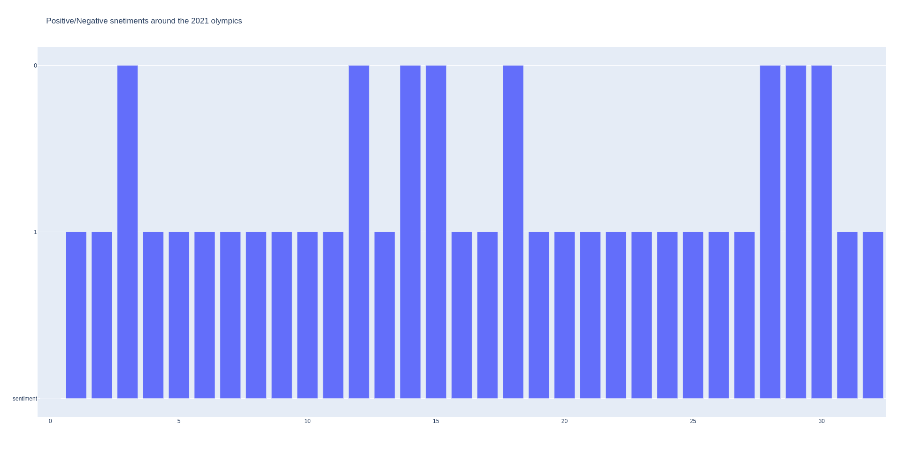

Slide 17
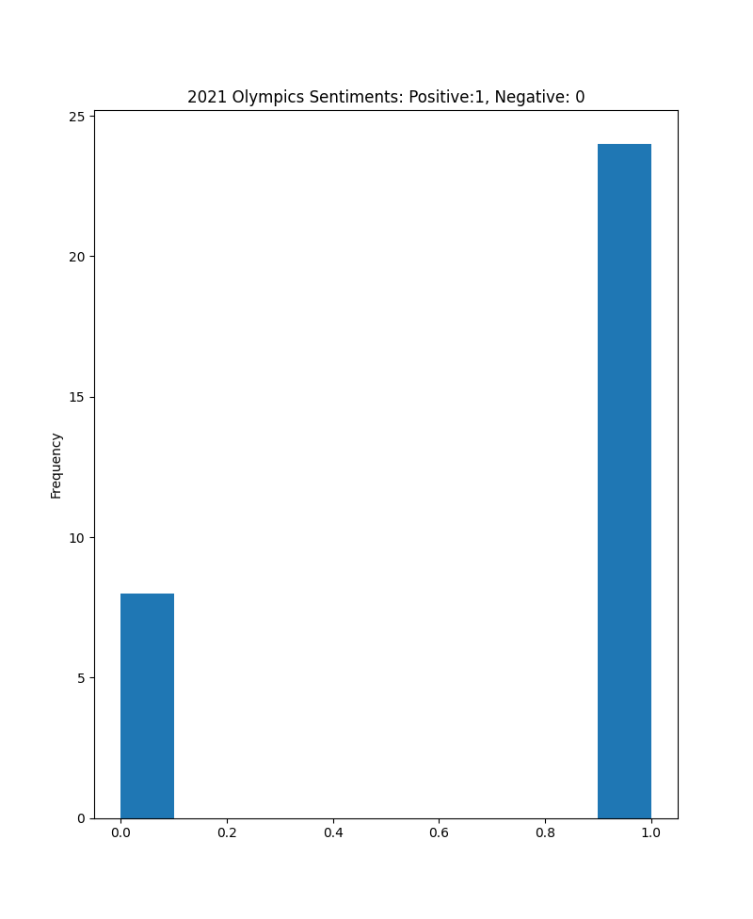


Slide 18
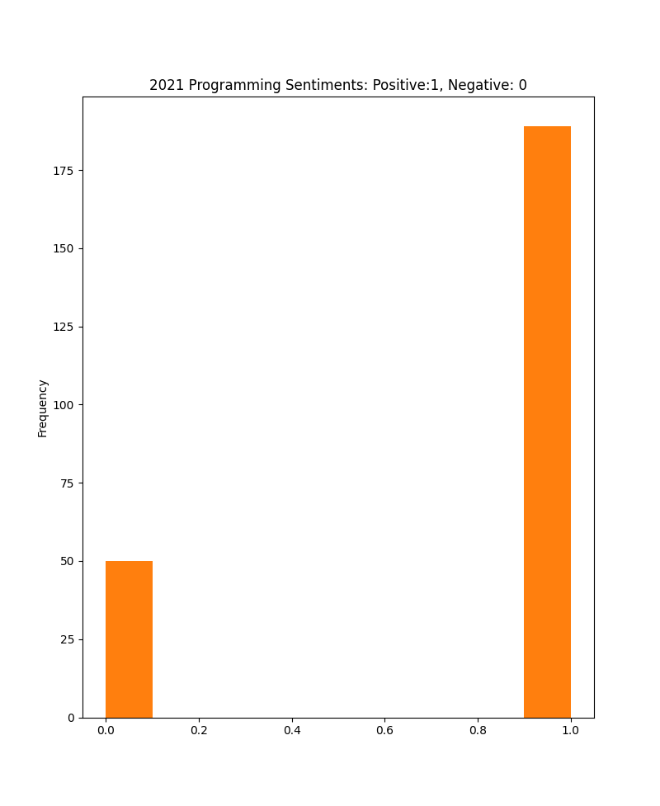

Slide 19
We don't do much in our data visualization, since we have done most of the pre-processing job already. Here, we need only represent our data in a graphical format and try to make sense of it.
We do this with Plotly, an interactive python data visualization library. For the purpose of our exercise, we will be using bar graphs.
We realize that sentiments towards programming and the Olympics so far in 2021 have been positive, which is good news!
We data, we can learn insights that are not immediately obvious, by extracting, transforming and loading data into a form that we can analyze. One can do this in several ways, and some ways are simpler than others, but they all can achieve near same results.
Data is the new currency

Slide 20
Thank you

