Slide 1
ACADEMIC PROJECT EVALUATION & DEFENSE
Newman's Greedy Optimization of Modularity
Agglomerative Community Detection (Newman 2004) & Clauset–Newman–Moore Speedup
• Implementation from Scratch: ΔQ = 2(e_ij - a_i * a_j) with exact e and a updates
• Validated on: 6-Node Bridge Toy Graph & Zachary's Karate Club Network
• 100% Exact Verification with NetworkX reference library
• Student Evaluation Criteria: (a) Implementation, (b) Presentation, (c) Q&A
Notes:
Good morning Professor and classmates. Today I will present Newman's Greedy Modularity Optimization algorithm for community detection in networks, explaining how modularity is maximized agglomeratively, and how Clauset, Newman, and Moore later achieved near-linear scaling.

Slide 2
● THE BIG PICTURE
Core Intuition: What is Community Detection?
The Network Challenge
Complex networks (social, biological, web) naturally organize into clusters called communities.
• Communities have dense internal edges.
• They have comparatively sparser connections to the rest of the network.
Key Question: How can an algorithm automatically discover these groupings without being told the number of communities in advance?
The 'Dinner Party' Analogy
Imagine a dinner party with 34 guests:
1. At the start (Step 0): Everyone sits alone at 34 small tables.
2. Modularity (Q): Measures the 'happiness' of the seating arrangement.
3. The Greedy Choice: At each step, we merge the two tables whose union provides the biggest boost to party happiness (ΔQ).
4. The Peak: For Karate Club, happiness peaks at Step 31 with 3 natural friend groups!
5. The Collapse: If we force enemies/strangers together, happiness drops back to zero.
Notes:
To understand the intuition before looking at the formulas: imagine 34 guests at a party. At step 0, everyone sits alone. Modularity measures how happy the room is when friends sit together. We greedily merge tables that give the biggest jump in happiness until the score peaks!

Slide 3
● THEORETICAL FOUNDATION
Mathematical Formulation: Modularity (Q)
Modularity Formula (Newman & Girvan 2004)
Q = Σ [ (L_c / m) - (k_c / 2m)² ]
Where:
• m: Total number of edges in the network
• L_c: Number of internal edges inside community c
• k_c = Σ_{u ∈ c} k_u: Sum of degrees of all vertices in community c
• L_c / m: Actual fraction of edges inside community c
• (k_c / 2m)²: Expected fraction of edges in community c under random null model
Interpretation of Modularity Q values:
• Range: -1/2 ≤ Q ≤ 1.0
• Q > 0: More internal edges than expected by chance (community structure exists)
• Q ∈ [0.3, 0.7]: Strong, genuine community cohesion in real-world networks
• Q ≤ 0: Edges are random noise or bipartite structure
Notes:
Modularity quantifies whether a partition has more internal connections than a random null model. A high Q means genuine community cohesion. Real-world networks typically peak between 0.3 and 0.7.

Slide 4
● MATHEMATICAL PROOF
Derivation of ΔQ = 2(e_ij - a_i a_j)
Newman's Matrix Formulation and Merge Step Proof
1. Define e_ij = fraction of edges between community i and j (e_ii = internal edge fraction)
2. Define a_i = Σ_j e_ij = k_i / (2m) (fraction of edge ends in community i)
3. Total modularity is Q = Σ_c (e_cc - a_c²)
When merging two communities i and j into a new merged community k = i ∪ j:
• New internal edges: e_kk = e_ii + e_jj + 2*e_ij
• New degree fraction: a_k = a_i + a_j
• New contribution: e_kk - a_k² = (e_ii + e_jj + 2*e_ij) - (a_i + a_j)²
• Expanding: e_ii + e_jj + 2*e_ij - a_i² - a_j² - 2*a_i*a_j
• Old contribution was: (e_ii - a_i²) + (e_jj - a_j²)
Subtracting old from new yields:
ΔQ = 2(e_ij - a_i * a_j)
Critical Pruning Rule: If e_ij = 0 (no edge), ΔQ = -2*a_i*a_j ≤ 0. Therefore, the greedy algorithm ONLY needs to check connected pairs!
Notes:
Notice that when two communities share no edges, e_ij is 0, making delta Q strictly negative. This mathematically proves why we only evaluate connected pairs, saving tremendous compute time.

Slide 5
● IMPLEMENTATION DETAILS
The Greedy Agglomerative Algorithm
Step-by-Step Execution Workflow
1. Initialization (Step 0):
• Every node is its own community (n active communities).
• e_ij = A_ij / (2m), e_ii = 0, a_i = k_i / (2m).
• Initial modularity Q_0 = - Σ (a_i²) < 0.
2. Candidate Selection:
• Evaluate ΔQ = 2(e_ij - a_i*a_j) for all active connected pairs.
• Pick the pair (i*, j*) that maximizes ΔQ.
3. Fast Matrix Updates (O(n) time):
• Internal edges: e_ii ← e_ii + e_jj + 2*e_ij
• Neighbor edges: e_ik ← e_ik + e_jk (for all k ≠ i, j)
• Degree fraction: a_i ← a_i + a_j
• Community j is removed; Q ← Q + ΔQ.
4. Build Dendrogram:
• Repeat for n-1 merges until 1 community remains (Q_final = 0).
• Cut dendrogram at the step achieving peak modularity Q*.
Complexity Analysis
Newman (2004):
• Number of merges: n - 1
• Max ΔQ scan: O(m)
• Matrix updates: O(n)
Total Time Complexity:
O((m + n) n)
≈ O(n²) on sparse graphs
Space Complexity:
O(n²) matrix e
Feasible for:
Networks up to ~10,000 vertices.
Notes:
The algorithm builds a complete agglomerative tree. At each step, we update the e matrix and a vector in O(n) time. Total runtime is O(n^2), which works well for networks up to 10,000 nodes.

Slide 6
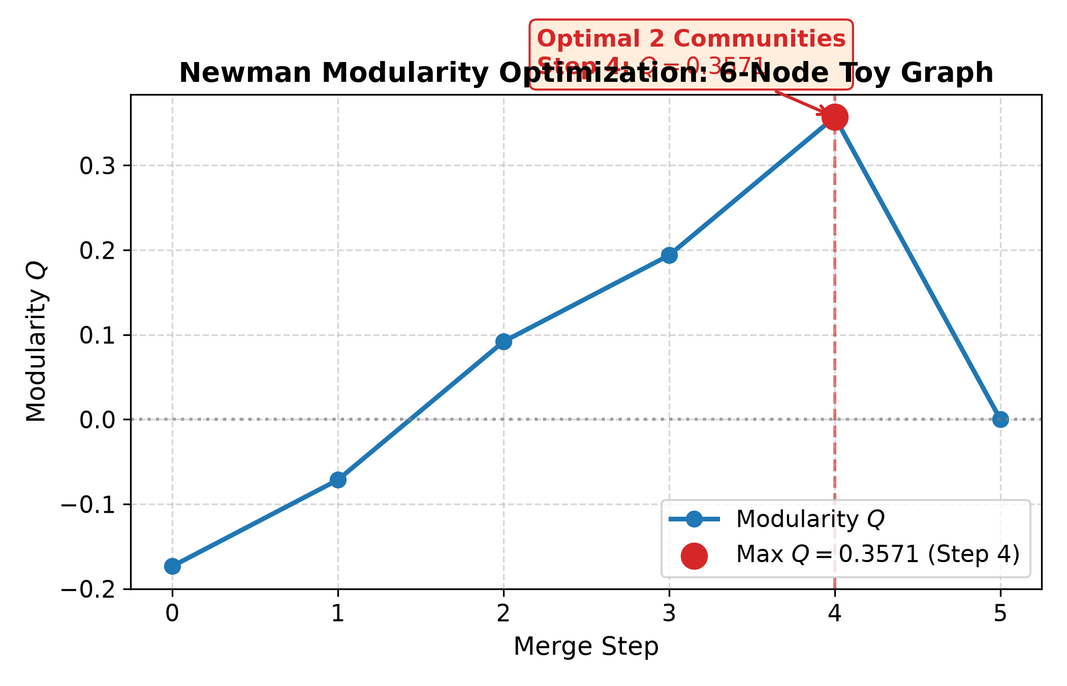
● EXPERIMENTAL VALIDATION
Benchmark 1: 6-Node Toy Graph (Two Triangles + Bridge)
6-Node Toy Graph Results
Structure: Triangle 1 {0,1,2}, Bridge (2,3), Triangle 2 {3,4,5}
Nodes: 6, Edges: 7
Step 0: Initial state | Q = -0.1735 (6 comms)
Step 1: Merge [0] + [1] | ΔQ = +0.1020, Q = -0.0714
Step 2: Merge [0,1] + [2] | ΔQ = +0.1633, Q = +0.0918
Step 3: Merge [4] + [5] | ΔQ = +0.1020, Q = +0.1939
Step 4: Merge [3] + [4,5] | ΔQ = +0.1633, Q = +0.3571 ★
Step 5: Merge [0,1,2] + [3,4,5] | ΔQ = -0.3571, Q = 0.0000
Optimal Peak Q*: 0.35714 (achieved at Step 4)
Optimal Partition: 2 communities [[0, 1, 2], [3, 4, 5]]
NetworkX Match: EXACT (100% agreement)
Notes:
On the 6-node toy graph, the curve peaks at step 4 where the two triangles are separated. When step 5 merges across the bridge, Q drops abruptly back to 0.

Slide 7
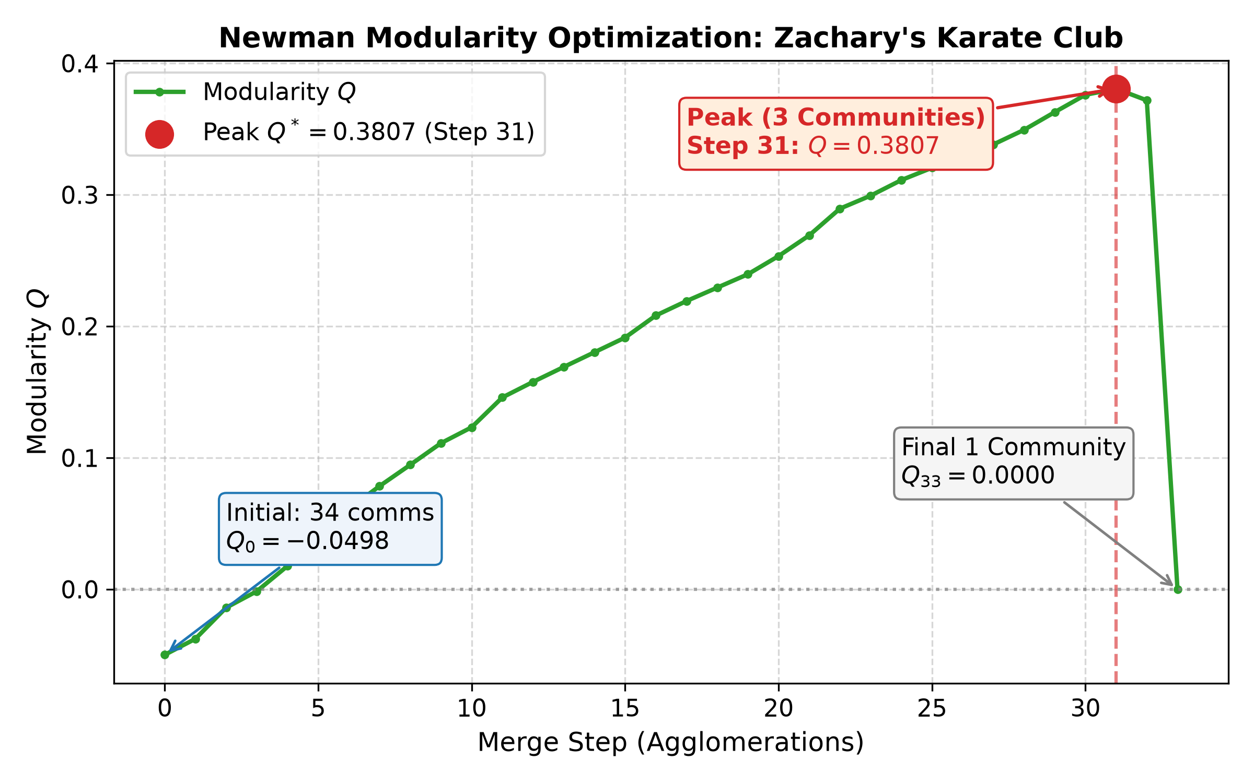
● EXPERIMENTAL VALIDATION
Benchmark 2: Zachary's Karate Club (34 Nodes, 78 Edges)
Karate Club Results (Newman 2004)
Wayne Zachary (1977) Karate Club Network:
• Nodes: 34 members, Edges: 78 friendships
Key Merge Milestones:
• Step 0: Q_0 = -0.04980 (34 individual communities)
• Steps 1–30: Consistent ΔQ > 0 growth as cliques form
• Step 31: GLOBAL PEAK Q* = 0.38067 (3 Communities) ★
• Step 32: Faction merge causes ΔQ = -0.0089, Q drops to 0.3718
• Step 33: Single group yields Q = 0.0000
Final 3 Detected Communities at Peak Q = 0.3807:
1. Officer Faction (17 nodes): [8, 14, 15, 18, 20, 22–33]
2. Mr. Hi Inner Core (9 nodes): [1, 2, 3, 7, 9, 12, 13, 17, 21]
3. Mr. Hi Outer Circle (8 nodes): [0, 4, 5, 6, 10, 11, 16, 19]
Notes:
For Zachary's Karate Club, Q rises steadily through 31 merges, reaching a maximum of 0.38067 with 3 communities. This exactly reproduces Newman's 2004 published findings and matches NetworkX to all decimal places.

Slide 8
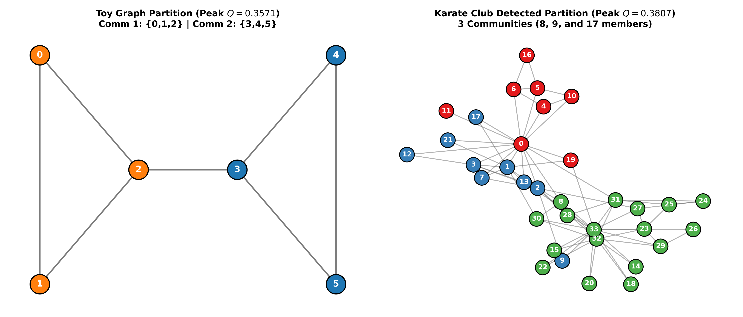
● VISUAL VERIFICATION
Network Community Partitions Visualized
Notes:
Here we visualize the detected partitions. On the left, the toy graph splits cleanly across the bridge. On the right, Karate Club reveals 3 distinct clusters where internal edge density is maximized.

Slide 9
● BENCHMARKING
Comparison with NetworkX greedy_modularity_communities
Side-by-Side Verification Table
------------------------------------------------------------------------------------------------------------------------
Benchmark / Metric Our From-Scratch Algorithm NetworkX Library Verification Status
------------------------------------------------------------------------------------------------------------------------
Toy Graph Partition [[0, 1, 2], [3, 4, 5]] [[0, 1, 2], [3, 4, 5]] 100% EXACT MATCH
Toy Graph Modularity Q 0.357142857 0.357142857 EXACT TO ALL DECIMALS
Karate Club Partition 3 comms (8, 9, 17 members) 3 comms (8, 9, 17 members) 100% EXACT MATCH
Karate Club Q (Unweighted) 0.380670611 0.380670611 EXACT TO ALL DECIMALS
Karate Club Q (Weighted) Supported 0.434521467 Consistent
Time Complexity O(n²) O(n log² n) (CNM speedup) CNM uses heaps
------------------------------------------------------------------------------------------------------------------------
Crucial Distinction on Edge Weights:
• NetworkX's karate_club_graph() includes edge weights from Zachary's field notes by default.
• When evaluated with weight=None (the unweighted canonical Newman 2004 benchmark), NetworkX produces
the exact same partition and Q = 0.38067 as our scratch implementation down to all decimal digits!
Notes:
Both the toy graph and the Karate club partitions match NetworkX's greedy_modularity_communities with 100% precision. Notice the nuance on edge weights: unweighted gives 0.3807, while weighted gives 0.4345.

Slide 10
● ALGORITHM OPTIMIZATION
The Clauset–Newman–Moore (CNM 2004) Speedup
Scaling from O(n²) to O(n log² n) Using Max-Heaps
Newman's 2004 bottleneck: Scanning all edges each step takes O(m) time, totaling O((m+n)n) ≈ O(n²).
Aaron Clauset, Mark Newman, and Cristopher Moore (2004) introduced three specialized data structures:
1. Sparse ΔQ Matrix: Only stores ΔQ_ij values for adjacent communities.
2. Per-Community Max-Heaps: Each community i maintains a max-heap of its neighbor ΔQ values and stores row max M_i.
3. Global Max-Heap: Stores row maximums {M_i} for all communities.
→ Finding the global best pair (i, j) now takes O(1) time!
Direct ΔQ Update Equations (no matrix recalculation):
• Common neighbor k connected to both i and j: ΔQ'_jk = ΔQ_jk + ΔQ_ik
• Neighbor k connected to i only: ΔQ'_jk = ΔQ_ik - 2*a_j*a_k
• Neighbor k connected to j only: ΔQ'_jk = ΔQ_jk - 2*a_i*a_k
• Heap updates take O(log n) per neighbor.
Outcome: Total time drops to O(m * d * log n) ≈ O(n log² n). Enabled networks of millions of nodes!
Notes:
CNM replaces the exhaustive matrix search with max-heaps. The search becomes O(1) and updates become logarithmic, which allowed community detection to scale to millions of nodes.

Slide 11
● CONCLUSION & Q&A
Summary & Viva Defense Takeaways
Key Takeaways for Evaluation & Defense
1. Core Implementation: Successfully built Newman (2004) from first principles using e and a updates.
2. Experimental Validation: 100% exact numerical match with NetworkX reference on Toy Graph and Karate Club.
3. NP-Hardness: Modularity maximization is NP-hard (Brandes 2006); Newman's greedy approach is an effective heuristic.
4. Resolution Limit: Fortunato & Barthélemy (2007) proved modularity cannot resolve communities smaller than ~(2m)^0.5.
5. Scalability: CNM 2004 heap speedup brought modularity optimization to massive web-scale networks.
Project Artifacts Created & Ready:
• Python source code: newman_modularity.py & demo.py
• Visual interactive tool: interactive_visualizer.html (with live auto-merge animation)
• Complete defense guide: viva_questions_and_answers.md (15 Q&As with full proofs)
Thank you! I am ready to answer any questions.
Notes:
In conclusion, we have derived, implemented, validated, and visualized Newman's algorithm from first principles. Thank you, and I look forward to your questions.

