Slide 1
Effects of food for cats randomized complete block design Junyan Deng
Interest
which food does the cats like most?
Assuming that if the food tastes good the cat would eat much, by weight.

Slide 2
Design of experiment
Test 3 times, morning， noon and diner.
The fourth meal is feed on midnight. This meal is not measured, offering all kinds of food to make sure both cats are at the same situation beginning for every day test.
Why we don’t block days?

Slide 3




Model
is the observation of ith food jth cat.
μ is overall mean.
is effect of food i.
is effect of cat j.

Slide 4



Assumption

Slide 5


Hypothesis

Slide 6
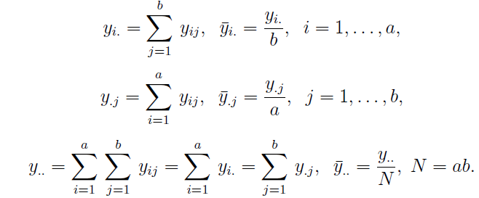
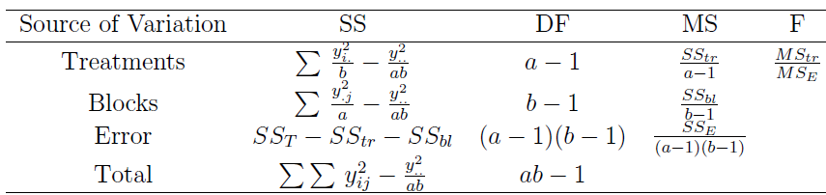
Notation

Slide 7

data

Slide 8
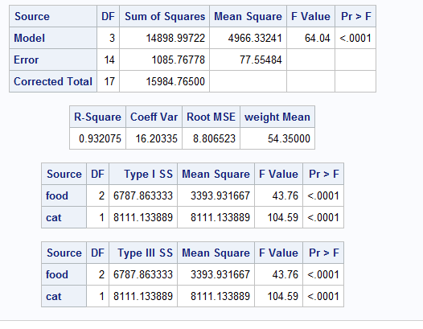
ANOVA table

Slide 9
Conclusion
Pr(food)<0.001, we conclude that the effects of food are different.
Pr(cat)<0.001, we conclude that the effects of cats are different. We should block the effect of cats.

Slide 10
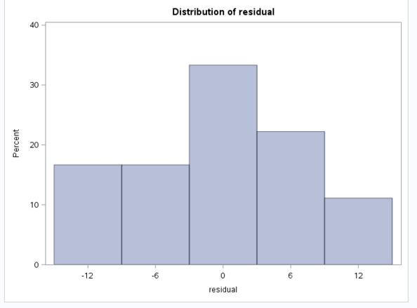
Model adequacy checking

Slide 11
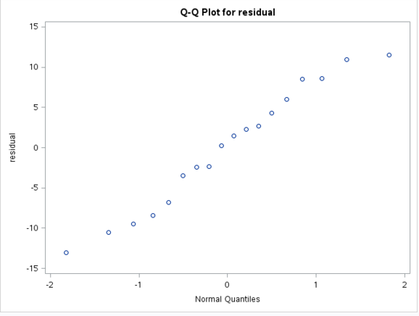

Slide 12
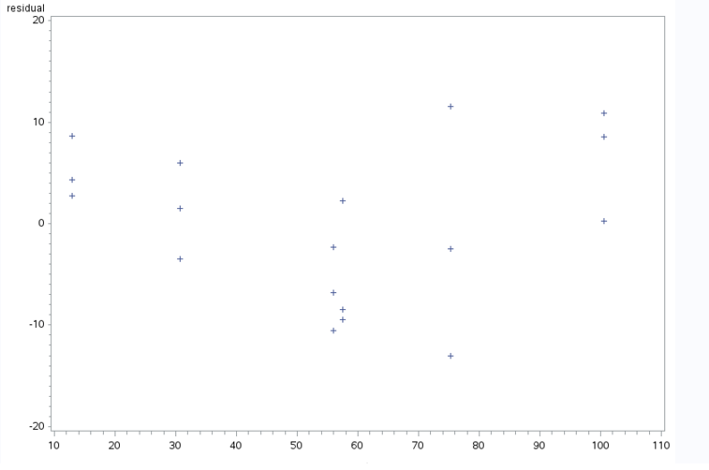
Residual vs predicted value

Slide 13
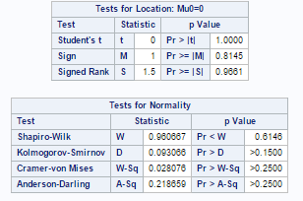

Slide 14
Is the analysis done?

Slide 15
Estimate of effects of food
μ.hat= y../18=55.52
τ1=y1./6-μ.hat=-2.53
τ2=y2./6-μ.hat=22.78
τ3=y3./6-μ.hat=-20.25
conclussion
Food 2 is the best. I will choose food 2 to feed my cats.

Slide 16
