Slide 1
Exploring the Furry Fandom

Slide 2
Why?

Slide 3
Furry is interesting

Slide 4
There's a lot to explore

Slide 5
So what is exploring?

Slide 11
Good.
What do we have to work with?

Slide 12
What have we learned so far?

Slide 13
Before I continue...

Slide 14
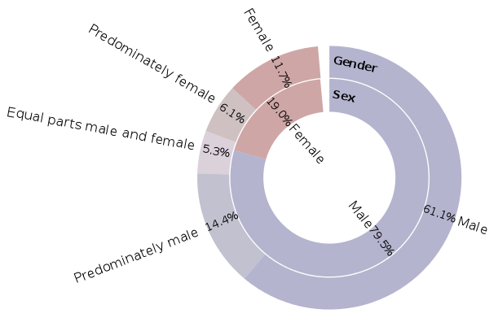
Sex and gender

Slide 15
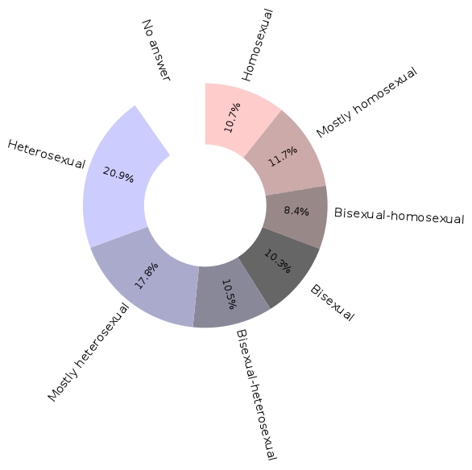
Orientation

Slide 16
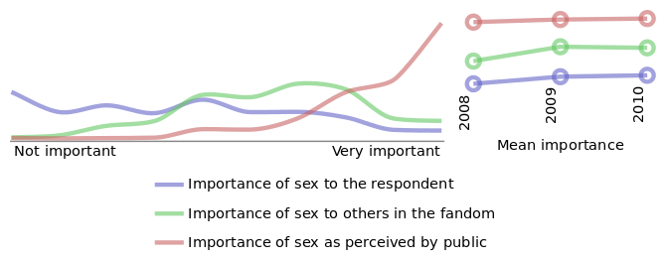
The Importance of Sex

Slide 17
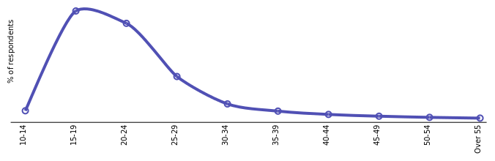
Age Distribution

Slide 18
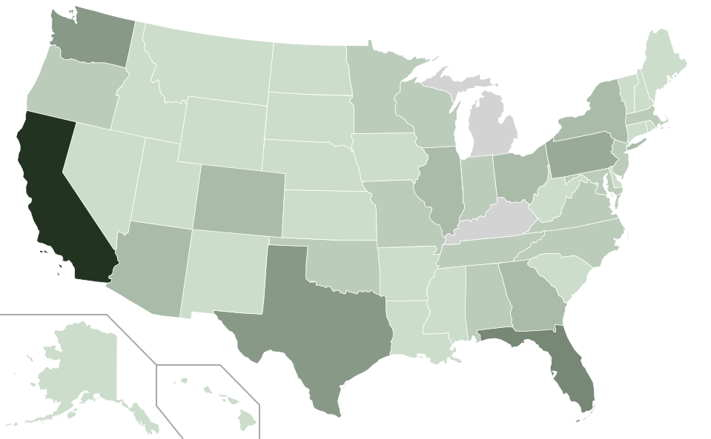
Population Distribution

Slide 19
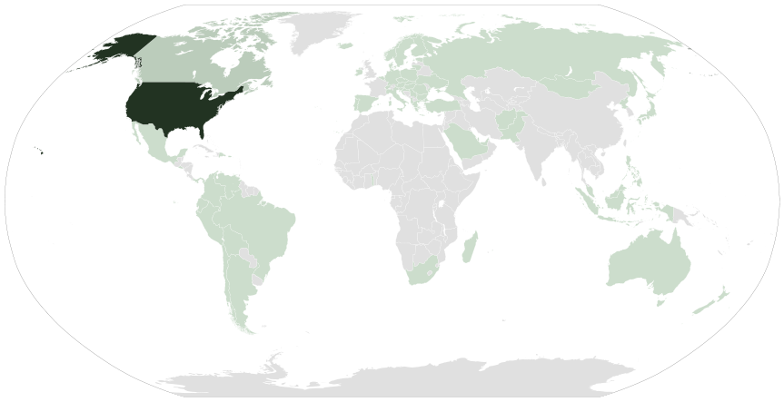
Population Distribution

Slide 20
Doxa and introspection

Slide 21
Where do we go from here?

