Slide 1
Dezvoltarea aplicaţiilor web client
Software Development
ASEM, october 2018

Slide 2
agenda
HTML Overview
General
- JavaScript Where To
- Types of CSS
- Importance of Styling
Semantics
- Semantics and Markup
- Better semantic tags
HTML/CSS Validators
HTML5 features
- Semantics
- Offline and storage

Slide 3
agenda
- Device access
- Connectivity
- Styling
- Performance and integration
- 2D/3D graphics and effects
- Multimedia
Practice
CSS/CSS3 Overview
General/Frameworks
Responsive Design/Grid system and media queries
Animations(Transforms/Transition/Animation)
Pre-processors (SCSS/LESS)

Slide 4
pre-processors
pre-processors

Slide 5
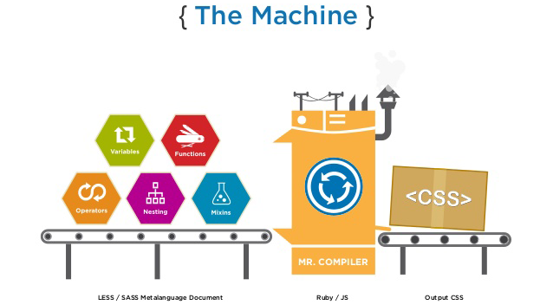
pre-processors

Slide 6
Set-up project
https://github.com/starniciuc/gulp-bootstrap-sass-kit
Bootstrap4 SCSS with Webpack 3 Starter kit
Update project
please open git-bash
cd ..project_path
git clone https://github.com/vbancila/UTM-UI-Courses.git
For install project please following next steps
cd your project
npm install
After this steps run npm
For launch html template npm run start
Please open in your browser adress http:\\localhost:8080

Slide 7
Preprocessing
CSS on its own can be fun, but stylesheets are getting larger, more complex, and harder to maintain. This is where a preprocessor can help. Sass lets you use features that don't exist in CSS yet like variables, nesting, mixins, inheritance and other nifty goodies that make writing CSS fun again.
Once you start tinkering with Sass, it will take your preprocessed Sass file and save it as a normal CSS file that you can use in your web site.
*.scss → *.css
Input output

Slide 8
Variables
$font-stack: Helvetica, sans-serif $primary-color: #333 ----------------------------------------------- body font: 100% $font-stack color: $primary-color | body { font: 100% Helvetica, sans-serif; color: #333; }

Slide 9
Nesting
nav ul margin: 0 padding: 0 list-style: none li display: inline-block a display: block padding: 6px 12px text-decoration: none | nav ul { margin: 0; padding: 0; list-style: none; } nav li { display: inline-block; } nav a { display: block; padding: 6px 12px; text-decoration: none; }

Slide 10
Partials
You can create partial Sass files that contain little snippets of CSS that you can include in other Sass files.
This is a great way to modularize your CSS and help keep things easier to maintain. A partial is simply a Sass file named with a leading underscore. You might name it something like _partial.scss.
The underscore lets Sass know that the file is only a partial file and that it should not be generated into a CSS file. Sass partials are used with the @import directive.

Slide 11
Import
// _reset.sass html, body, ul, ol margin: 0 padding: 0 -------------------------------------------------------- // base.sass @import reset body font: 100% Helvetica, sans-serif background- color: #efefef | html, body, ul, ol { margin: 0; padding: 0; } body { font: 100% Helvetica, sans-serif; background-color: #efefef; }

Slide 12
Mixins
=border-radius($radius) -webkit-border-radius: $radius -moz-border-radius: $radius -ms-border-radius: $radius border-radius: $radius .box +border-radius(10px) | .box { -webkit-border-radius: 10px; -moz-border-radius: 10px; -ms-border-radius: 10px; border-radius: 10px; }

Slide 13
Extend/Inheritance
%message border: 1px solid #ccc padding: 10px color: #333 .success @extend %message border-color: green .error @extend %message border-color: red .warning @extend %message border-color: yellow | .message, .success, .error, .warning { border: 1px solid #cccccc; padding: 10px; color: #333; } .success { border-color: green; } .error { border-color: red; } .warning { border-color: yellow; }

Slide 14

Practice

Slide 15
Practice
Your HTML/ Style and Images created in last lesson add them in new created project. Separate respectively code by components and areas/layout.
Change CSS to SCSS
Add colors into variables
Import custom font Roboto - https://fonts.google.com/specimen/Roboto?selection.family=Roboto
Create a simple mixin for border-radius and use it for buttons

Slide 16
useful links
http://sass-lang.com/guide
https://github.com/vbancila/UTM-UI-Courses/tree/master/starter-kit
https://webpack.js.org/

Slide 17


