Slide 1
ohm: Sampling-based Online Health Monitoring of HPC Applications
Abhishek Kulkarni
OSL Lab Lunch Talk
November 14 2011

Slide 2

Epic failure is an option!

Slide 3
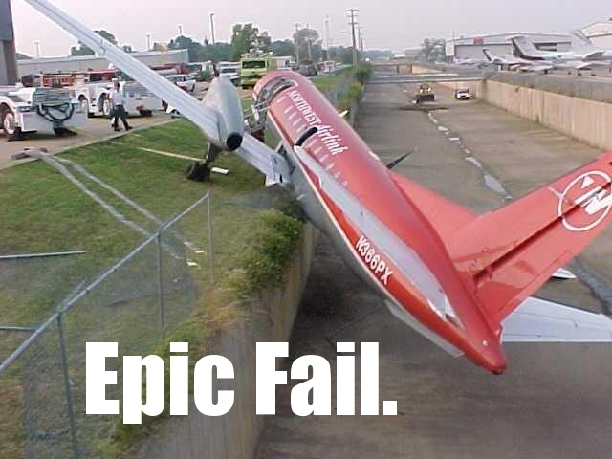
Epic failure is an option!
Or is it?

Slide 4
HPC applications are a black-box
Running time in days, if not months

Slide 5
HPC applications are a black-box
Running time in days, if not months
I would like to know what my application is doing

Slide 6
HPC applications are a black-box
Running time in days, if not months
I would like to know what my application is doing
Find out if the application is ...
  Executing correctly

Slide 7
HPC applications are a black-box
Running time in days, if not months
I would like to know what my application is doing
Find out if the application is ...
  Executing correctly
  In a hung state

Slide 8
HPC applications are a black-box
Running time in days, if not months
I would like to know what my application is doing
Find out if the application is ...
  Executing correctly
  In a hung state
  In bad health

Slide 9
Silent Data Corruption
“SDC occurs when incorrect data is delivered by a computing system to the user without any error being logged” - Cristian Constantinescu (AMD)

Slide 10
Silent Data Corruption
“SDC occurs when incorrect data is delivered by a computing system to the user without any error being logged” - Cristian Constantinescu (AMD)
Causes:
  Temperature/voltage fluctuations, particles, manufacturing residues, oxide breakdown, electro-static discharge…

Slide 11
Silent Data Corruption
“SDC occurs when incorrect data is delivered by a computing system to the user without any error being logged” - Cristian Constantinescu (AMD)
Causes:
  Temperature/voltage fluctuations, particles, manufacturing residues, oxide breakdown, electro-static discharge…
more prevalent in new technologies [Borkar 2009; Pan et al 2008; Constantinescu 2006]

Slide 12
So, how do I know what my application is doing?

Slide 13
So, how do I know what my application is doing?
Application I/O
Print health parameters
Checkpoint state periodically

Slide 14
So, how do I know what my application is doing?
Application I/O
Print health parameters
Checkpoint state periodically
Post updates to Twitter

Slide 15
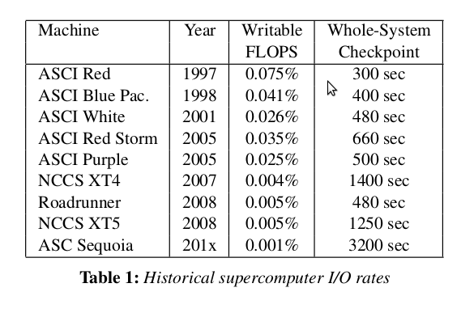
”Writable” FLOPS

Slide 16
”Writable” FLOPS
Supercomputers have far more compute capacity than I/O bandwidth
Long waiting periods for I/O
Less I/O leads to better scalability

Slide 17
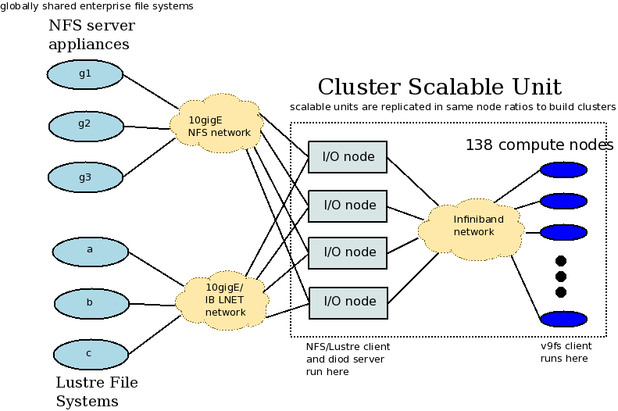
Staged I/O architecture

Slide 18
I/O staging
Suitable for storing logs
Post-facto data analysis

Slide 19
I/O staging
Suitable for storing logs
Post-facto data analysis
Better suited for reactive fault tolerance
  Root-cause analysis
  Learning approaches

Slide 20
Runtime monitoring
Out-of-core processing
Applications
  Health monitoring
  In-situ visualization
  Self-adaptive applications
Application-specific ”health parameters”

Slide 21
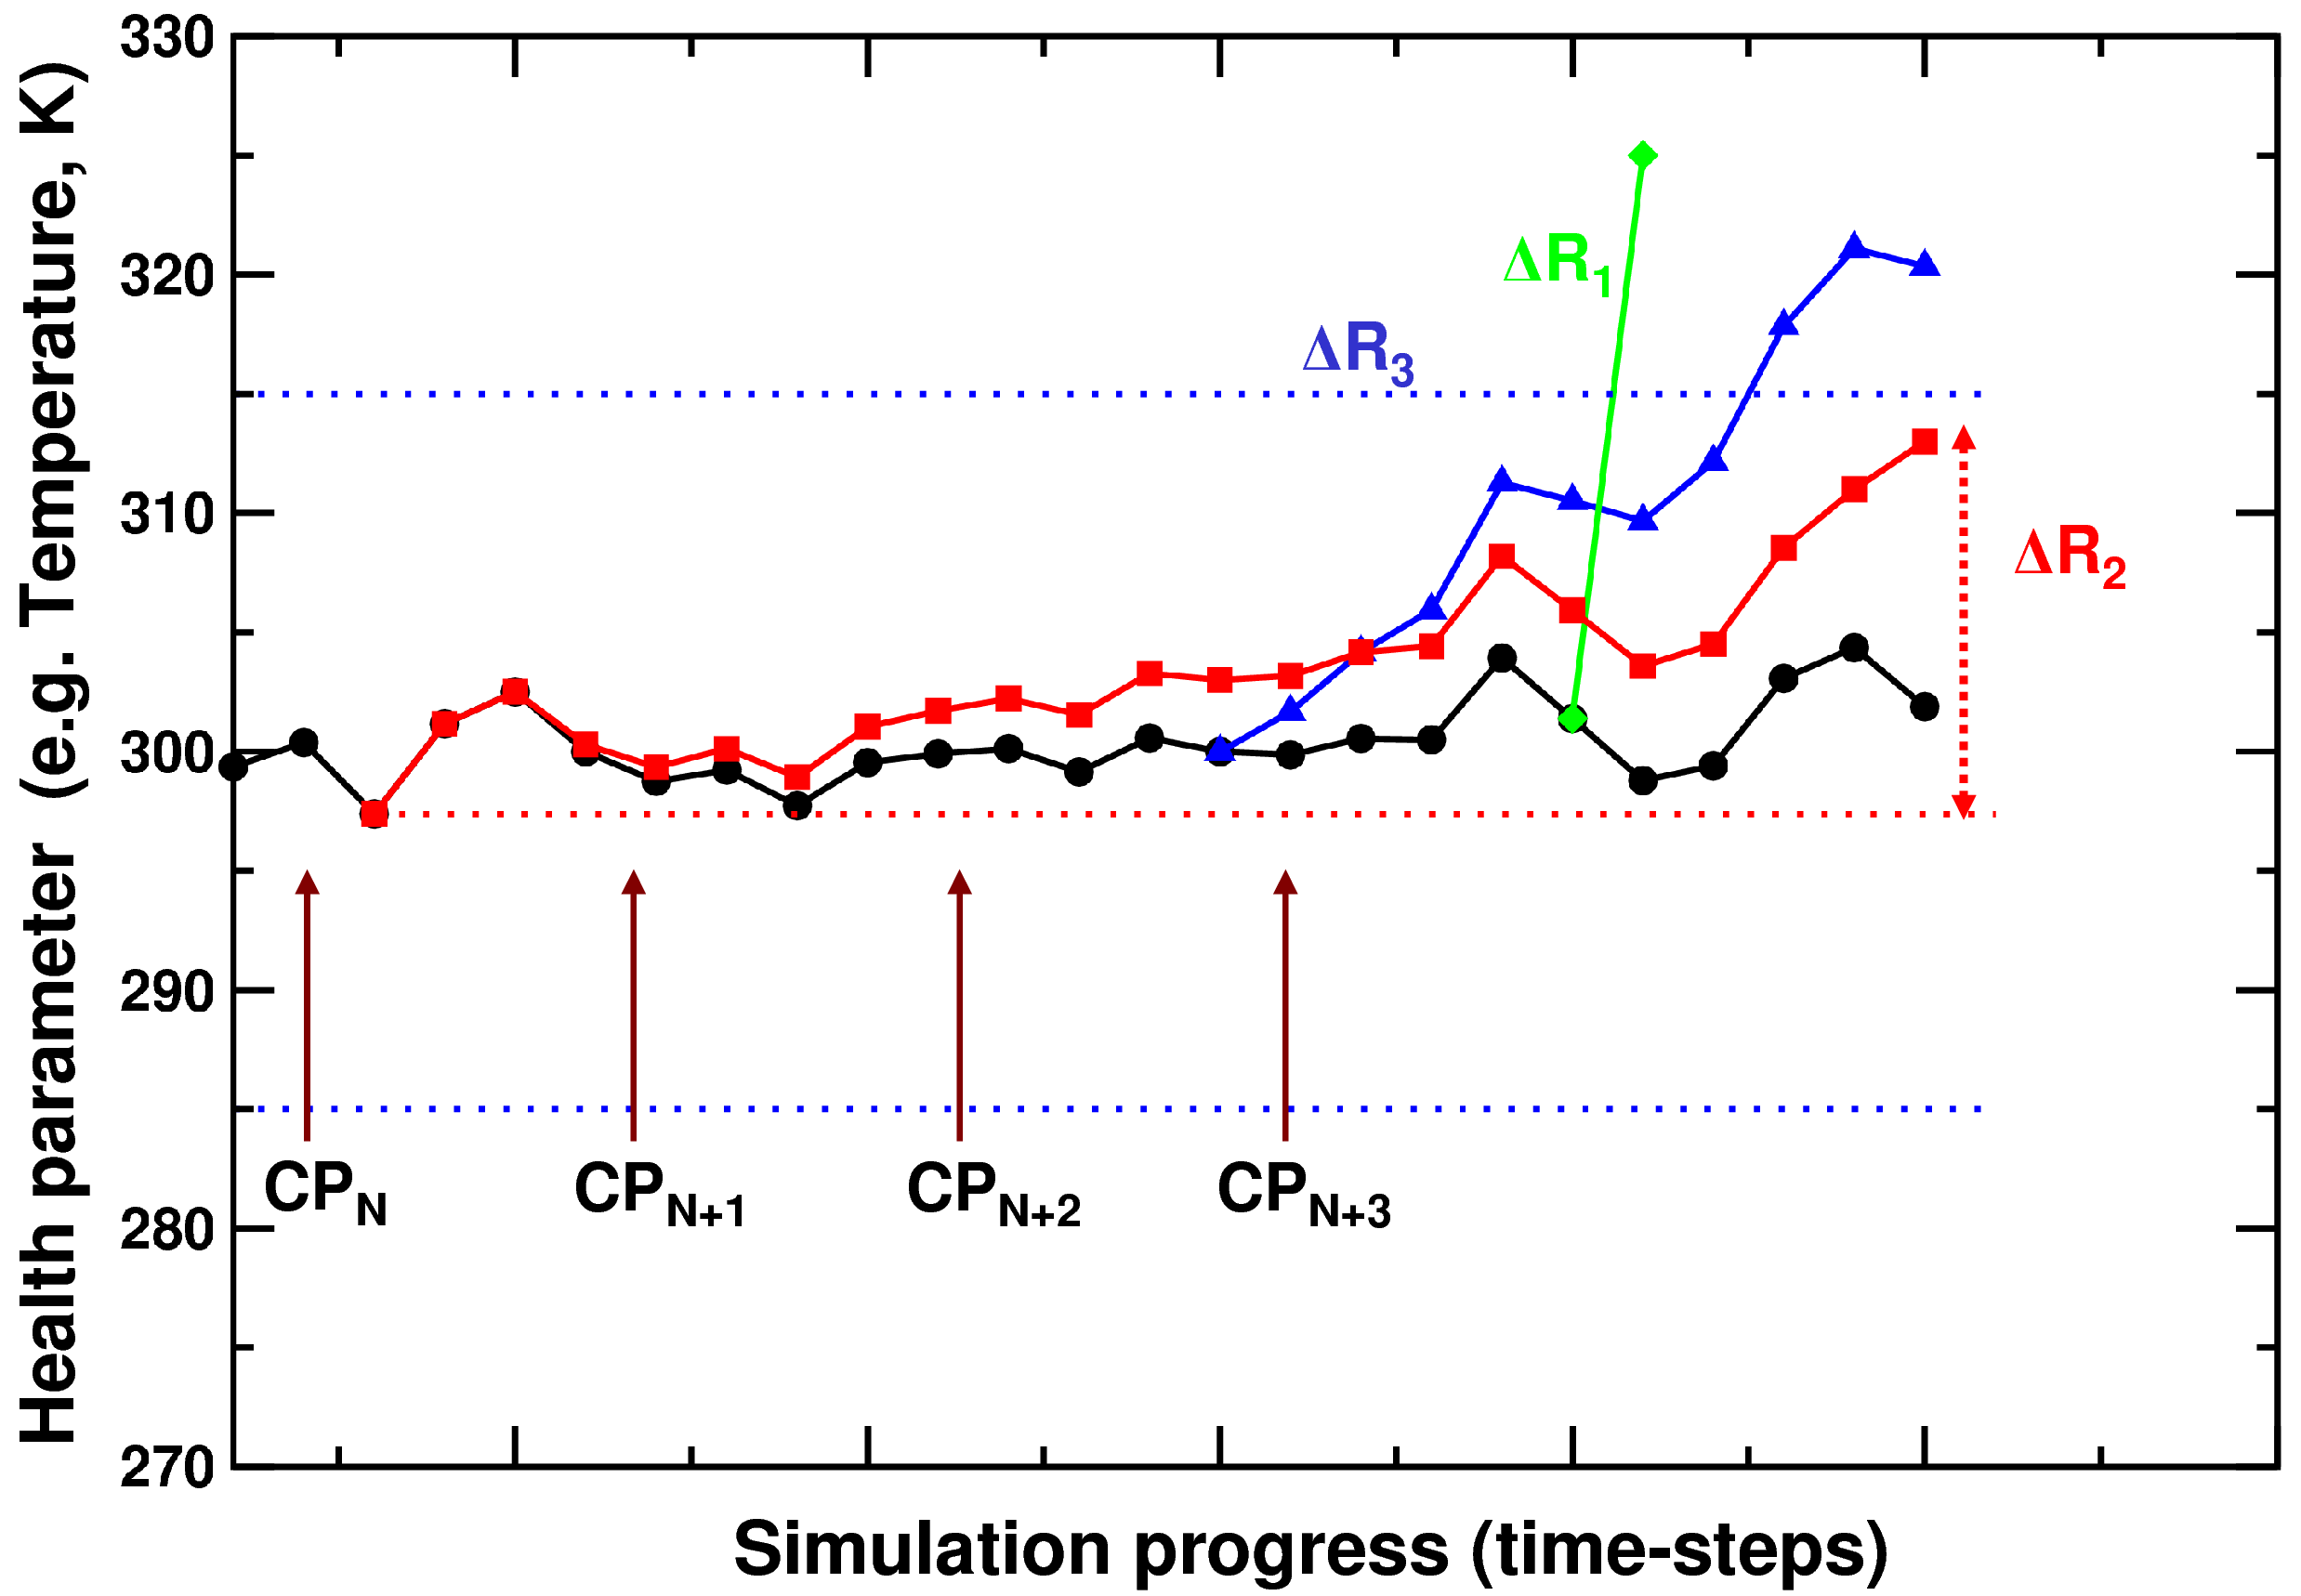
Black curve denotes a healthy trajectory. A rule based detection of variation in the health parameters can detect changes in simulation health and potential hardware or software failures. For example: ΔR1 is a rule to monitor a large change in a single time-step; ΔR2 is a rule to monitor user-defined change over last N (also user-defined) steps; ΔR3 is a violation of an acceptable range (user-defined) of the health parameter. Based on where these faults are traced back to, the simulation can be rolled back to a healthy checkpoint (CPX).
Agarwal 2010

Slide 22
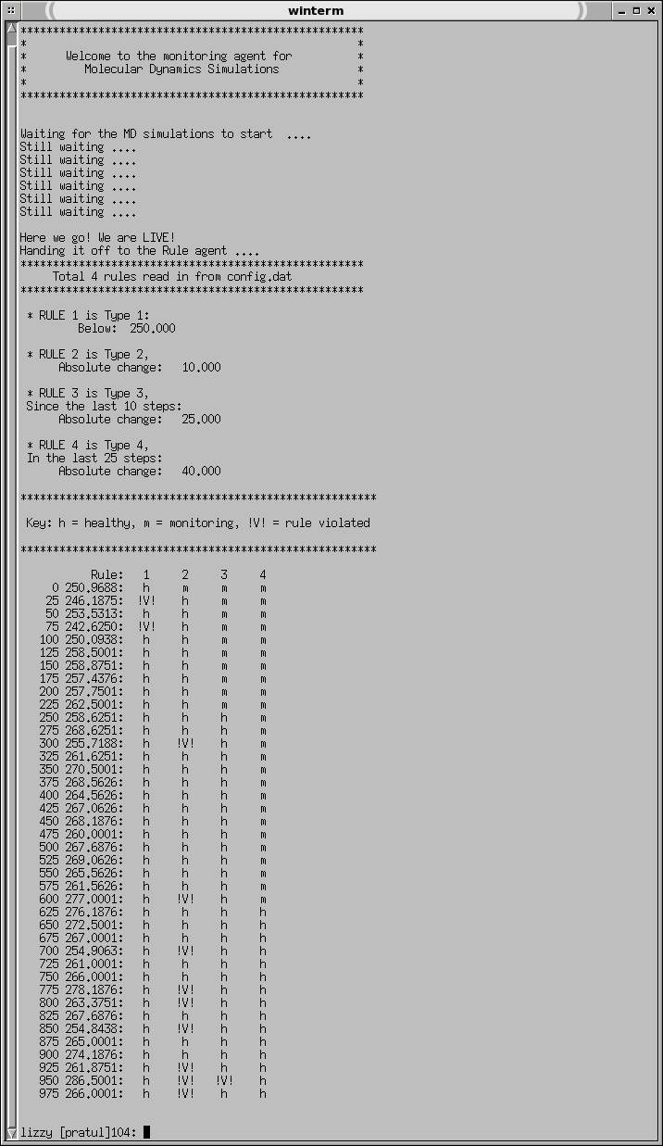
MD Monitoring Agent
Works for real MD apps
  AMBER
  LAMMPS
Requires modifying the applications
I/O based approach very fragile
Agarwal 2010

Slide 23
ohm example (printing values)
-- printing values
app = ohm_pid()
temp = app.probe {"temp", 1.0}
energy = app.probe {"energy", 1.0}
rule{temp, energy} {
function ()
print("temp = " .. temp[1])
print(”energy = " .. energy[1])
end
}

Slide 24
Plotting temp over time
-- plotting values
require('gnuplot_t')
app = ohm_pid()
init {
gp = gnuplot_t.new()
gp{
pre = '[1:16]',
f1 = 'x',
post = 'title "temp(x)"',
}
}
temp = app.probe {"temp", 1.0}
rule{temp} { function () gp{f1 = temp} end }

Slide 25
Runtime assertions
app = ohm_attach(”1234”)
temp = app.probe {"temp", 1.0}
energy = app.probe {"energy", 1.0}
rule{temp, energy} {
function ()
if (temp[1] – temp[2]) > 50 then
-- do something
end
end
}

Slide 26
Ohm probes
Probes are values from the running process
Implemented as FIFO buffers
Var probes:
  app.probe(”foo”)
Execution context probes:
  app.function
  app.eip
  app.esp
foo
bar

Slide 27
Eager probes
Periodic sampling interval
Currently specified when defining the ohm prescription
Models continuous variables

Slide 28
DWARF
Commonly used debugging format
The name is a medieval fantasy complement to "ELF" that has no official meaning, although the backronym 'Debugging With Attributed Record Formats' was later proposed. - Wikipedia
Typically generated when compiled:
  gcc -g -o app app.c
ohm doctor reads the Debugging Information Entries (DIE) at runtime to locate the variables

Slide 29
2 .debug_info
3
4 COMPILE_UNIT<header overall offset = 0>:
5 <0>< 11> DW_TAG_compile_unit
6 DW_AT_producer GNU C 4.6.1
7 DW_AT_language DW_LANG_C89
8 DW_AT_name whetdc.c
9 DW_AT_comp_dir /home/adkulkar/projects/ohm
10 DW_AT_low_pc 0x4008a4
11 DW_AT_high_pc 0x4019b7
12 DW_AT_stmt_list 0
13
14 LOCAL_SYMBOLS:
15 <1>< 45> DW_TAG_typedef
16 DW_AT_name size_t
17 DW_AT_decl_file 2 /usr/lib/gcc/x86_64-linux-gnu/4.6.1/include/stddef.h
18 DW_AT_decl_line 212
19 DW_AT_type <56>
20 <1>< 56> DW_TAG_base_type
21 DW_AT_byte_size 8
22 DW_AT_encoding DW_ATE_unsigned
23 DW_AT_name long unsigned int
24 <1>< 63> DW_TAG_base_type
25 DW_AT_byte_size 4
26 DW_AT_encoding DW_ATE_signed
27 DW_AT_name int

Slide 30
global vars are easy!
752 <1>< 1737> DW_TAG_variable
753 DW_AT_name T1
754 DW_AT_decl_file 1 /home/adkulkar/projects/ohm/whetdc.c
755 DW_AT_decl_line 82
756 DW_AT_type <743>
757 DW_AT_external yes(1)
758 DW_AT_location DW_OP_addr 0x6020d0
759 <1>< 1758> DW_TAG_variable
760 DW_AT_name T2
761 DW_AT_decl_file 1 /home/adkulkar/projects/ohm/whetdc.c
762 DW_AT_decl_line 82
763 DW_AT_type <743>
764 DW_AT_external yes(1)
765 DW_AT_location DW_OP_addr 0x6020e0

Slide 31
Stack variables
634 <2>< 1498> DW_TAG_formal_parameter
635 DW_AT_name N
636 DW_AT_decl_file 1 /home/adkulkar/projects/ohm/whetdc.c
637 DW_AT_decl_line 429
638 DW_AT_type <77>
639 DW_AT_location DW_OP_fbreg -24
640 <2>< 1511> DW_TAG_formal_parameter
641 DW_AT_name J
642 DW_AT_decl_file 1 /home/adkulkar/projects/ohm/whetdc.c
643 DW_AT_decl_line 429
644 DW_AT_type <77>
645 DW_AT_location DW_OP_fbreg -32

Slide 32
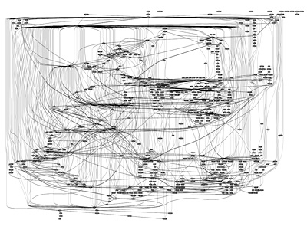
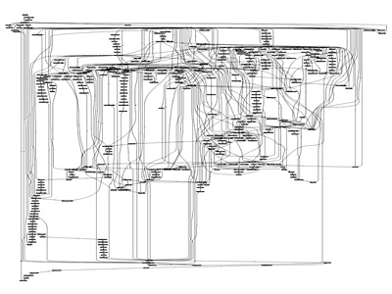
Applications are complex

Slide 33
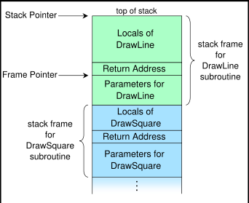
Call stack layout
if a subroutine named DrawLine is currently running, having been called by a subroutine DrawSquare

Slide 34
Cost model
G = {g1, g2, …, gM} Active global probes
S = {sM+1, sM+2, …, sN} Active stack probes
T = {t1,....,tN} Probe overhead
T_i = copy(v, v') for i in 1..M
T_i = stackdepth(s_i) for i in M..N
T' = sum(i: 1,M){ t_i } + sum(i: M, N){ t_i} Interrupt time

Slide 35
ohm rules
rule{temp, energy} {
function ()
print("temp = " .. temp[1])
print(”energy = " .. energy[1])
end
}
Triggered only when the probes they depend on change
Functional reactive programming

Slide 36
Lazy probes
Models discrete variables
Asynchronous (value obtained when trace statement executes)
Implemented using dynamic instruction rewriting

Slide 37
Lightweight tracing
#define TRACE(_point, _args...) \
do { \
if (_point) printf(_args); \
} while (0)
But branch instructions are expensive!

Slide 38
So we add code bloat instead
#define NOP5 ".byte 0x0f, 0x1f, 0x44, 0x00, 0x00;"
#define TRACE(_point, _args...) \
do { \
asm goto ( \
"0: " NOP5 \
".pushsection trace_table, \"a\";" \
".quad " #_point ", 0b, %l0;" \
".popsection" \
: : : : __lbl_##_point); \
if (0) { \
__lbl_##_point: printf(_args); \
} \
} while (0)
We patch the NOP instruction at runtime to send the values to our DSL

Slide 39
We patch the NOP instruction at runtime to send the values to our DSL

Slide 40
Questions?

