Slide 1
FoodHub Order Data Analysis Python Foundations Project
AI & ML Business Applications UT Austin – Great Learning
Presented by: Anoop Krishnan | 25 May 2026

Slide 2
Contents / Agenda
Executive Summary
Business Problem Overview and Solution Approach
Data Overview
EDA - Univariate Analysis
EDA - Multivariate Analysis
Appendix

Slide 3
Executive Summary
CONCLUSIONS (Q17)
American (31%) & Japanese (25%) cuisines dominate - Top 3 cuisines account for 71% of all orders
71.2% of orders are on weekends (1,351 of 1,898) - FoodHub is primarily a weekend service
Only 29.24% of orders exceed $20, yet these generate ~60% of net commission revenue ($3,689 of $6,166)
38.78% of orders (736) are unrated -major customer-retention and feedback gap
Cost, prep time and delivery time are uncorrelated (max r = 0.04) -each is an independent driver
Weekday delivery averages 28.34 min vs 22.47 min on weekends -26% slower despite lower order volume
10.54% of orders (200) exceed 60 min total time (prep + delivery) -clear SLA risk
RECOMMENDATIONS (Q17)
Scale weekend staffing for American & Japanese restaurants to match demand without sacrificing speed
Add post-order push-notification prompts to close the 38.78% unrated-order gap
Introduce bundle / upsell deals to shift more orders above $20 and boost high-commission revenue
Feature and promote the 4 promo-eligible restaurants: Meatball Shop 4.51(*), Blue Ribbon FC 4.33(*),
Shake Shack 4.28(*), Blue Ribbon Sushi 4.22(*) -all verified with >50 rated orders
Fix weekday delivery lag -route optimisation & dynamic dispatch to bring avg below 25 min
Implement 55-min total-time alert + priority dispatch to reduce 60+ min orders below 5%
Expand loyalty rewards to the top 50 frequent customers; automate 20% vouchers at 8+ orders

Slide 4
Business Problem Overview and Solution Approach
PROBLEM STATEMENT
FoodHub is a food-aggregator app operating in New York City that connects customers to restaurants via a single smartphone platform. The company earns revenue through fixed commissions: 25% on orders >$20, 15% on orders $5-$20, and 0% on orders <=$5. As order volume grows, the data science team must analyse historical order data to understand demand patterns, improve customer experience, and optimise revenue.
SOLUTION APPROACH - 5-STEP EDA PIPELINE
Step 1 - Load Data : Read CSV (1,898 rows x 9 columns) into a pandas DataFrame
Step 2 - Clean Data : Identify 'Not given' ratings as hidden NaN; verify no other missing values
Step 3 - Univariate EDA : Explore distributions of all 9 variables individually (Q6-Q11)
Step 4 - Multivariate : Analyse relationships & cross-variable patterns (Q12-Q16)
Step 5 - Business Insights : Derive data-driven conclusions & actionable recommendations (Q17)
TOOLS USED
Python 3 | pandas & numpy | matplotlib & seaborn | Google Colab (Jupyter)

Slide 5
Data Overview
Q1 - DATASET SHAPE: 1,898 rows × 9 columns (each row = one unique food order)
Q2 - DATA TYPES
int64 : order_id, customer_id, food_preparation_time, delivery_time
float64 : cost_of_the_order
object : restaurant_name, cuisine_type, day_of_the_week, rating
Q3 - MISSING VALUES
No standard NaN values in any column. However, the 'rating' column contains 736 entries labelled
'Not given' -a hidden missing value. These were replaced with NaN for correct numeric analysis.
>> 736 of 1,898 orders (38.78%) have no customer rating.
Q4 - DESCRIPTIVE STATISTICS
cost_of_the_order : Mean $16.50 | Min $4.47 | Max $35.41 (right-skewed, median $14.14)
food_preparation_time: Mean 27.37 min | Range 20–35 min (near-uniform distribution)
delivery_time : Mean 24.16 min | Range 15–33 min
Q5 - UNRATED ORDERS
736 orders (38.78%) have rating = 'Not given'. Treating these as NaN ensures accurate
mean/median calculations and avoids inflating or deflating the average customer rating.

Slide 6
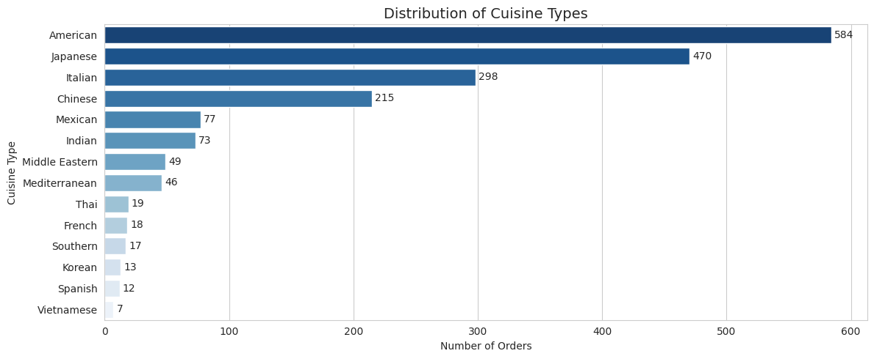
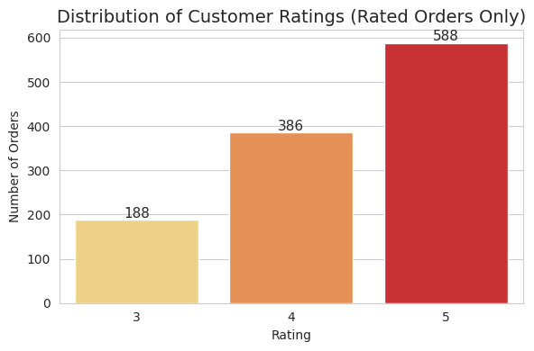
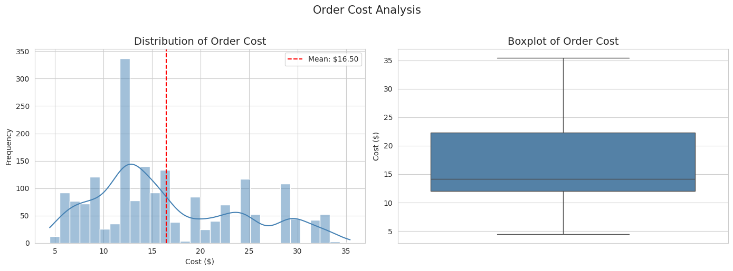
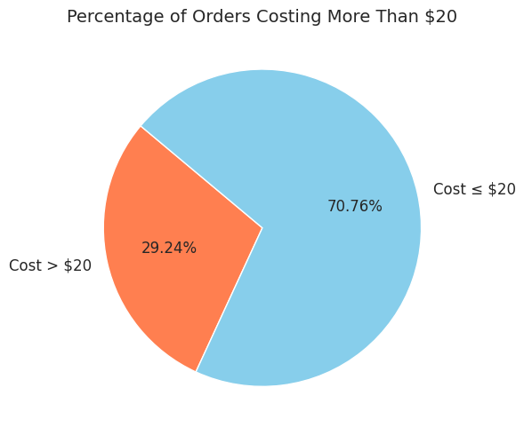
Univariate Analysis
Q6 - Distribution of Cuisine Types
Q7 - Distribution of Customer Ratings
Q8 - Order Cost Distribution & Spread
Q9 - Orders Costing More Than $20 (29.24%)
Key Findings: American (584) & Japanese (470) lead orders · Shake Shack #1 with 219 orders · 51.6% of rated orders = 5(*) · Only 29.24% of orders exceed $20

Slide 7
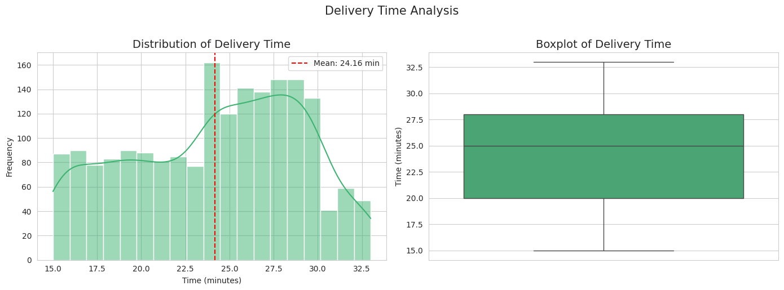
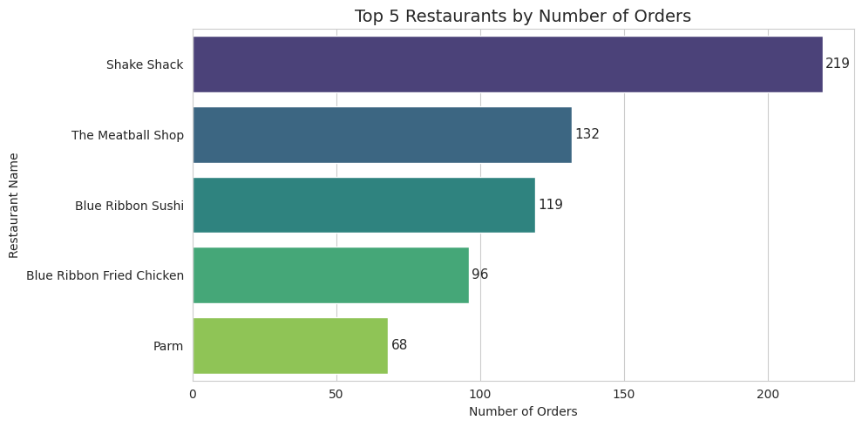
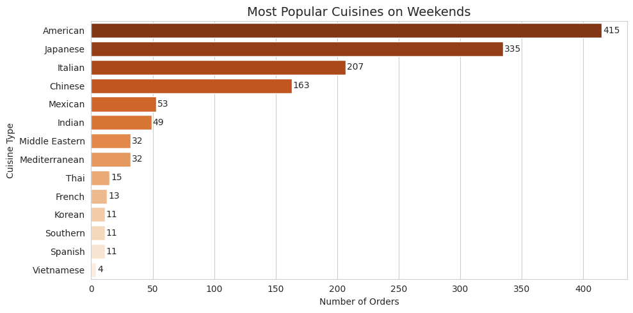
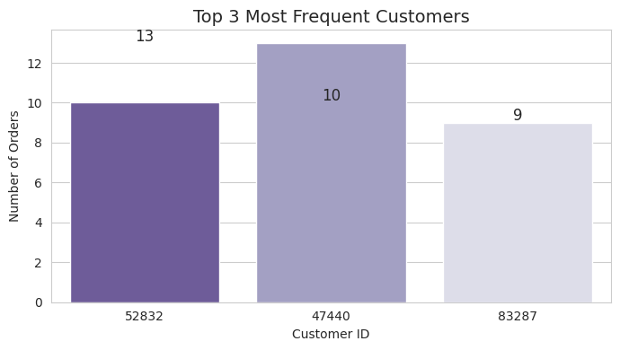
Univariate Analysis (continued - Q8-Q11)
Q10 - Delivery Time Distribution
Q11 - Top 5 Restaurants by Order Count
Q6 (Extra) - Most Popular Cuisines on Weekends
Q11 (Extra) - Top 3 Most Frequent Customers
Key Findings: Weekend orders 2.5× weekday volume · American & Japanese peak on weekends · Mean cost $16.50 · Mean delivery 24.16 min · Top customer #52832 placed 13 orders

Slide 8
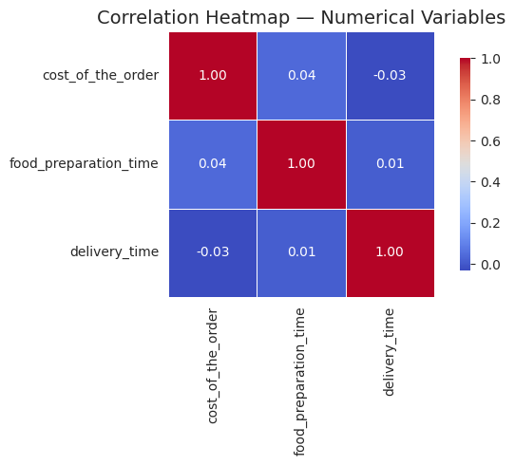
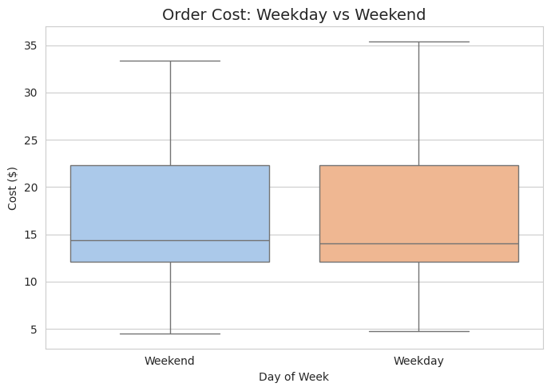
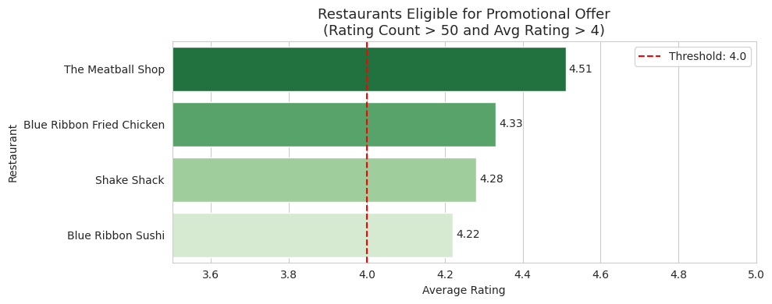
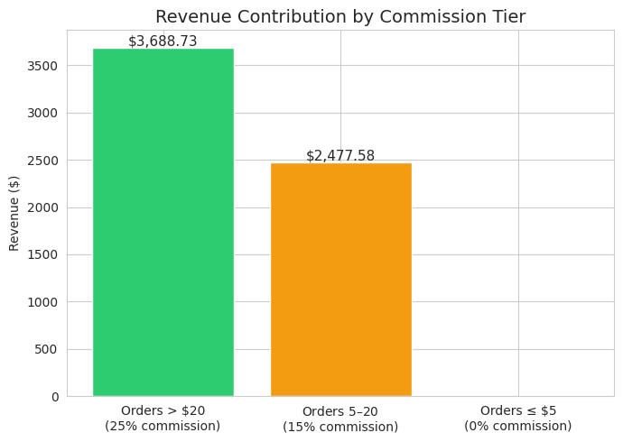
Multivariate Analysis
Q12 - Correlation Heatmap: Cost, Prep & Delivery
Q12 - Order Cost: Weekday vs Weekend
Q13 - Restaurants Eligible for Promotion
Q14 - Revenue by Commission Tier
Key Findings: Near-zero correlations between all 3 numeric variables · Weekday delivery 28.34 min vs 22.47 min weekend · 4 restaurants qualify for promotion · Net revenue = $6,166.30

Slide 9
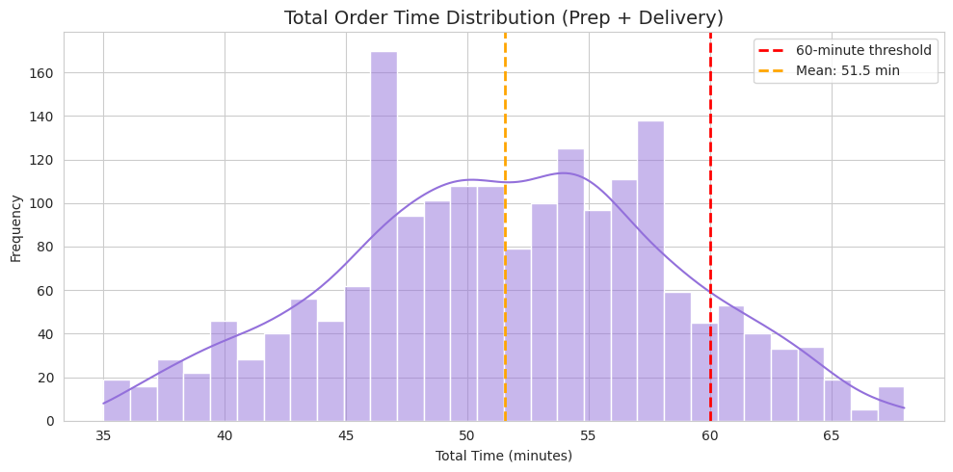
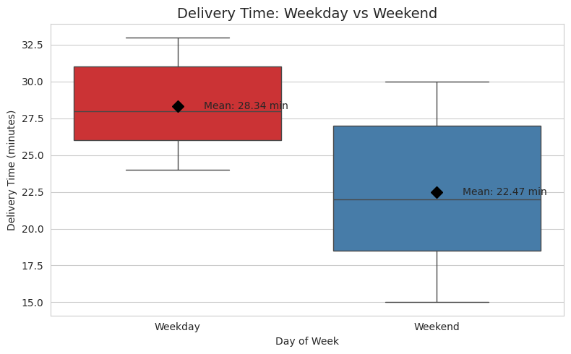
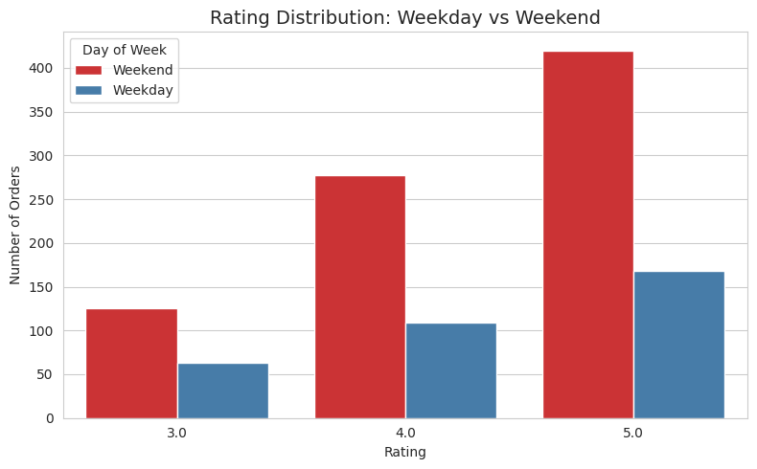
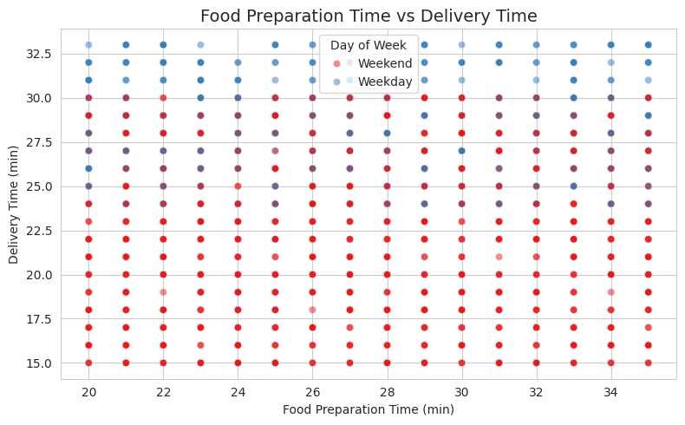
Multivariate Analysis (continued - Q12, Q15-Q16)
Q15 - Total Order Time Distribution (Prep + Delivery)
Q16 - Delivery Time: Weekday vs Weekend
Q12 (Extra) - Rating Distribution: Weekday vs Weekend
Q12 (Extra) - Prep Time vs Delivery Time (Scatter)
Key Findings: 10.54% of orders exceed 60 min total time · Mean total = 51.5 min · Weekend orders receive higher 5(*) ratings · No correlation between prep & delivery time

Slide 10
APPENDIX

Slide 11
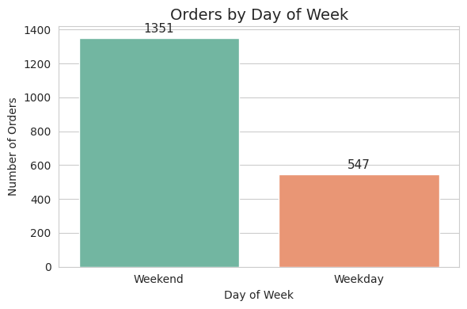
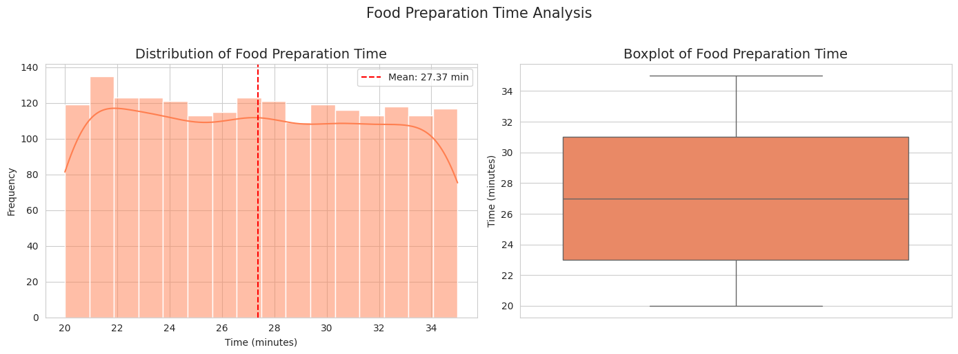
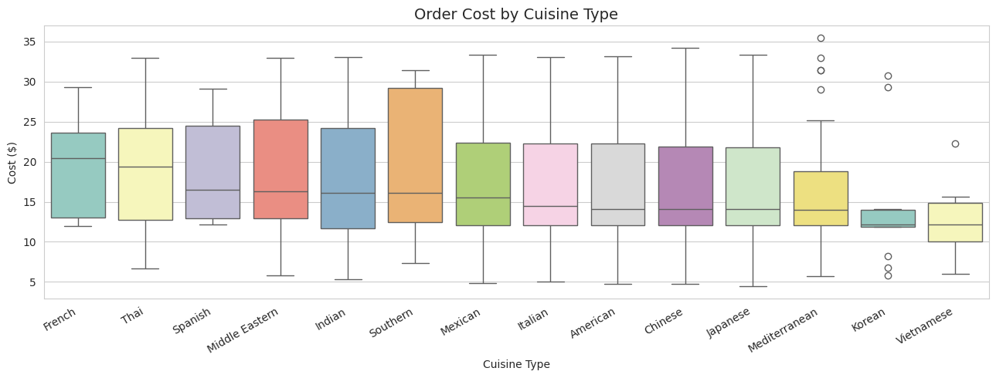
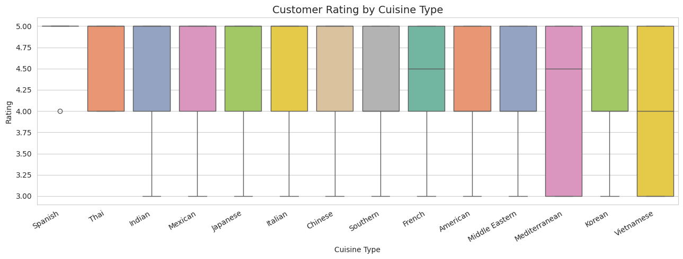
Appendix - Supplementary Analysis & Data Reference
Q6 (Supp.) - Orders by Day of Week: Weekend vs Weekday
Q10 (Supp.) - Food Preparation Time Distribution
Q12 (Supp.) - Order Cost by Cuisine Type
Q12 (Supp.) - Customer Rating by Cuisine Type
Data Dictionary
order_id (int) | customer_id (int) | restaurant_name (str) | cuisine_type (str) | cost_of_the_order (float, USD) | day_of_the_week (str: Weekend/Weekday) | rating (str -> NaN if 'Not given') | food_preparation_time (int, min) | delivery_time (int, min)
Tools & Environment: Python 3 | pandas | numpy | matplotlib | seaborn | Google Colab | Dataset: 1,898 rows x 9 columns | Source: FoodHub order data

