Slide 1
FCMI/PCMI Detailed

Slide 2

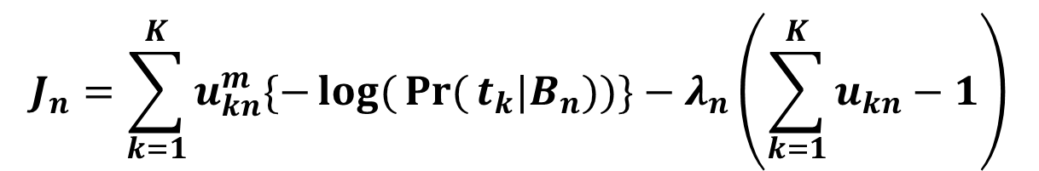
Alternating Optimization for T and U
Step 1: Fix T and optimize U.
$$J(T,U;{B},Λ)=\sum_{n=1}^{N}{\sum_{c=1}^{C}{u_{kn}^{m}\{−\log{(}\operatorname{Pr}{(}t_{k}|B_{n}))\}}}−\sum_{n=1}^{N}{λ_{n}\left(\sum_{k=1}^{K}{u_{kn}−1}\right)}$$
Assuming that bags B₁,B₂…B_{n} are independent, we can reduce J to N simpler problems.
$$J_{n}=\sum_{k=1}^{K}{u_{kn}^{m}\{−\log{(}\operatorname{Pr}{(}t_{k}|B_{n}))\}}−λ_{n}\left(\sum_{k=1}^{K}{u_{kn}−1}\right)$$

Slide 3
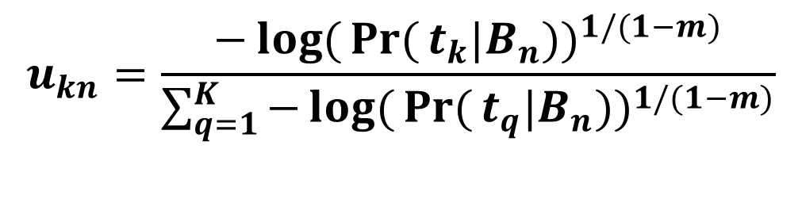
Setting the gradient of J_{n} with respect to u to 0 yields
$$u_{kn}=\frac{−\log{(}\operatorname{Pr}{(}t_{k}|B_{n}))^{1/(1−m)}}{\sum_{q=1}^{K}{−\log{(}\operatorname{Pr}{(}t_{q}|B_{n}))^{1/(1−m)}}}$$
Notes:
Further simplication leads to an update for each individual membership.

Slide 4
Step 2: Fix U and optimize T.
Further simplification requires specification of Pr(t_{k}|B_{n}).
How should we combine the probabilities of individual instances in B_{n} to obtain Pr(t_{k}|B_{n})?
Need to define parameters of t_{k}.

Slide 5
Probability of an Instance in TC k
t_{k}=(c_{k}, s_{k}), where
c_{k} is concept k’s centroid
s_{k} is concept k’s scaling vector
s_{y}
y
c_{x}
s_{x}
b_{n1}
c_{y}
Bag B_{n}
x
?
Scaled Similarity
b_{n1}
Pr(b_{n1}єt_{k})
b_{n2}
Pr(b_{n2}єt_{k})
l=1:L are the individual instance features.
…
…
b_{nI}
Pr(b_{nI}єt_{k})

Slide 6
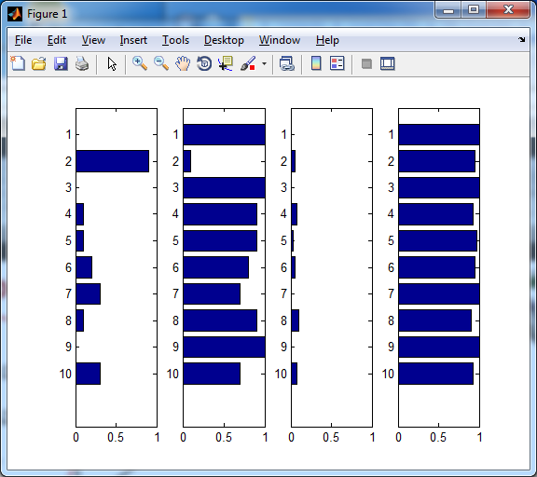
Probability of a Bag given TC k
Pr(b_{n1}єt_{k})
NOISY-OR
Pr(b_{n2}єt_{k})
…
Pr(b_{nI}єt_{k})
For positive bags, at least one Pr(b_{n1}єt_{k}) should be high.
For negative bags, no Pr(b_{n1}єt_{k}) should be high.

Slide 7
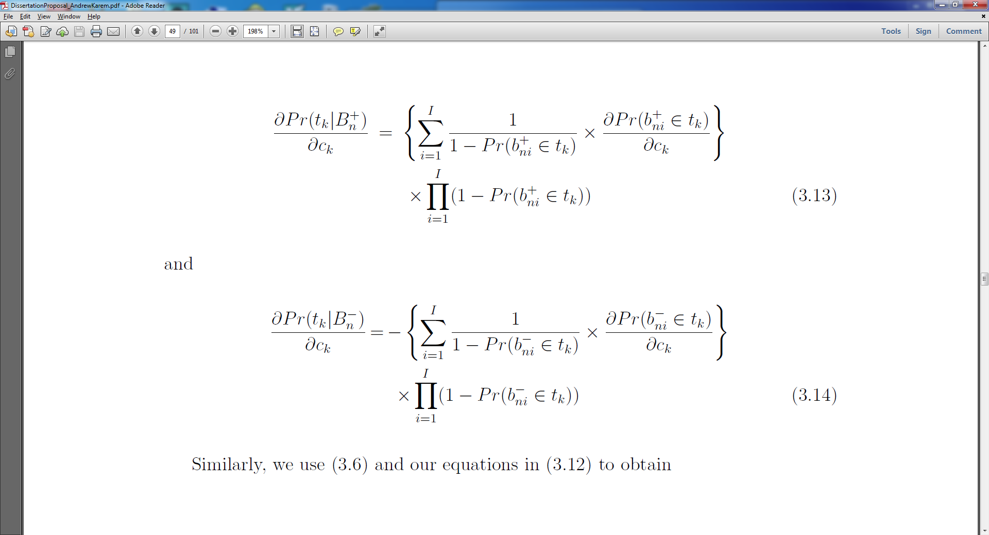
We recall that t_{k} consists of centroid c_{k} and scaling vector s_{k}.

Slide 8
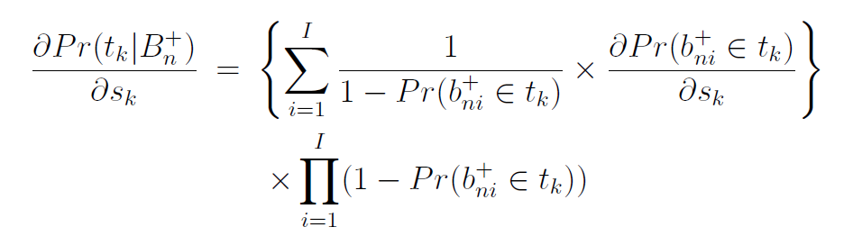
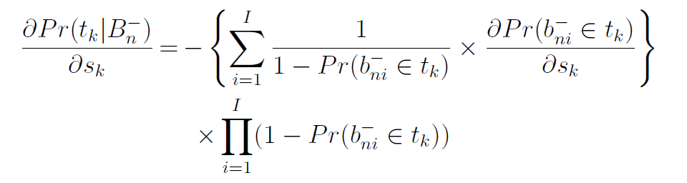

Slide 9
We now have the derivatives necessary to
perform gradient descent to optimize t_{k}.

Slide 10
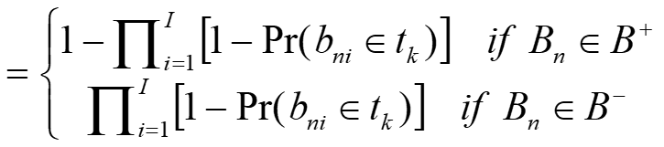



Positive and Negative Bag Memberships
For positive bags, bag probability (and membership) is high when instances are close to TC.
For negative bags, bag probability (and membership) is high when instances are far from TC.
TC
$$u_{kn}=\frac{1}{K}$$
TC

Slide 11
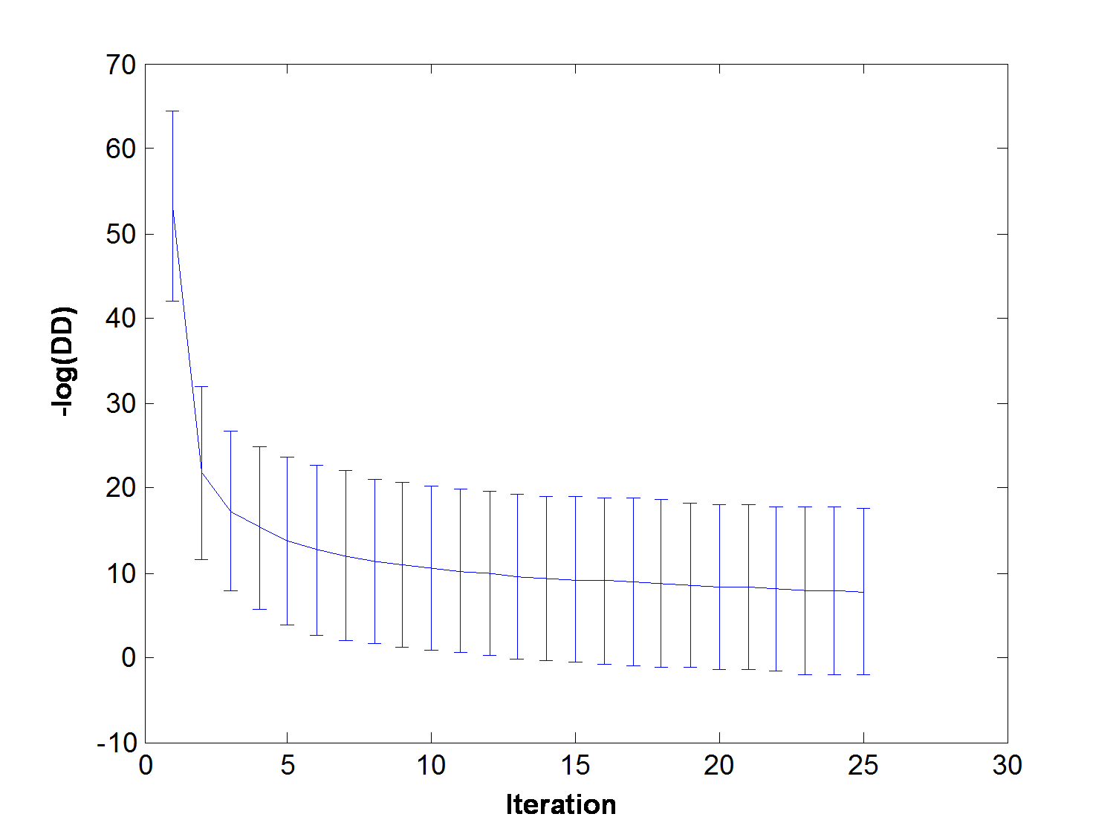
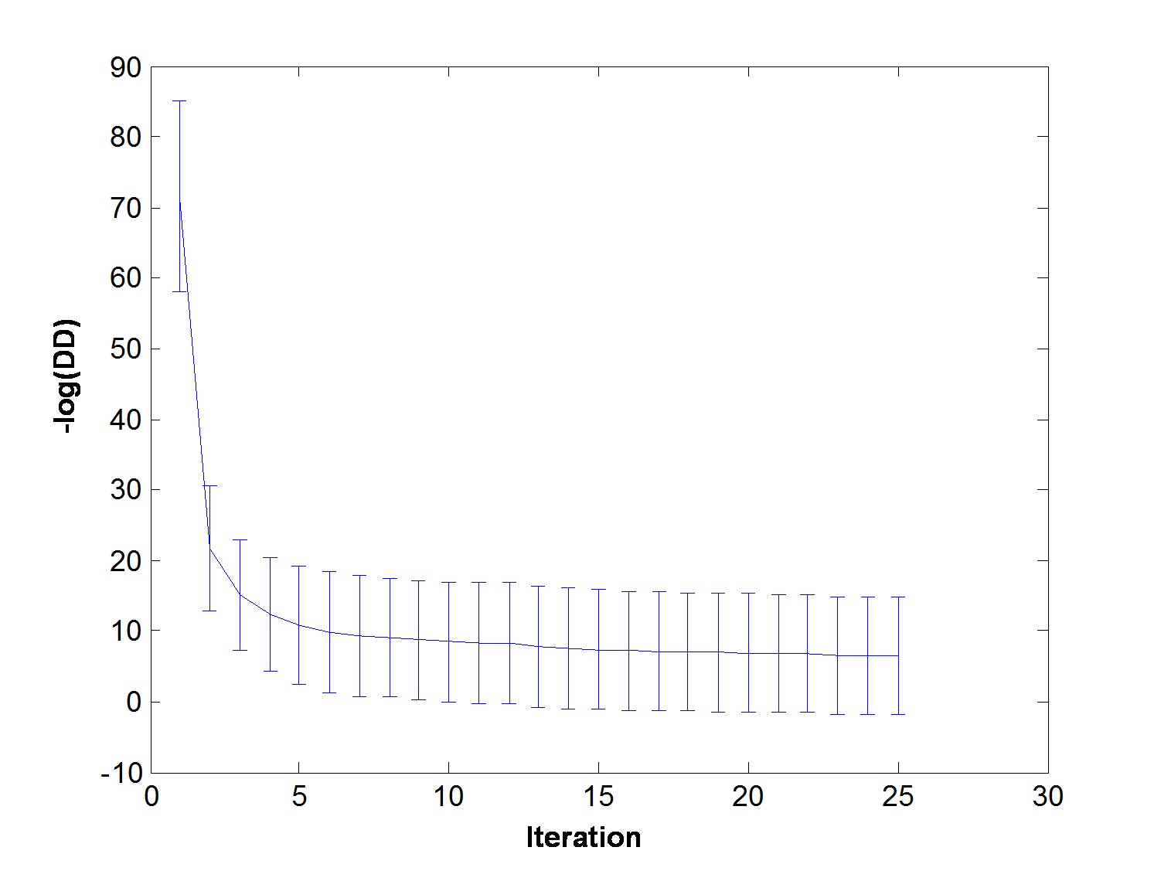
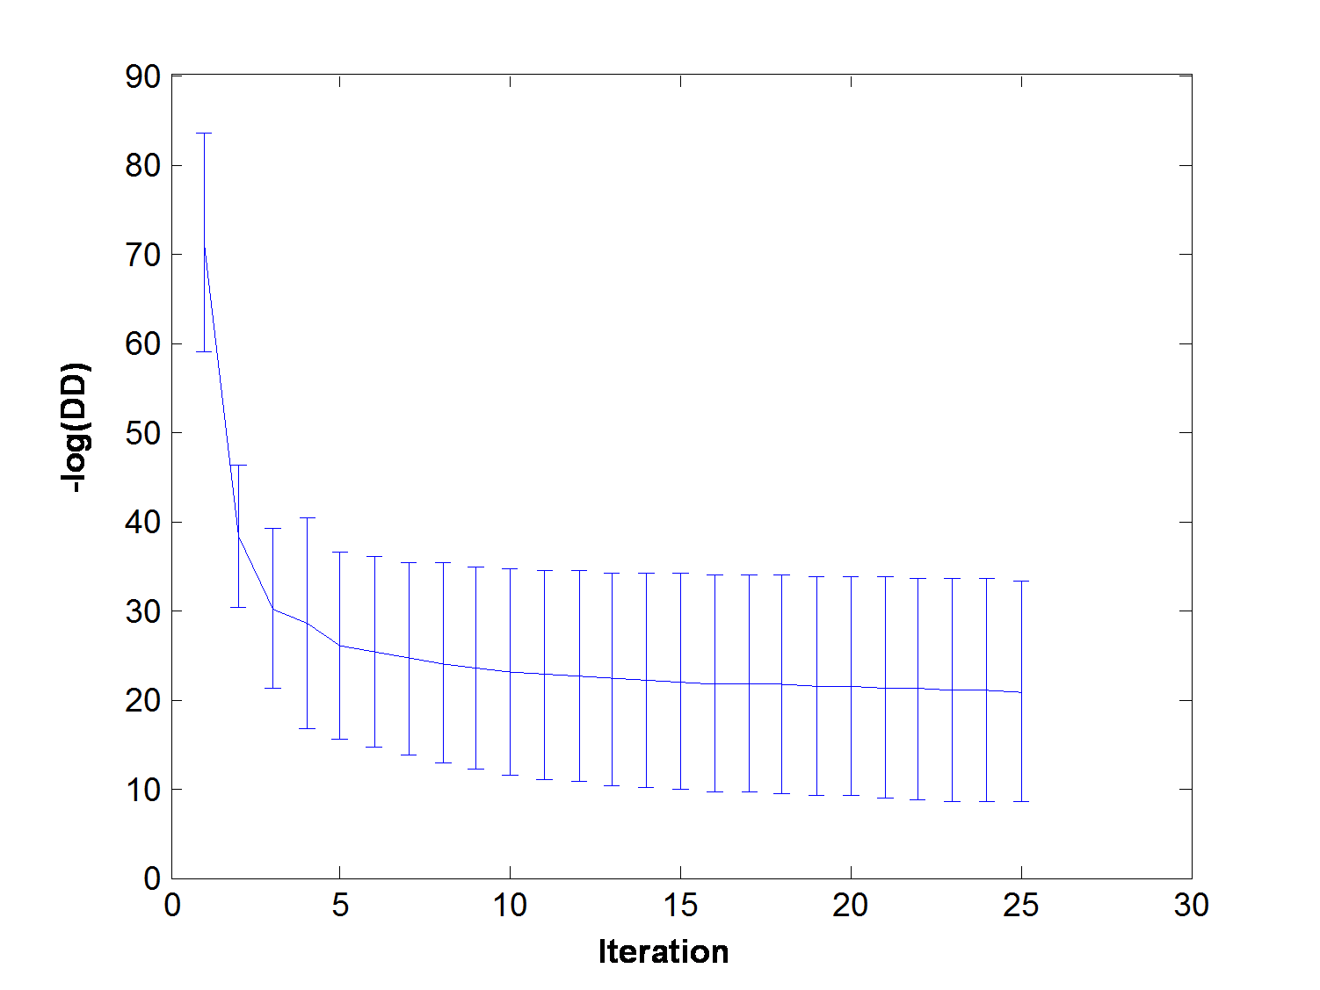
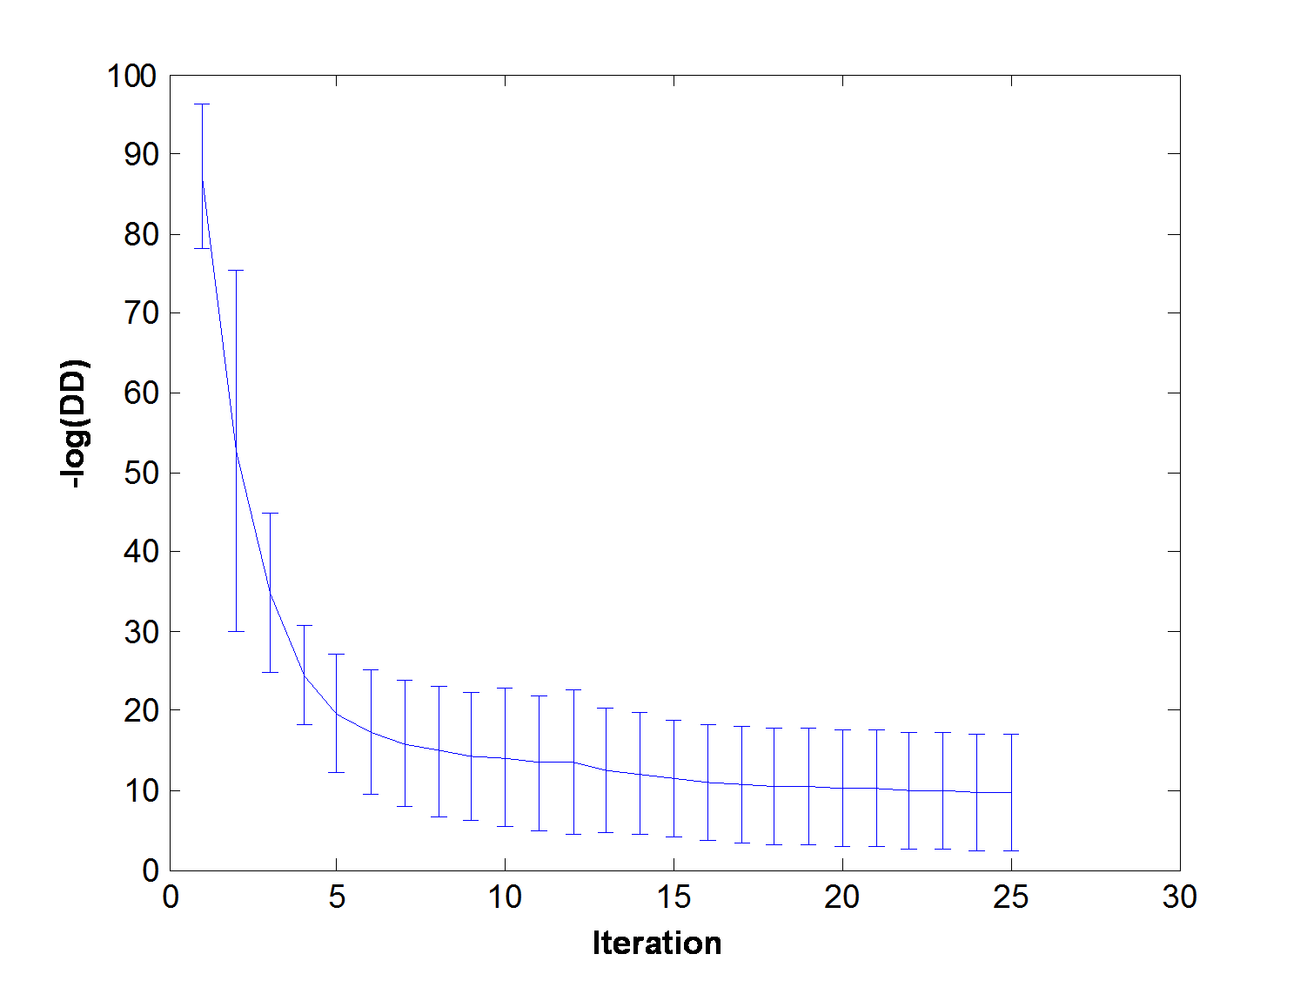
Data-1TC, Data-2TC Objective Functions
DD
FCMI, K=2
FCMI, K=2
FCMI, K=4

Slide 12
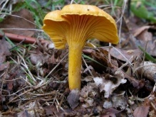
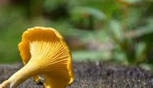
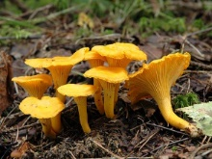
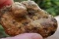
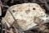

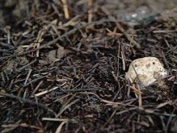
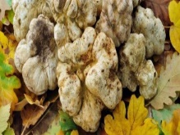

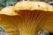
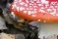



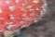
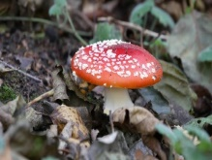
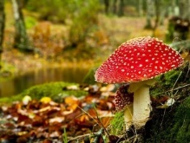

MIL and Within-class Variation
Other Instances
Negative Bag Instances
Feat 2
Feat 1
Target concept t₁
Target concept t₂
Target concept t₃
Notes:
Number of instances may vary.

Slide 13
FCMI Selection Results
 | SelVec Mean | SelVec STD
MUSK1 | 16.5 | 1.7795
MUSK2 | 14 | 1.3333
ELEPHANT | 17.4000 | 0.9661
FOX | 18.3000 | 0.9487
TIGER | 13.2000 | 1.9322
BEO | 19 | 0.6667

