Slide 1
Running ModelSim GUI
- Full-Adder Example Case -
Dynalith Systems
www.Dynalith.com
Oct. 2005.

Slide 2
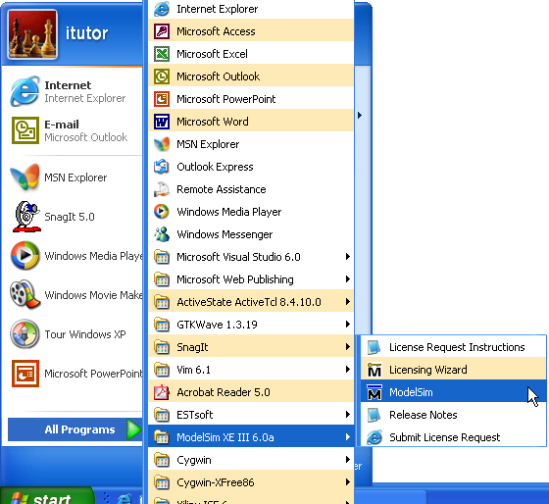

Invoking ModelSim from start menu

Slide 3
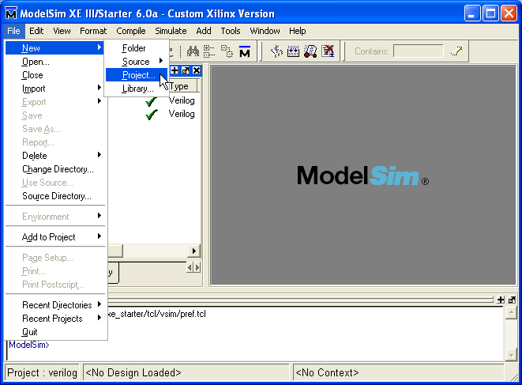
File->New->Project

Slide 4
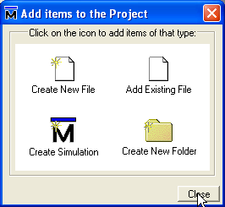
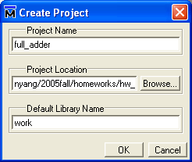
Specify project name and location

Slide 5
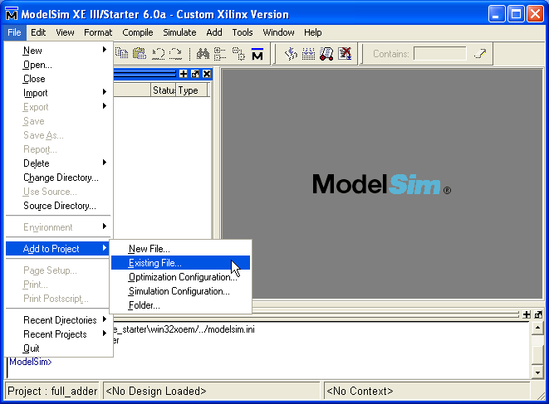
File->Add to Project->Existing File

Slide 6
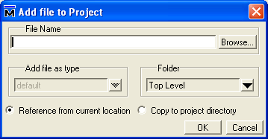
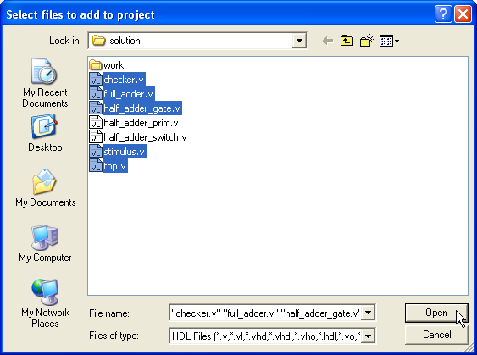
Add files

Slide 7
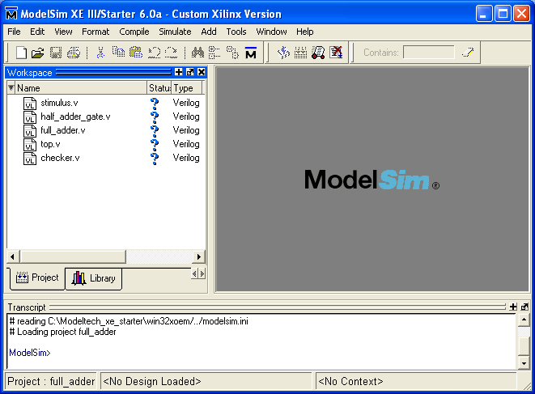
After adding files

Slide 8
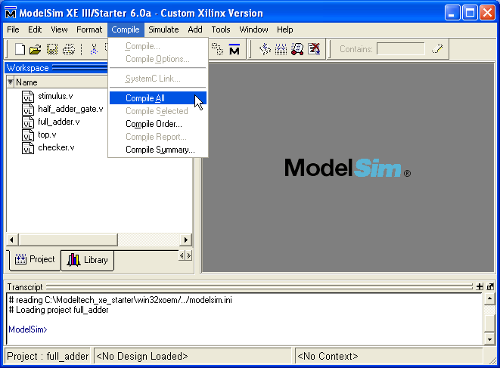
Compile->Compile All

Slide 9

After compilation

Slide 10
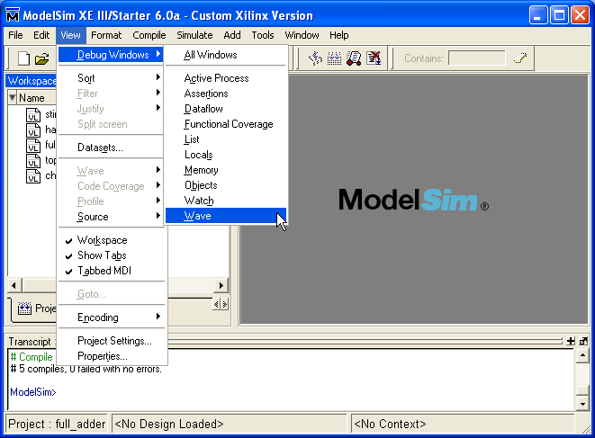
View->Debug Windows->Wave

Slide 11
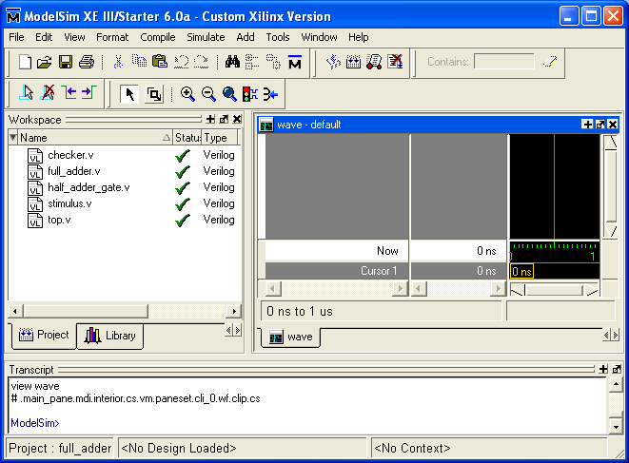
After adding wave window

Slide 12
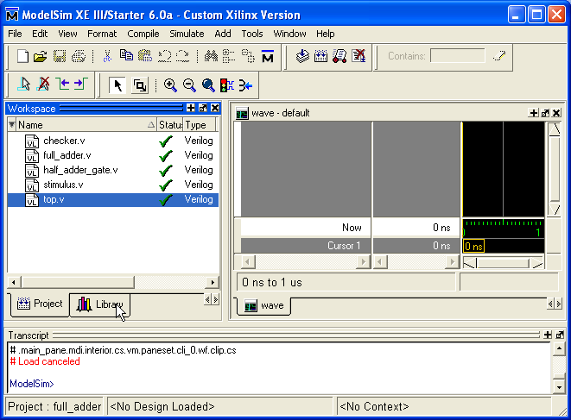
Select Library tab

Slide 13
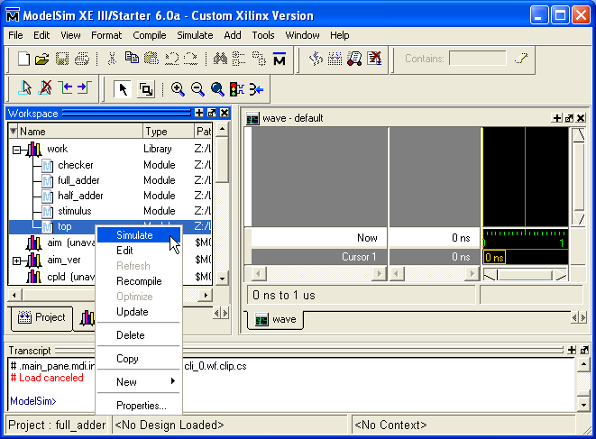
Run simulation with top-level

Slide 14
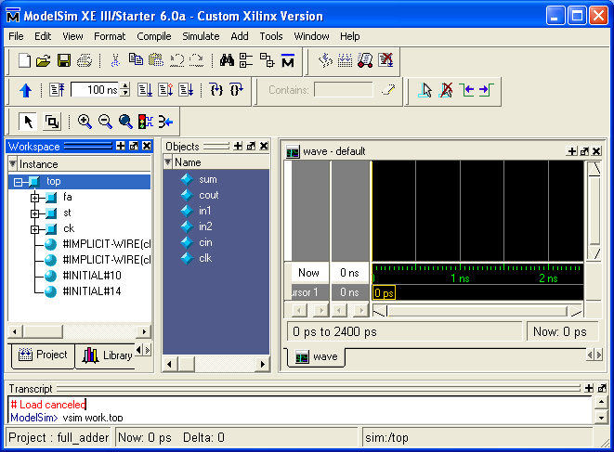
After simulation

Slide 15
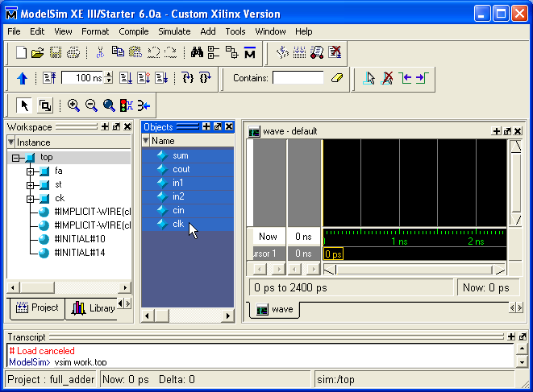
Selecting signals to be view

Slide 16
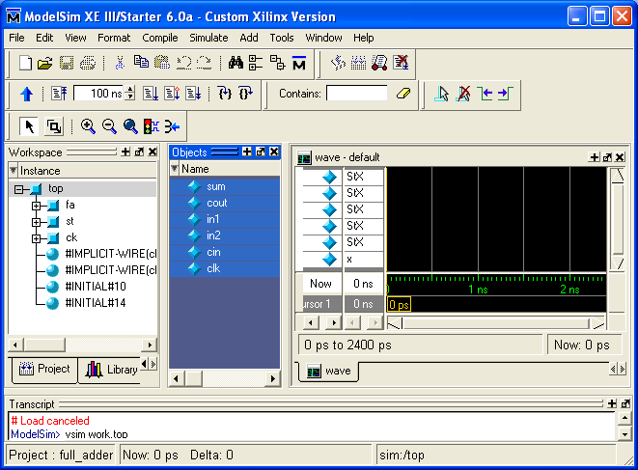
After selection

Slide 17
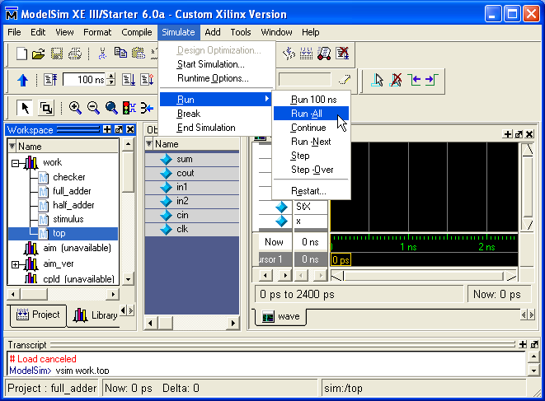

Slide 18
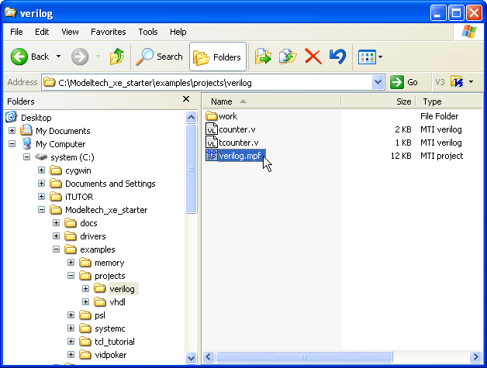
Invoke ModelSim project (2/9)

Slide 19
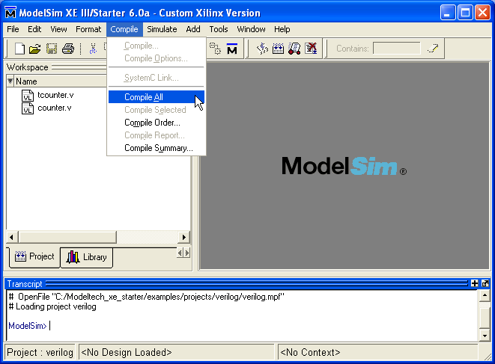
Compile (3/9)

Slide 20
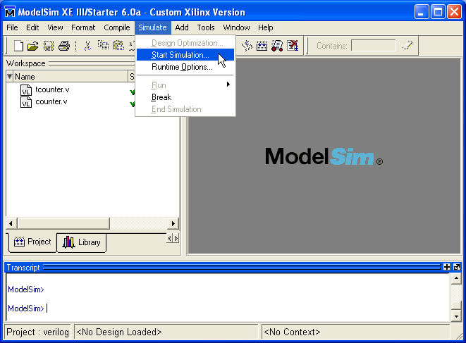
Start simulation (4/9)

Slide 21
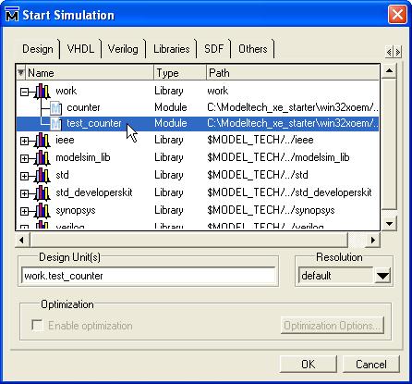
Select top-level (5/9)

Slide 22
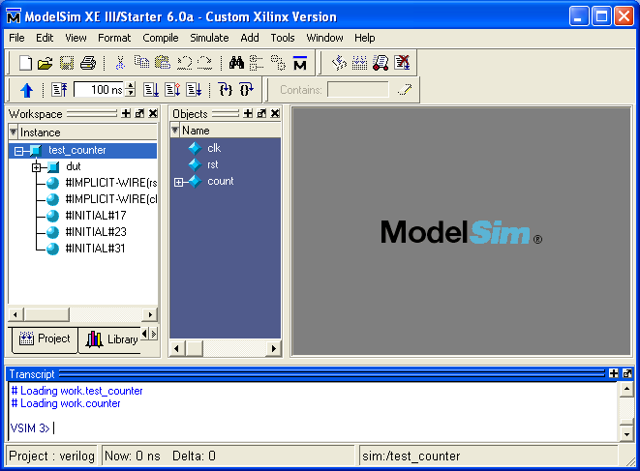
After simulation (6/9)

Slide 23
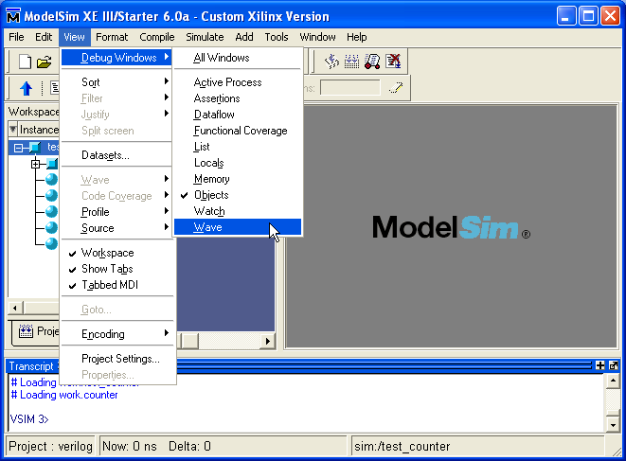
Activate waveform window (7/9)

Slide 24
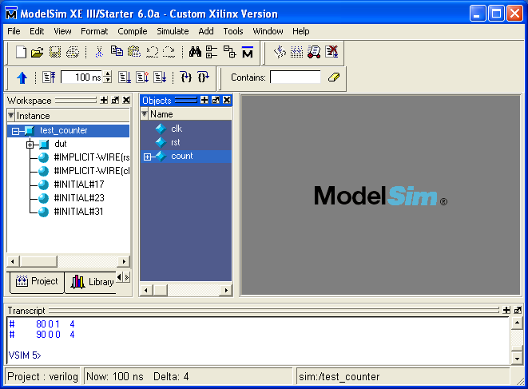
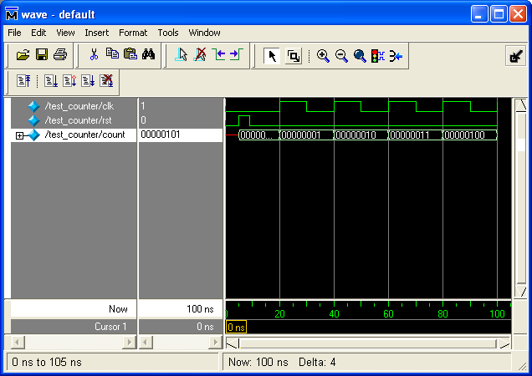
Display waveform (8/9)

Slide 25
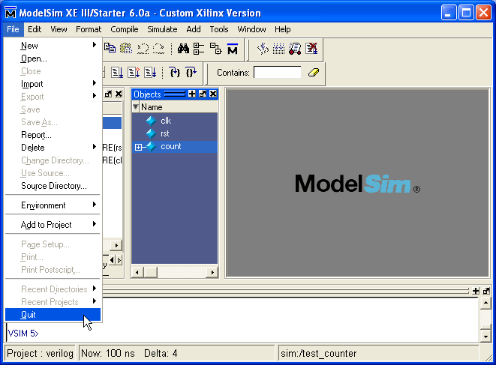
Exiting ModelSim (9/9)

Slide 26

Invoking ModelSim from desktop icon

Slide 27
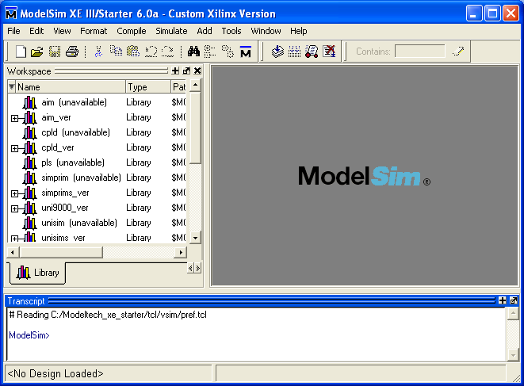
ModelSim

Slide 28

This slide is prepared by Ando Ki in the hope that it will be useful to understand iPROVE/iTUTOR related products, but WITHOUT ANY WARRANTY.

