Slide 1
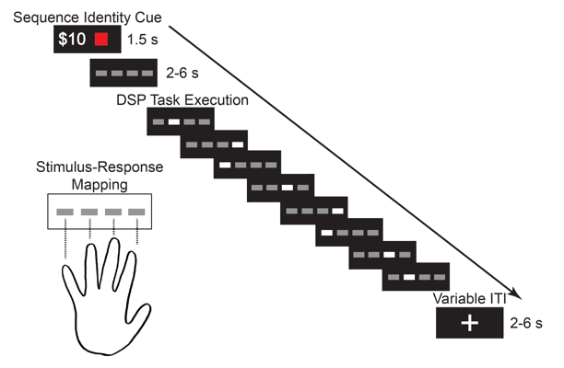
Warm-up
Random sequences
No incentives
Training
Cued sequences
Incentives (+/- $5, $10, $30)
Rest
24 hrs
Retention Test
Cued and random
No incentives
Reward
N = 32
Punishment
N = 32
Control
N = 29

