Slide 1
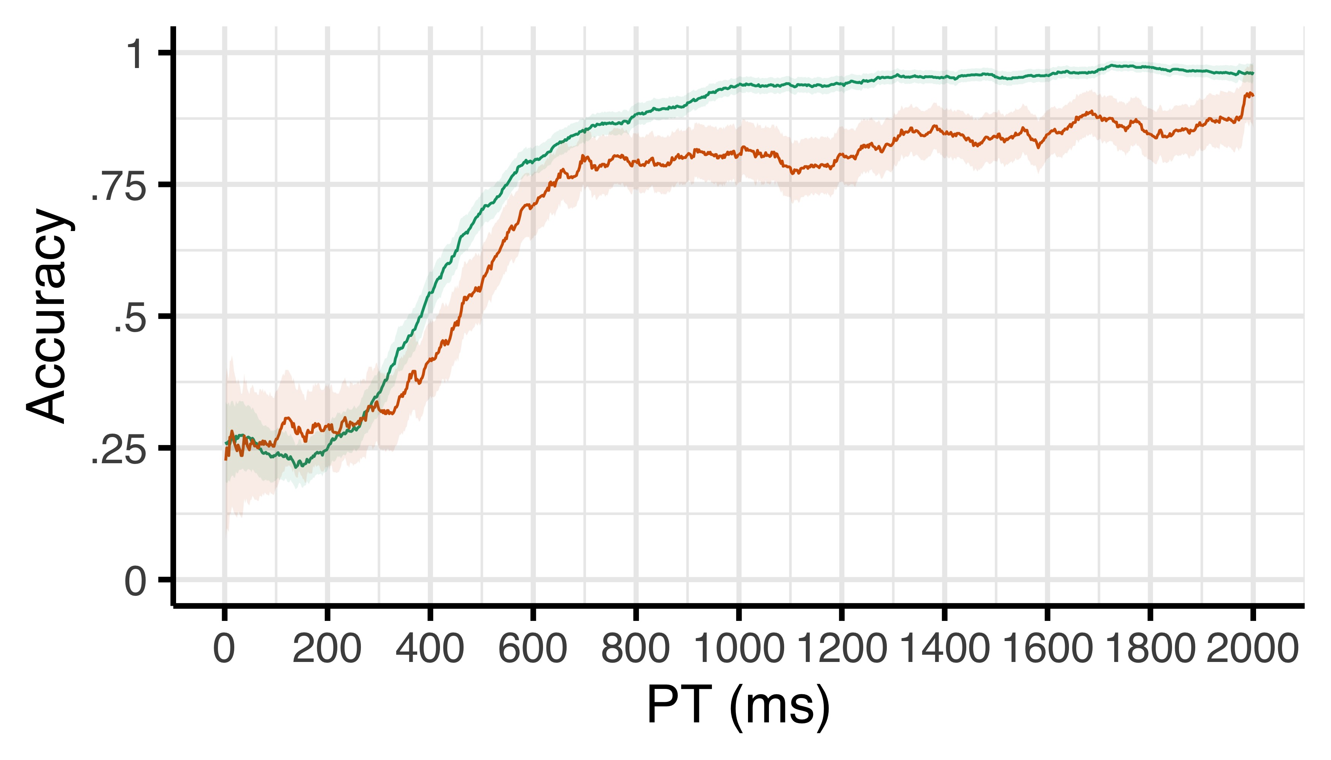
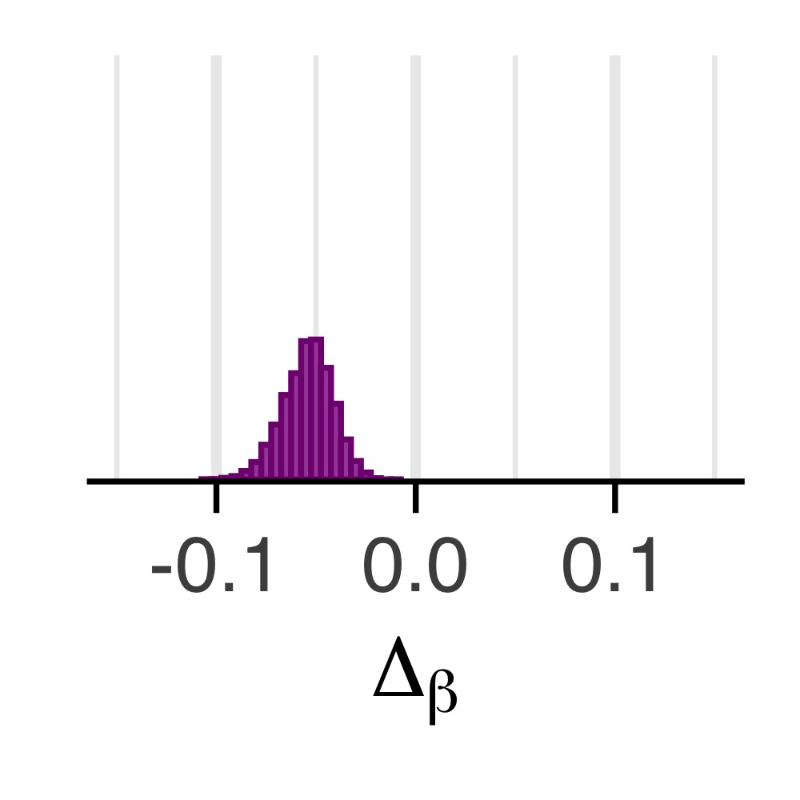
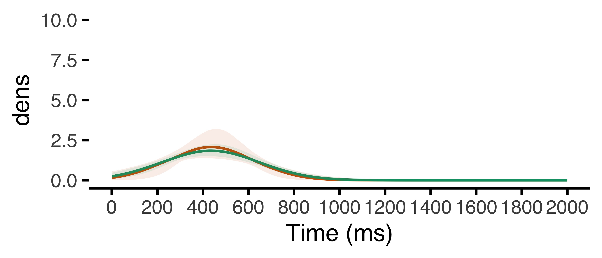
a
After correct
After error
Chance
b
c
Δ Efficacy (β)
Speed (μ)
Density
Noise (σ)

