Slide 1

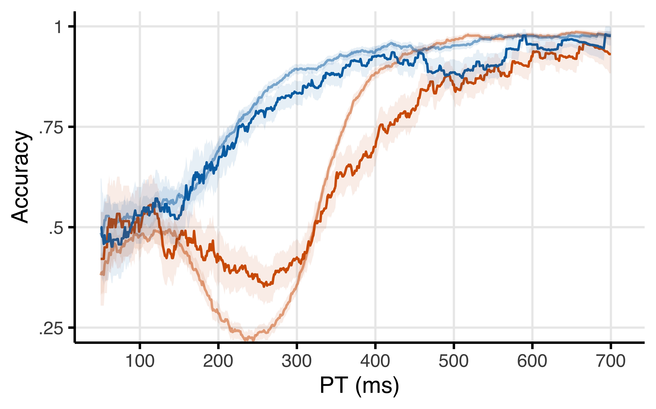
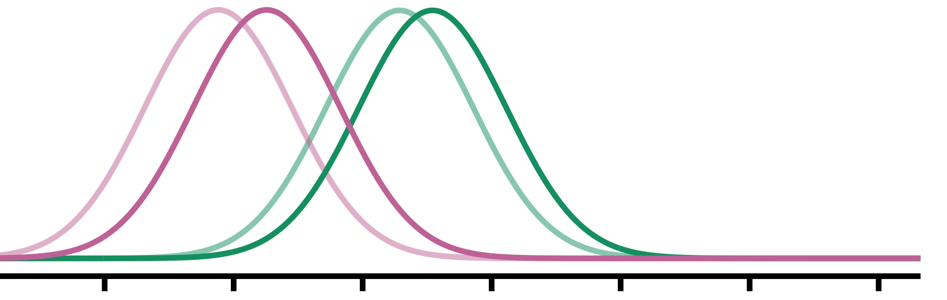
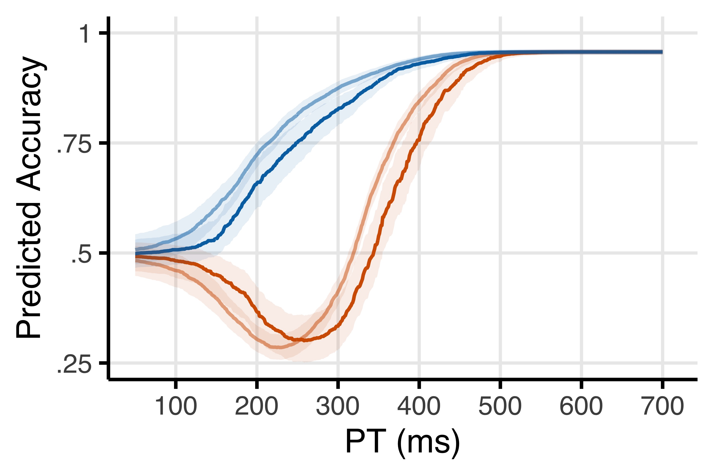


a
b
Mapping
$$Δμh$$
$$Δμg$$
habit
goal
0
Previous Error
1
c
Congruency
c
i
0
Previous Error
1

