Slide 1
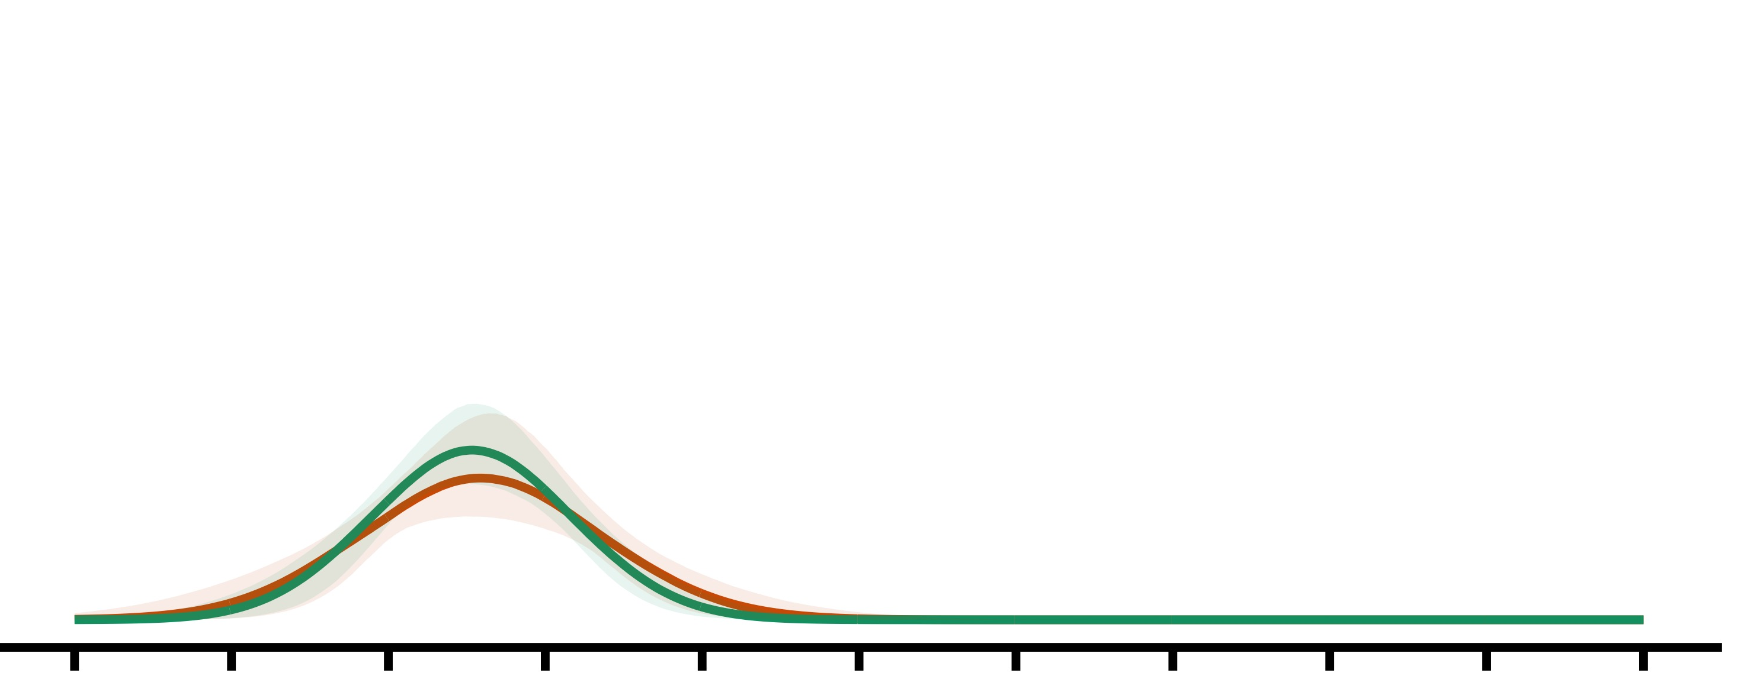
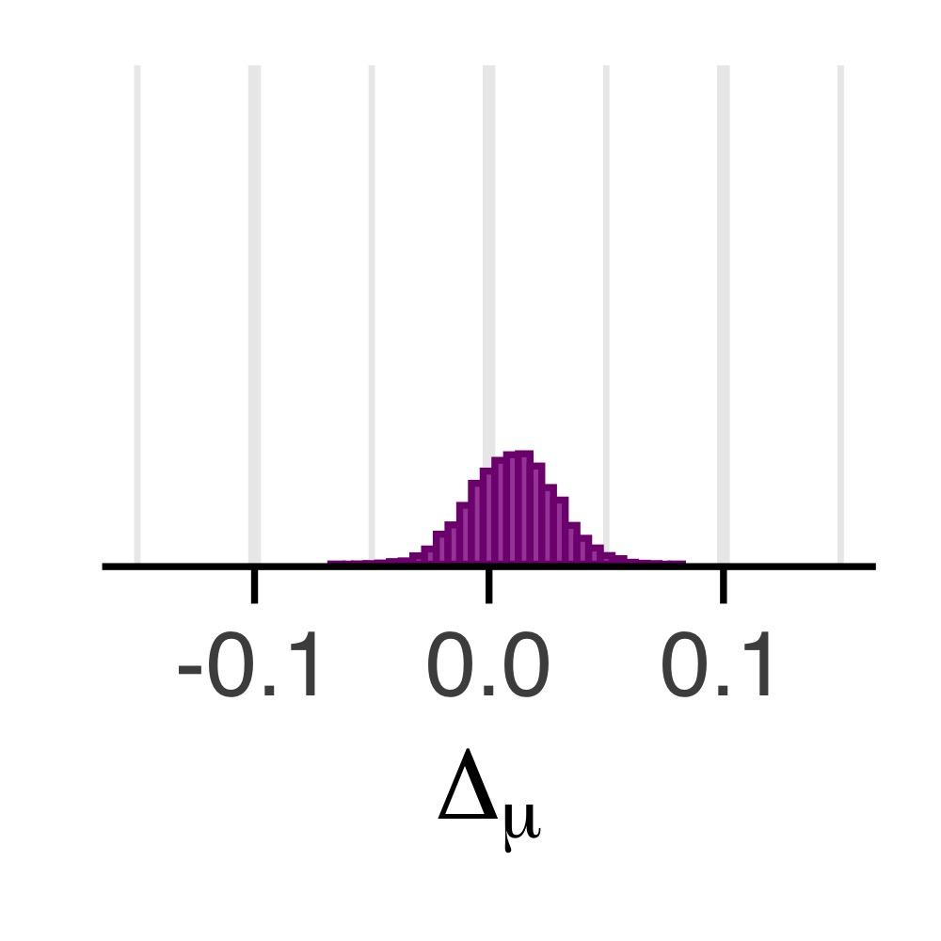
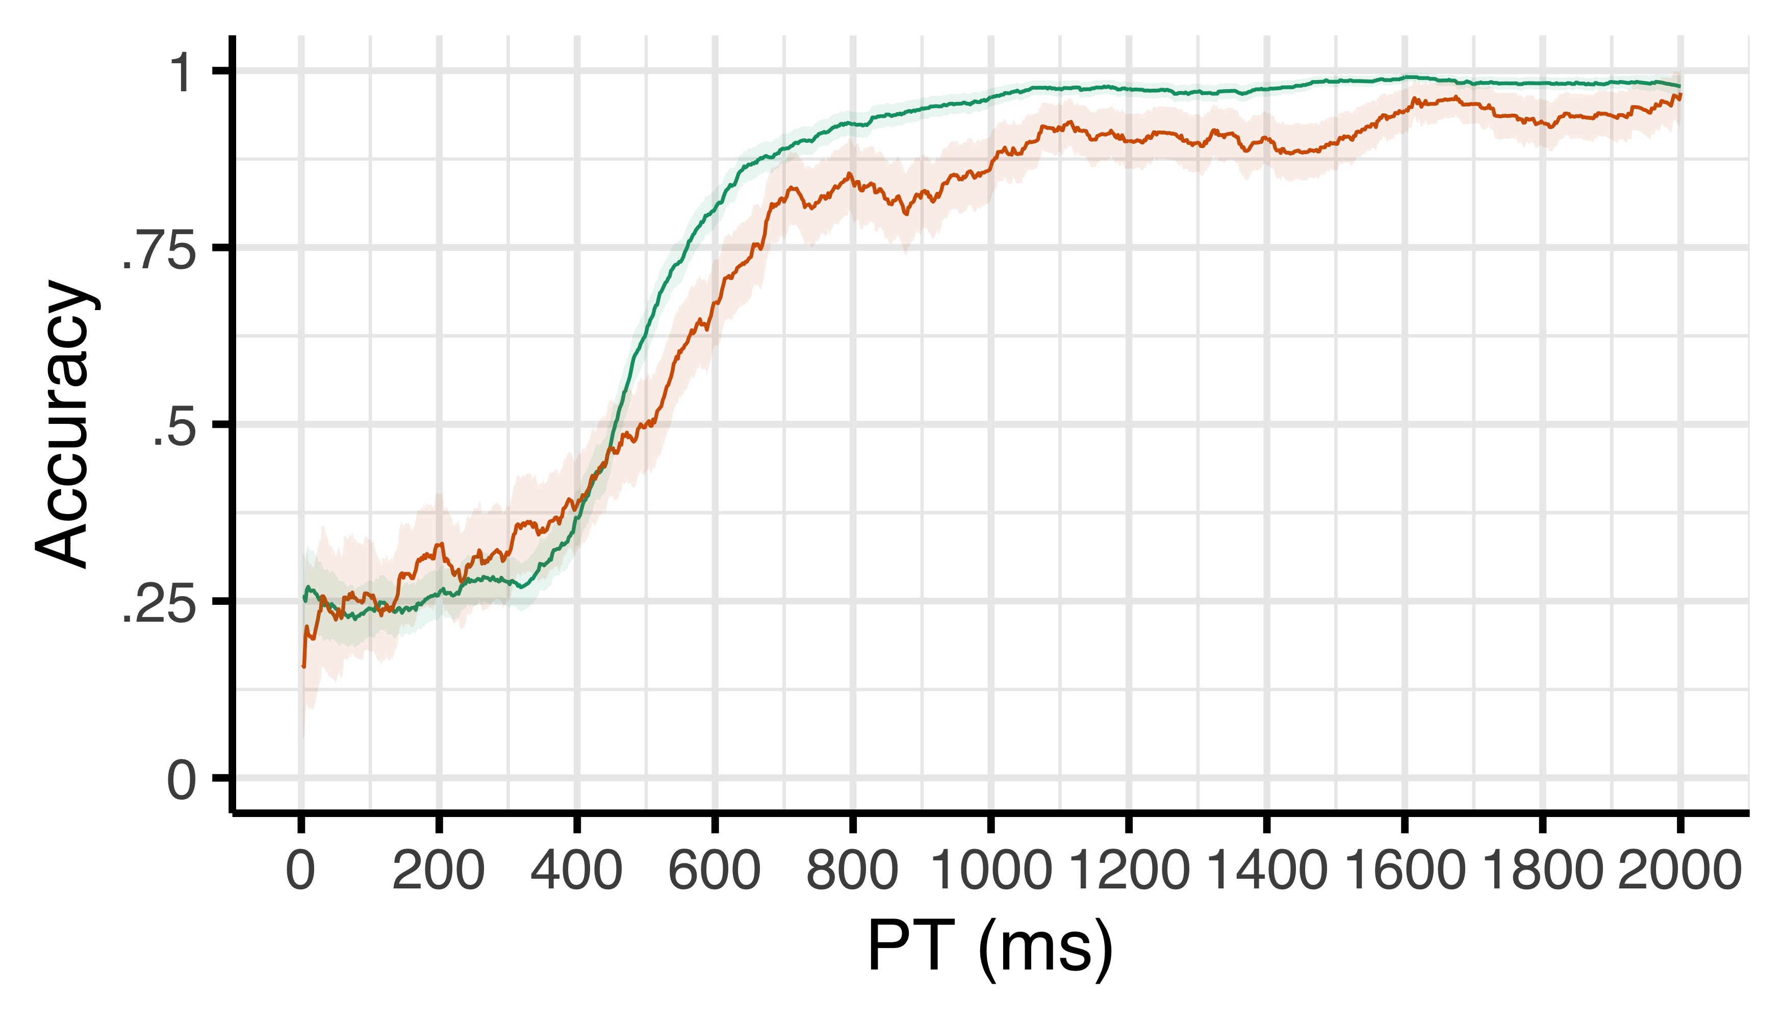
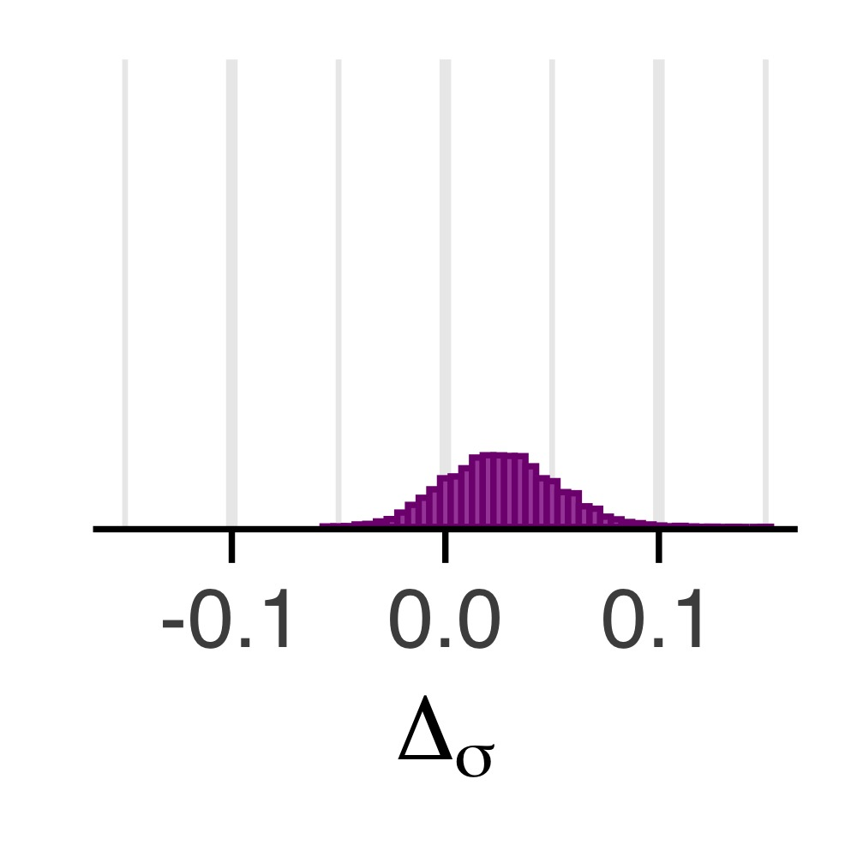
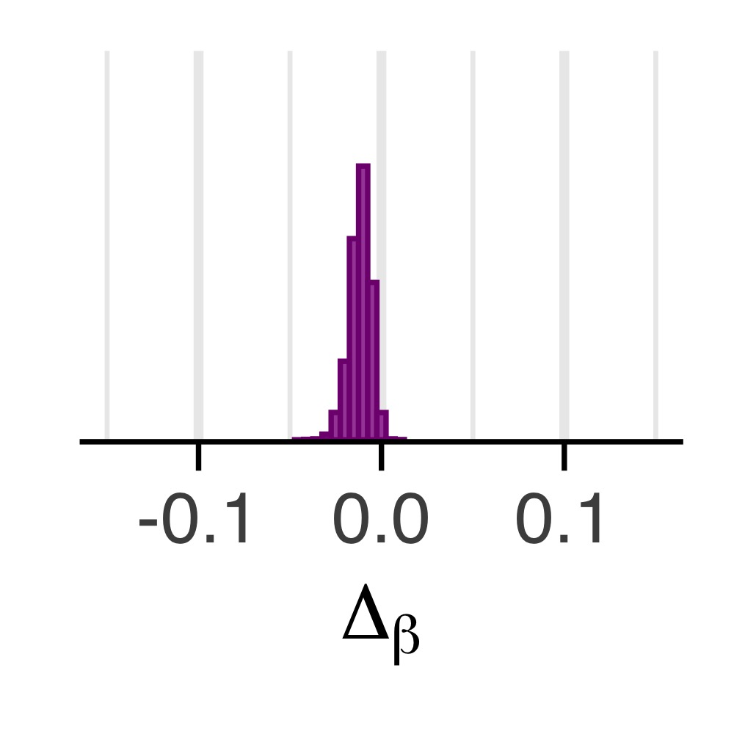
a
c
M_{diff} = .01; pd = .71
Density
Speed (μ)
After correct
After error
Noise (σ)
d
b
M_{diff} = .03; pd = .84
Efficacy (β)
e
M_{diff} = -.01; pd = .99
Chance

