Slide 1
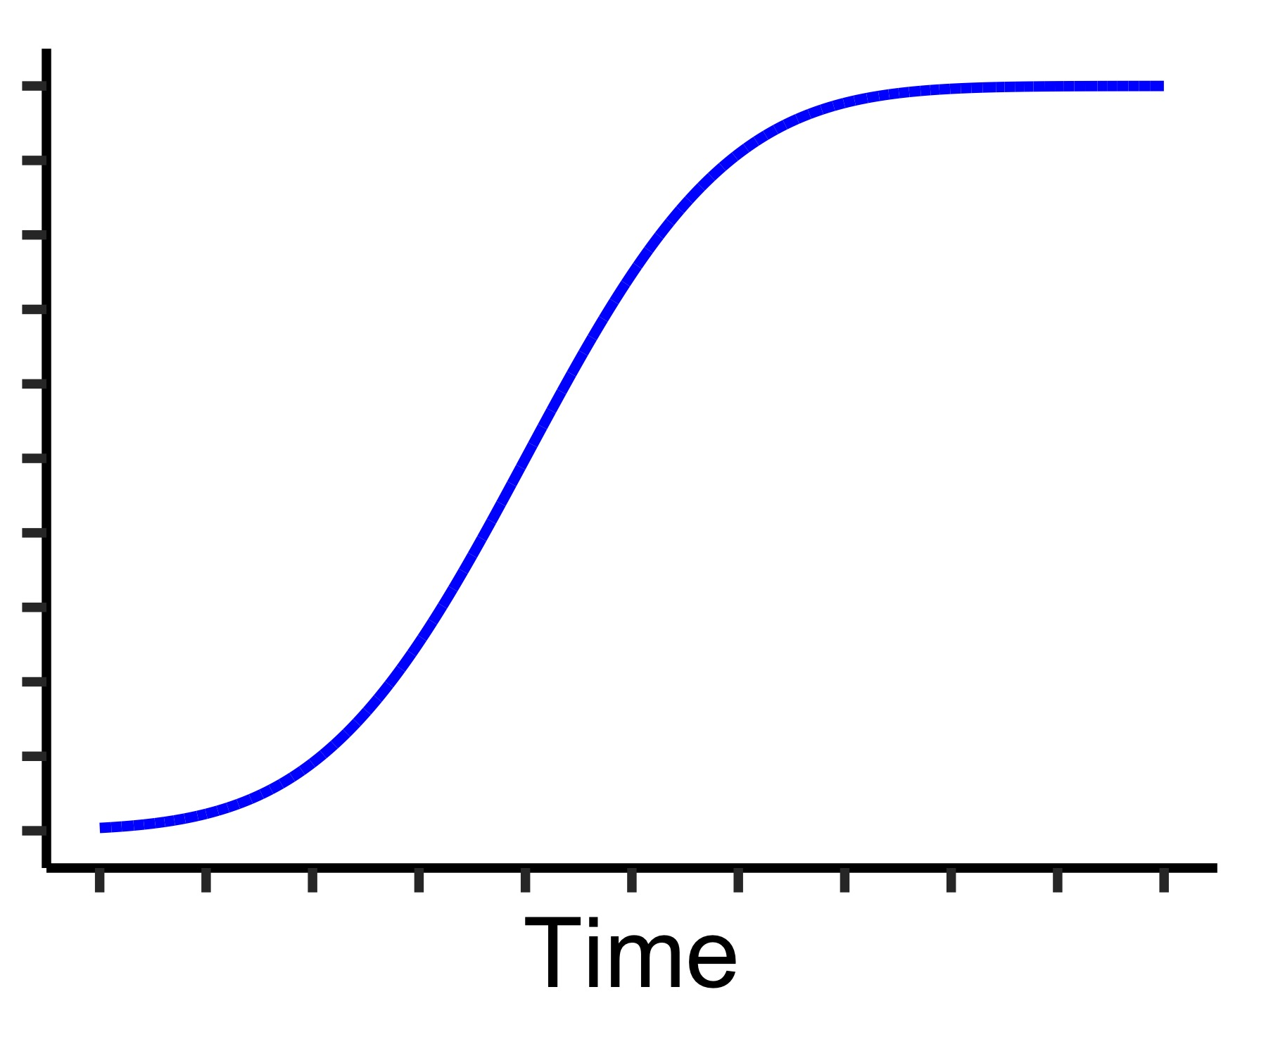
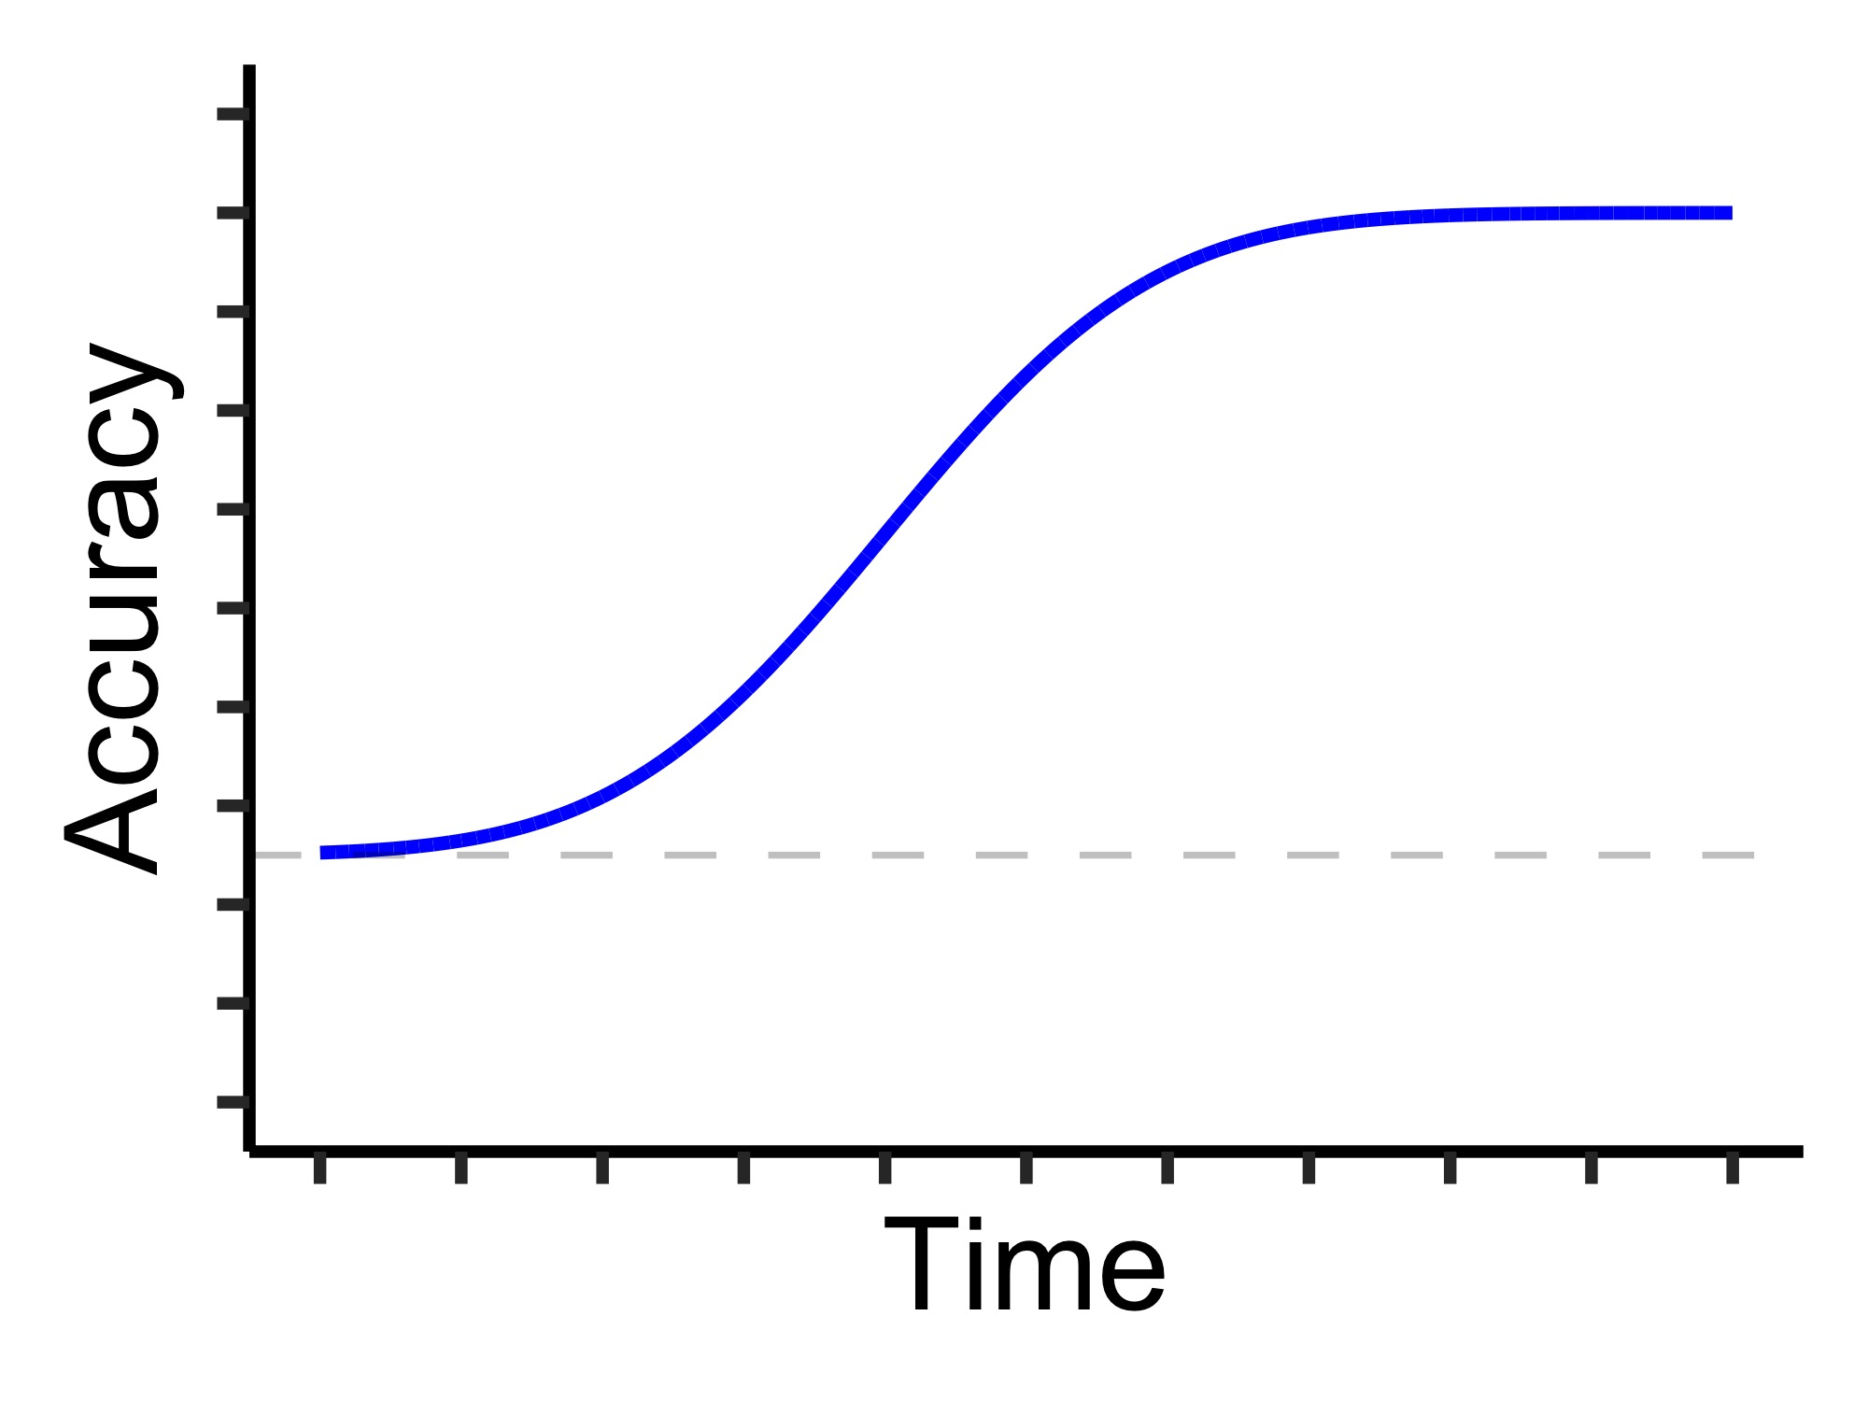
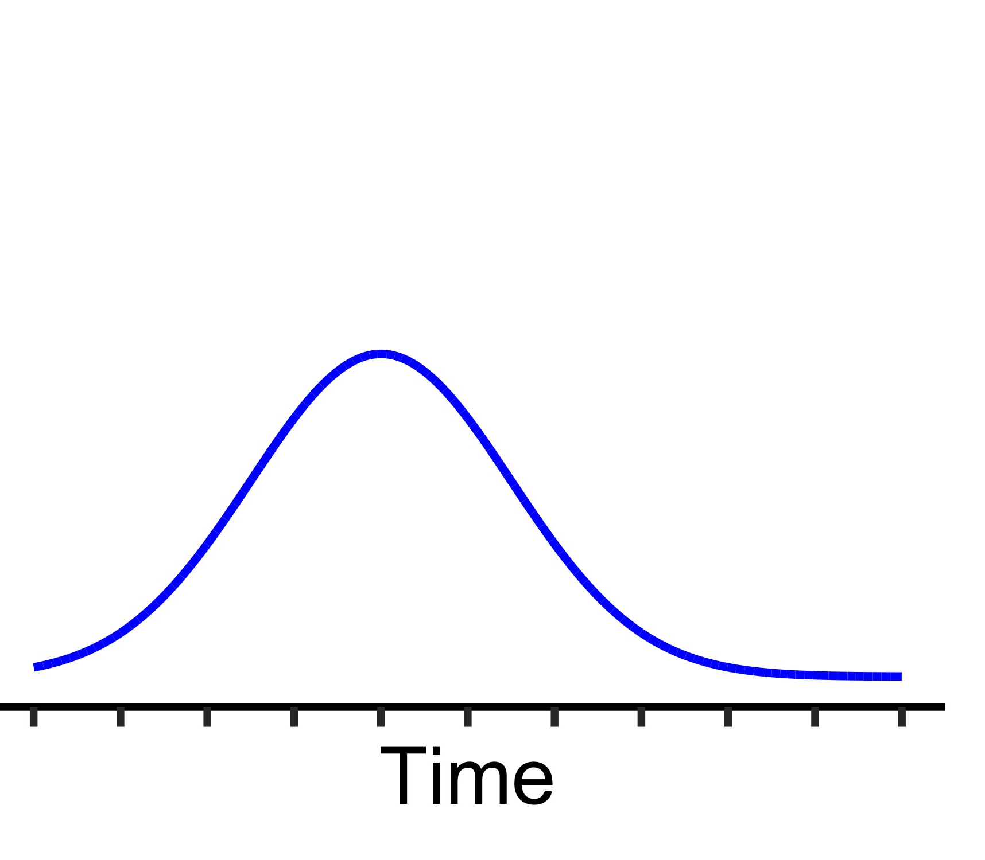
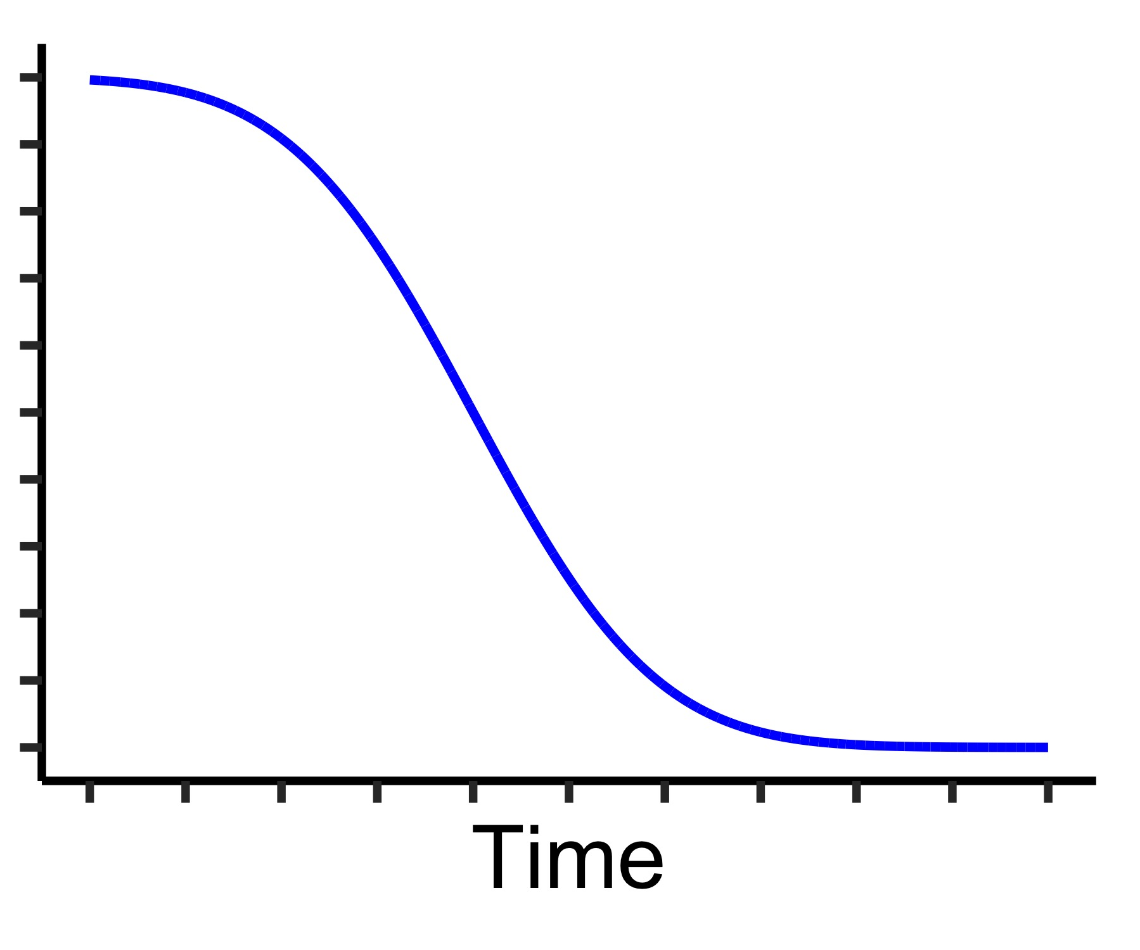

A
B
Forced Response
Stimulus-response task
RT Cue
Ռ
Ճ
Չ
Ջ
Stimulus
f
g
h
j
500ms
"
"
"
Response
PT
C
β: P(correct | ready), “efficacy”
Response preparation model
P(ready)
$$×$$
Normal(μ, σ)
$$+$$
P(not ready)
$$×$$
α: P(correct | not ready)

