Slide 1
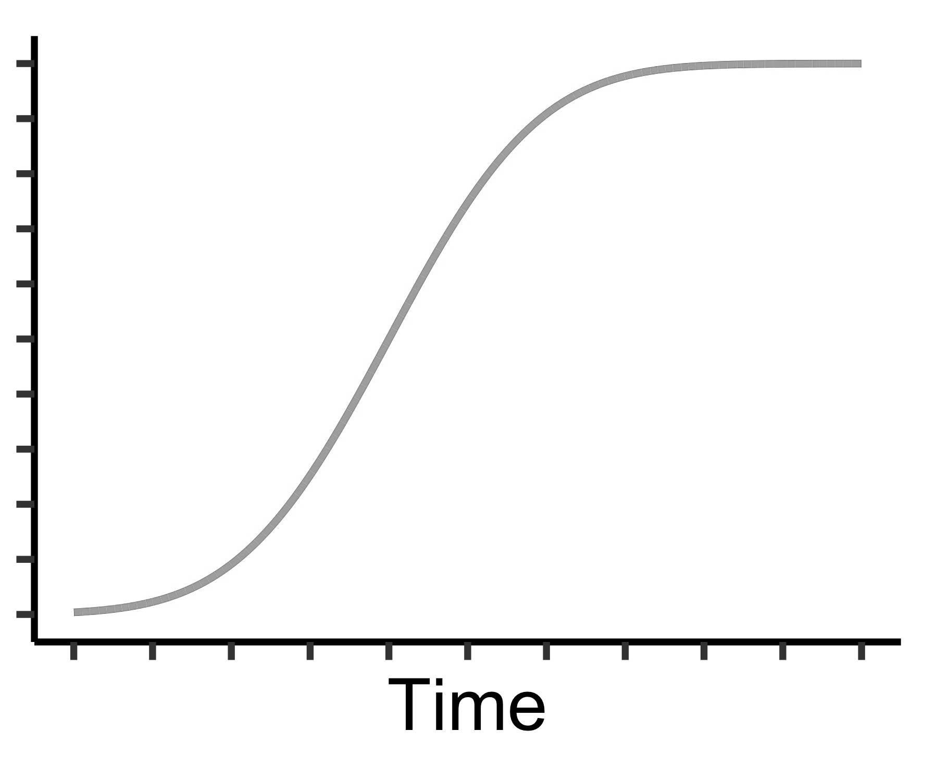
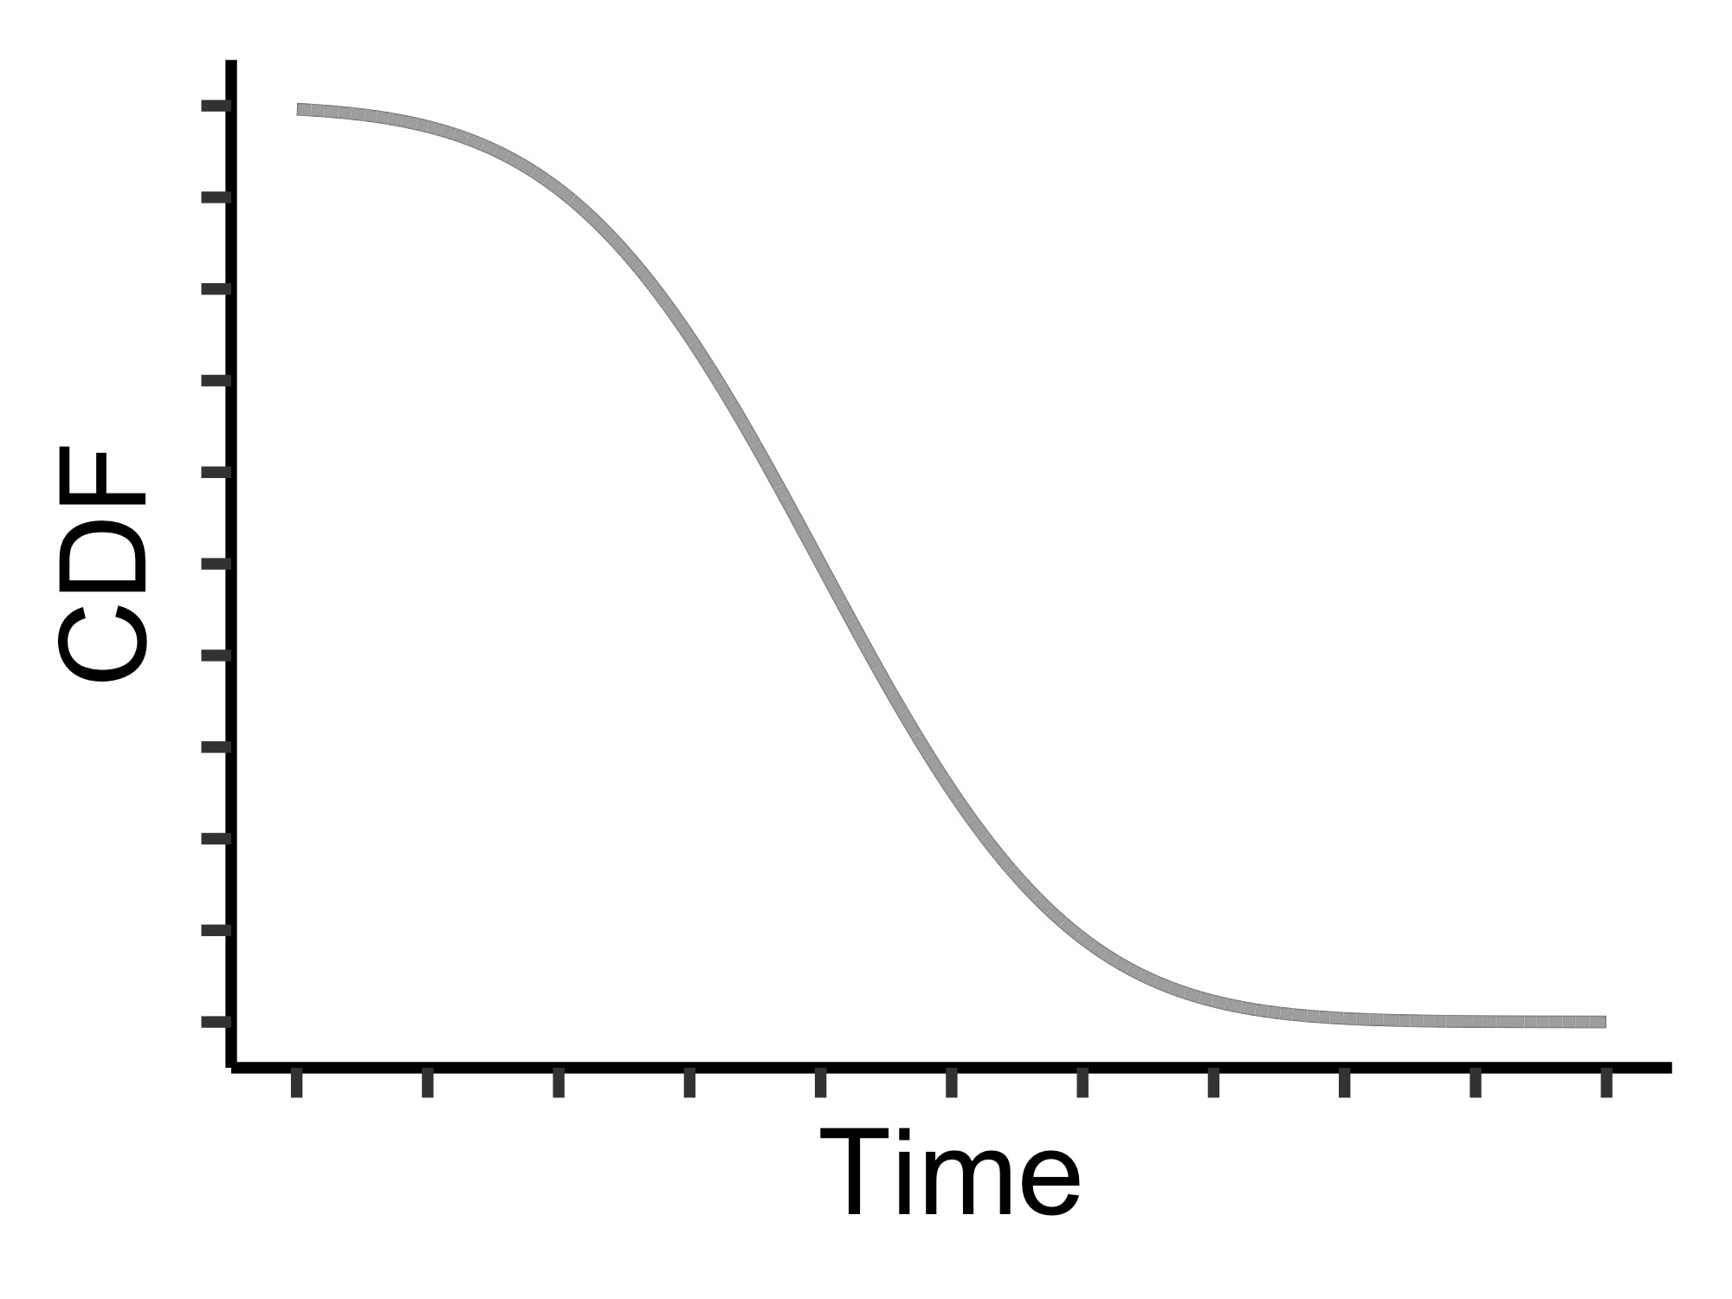
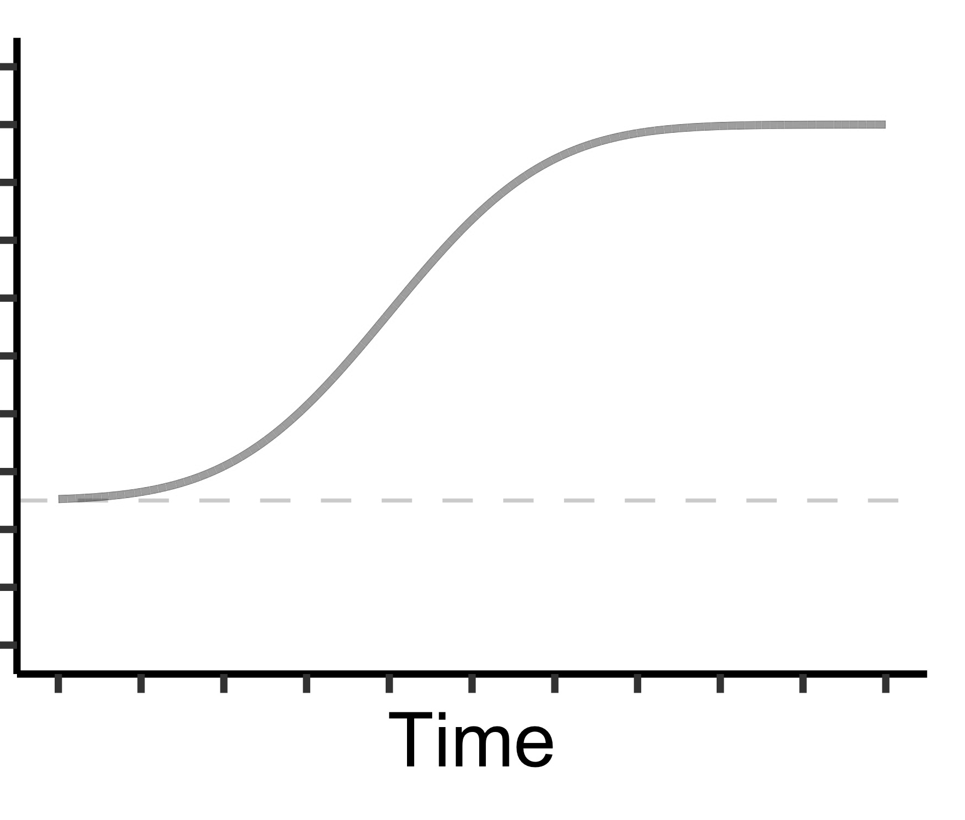
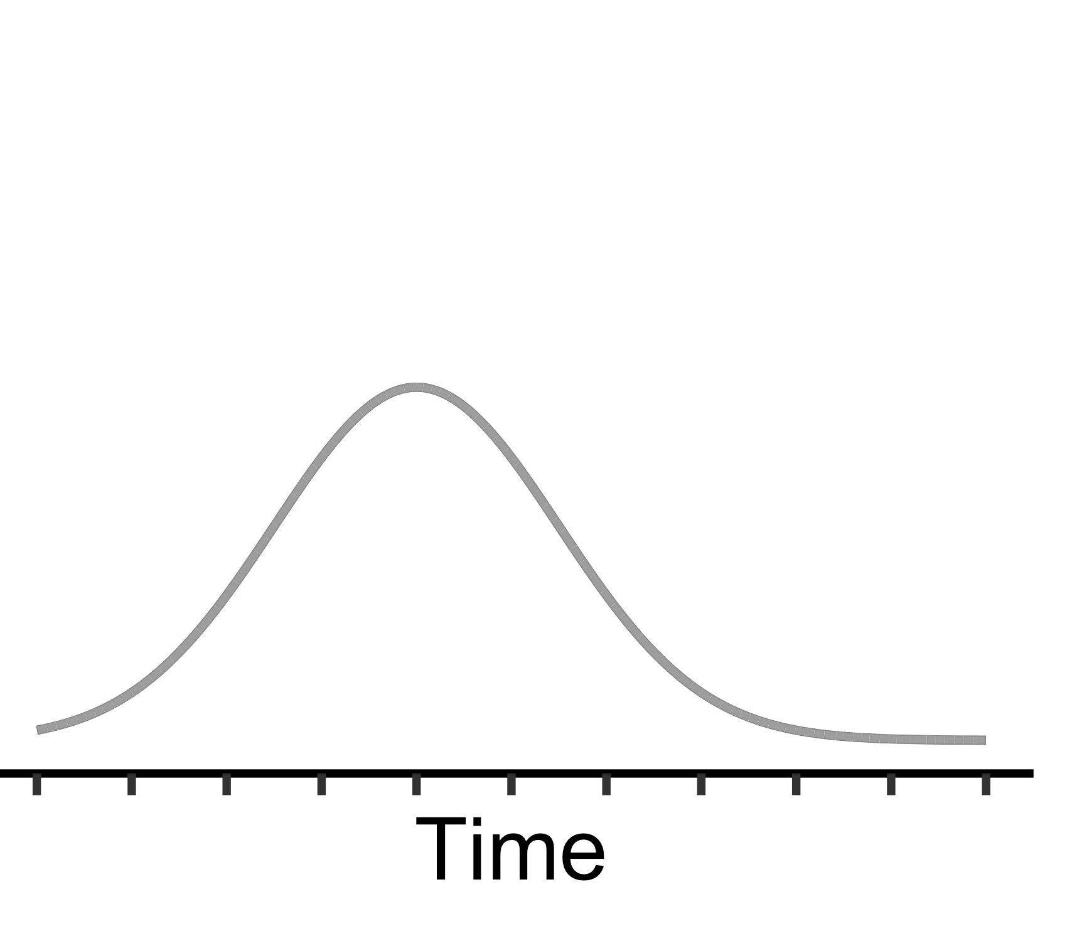

A
B
Forced Response
Stimulus-response task
RT Cue
Ռ
Ճ
Չ
Ջ
Stimulus
f
g
h
j
500ms
"
"
"
Response
processing time
C
1
1
Response preparation model
β
P(correct | ready)
1
P(ready)
Normal(μ, σ)
0
0
P(correct)
1
1
P(not ready)
P(correct | not ready)
0
α
0
0
1. Get CDFs
2. Multiply by weights
3. Sum products

