Slide 1
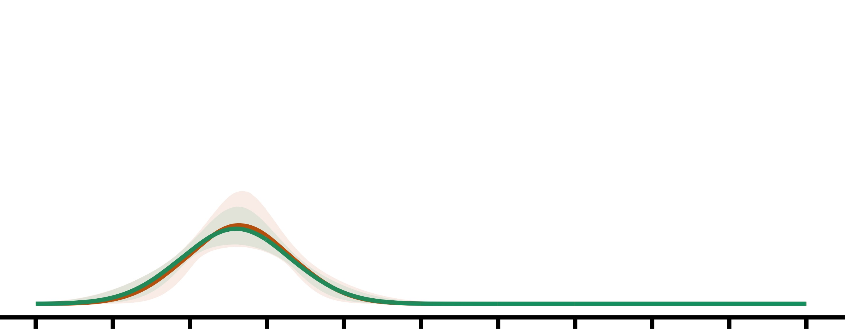
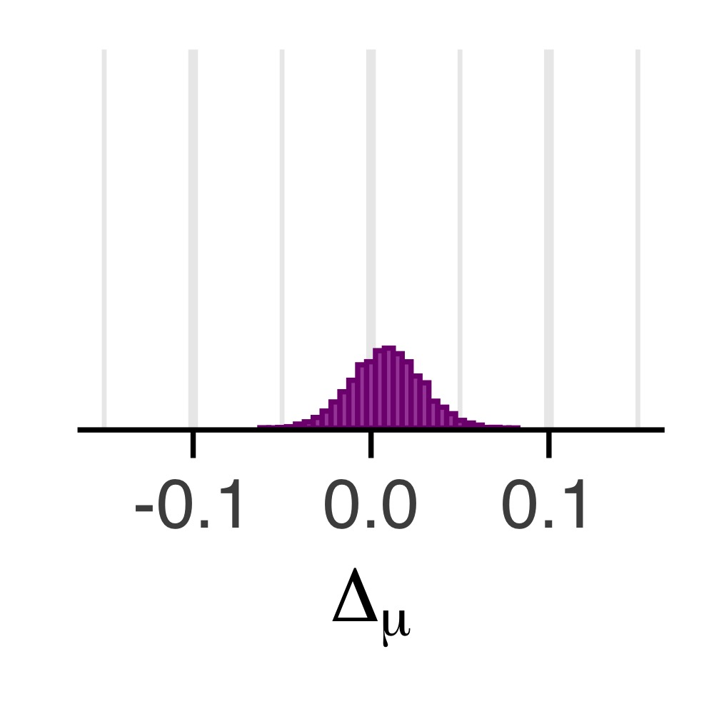
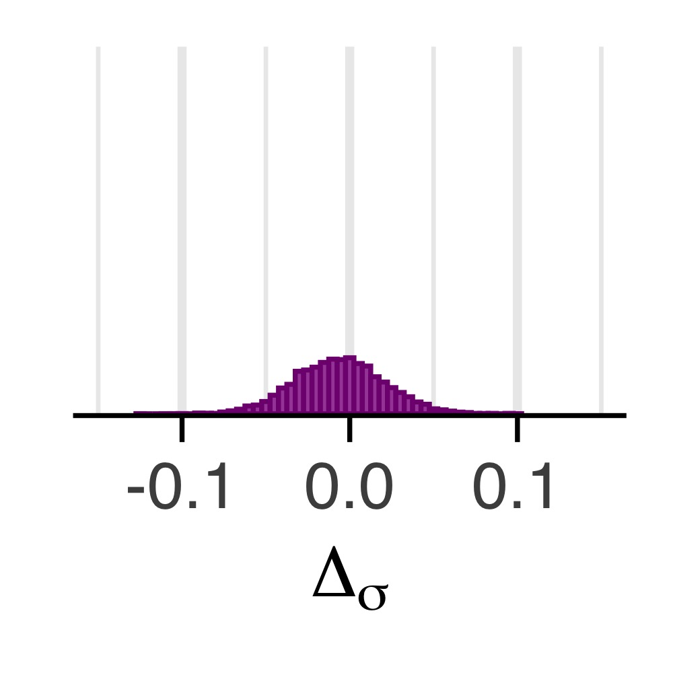
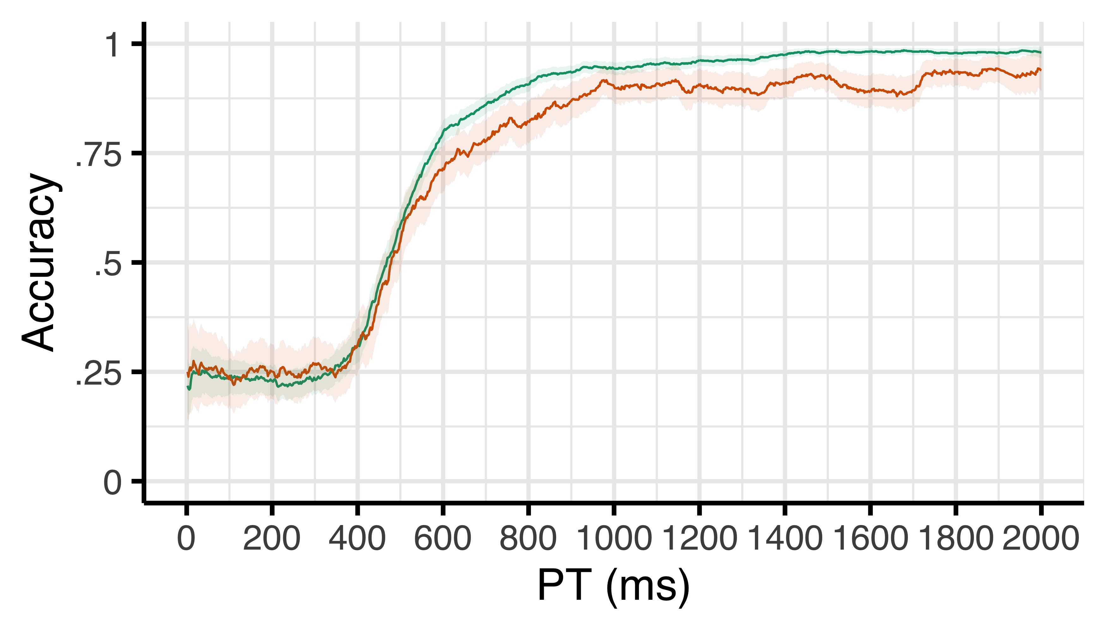
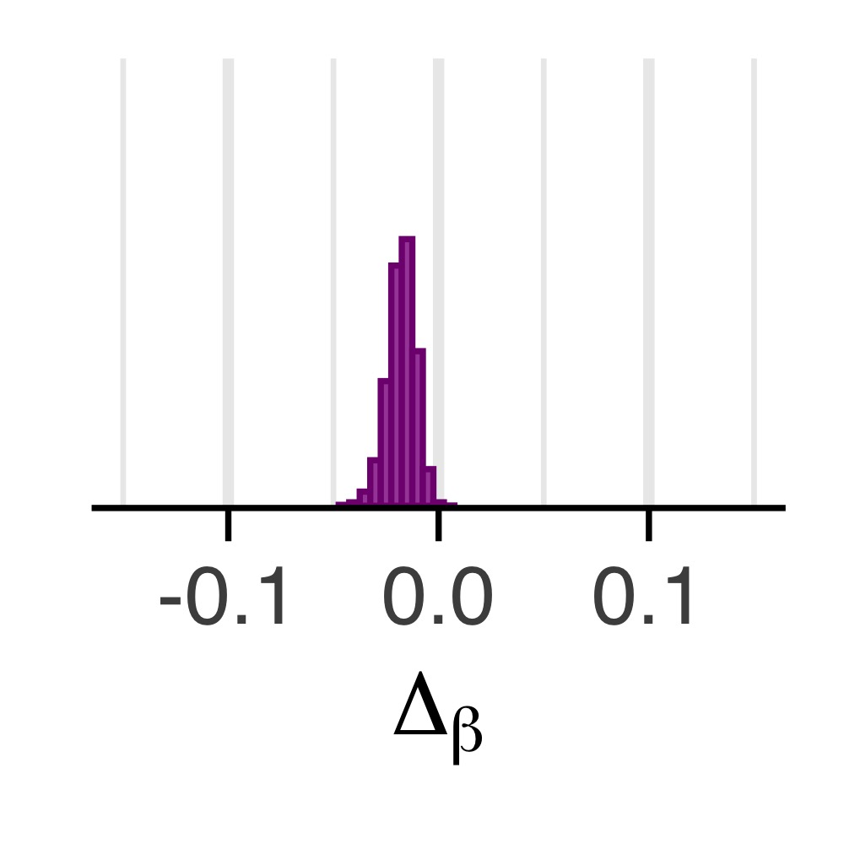
a
c
M_{diff} = .01; pd = .68
Speed (μ)
Density
After correct
After error
Noise (σ)
d
b
M_{diff} = -.01; pd = .59
Efficacy (β)
e
M_{diff} = -.02; pd = .999
Chance

