Slide 1
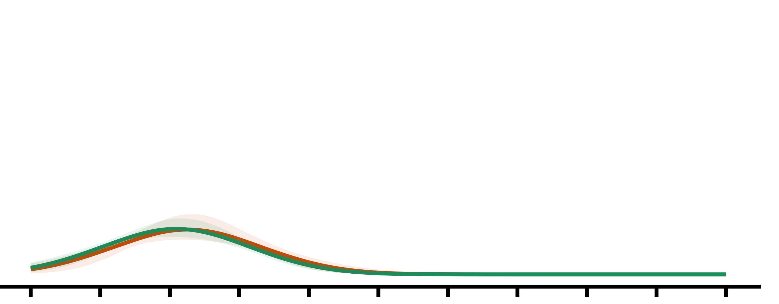
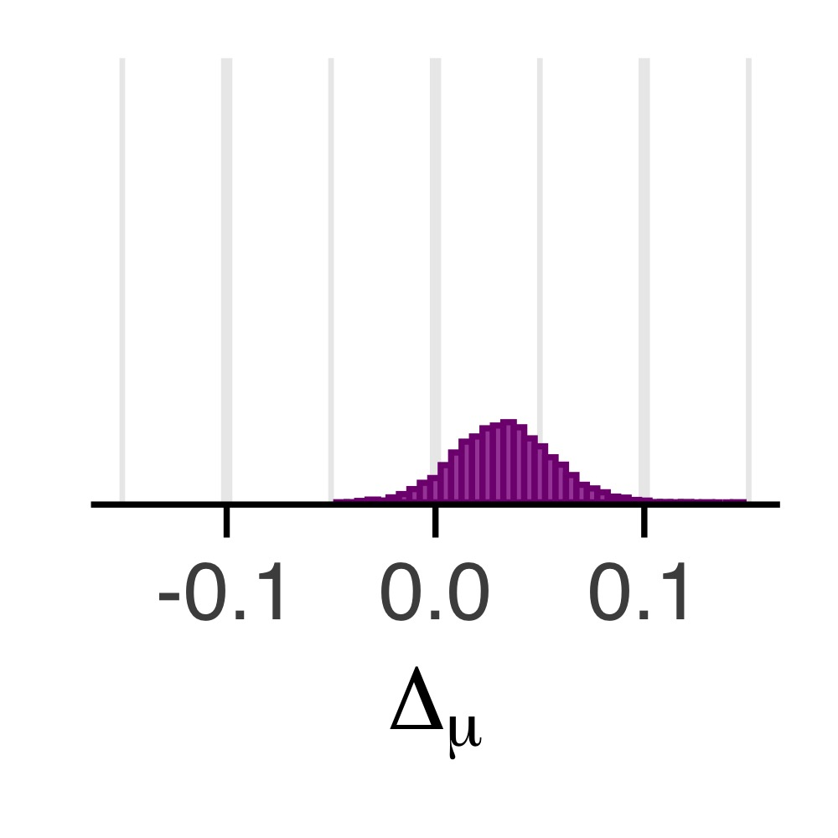
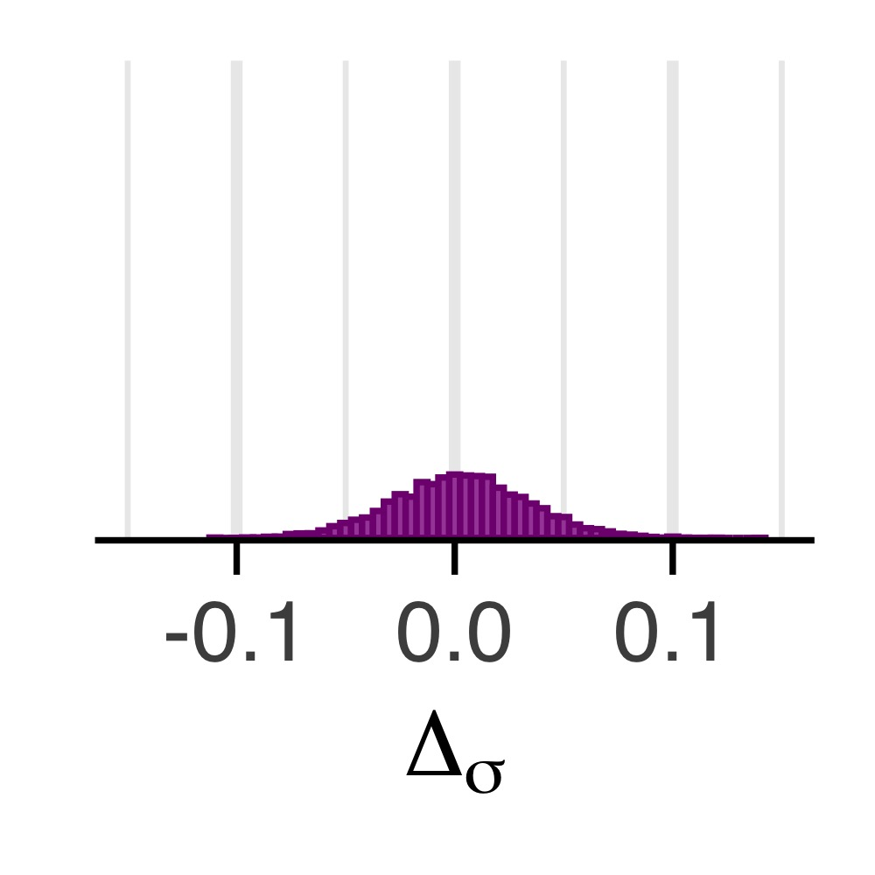
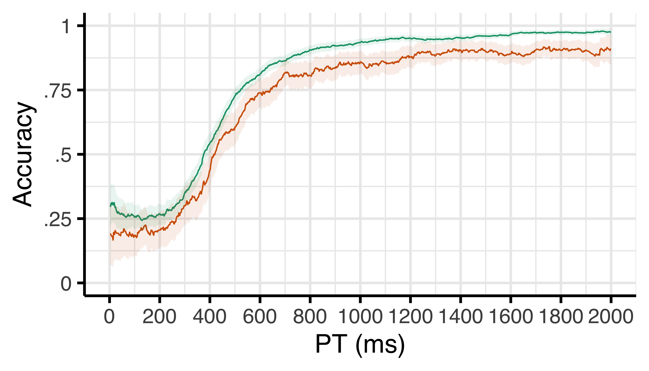
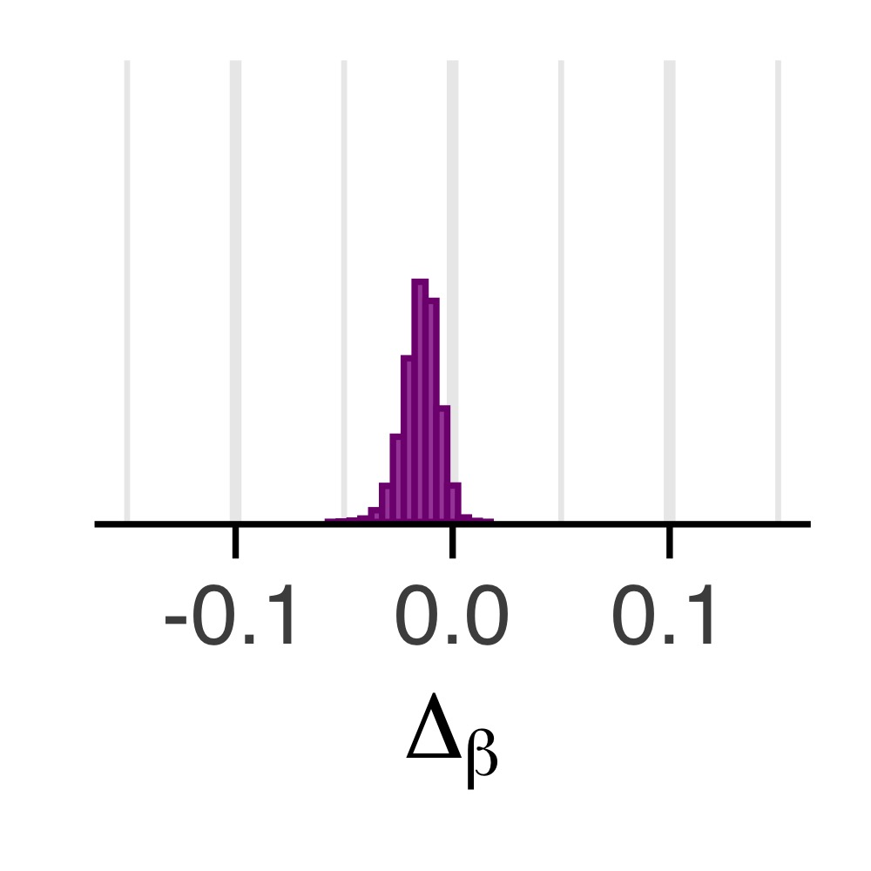
a
c
M = .03; pd = .93
Density
Speed (μ)
After correct
After error
d
b
Noise (σ)
M = .00; pd = .54
Efficacy (β)
e
M = -.01; pd = .98
Chance

