Slide 1
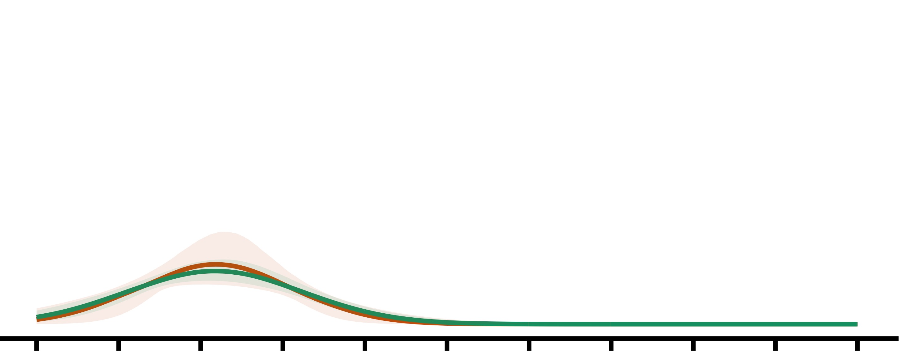
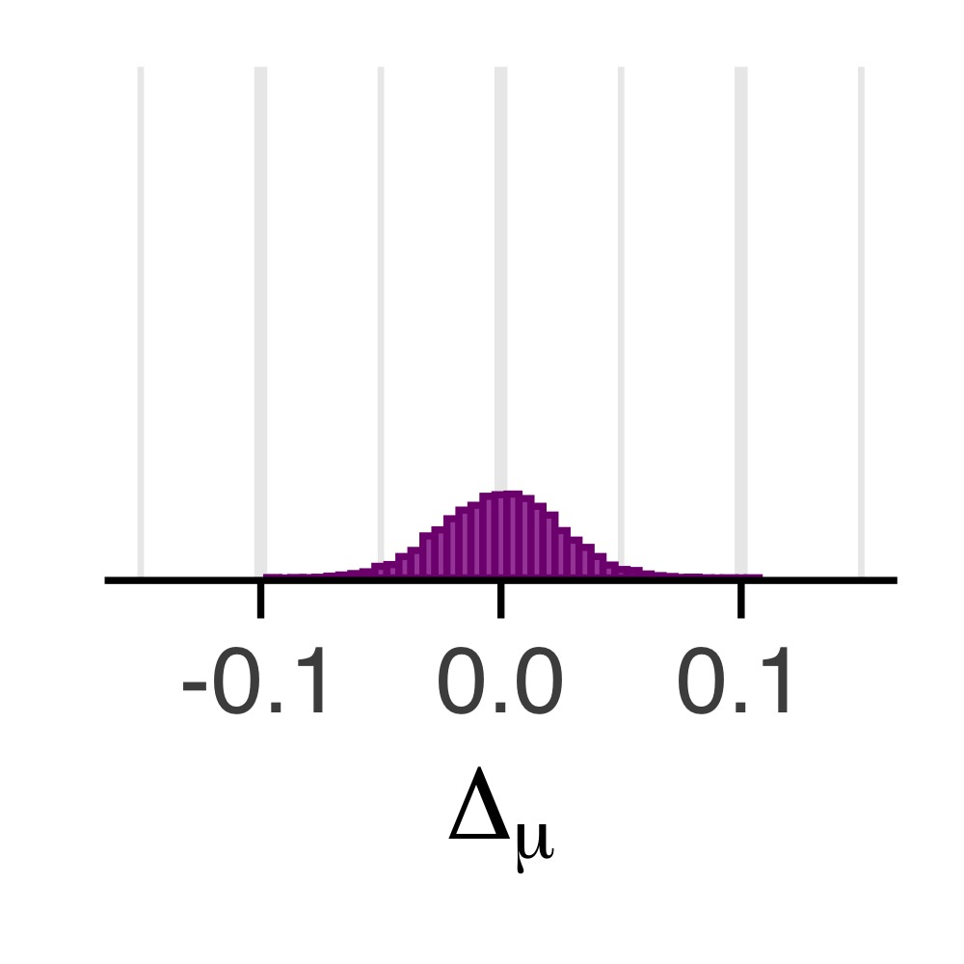
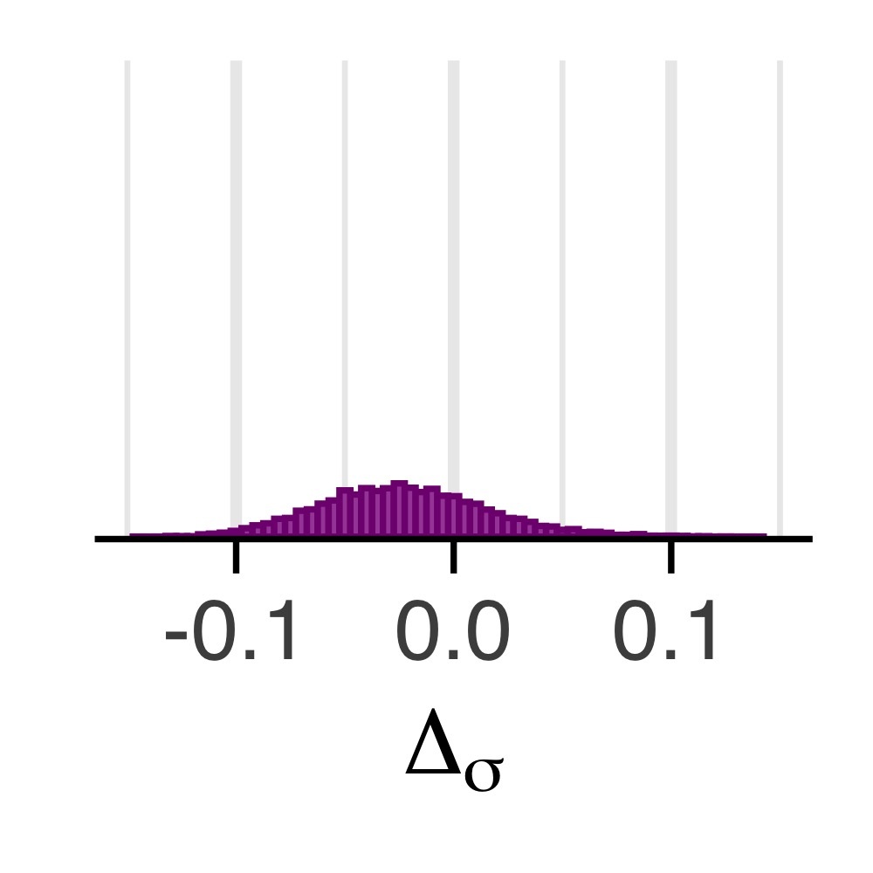
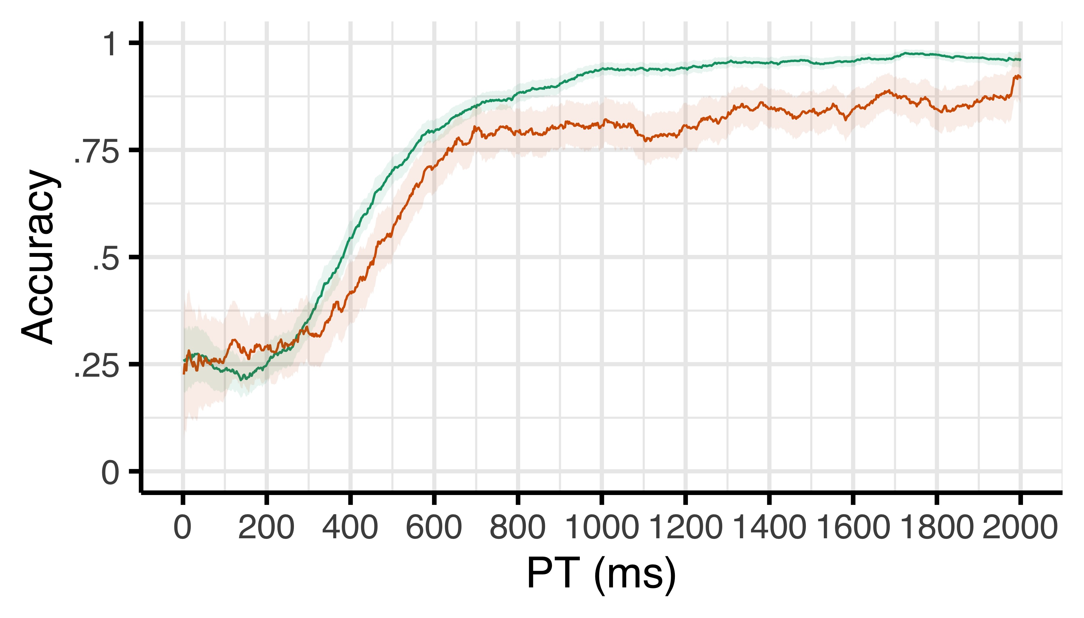
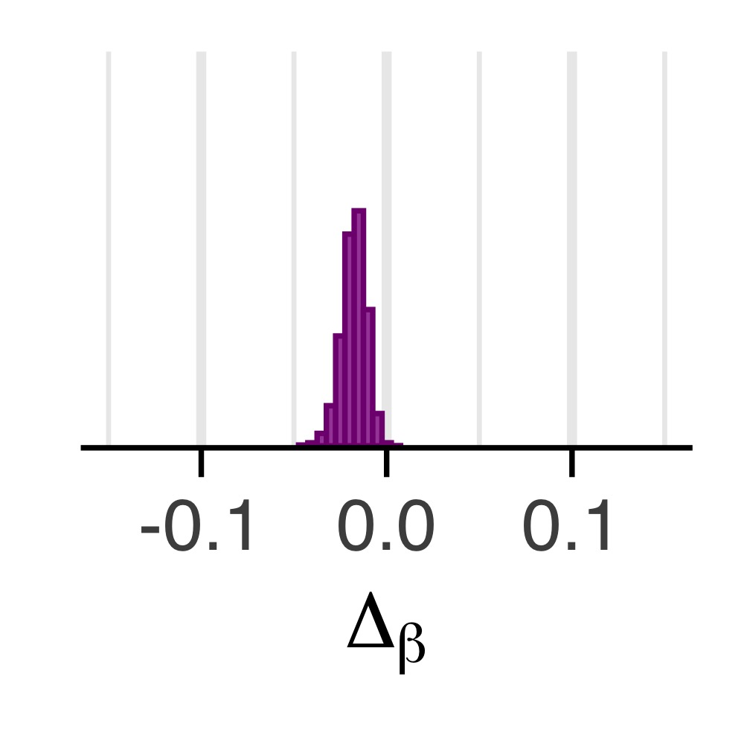
a
c
M_{diff} = .00; pd = .50
Density
Speed (μ)
After correct
After error
d
b
Noise (σ)
M_{diff} = -.02; pd = .73
Efficacy (β)
e
M_{diff} = -.05; pd = 1.0
Chance

