Slide 1




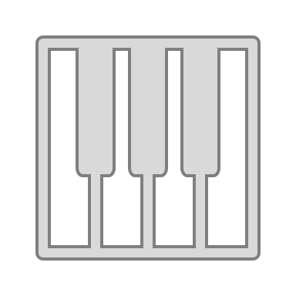

A
-1
+1
+$1
B
C
Loss
Gain
Precision
Optimal Aim
Aim
D
E
Increased Stakes
Increased precision

