Slide 1
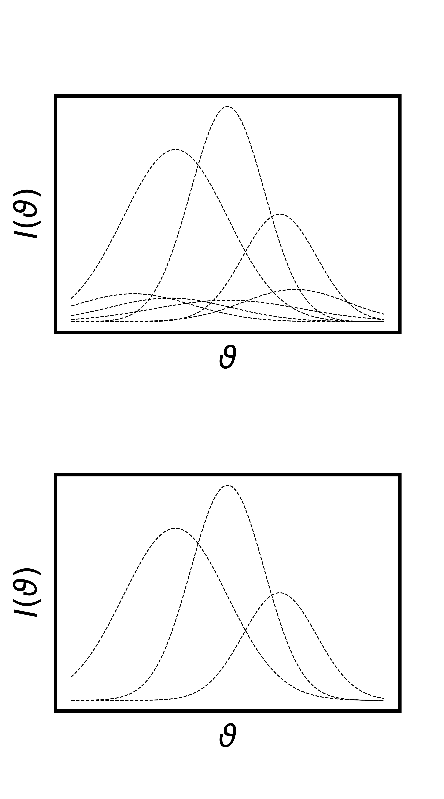

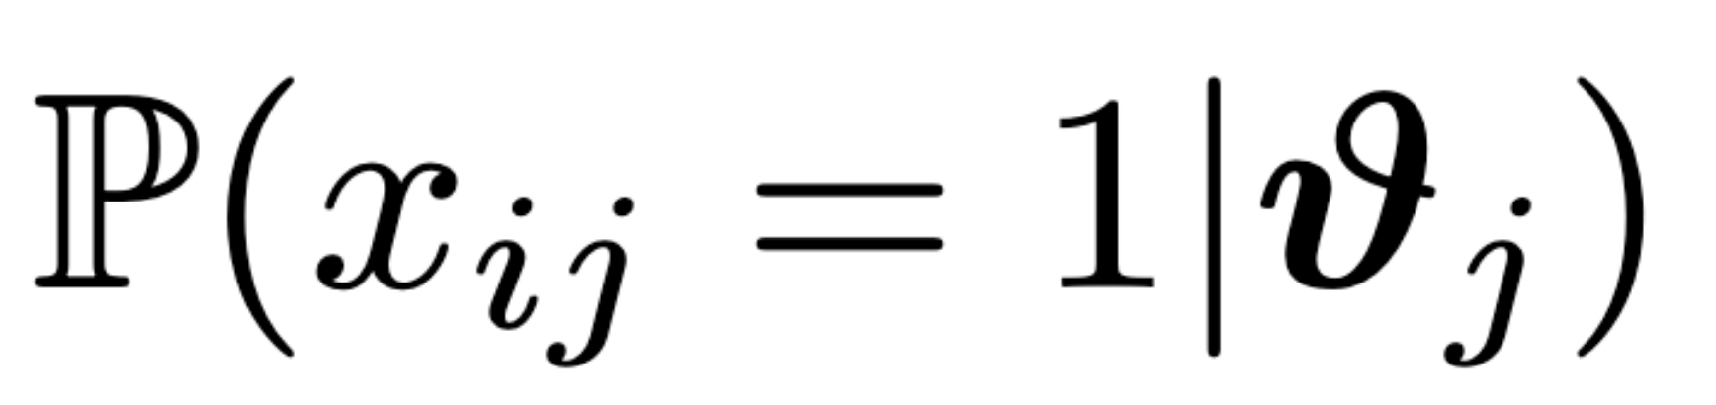

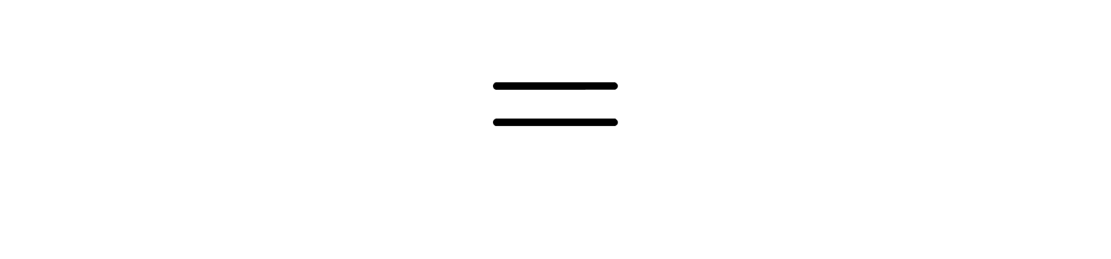
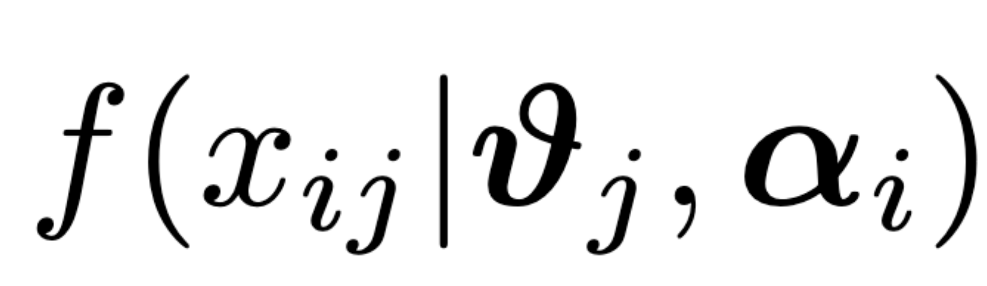




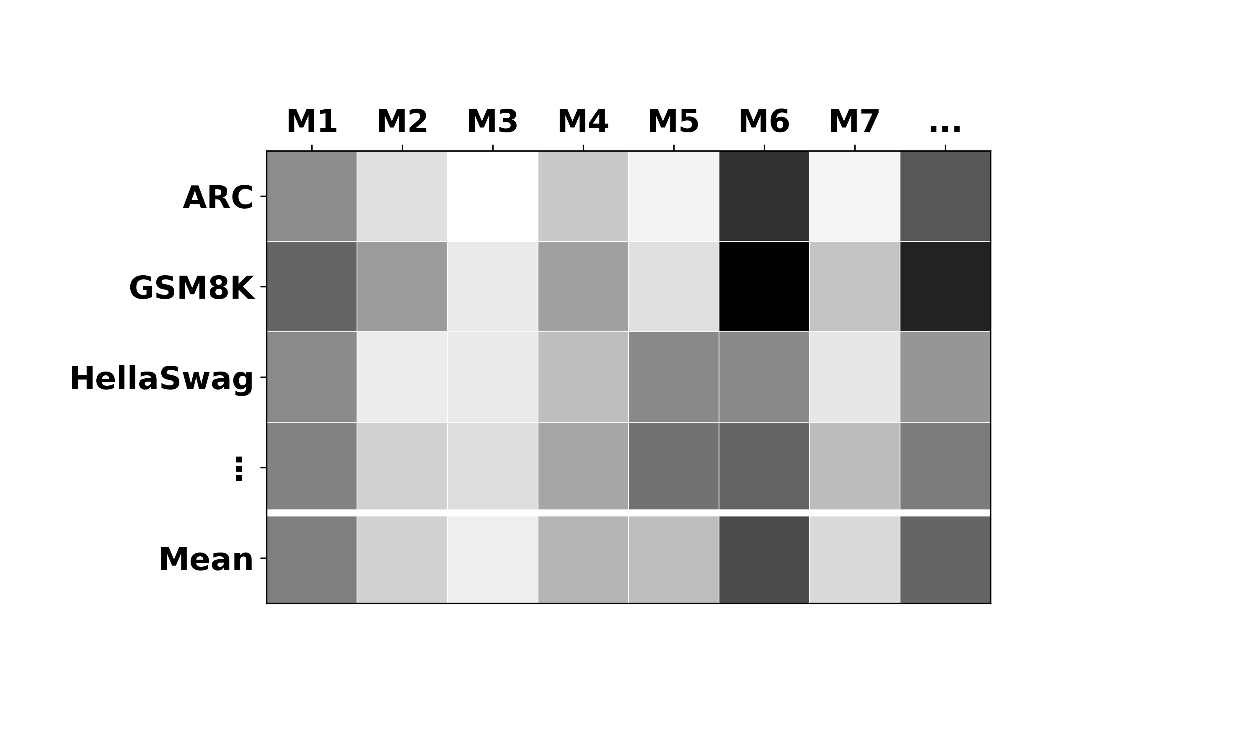
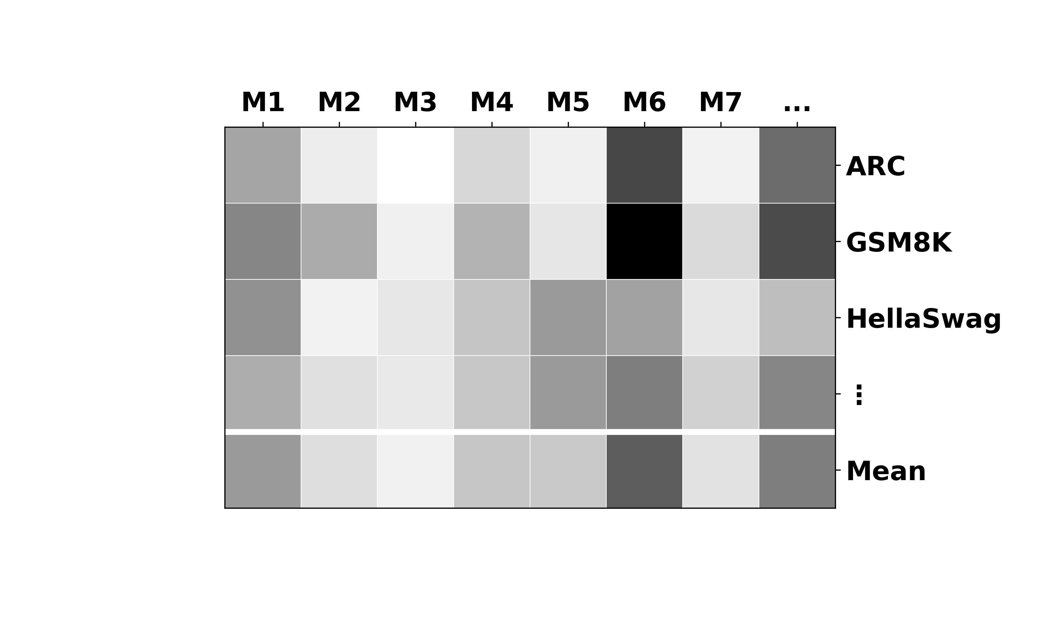

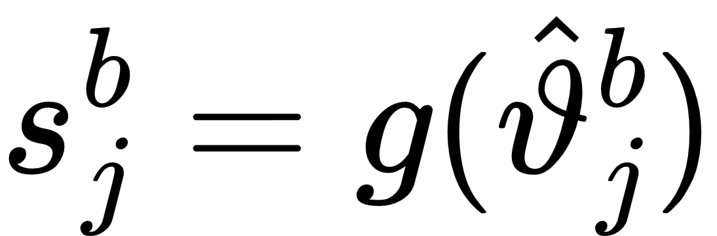

28,632 items
845 items
ARC
ARC
GSM8K
Preprocess
Items
GSM8K
Cross-Validated Subsampling
Fit Item Models
Info-Filter
enough variance
HellaSwag
HellaSwag
not too
easy
draw items
correlated w/ score
predict score
MMLU
MMLU
keep best
TruthfulQA
TruthfulQA
Winogrande
Winogrande
Cross-Validated Score Reconstruction
per benchmark
for their sum
point scores
latent abilities

