Slide 1
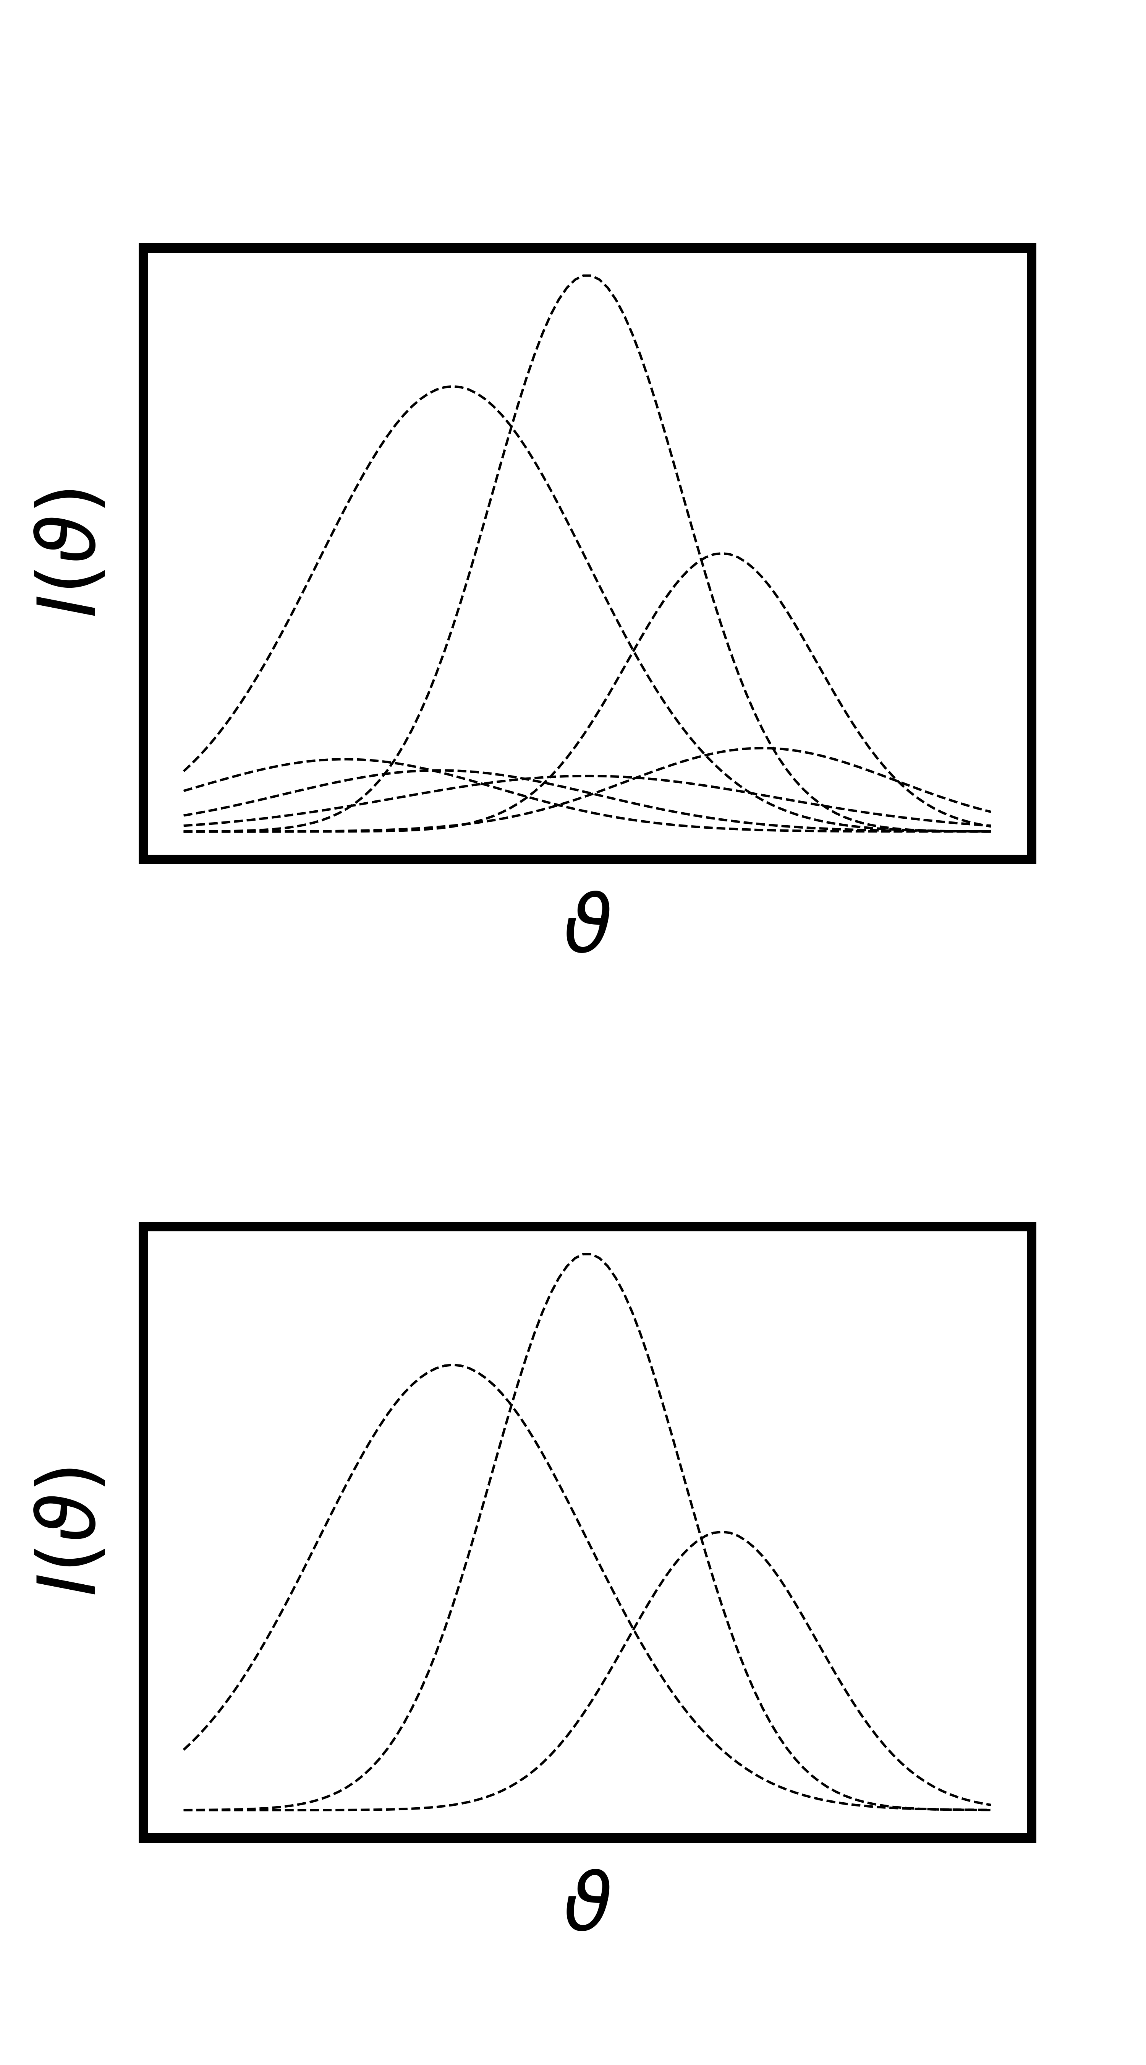
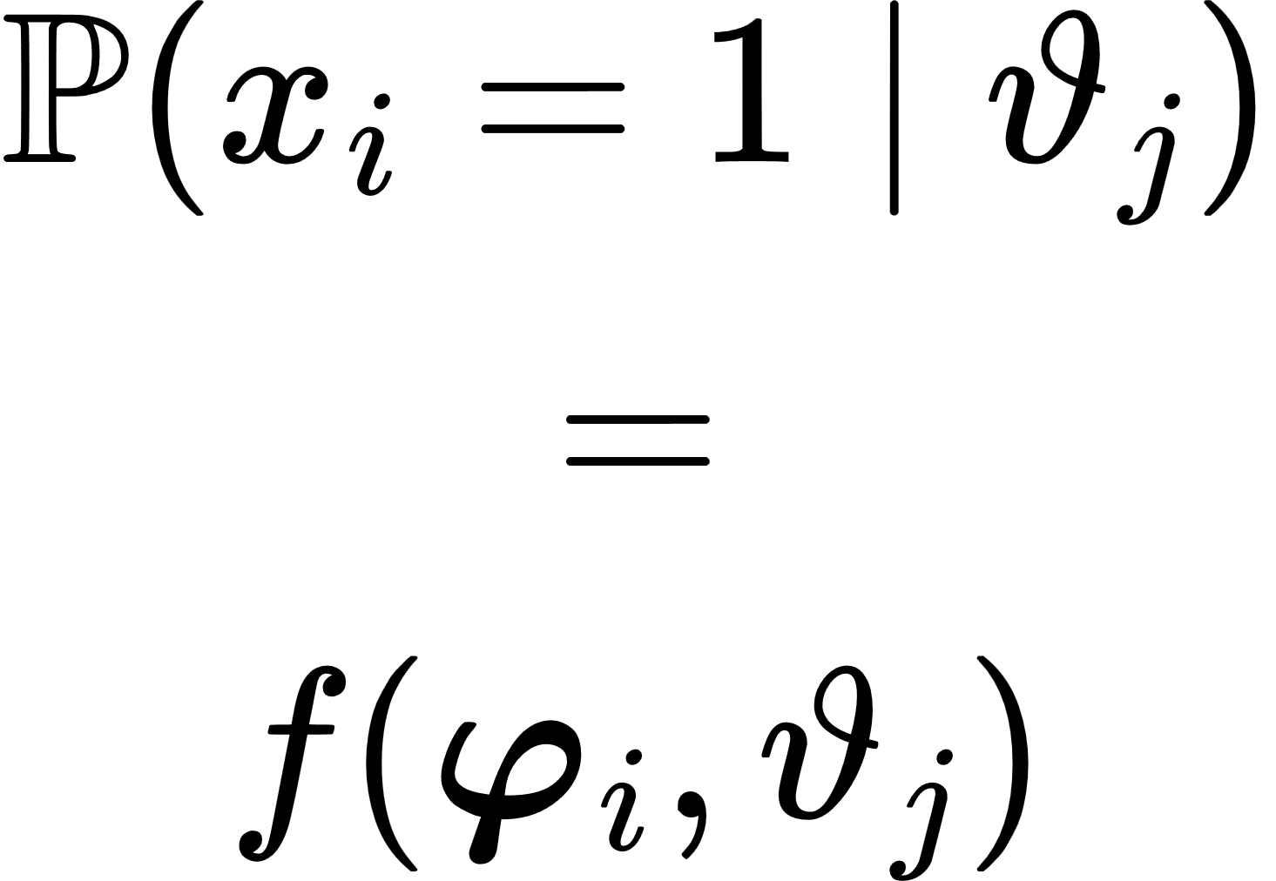


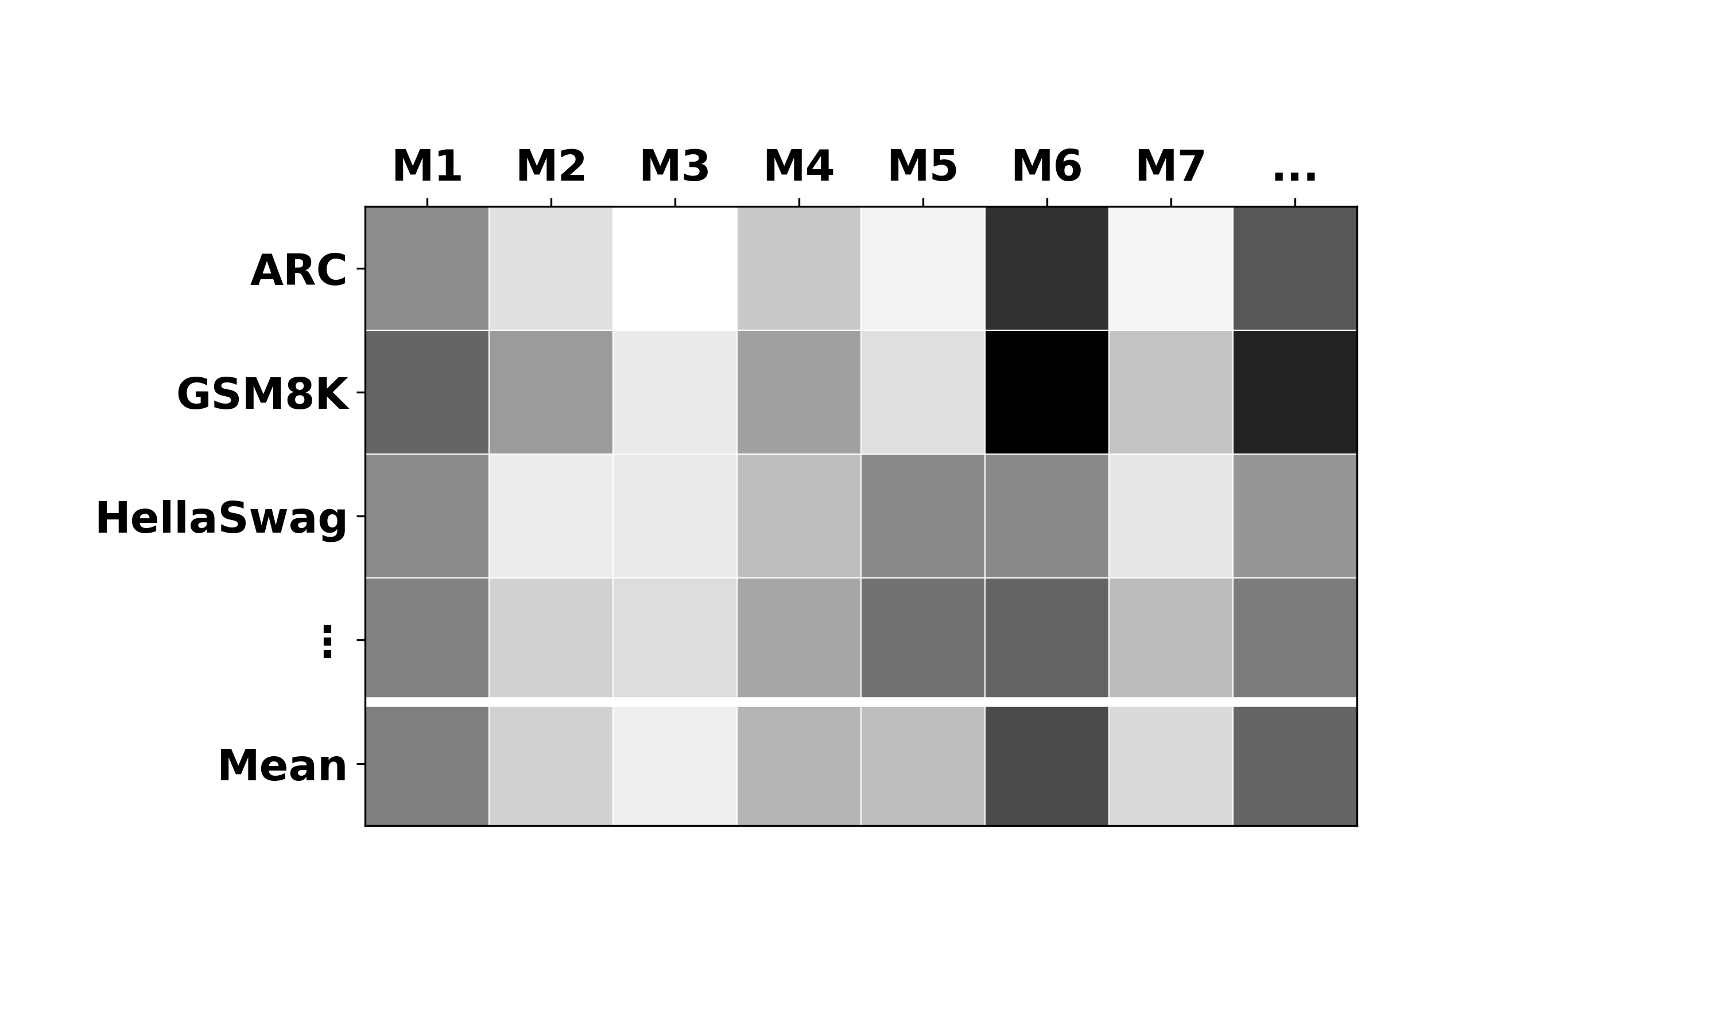
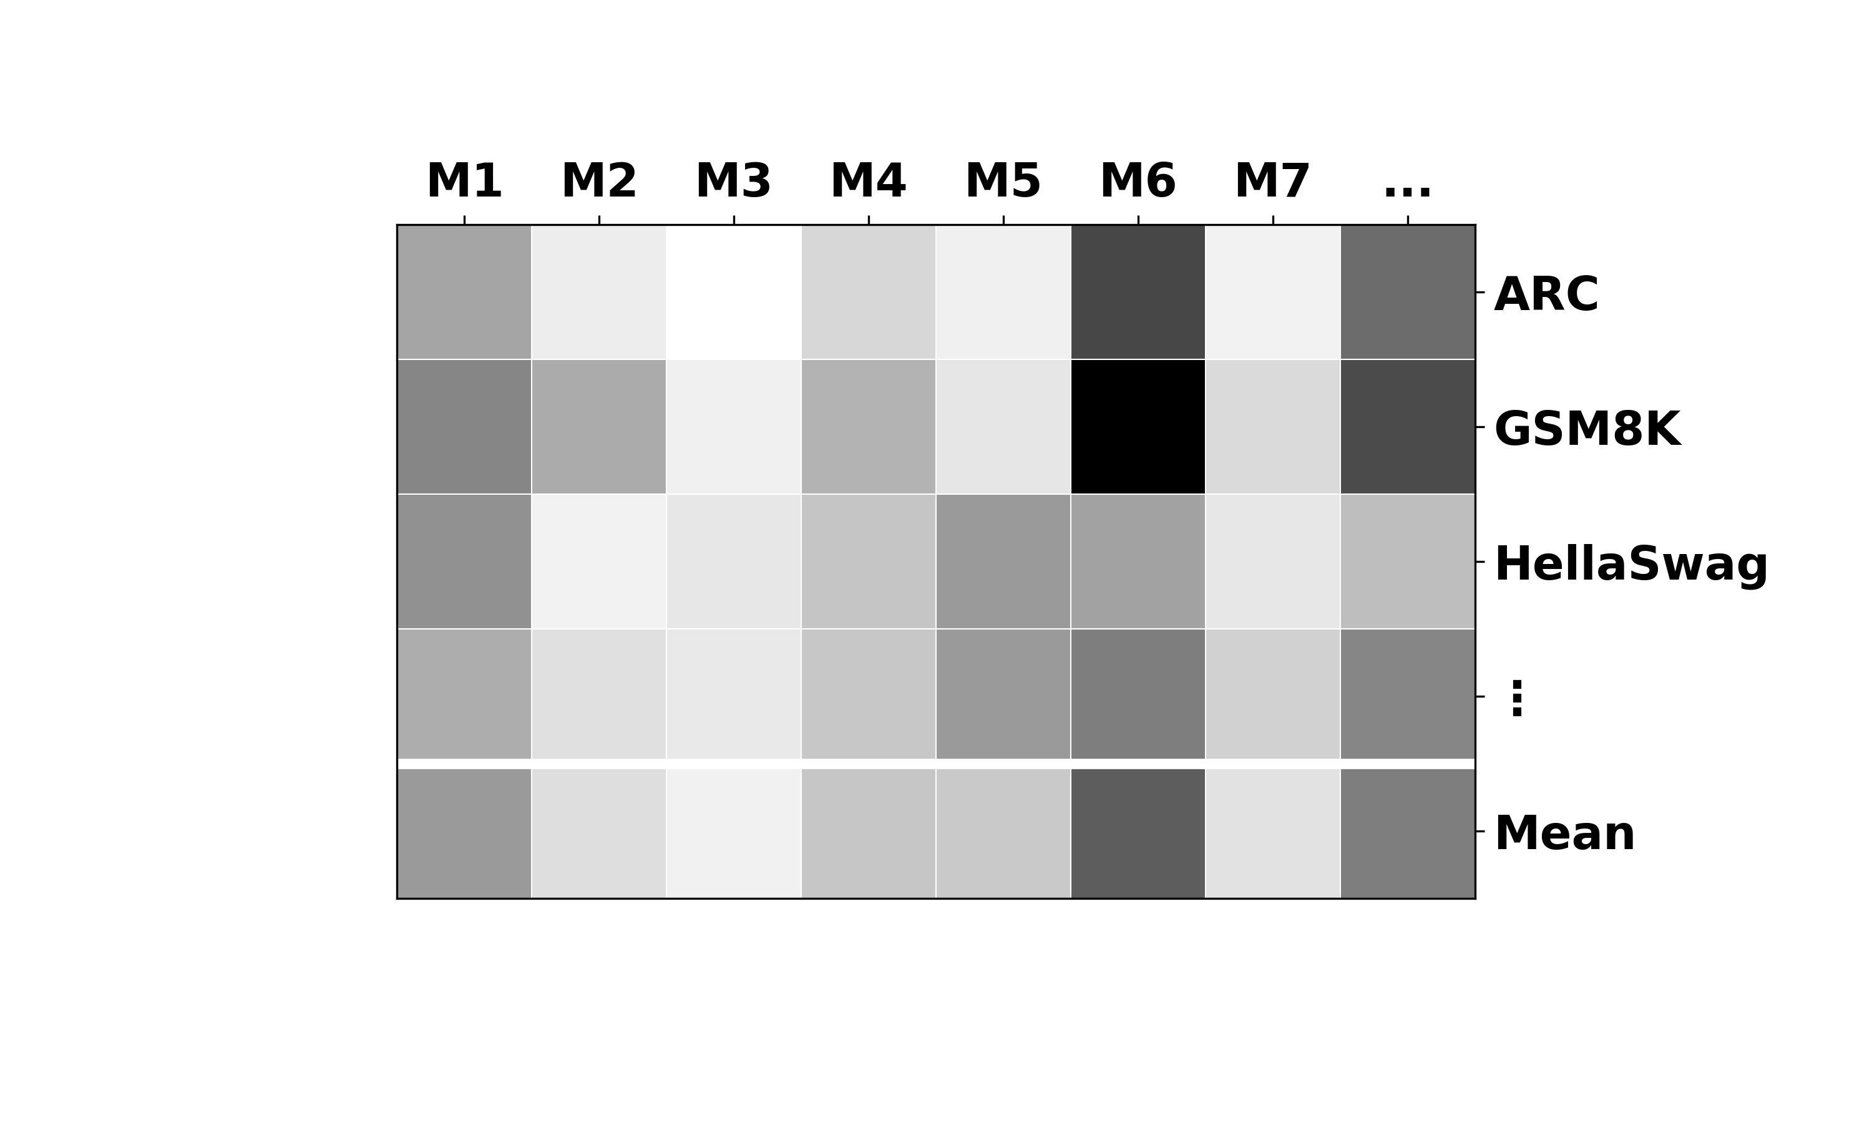
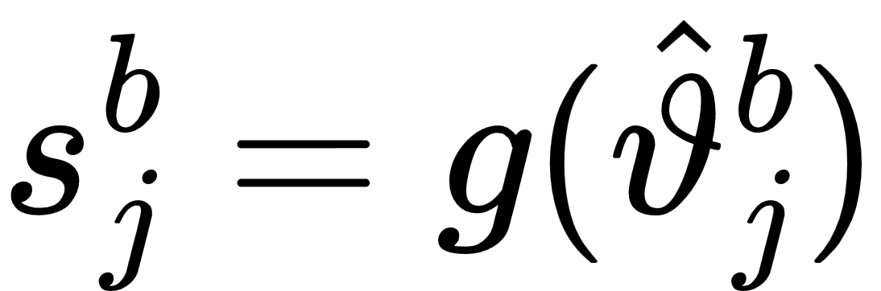
# 22.6k
#0.9k
ARC
ARC
GSM8K
GSM8K
Preselect
Fit IRT
HellaSwag
challenging
+
corr. w/ score
HellaSwag
remove redundancies
MMLU
MMLU
TruthfulQA
TruthfulQA
Winogrande
Winogrande
reconstruct
point score
latent ability

