Slide 1

New Scheduler Design

Slide 2
Problem Definition :-
Current Scheduler backend service having Azkaban as Scheduler Manager which is having many issues like as
Azkaban does not provide a proper user guide and lacks contributions to community service.
A lot of known and unknown issues are encountered on a day to days basis.
No support the issue and vulnerabilities fixes.
Not observed the frequently releases on Azkaban.
Separate workflow manager for scheduler.
Unnecessary services have involved to support schedule feature.
Maintaining 3 services (Azkaban, Scheduler -backend and Scheduler-frontend) to provide scheduling feature.
Multiple database management for the scheduler feature.
Hence, we are Deprecating the existing scheduler and we will implement this feature as in Notebook Front End ,
Workflow Front End and Workflow backed for scheduling purpose and new scheduler API’s will be added in workflow backend.
Initial Level we will thinking to use Kubernetes default scheduler feature instead of Azkaban as Scheduler Manager.

Slide 3

New Scheduler Flow
Workflow execution pod1
Notebooks Pod1
Monitor-Frontend
Monitor-backend
Executing /Monitoring workflow execution pod
Workflow execution pod1
Notebooks Pod1
Monitoring/logs
Workflow execution podN
Notebooks Pod N
Notebook Frontend
Kubernetes
Workflow-Backend
Scheduled Jobs
Scheduled Jobs
Scheduled Jobs
Schedule Notebooks/ Workflow
Scheduled Jobs
Callback URL to run workflow / Notebooks
Workflow Frontend
Scheduler Spawner
CRON JOBS
Kubernetes
Schedule the job with callback URL and object Id

Slide 4
Workflow backend will handle all scheduling task like CURD Operation APIs in JAVA
Basic API’s for Scheduler are
Sr No | Http Method | API | API Description | Payload or Response
1 | POST | / api/v1/schedules/create | It is used to create schedule | Payload { "scheduleId": "", "displayName": "", "projectId": "", "workflowId": "", “notebookId": "", "scheduleObjectId": "", "scheduleObjectName": "", "scheduleDescription": "", "scheduleObjectType": "", "cronExpression": null, "scheduleGraphJson": "", "createdBy": "", "createdDate": "", "updatedBy": "", "updatedDate": "" }

Slide 5
Workflow backend will handle all scheduling task like CURD Operation APIs in JAVA
Basic API’s for Scheduler are
2 | PUT | / api/v1/schedules/update | It is used to Update the schedule | { "scheduleId": "", "displayName": "", "projectId": "", "workflowId": "", “notebookId": "", "scheduleObjectId": "", "scheduleObjectName": "", "scheduleDescription": "", "scheduleObjectType": "", "cronExpression": null, "scheduleGraphJson": "", "createdBy": "", "createdDate": "", "updatedBy": "", "updatedDate": "" }
3 | DELETE | / api/v1/schedules/delete ?scheduleId={scheduleId} | It will delete the schedule based on Schedule Id | Response True if deleted successfully Other wise False

Slide 6
4 | GET | / api/v1/schedules/search ?projectId={projectId}& searchString=& scheduleSubType=all& profile=DETAILED& offset=0& limit=10& order=updatedDate.desc | It will search or list all the schedules present in current Project | Response { "totalRecordCount":"", "data":[ { "scheduleId":"", "displayName":"", "projectId":"", "scheduleObjectId":"", "scheduleObjectName":"", "scheduleDescription":null, "scheduleObjectType":"", "cronExpression":null, "scheduleGraphJson":null, "createdBy":"mosaic", "createdDate":"", "updatedBy":"", "updatedDate":"" } ] }
5 | POST | /api/v1/schedules/execute? scheduleId={scheduleId}& scheduleObjectName ={scheduleObjectName} | It will execute the schedule based on schedule Id and schedule Object Name
6 | PUT | /api/v1/schedules/suspend/ {scheduleId} | It will stop or suspend the executing schedule based on schedule id

Slide 7
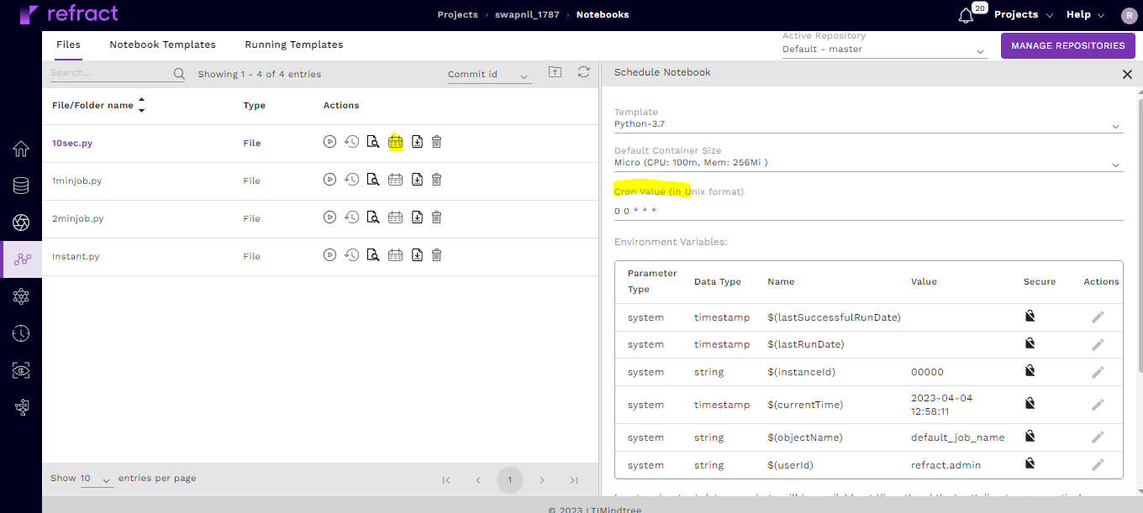
Schedule Notebook

Slide 8
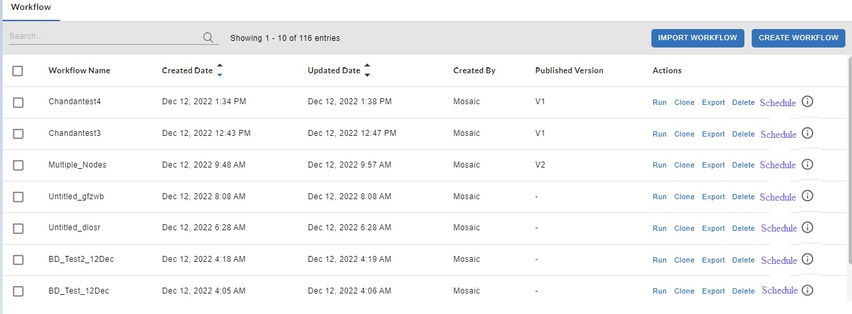
Schedule Workflow

Slide 9
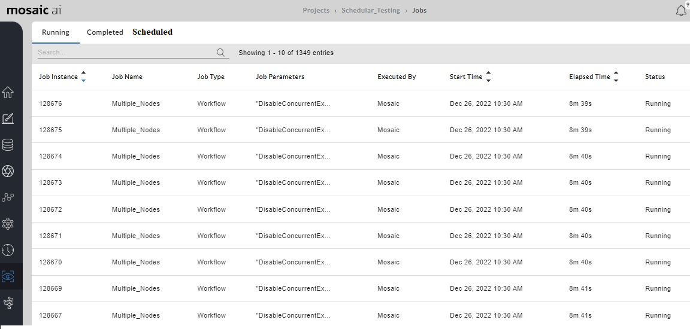
Monitor tab we have Scheduled option

Slide 10
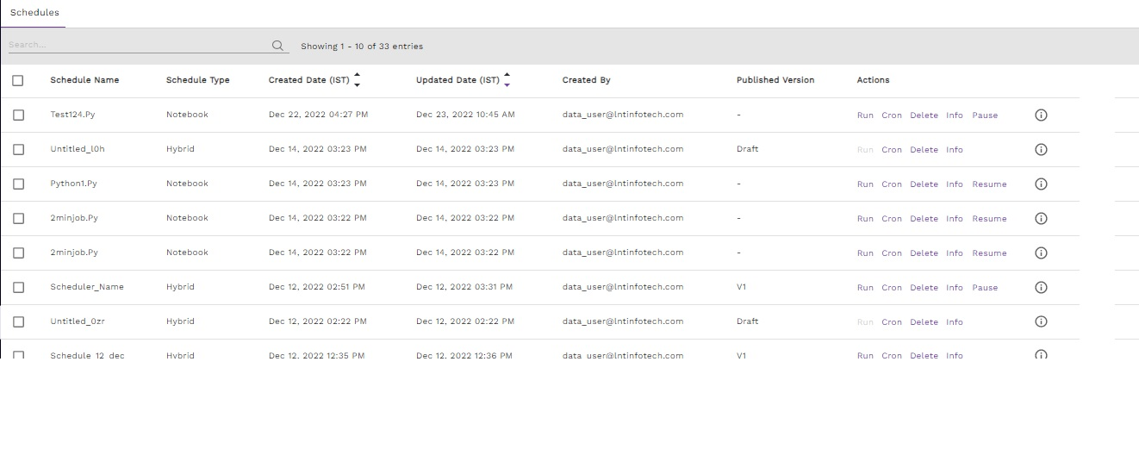
List View of Schedules

Slide 11
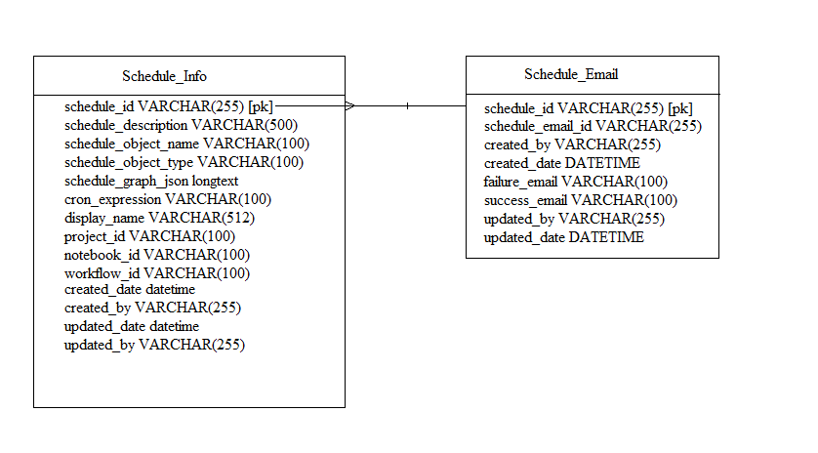
DB LEVEL CHANGES AND TABLES:

Slide 12
Things to Design and Discuss
Api of kubespawner and how workflow backend will communicate with kubespawner service.
How we can schedule custom plugins

