Slide 1
Digital Image Processing
Semester Project
Adeel Ahmad
Roll No. 14I-0169
Instructor: Adeel Mumtaz

Slide 2
Methodology
Apply a gaussian blur to image containing all questions
Extract edges using Canny Edge Detection algorithm
Create a reference table for template circle image
Apply generalized hough transform and match a template circle image and extract column containing all MCQs
Extract individual MCQs from the extracted column and store its co-ordinates for later use
Read letter from circled MCQ using cross correlation

Slide 3
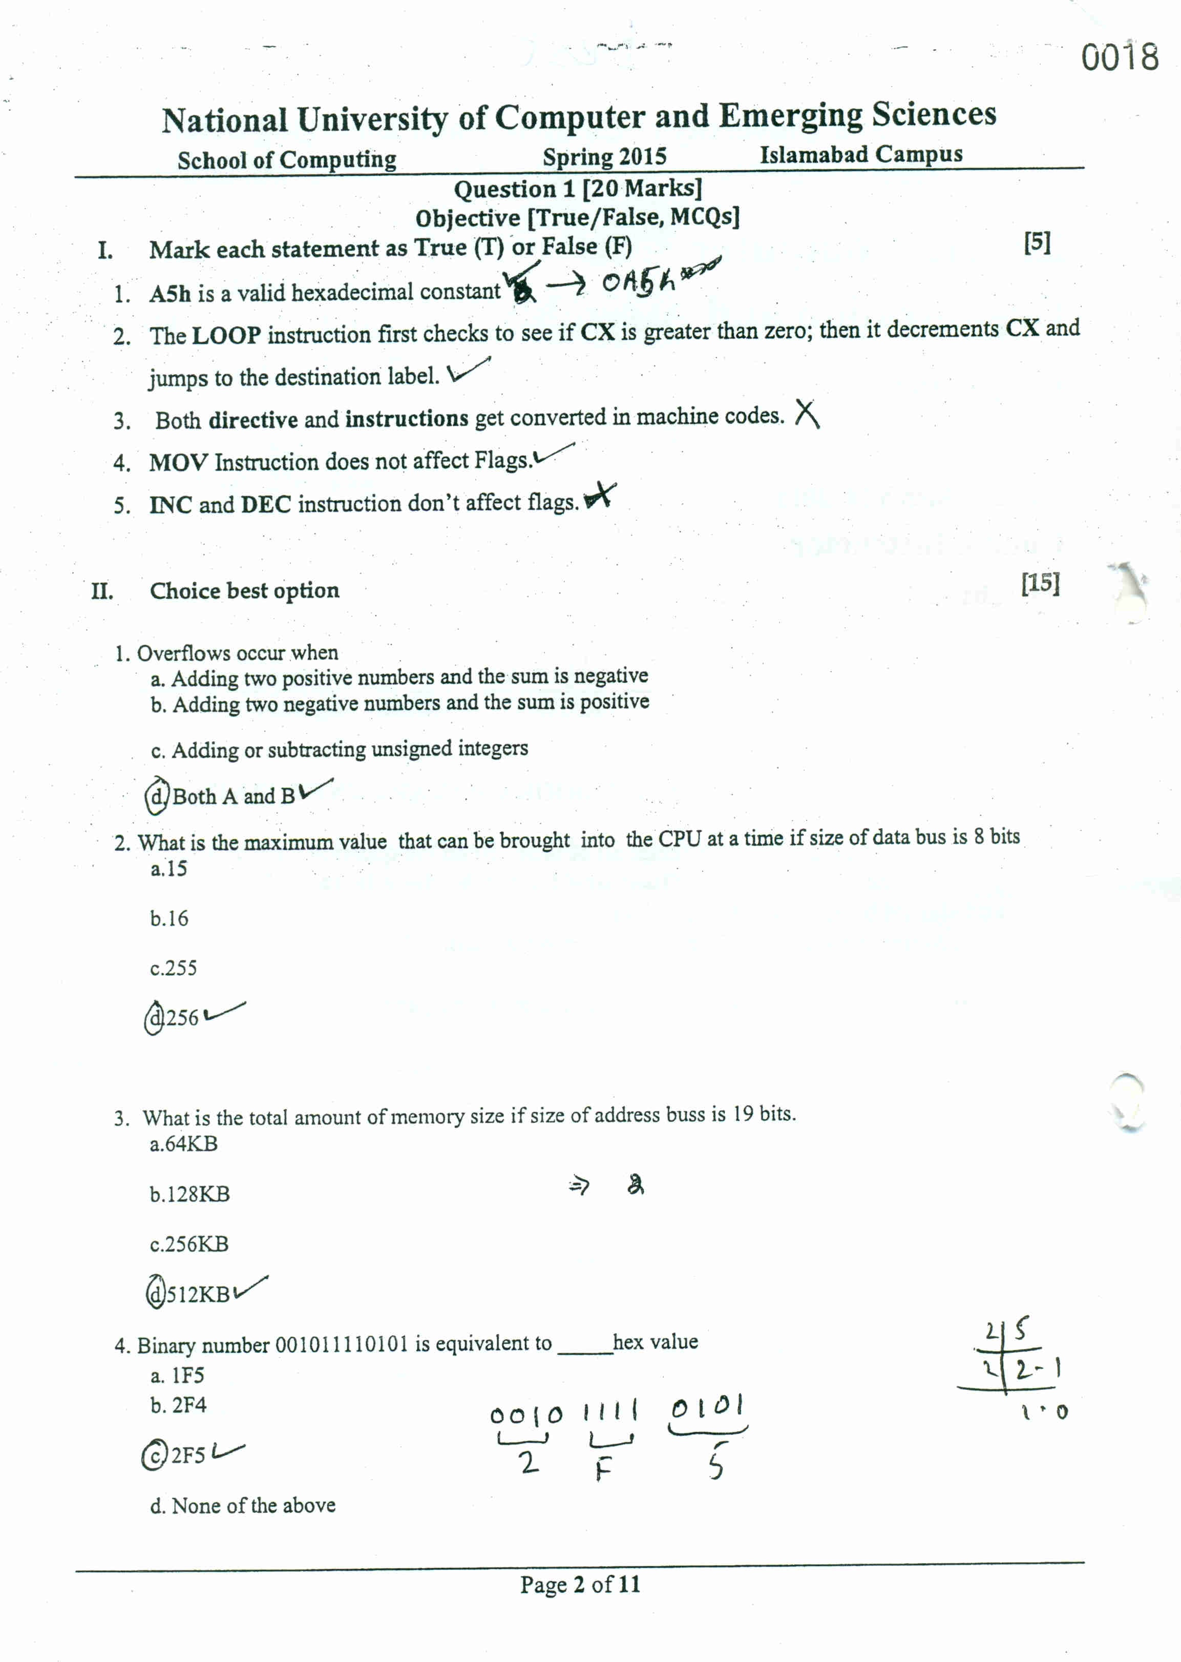
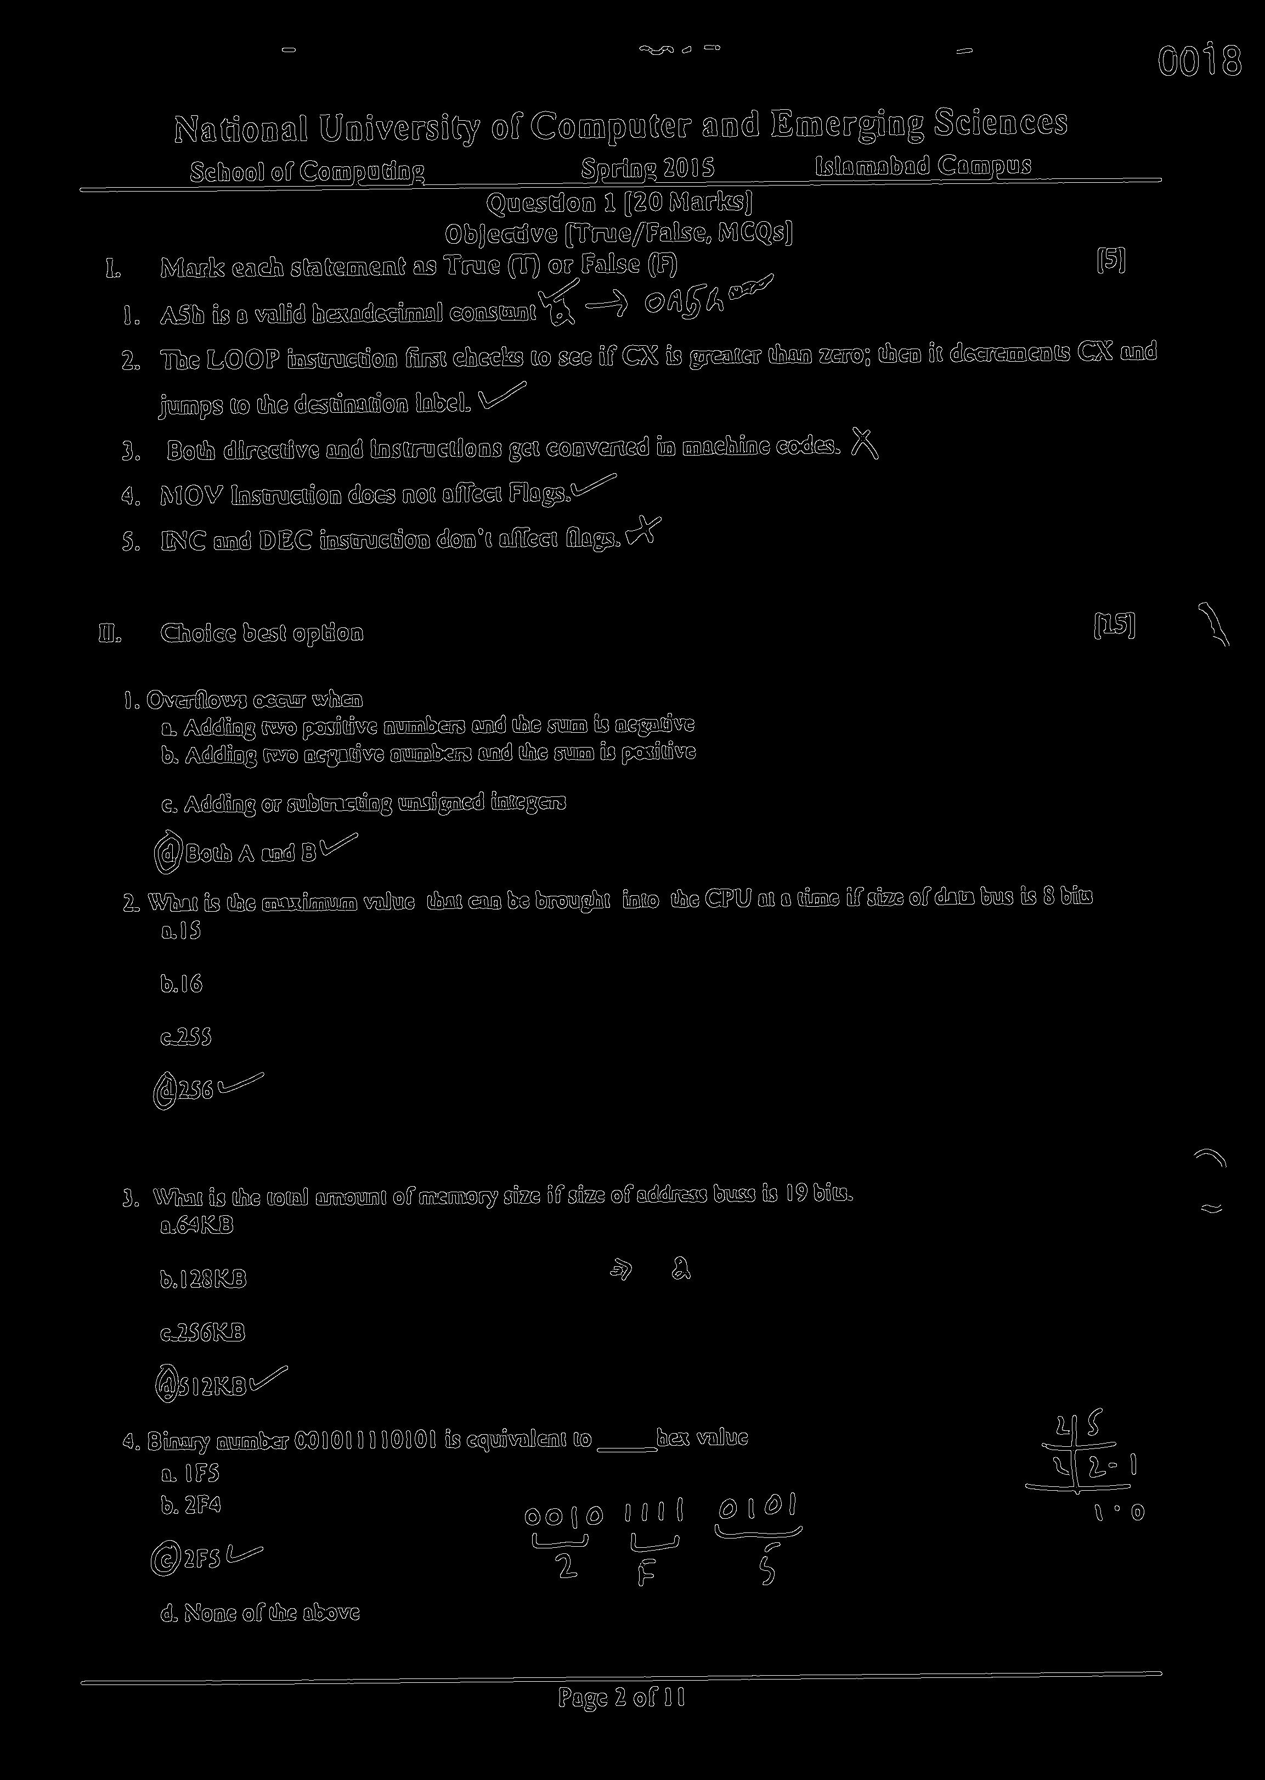
(Before/After) Applying Gaussian blur and Canny Edge detection

Slide 4


Template circle image
Template image was created
using GIMP. This provided
excellent results.
Template image extracted from original image.
This did not give satisfactory results.

Slide 5
Column containing all MCQs
Using only a portion of the image
drastically reduces the computational
time required for applying Hough transform.
it also improves the accuracy as there are less
objects that could potentially causes errors

Slide 6
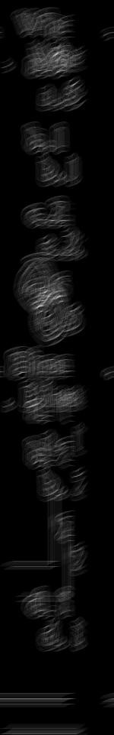

Accumulator array showing brightest point i.e the matched portion
Left image shows accumulator array,
and right image shows its corresponding brightest point circled in the original image

Slide 7

Reading letter from circled MCQ
Extracted MCQ
Template letters
I used 2D cross correlation to find similarities between the extracted MCQ and
Template letters. The match with highest value corresponds to matched letter

Slide 8


Reading Question number
Extracted Question no.
Template numbers
I used 2D cross correlation to find similarities between the extracted MCQ and
Template letters. The match with highest value corresponds to matched letter

Slide 9
Accuracy and Time
Accuracy: 14/15 or 93.33%
Time: 1 minute 59 seconds

Slide 10
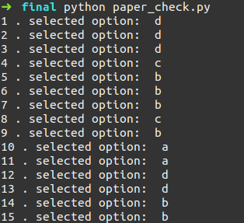
Final Output
Incorrect result on question no. 6

Slide 11
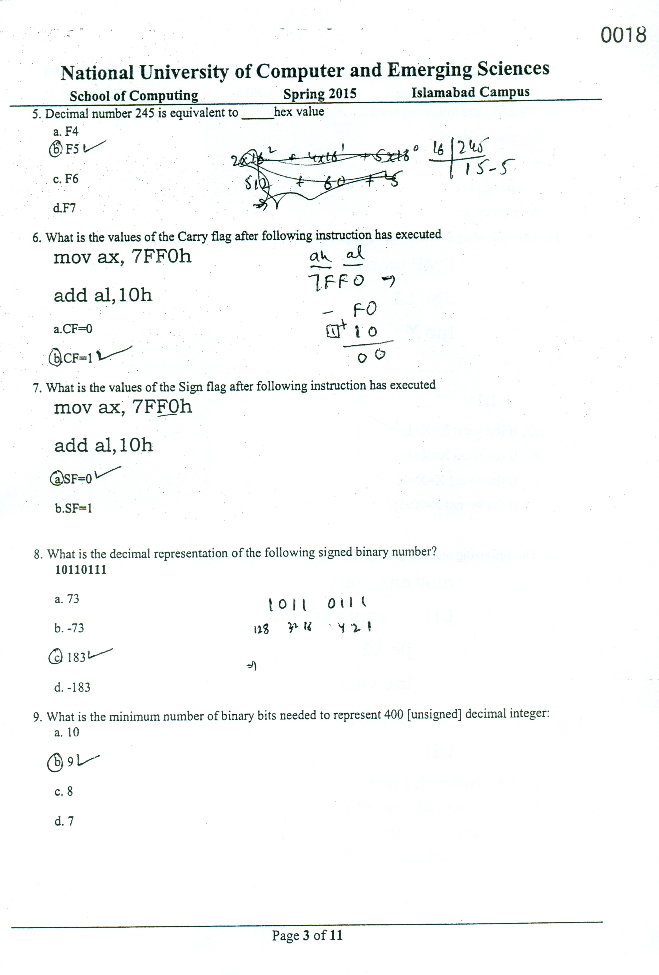

Reason for incorrect output on question 6

Slide 12
Third Party Code
The code for generalized hough transform was written by me. Functions used from other libraries are mentioned below
scipy.ndimage.gaussian_filter()
skimage.filter.canny()
scipy.signal.signaltools.correlate2d()
Libraries
NumPy
SciPy
Skimage
Matplotlib

