Slide 1


Iridium® Brand Guidelines
REMOVE THIS SLIDE!
TRADEMARKS
APPROVED LOGOS & IDENTIFIERS
Iridium trademarks always should be marked with the appropriate superscript designator: TM, SM, or ® (first time that they’re used):
Iridium®
Iridium Certus®
Iridium CertusTM 9810
Iridium CertusTM 9770
Iridium Connected®
Iridium Burst®
Iridium Edge®
Iridium Edge® Solar
Iridium Edge® Pro
Iridium Extreme®
Iridium Extreme® PTT
Iridium GO!®
Iridium SafetyCastSM
Iridium GoChat®
Iridium OpenPort®
Iridium Pilot®
Netted Iridium®
Short Burst Data ®
SBD®
Global Line of SightSM
GLOSSM
Everything Within Reach.®
Reliability Above All.®
Your World. Our Network.®
Corporate Logo
For use on corporate communications, presentations, graphics, etc.
Iridium Connected Logo
Only for use when describing partner products enabled by the Iridium network.
The Iridium Everywhere logo has been retired and should no longer be used in any instance.
The Iridium Certus identifier, mobius strip, and connected logo have been retired and should no longer be used.
The Iridium NEXT identifier has been retired for general use. It should only be used in reference to the historic Iridium NEXT mission.
Using another company’s product and/or trademark in Iridium materials without the consent of the trademark holder or in a manner that may be construed as an endorsement of Iridium by the other company may subject Iridium to liability for trademark misuse! Care should be taken to avoid using easily identifiable, third-party products and/or trademarks or referencing specific individuals in marketing material in a manner that may be construed as endorsing Iridium.
Last Updated Feb. 28, 2020. For the latest, please view the guidelines on IridiumConnect.
For more information or questions, please contact brand.iridium@iridium.com

Slide 2
Iridium® Brand Guidelines
REMOVE THIS SLIDE!
Iridium NEXT
Iridium Certus®
Iridium NEXT refers to the launch program to refresh the Iridium constellation. Since the Iridium NEXT launch program is now complete, references to Iridium NEXT and use of the Iridium NEXT identifier are being phased out and should only be used in reference to the historic campaign.
Notes:
The Iridium constellation/network: Iridium NEXT should not be used to describe the upgraded constellation (this is now simply “the Iridium constellation” or “Iridium network”). You can use “enhanced” or “upgraded” to differentiate between the original and upgraded constellations.
Iridium satellites: Iridium NEXT should not be used to describe the new satellites. Since they have all been replaced, they are now just “Iridium satellites”. You can use “enhanced” or “upgraded” to differentiate between the original satellites. References to “Block 1” should be avoided in public communications.
Iridium Certus should never be written or referred to as just “Certus” in any situation.
Iridium Certus is a service platform with offerings at midband and broadband speeds.
Midband services include: Iridium Certus 20 and Iridium Certus 100
Broadband services include: Iridium Certus 200, Iridium Certus 350, and Iridium Certus 700
Approved language regarding Iridium Certus 1400: The Iridium network is capable of supporting speeds up to 1408 Kbps. Future development of Iridium Certus 1400 service is dependent on market demand.
Iridium Certus BCX and Iridium Certus SFX are internal terms and should not be used in public/external communications going forward. Rather, they should be referred to by their product names.
BCX = Iridium CertusTM 9810
SFX = Iridium CertusTM 9770

Slide 3
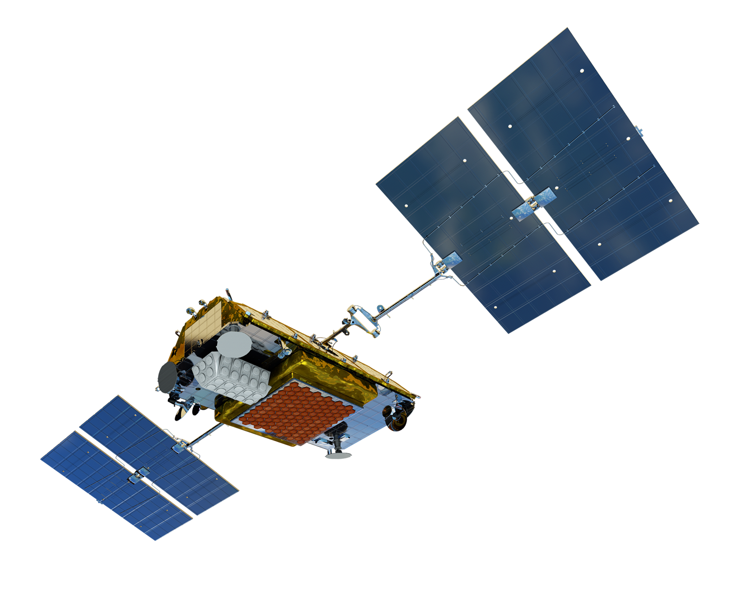









Iridium® Brand Assets The below high-resolution assets can be pasted into your presentation as supporting graphics.
REMOVE THIS SLIDE!
Click here to access additional assets and product photography from IFP.

Slide 5
Legal Disclosures
Statements made in this Presentation are not warranties, and IRIDIUM EXPRESSLY DISCLAIMS ALL WARRANTIES, IMPLIED WARRANTIES, WARRANTIES OF MERCHANTABILITY AND WARRANTIES OF FITNESS FOR A PARTICULAR PURPOSE, except as expressly set forth in the relevant Iridium Limited Warranty and the Iridium Product Sales Terms and Conditions.
The views and opinions expressed in this Presentation are solely those of the presenter and do not necessarily represent those of Iridium which makes no warranty as to accuracy or completeness of the information provided or the views or opinions presented. The information in this Presentation is subject to change without notice.
Read and understand the Iridium User Manual and the safety warnings and information contained in that Manual before using any Iridium product.
Iridium® is a registered mark of Iridium Satellite LLC and its affiliates. All other registered marks, trademarks, service marks and logos are property of their respective holders. Information is subject to change without notice.

Slide 6
This is an optional takeaway box to summarize the content in the slide

Slide 12
The Following Slides Can Be Used as Samples to Develop Charts and Graphs

Slide 13
This is an optional takeaway box to summarize the content in the slide

Slide 14
This is an optional takeaway box to summarize the content in the slide

Slide 15
This is an optional takeaway box to summarize the content in the slide

Slide 16
Closing

Slide 19
Statements made in this Presentation are not warranties, and IRIDIUM EXPRESSLY DISCLAIMS ALL WARRANTIES, IMPLIED WARRANTIES, WARRANTIES OF MERCHANTABILITY AND WARRANTIES OF FITNESS FOR A PARTICULAR PURPOSE, except as expressly set forth in the relevant Iridium Limited Warranty and the Iridium Product Sales Terms and Conditions.
The views and opinions expressed in this Presentation are solely those of the presenter and do not necessarily represent those of Iridium which makes no warranty as to accuracy or completeness of the information provided or the views or opinions presented. The information in this Presentation is subject to change without notice.
Read and understand the Iridium User Manual and the safety warnings and information contained in that Manual before using any Iridium product.
Iridium® is a registered mark of Iridium Satellite LLC and its affiliates. All other registered marks, trademarks, service marks and logos are property of their respective holders. Information is subject to change without notice.

Slide 21
This is an optional takeaway box to summarize the content in the slide

Slide 26
The Following Slides Can Be Used as Samples to Develop Charts and Graphs

Slide 27
This is an optional takeaway box to summarize the content in the slide

Slide 28
This is an optional takeaway box to summarize the content in the slide

Slide 29
This is an optional takeaway box to summarize the content in the slide

