Slide 1
eTutorial –
Form 16A
June 22, 2011
Tax Information Network of Income Tax Department (managed by NSDL)

Slide 2
Form 16A from TIN
As per Income Tax Department (ITD) circular no. 03/2011 dated May 13, 2011 Companies and Banks are required to issue Form 16A from TIN to their deductees for deductions made from April 1, 2011 (F.Y. 2011-12).
Form 16A is available to registered TANs at TIN.
Form 16A is available from F.Y. 2010-11.
Form 16A can be requested from TIN by all category of deductors (example; Individual, Firm, HUF, Company, Government, etc.)
Tax Information Network of Income Tax Department (managed by NSDL)

Slide 3
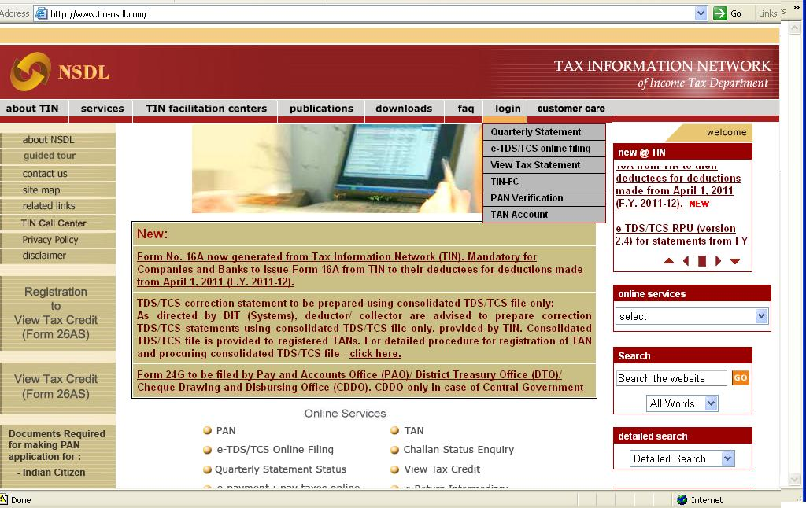
Login to TAN Account at TIN website
Log in page can be accessed under the menu “login” at home page under the option “TAN Account”
Click here to login TAN account.
Tax Information Network of Income Tax Department (managed by NSDL)

Slide 4
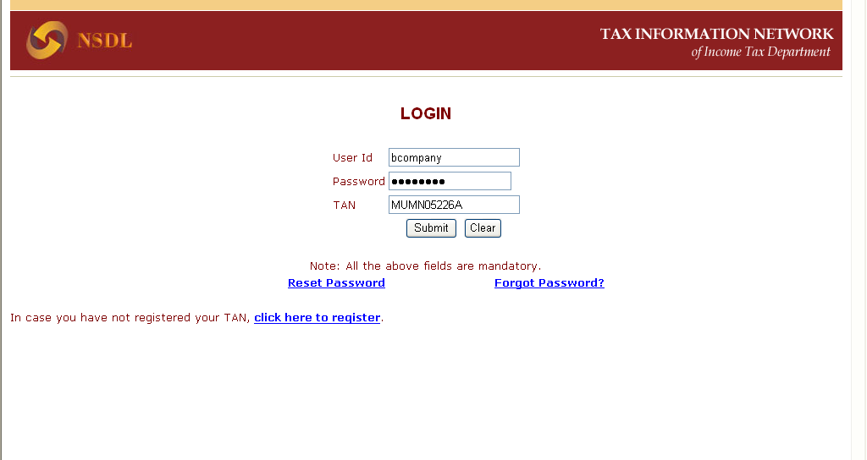
Online TAN Account Login Screen
Login to the TAN account with the registered user ID, password and TAN.
Tax Information Network of Income Tax Department (managed by NSDL)

Slide 5
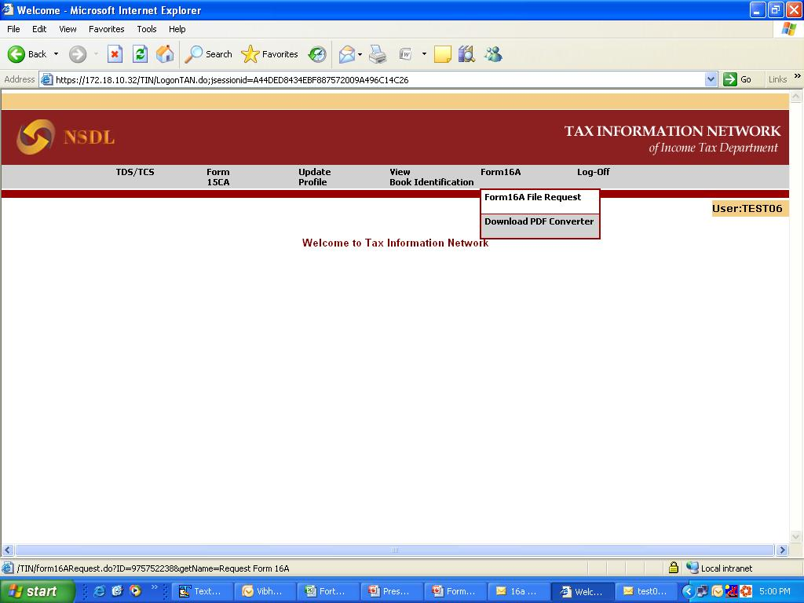
Online TAN Account –
Request for Form 16A file
Users can request Form 16A from F.Y. 2010-11 onwards
Tax Information Network of Income Tax Department (managed by NSDL)

Slide 6
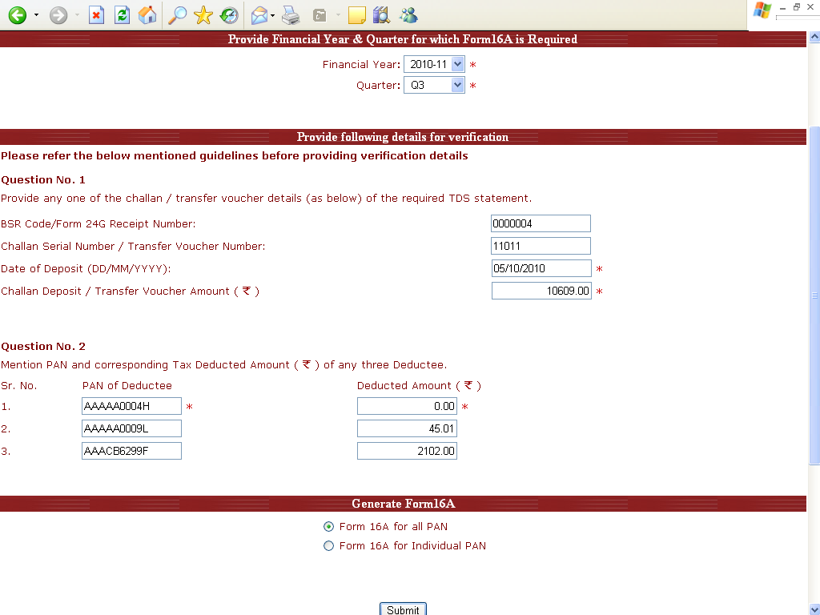
Online TAN Account –
Input Screen for Request for Form 16A
Form 16A files can be requested for the period for which TDS/TCS statement has been successfully accepted at the TIN central system.
Please check status of TDS/TCS statement at the TIN website under ‘Quarterly Statement Status’ view.
Select Financial Year and Quarter from the drop down for which Form 16A is required.
Tax Information Network of Income Tax Department (managed by NSDL)

Slide 7
Guidelines to request Form 16A file
Verification details:
To request for the Form 16A file, provide the following updated details (corrected details, if any correction statement is submitted and accepted) of the TDS statement for the quarter for which file is required:
  challan/transfer voucher and
  deductee details
If statements for Form 26Q and 27Q are filed for the period of request of Form 16A (example, request for F.Y. 2010-11, Q4), provide details pertaining to any one statement.
Example: if challan / transfer voucher details are provided for Form 26Q, deductee details also should be provided of Form 26Q only.
Question No 1.
  Provide details of any one challan / transfer voucher as reported in the TDS statement for the quarter.
Tax Information Network of Income Tax Department (managed by NSDL)

Slide 8
Guidelines to request Form 16A file
  Question No. 2
  Provide details of any three distinct deductee records (valid PAN and corresponding deducted amount) present in the TDS/TCS statement.
  It is not necessary to mention deductee details associated to the challan / transfer voucher provided in question no.1.
  Example:
  Any of the ticked details can be mentioned during verification
  In case of multiple entries for a PAN in TDS/TCS return, individual amount for a record is to be quoted not the sum total of amount deducted for that PAN.
PAN and Amount of Tax deducted to be quoted when Count of Deductee records is more than 3 in the TDS/TCS return
Sr. No. | PAN of Deductee | PAN with multiple records with same deducted amount |  | PAN with multiple records with different deducted amount
 |  | Amount of Tax deducted | To be quoted | Amount of Tax deducted | To be quoted
1 | BJDPS4564B | 1000.00 |  | 1,000.00
2 | BJDPS4564B | 1000.00 |  | 4,000.00
3 | BJDPS4564B | 1000.00 |  | 5,500.00
4 | ADAPR1234B | 2500.00 |  | 2,500.00
5 | BATPS1448G | 3000.00 |  | 3,000.00
Tax Information Network of Income Tax Department (managed by NSDL)

Slide 9
Guidelines to request Form 16A file
  If distinct deductee detail record in the quarter is less than three then provide available distinct combination of valid PAN of deductee and corresponding deducted amount.
  For example:
  **You may mention all three transactions or only one
PAN and Amount of Tax deducted to be quoted when Count of Deductee records is equal to or less than 3 (different PAN and deducted amount)
Sr No | PAN of Deductee | PAN with multiple records same deducted amount
 |  | Amount of Tax deducted | To be quoted
1 | BJDPS4564B | 1000.00
2 | ADAPR1234B | 2500.00
3 | BATPS1448G | 3000.00
PAN and Amount of Tax deducted to be quoted when Count of Deductee records equal to or less than 3 (same PAN and deducted amount)**
Sr No | PAN of Deductee | PAN with multiple records different deducted amount
 |  | Amount of Tax deducted | To be quoted
1 | BJDPS4564B | 1000.00
2 | BJDPS4564B | 1000.00
3 | BJDPS4564B | 1000.00
Tax Information Network of Income Tax Department (managed by NSDL)

Slide 10
Online TAN Account –
Verification Screen for Form 16A
Provide details of any one challan / transfer voucher present in the TDS/TCS statement.
Tax Information Network of Income Tax Department (managed by NSDL)

Slide 11
Online TAN Account –
Verification Screen for Form 16A
Provide details of any three distinct deductee records (PAN and corresponding deducted amount) present in the TDS/TCS statement, i.e. it is not required to mention deductee details which are associated to the challan / transfer voucher provided.
If distinct deductee details record in the statement is less than three then provide available distinct combination of PAN of deductee and corresponding deducted amount
Tax Information Network of Income Tax Department (managed by NSDL)

Slide 12
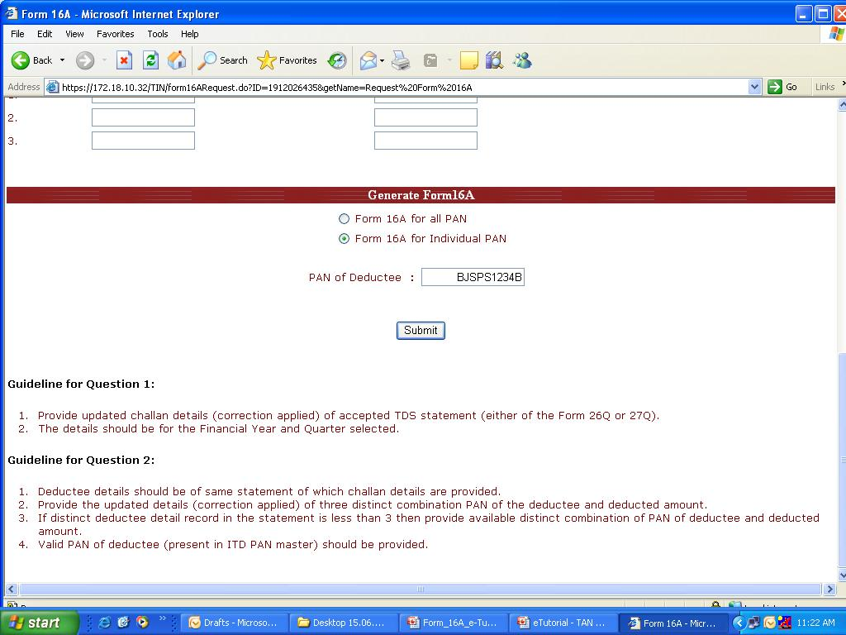
Online TAN Account –
Option to place request for Form 16A
Option 1
Option 2
Request for Form 16A can be placed
either for all PANs or
for a single PAN for which statement has been filed in the quarter.
On selecting the option for Form 16A for Individual PAN, deductor needs to fill in the PAN of the deductee for which Form 16A is required.
Text file in compressed format (.zip) will be sent on registered email ID.
Tax Information Network of Income Tax Department (managed by NSDL)

Slide 13
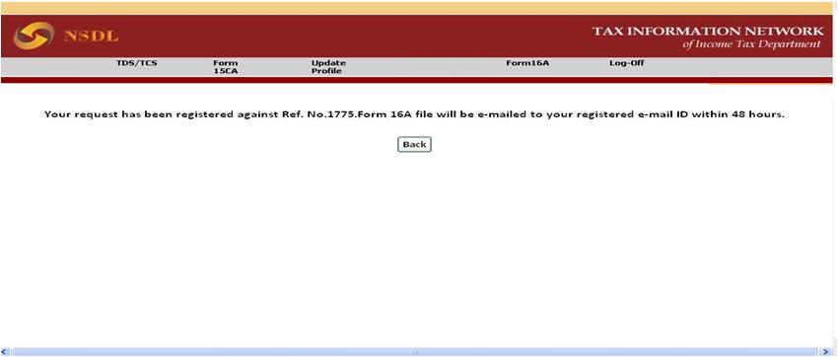
Online TAN Account –
Form 16A File Request Confirmation Screen
After successful verification, request number is generated and the Form 16A file is e-mailed to the user within 48 hours on the e-mail ID provided at the time of TAN registration.
Tax Information Network of Income Tax Department (managed by NSDL)

Slide 14
Form 16A Text File
On successful request, Form 16A text file (in compressed format .zip) will be sent on the registered email ID provided in the TAN account within 48 hours.
If Form 16A file is greater than 2 MB after zipping, then the Form 16A zip files will be sent in multiple files of 2 MB.
In order to convert the text file into PDF, user has to download PDF Converter Utility from the TAN account.
Tax Information Network of Income Tax Department (managed by NSDL)

Slide 15
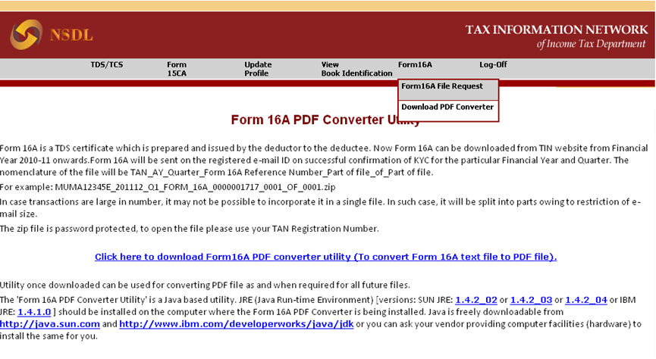
Online TAN Account –
Form 16A PDF Converter Utility Download screen
Click to download PDF Converter Utility.
Tax Information Network of Income Tax Department (managed by NSDL)

Slide 16
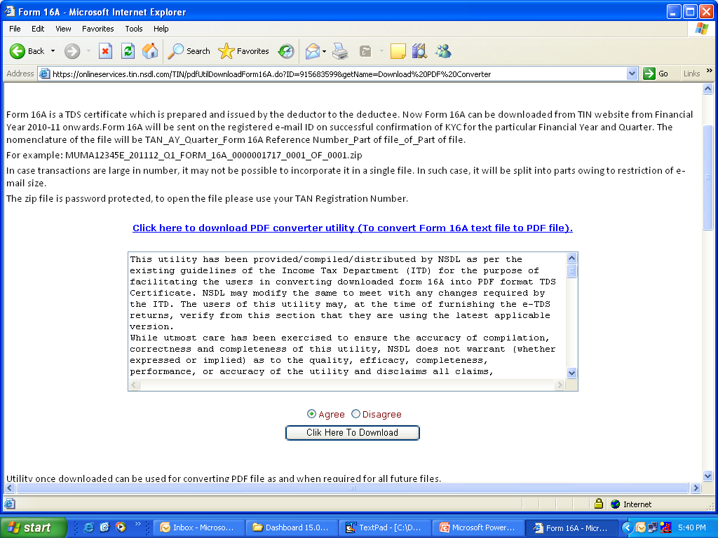
Terms and Conditions to download
Form 16A PDF Converter Utility
Read ‘Terms and Conditions’ to download PDF converter utility.
Click on the link above to read the ‘Terms and Conditions’ to download the Form 16A PDF Converter Utility.
Click ‘Agree’ to activate the option ‘Click Here To Download’ the PDF converter utility.
Tax Information Network of Income Tax Department (managed by NSDL)

Slide 17
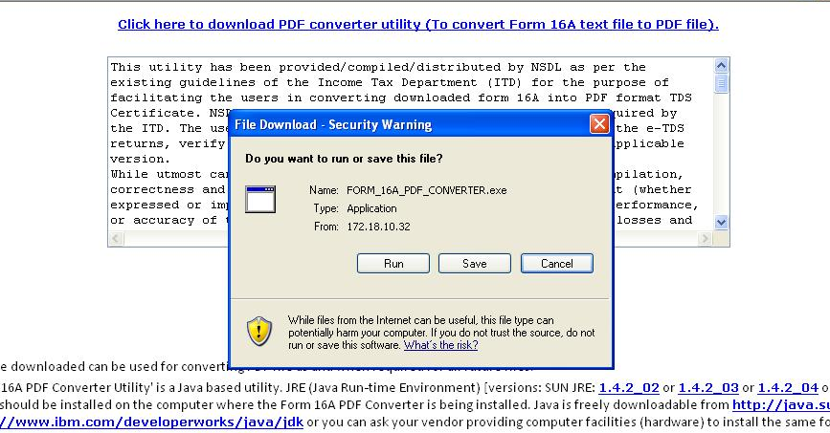
Download Form 16A PDF Converter Utility from TAN Account
Click ‘save’ to download and save the Form 16A PDF Converter Utility on your computer.
Tax Information Network of Income Tax Department (managed by NSDL)

Slide 18
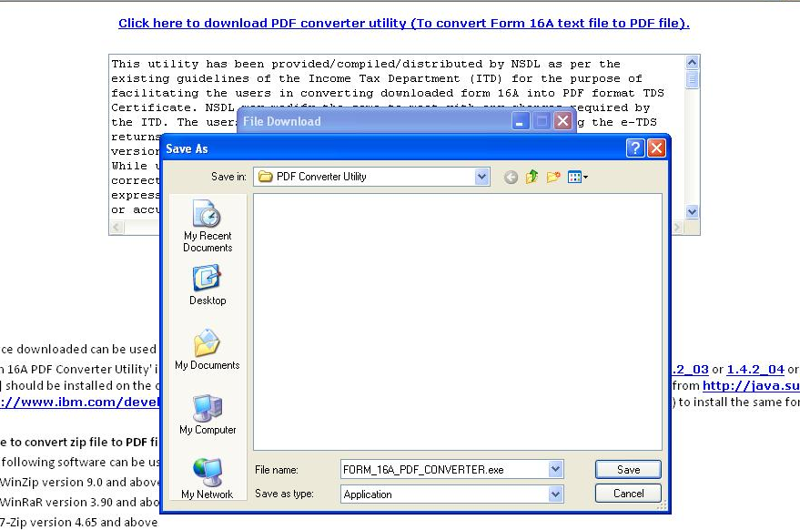
Form 16A PDF Converter Utility Download
Provide path to save the Form 16A PDF converter utility.
Tax Information Network of Income Tax Department (managed by NSDL)

Slide 19
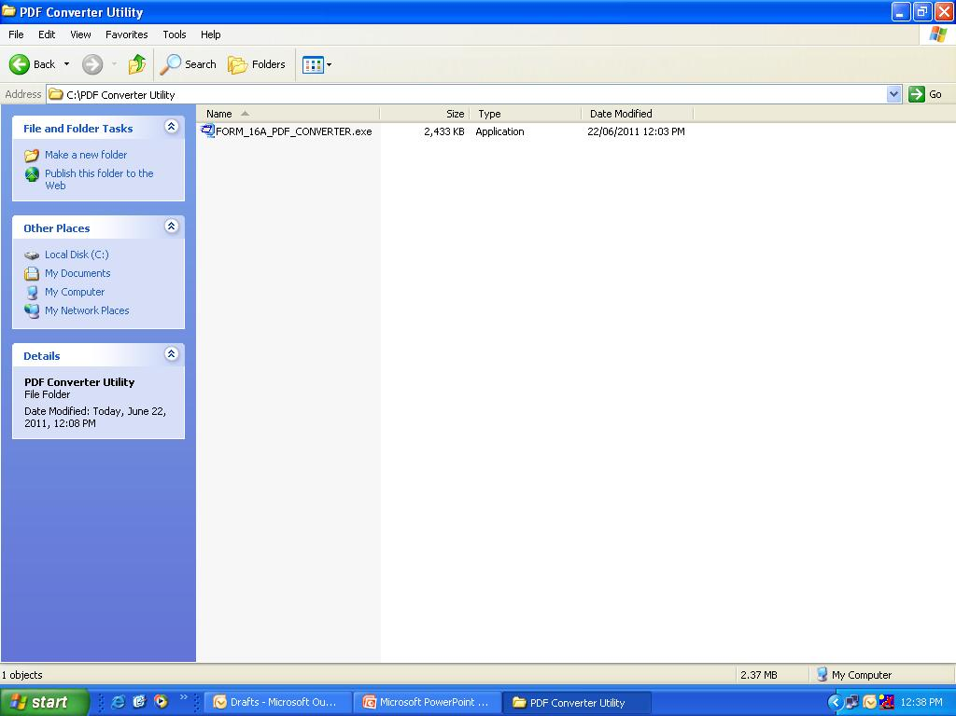
Form 16A PDF Converter Utility Download
File saved at the selected path in the C drive in folder named FORM_16A_PDF_CONVERTER.exe.
Tax Information Network of Income Tax Department (managed by NSDL)

Slide 20
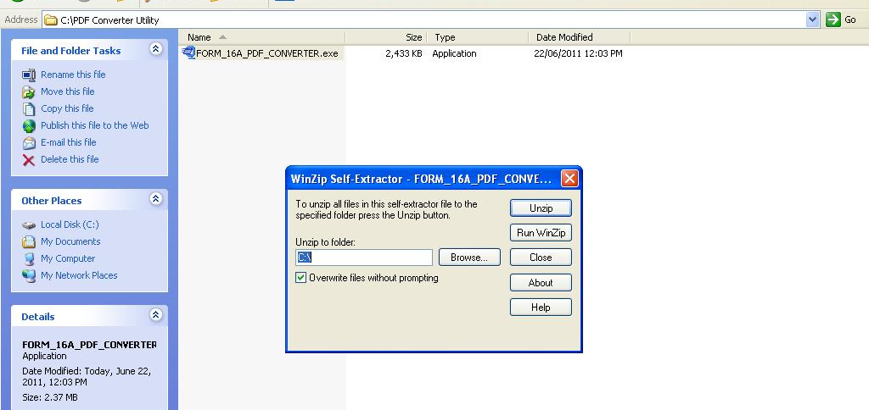
Unzipping Form 16A PDF Converter Utility
Double click on ‘FORM_16A_PDF_CONVERTER.exe’ to extract the Form 16A PDF Converter Utility.
To extract the utility click on unzip. Default path will be C drive. To provide any other path click on ‘Browse’ and select the desired path to save the Form 16A PDF converter utility.
Tax Information Network of Income Tax Department (managed by NSDL)

Slide 21
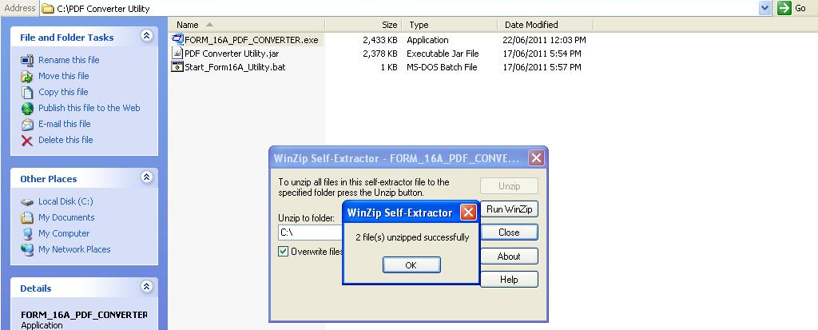
Form 16A PDF Converter Utility unzipped
After unzipping two files are created ‘PDF Converter Utility.jar’ and ‘Start_Form16A_Utility.bat’.
Tax Information Network of Income Tax Department (managed by NSDL)

Slide 22
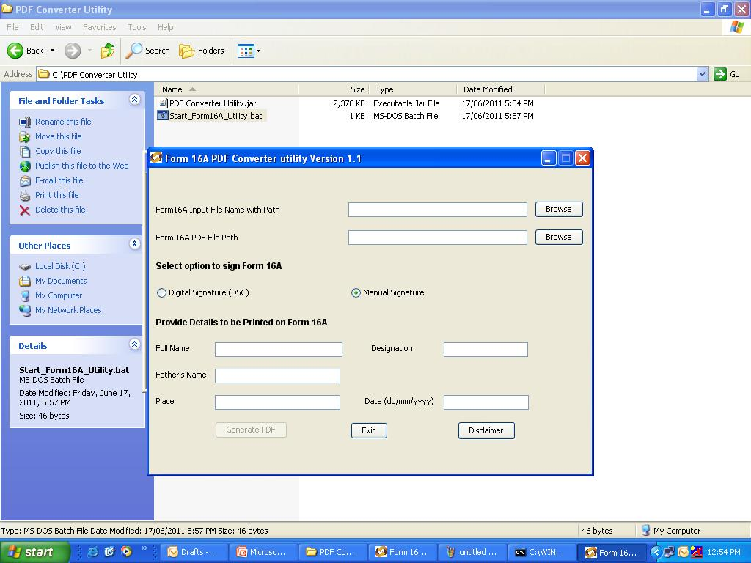
Executing Form 16A PDF Converter Utility
Double click on ‘Start_Form16A_Utility.bat’ to operate the Form 16A PDF Converter Utility.
Tax Information Network of Income Tax Department (managed by NSDL)

Slide 23
Procedure to convert Form 16A text file to Form 16A PDF File
Extract Zip file containing Form 16A data in text form by using WinZip version 9.0 and above, WinRaR version 3.90 and above and 7-Zip version 4.65 and above.
Extract zip file by providing the TAN registration number.
Open the “Form 16A PDF converter utility” by double clicking the file “PDF Converter Utility.jar”.
Click on “Browse” button of “Form 16A Input File Name with Path” and provide path of Form 16A text files.
Option to digitally sign or manually sign Form 16A is available.
Tax Information Network of Income Tax Department (managed by NSDL)

Slide 24
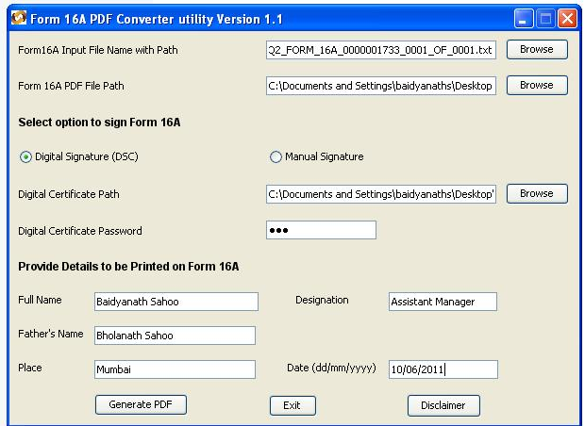
Procedure to generate Form 16A PDF File with Digital Signature
Browse and select Input file Form 16A text file received from TIN website.
Browse and select Output file path to generate Form 16A PDF file.
Browse and select DSC to digitally sign Form 16A PDF.
Enter Password of DSC. Password is case sensitive.
Provide following details of responsible person to be printed on Form 16A.
Click to generate PDF.
Tax Information Network of Income Tax Department (managed by NSDL)

Slide 25
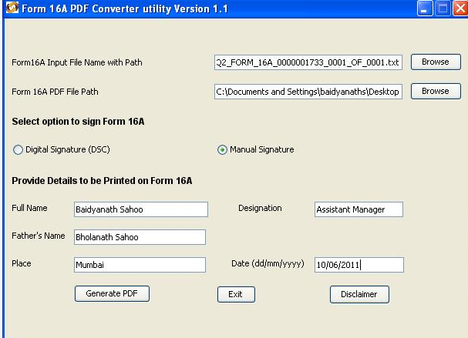
Procedure to generate Form 16A PDF File with Manual Signature
Browse and select Input file Form 16A text file received from TIN website.
Browse and select Output file path to generate Form 16A PDF file.
Select ‘manual signature’ to generate PDF. Utility will generate Form 16A without signature of responsible person. Deductor has to print and sign each physical Form 16A manually.
Provide following details of responsible person to be printed on Form 16A.
Click to generate PDF.
Tax Information Network of Income Tax Department (managed by NSDL)

Slide 26
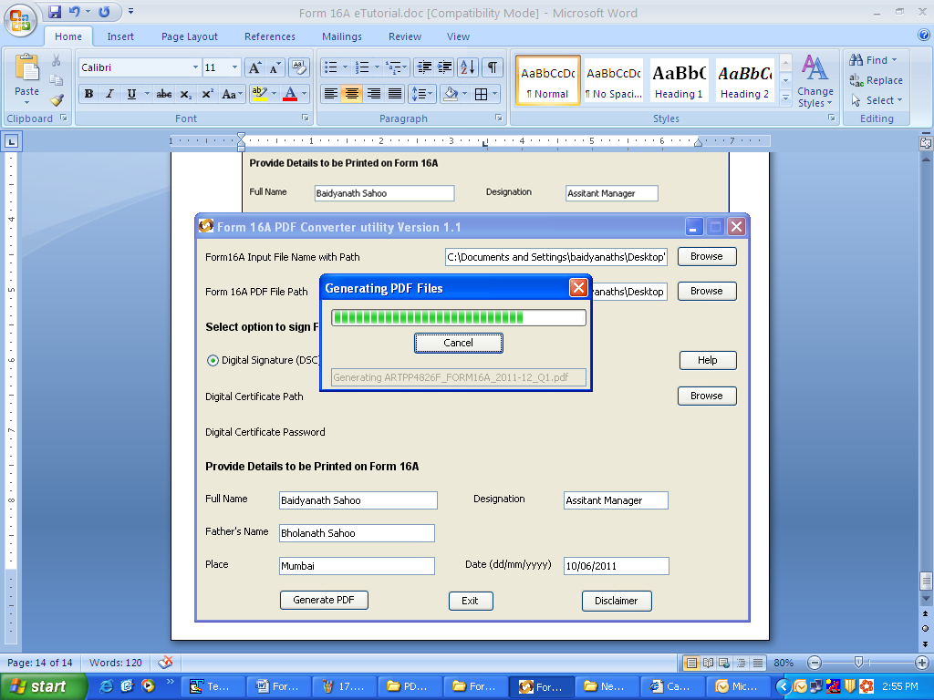
Generation of Form 16A PDF File
PDF files getting generated
Tax Information Network of Income Tax Department (managed by NSDL)

Slide 27
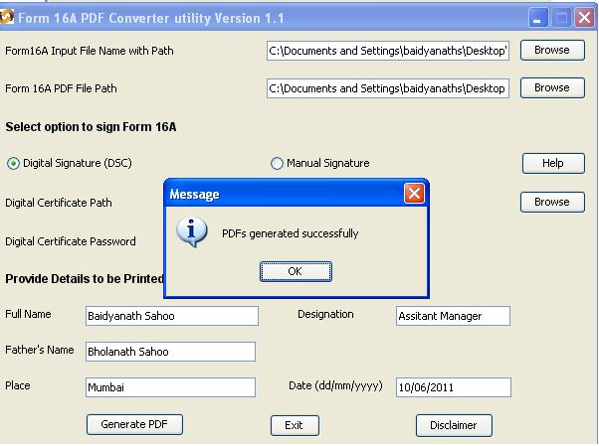
Successful generation of Form 16A PDF
PDF files generated successfully at the provided path
Tax Information Network of Income Tax Department (managed by NSDL)

Slide 28
Form 16A PDF
Form 16A PDF will be generated in a folder.
Nomenclature of the folder: TAN_Form16A_FY_Quarter_date of PDF conversion.
For example: AGRA10001E_FORM16A_2011-12_Q1_20-06-2011
Form 16A PDF will be generated PANwise.
Nomenclature of PDF: PAN_Form16A_2011-12_Quarter.pdf
For example: AAACA1924F_FORM16A_2011-12_Q1.pdf
Form 16A file is generated for valid PANs only.
For deductee records with invalid PANs or PAN which are not present in the Income Tax Department database, PDF will not be generated.
Tax Information Network of Income Tax Department (managed by NSDL)

Slide 29
Contents of Form 16A
Form 16A from TIN will contain the following details:
  Six digit unique Form 16A certificate number
  TAN of Deductor
  PAN of the deductee
  Name and Address of Deductor and Deductee*
  Name of Commissioner of Income Tax (TDS)
  Assessment Year and Period (quarter)
  Nature of payment wise details of amount paid/credited
  *Name and address of TAN and PAN will be as per data available in ITD database
Tax Information Network of Income Tax Department (managed by NSDL)

Slide 30
Contents of Form 16A
Form 16A from TIN will contain the following details:
  Status of Booking
  Summary of tax deducted at source in respect of deductee
  Details of tax deducted and deposited through challans
  Details of tax deducted and deposited through transfer voucher
  ‘Last Updated’ date till which details of Form 16A is updated
  Verification and responsible person details
Tax Information Network of Income Tax Department (managed by NSDL)

Slide 31
Sample Form 16A PDF
Form 16A PDF file with digital signature
Form 16A PDF file without digital signature
Tax Information Network of Income Tax Department (managed by NSDL)

Slide 32
Thank You
Tax Information Network of Income Tax Department (managed by NSDL)

