Slide 1
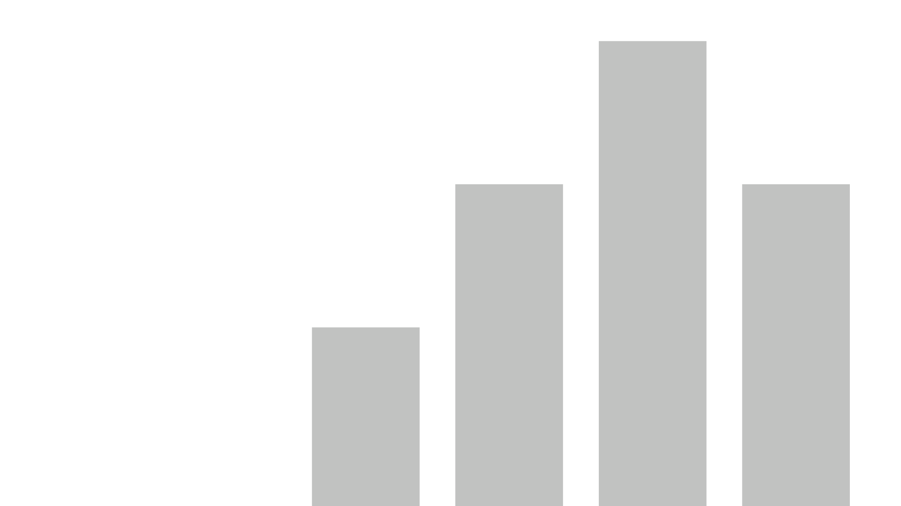


Healthy Lifestyle Analysis
View in Power BI
Data Analytics Bootcamp
Final project
Anne Adler
19.05.2022

Slide 2
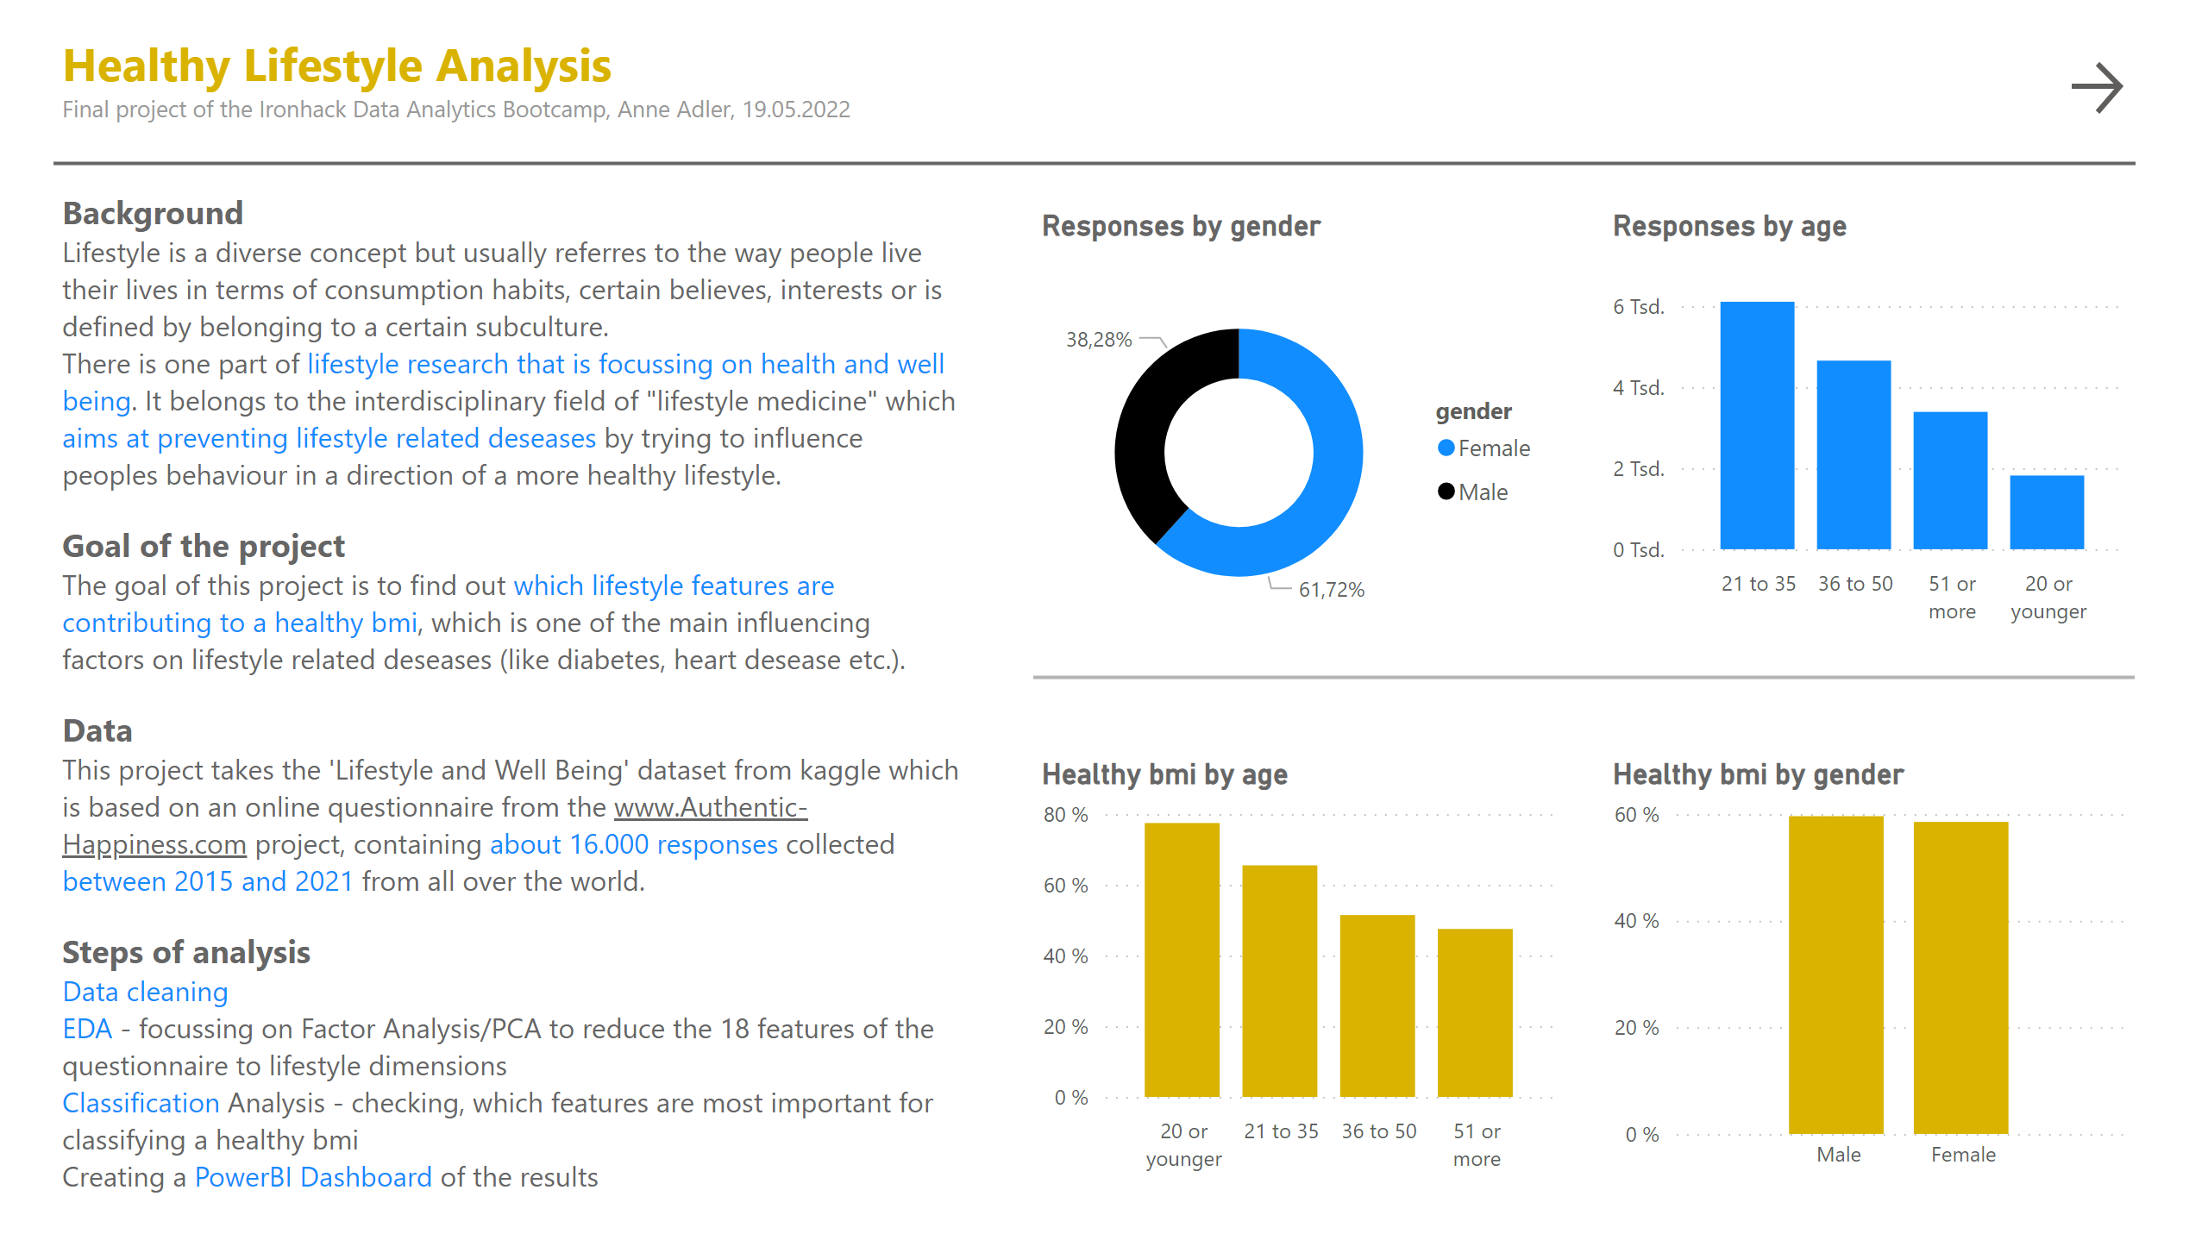
About
Notes:
textbox
No alt text provided
shape
No alt text provided
textbox
No alt text provided
Responses by age
No alt text provided
Healthy bmi by gender
No alt text provided
Healthy bmi by age
No alt text provided
Responses by gender
No alt text provided
shape
No alt text provided
actionButton
No alt text provided

Slide 3
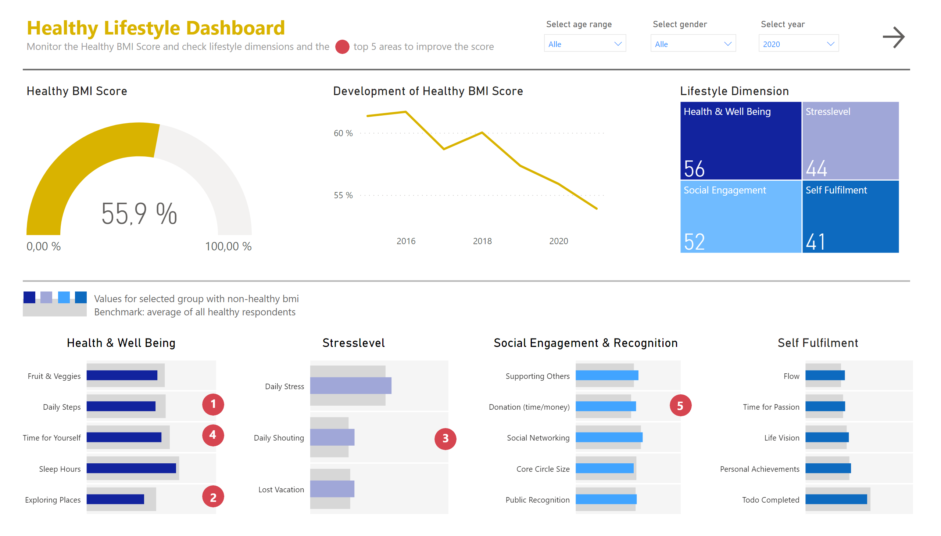
Dashboard
Notes:
Healthy BMI Score
No alt text provided
Development of Healthy BMI Score
No alt text provided
textbox
No alt text provided
shape
No alt text provided
slicer
No alt text provided
slicer
No alt text provided
slicer
No alt text provided
Lifestyle Dimension
No alt text provided
Social Engagement & Recognition
No alt text provided
Stresslevel
No alt text provided
Health & Well Being
No alt text provided
Self Fulfilment
No alt text provided
shape
No alt text provided
shape
No alt text provided
shape
No alt text provided
shape
No alt text provided
shape
No alt text provided
textbox
No alt text provided
textbox
No alt text provided
textbox
No alt text provided
textbox
No alt text provided
textbox
No alt text provided
shape
No alt text provided
shape
No alt text provided
shape
No alt text provided
shape
No alt text provided
shape
No alt text provided
shape
No alt text provided
textbox
No alt text provided
shape
No alt text provided
actionButton
No alt text provided

Slide 4
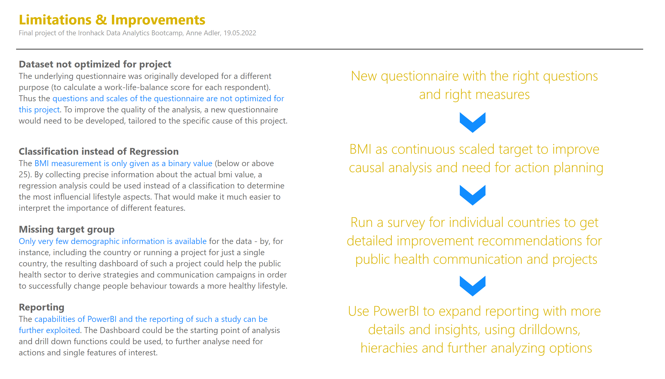
Wrap-up
Notes:
textbox
No alt text provided
textbox
No alt text provided
shape
No alt text provided
textbox
No alt text provided
textbox
No alt text provided
textbox
No alt text provided
textbox
No alt text provided
shape
No alt text provided
shape
No alt text provided
shape
No alt text provided

