Slide 1
Screens
Text to follow

Slide 2
Title
Nutrition
Mission

Slide 3

Mission assign
Mission
Picture
Mission
Assignment

Slide 4
DFAC Decision
Eat DFAC
Eat Out

Slide 5
Eat DFAC
DFAC Simulation

Slide 6
DFAC Report
Final Report from DFAC Nutrition
Mission
Update

Slide 7
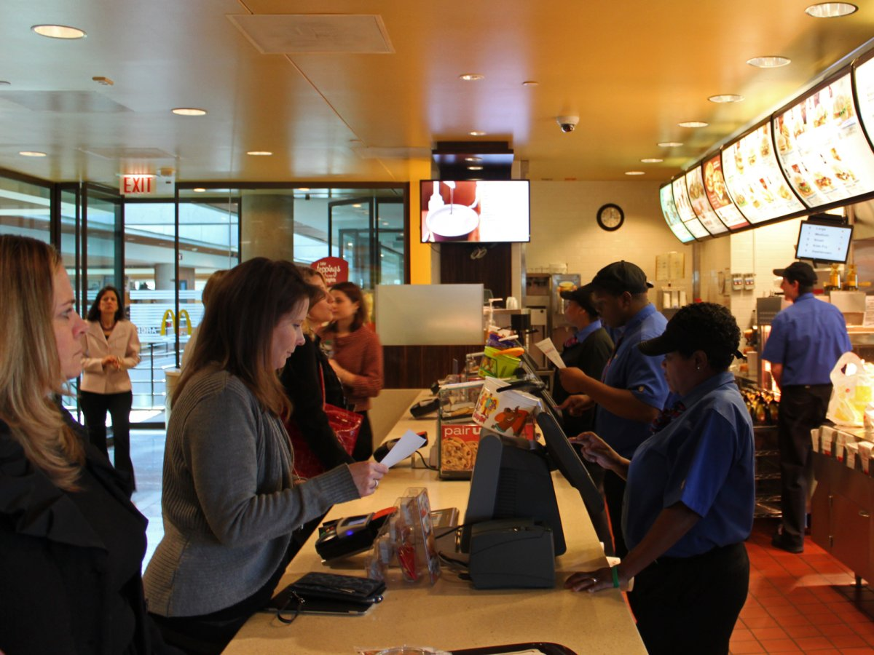
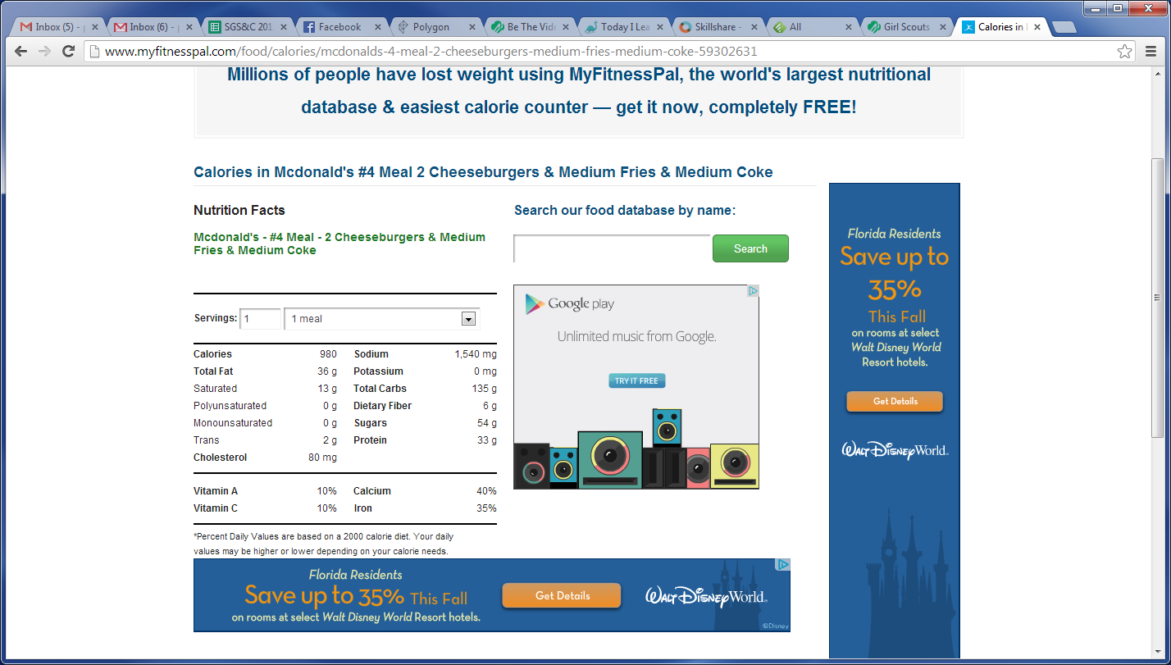
Eat Out
Continue

Slide 8
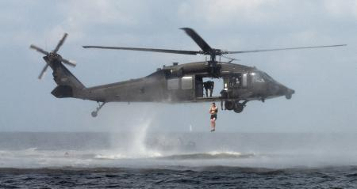
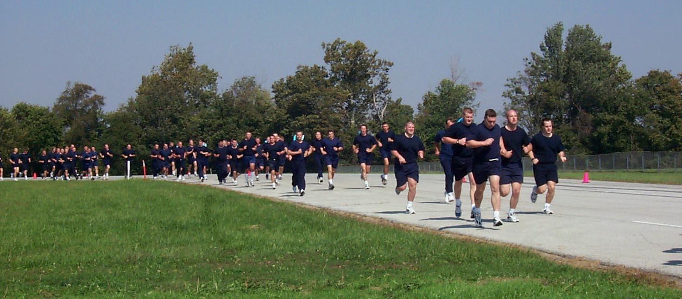
Mission Report Success
Due to bad nutritional habits you are being sent for additional PT. Report to Mean Jean the Training Machine for your remediation. Next time pay attention to what you are doing to your body.
Finish

Slide 9
Mission Report Failure
Due to your awesome nutrition you get to go Helocasting. This is obviously totally rad!
Try Again

