Slide 1
TraxEco IT Inventory System
Indonesian Customs (Bea Cukai) Compliance & INSW Integration
Live System Screenshot Deck • Bea Cukai PER-24/BC/2023 Specification
INSW API Gateway | PER-24/BC/2023 | 05:00 AM Daily Cut-off Window | Live App Captures

Slide 2

Executive Overview & System Dashboard
Live Application Command Center for Declarations & Stock Tracking
System Highlights
✔ PER-24/BC/2023: 100% compliant with Bea Cukai mandatory schemas.
✔ Real-time Metrics: Instant tracking of inbound, outbound & pending files.
✔ AXDB ERP Sync: Direct connection to enterprise ERP database.
✔ 05:00 AM Cut-off: Automated daily operational audit window.

Slide 3

Daftar Barang Master (Customs Item Master)
Live Master Item Aggregator with Automated Categories 1 to 8
Master Data Features
✔ Unique Aggregation: Deduplicates Kode Barang across all declarations.
✔ Kategori 1 - 8 Badges: Visual badges for Mesin, Bahan Baku, Produksi, Scrap, WIP.
✔ Auditor Filter: Dropdown filter for Bea Cukai category inspection.
✔ Sticky Header: Seamless scrolling with numbered page buttons.

Slide 4

Pemasukan & Pengeluaran (Automated PDF Import)
Live Vector OCR Extractor & 3-Layer Category Classifier
PDF Import Features
✔ Multi-Format Parsing: BC 2.0, BC 2.3, BC 2.7, BC 4.0, BC 2.6.1 & BC 2.6.2.
✔ Zero Manual Entry: Extracts items directly from vector PDF structure.
✔ 3-Layer Classifier: Matches HS Code, Keywords & Custom DB Mappings.
✔ Automatic Kategori: Fills INSW Category codes 1-8 with 0 manual clicks.

Slide 5
Stock Opname Management (kdKegiatan: 32)
Live AXDB Stock Opname Journal Sync & Physical Stock Count
Stock Opname Features
✔ AXDB Journal Sync: Direct physical stock count sync from ERP.
✔ System Balance Check: Compares actual stock counts against system balance.
✔ 5AM Cut-off Window: DATEADD(hour, -5, t.MODIFIEDDATETIME) SQL logic.
✔ Batch Push: Direct single-click push to INSW API gateway.

Slide 6
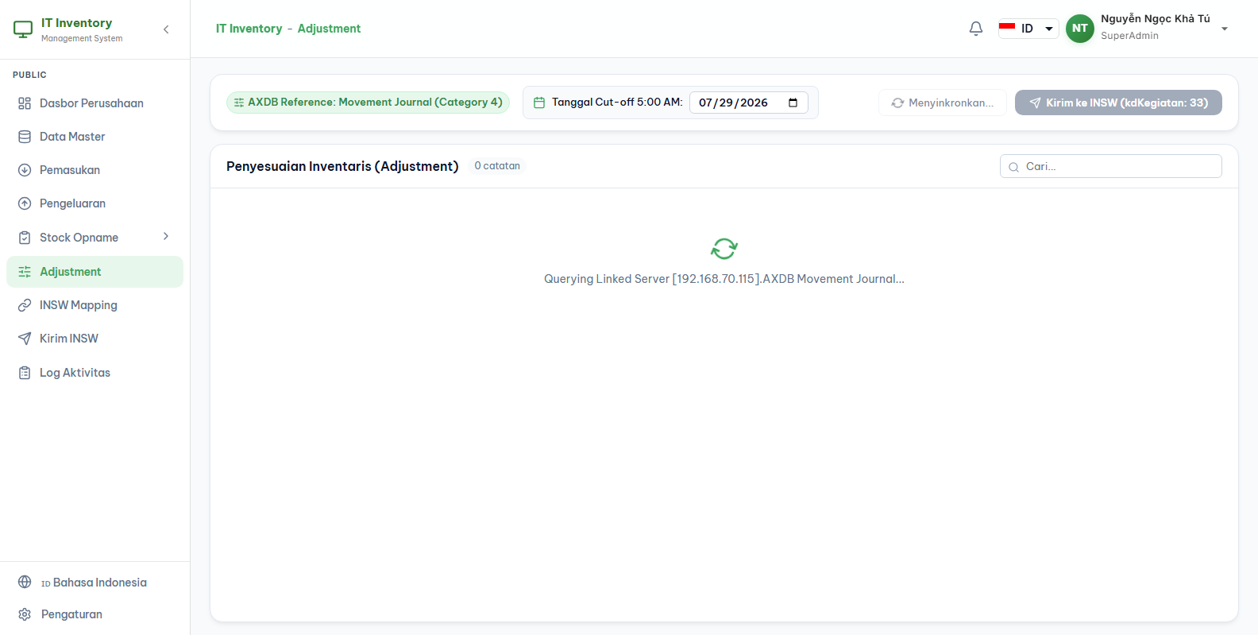
Inventory Adjustment (kdKegiatan: 33)
Live AXDB Movement Journal Synchronization for Stock Gain & Loss
Adjustment Features
✔ Movement Journal Sync: Syncs adjustment entries from AXDB Movement Journal.
✔ Stock Gain & Loss: Handles positive gains and negative losses/scrap correctly.
✔ Audit Reference: Tracks adjustment document numbers & timestamps.
✔ INSW Transmission: Sends verified adjustment records directly to gateway.

Slide 7

Audit Trail & Push History (INSW_PushLog)
Live Historical Push History & Transmission Audit Log
Push History System
✔ Push Log Database: Stores fileId, username, status, httpStatus & duration.
✔ Full Payload Retention: Saves both Request & Response bodies for inspection.
✔ HTTP 200 Verification: Captures official INSW success response codes.
✔ Duplicate Safeguard: Prevents accidental re-transmission of sent files.

Slide 8
Certified System Readiness
Ready for Official Bea Cukai Audit & INSW Production Deployment
✔ 100% Compliant with Bea Cukai PER-24/BC/2023 & PER-09/BC/2014.
✔ Automated PDF Extractor + Smart Category 1-8 Classifier.
✔ ERP AXDB Synchronization for Stock Opname (32) & Adjustment (33).
✔ 05:00 AM Daily Cut-off Operational Window Calculation.
✔ Complete Push Log Audit Trail & Production Build Verified.

