Slide 1
HTML

Slide 2
HTML
HTML stands for Hyper Text Markup Language
HTML is the standard markup language for creating Web pages
HTML describes the structure of a Web page
HTML consists of a series of elements
HTML elements tell the browser how to display the content
HTML elements label pieces of content such as "this is a heading", "this is a paragraph", "this is a link", etc.

Slide 3
HTML Introduction
<!DOCTYPE html>
<html>
<head>
<title>Page Title</title>
</head>
<body>
<h1>This is a Heading</h1>
<p>This is a paragraph.</p>
</body>
</html>

Slide 4
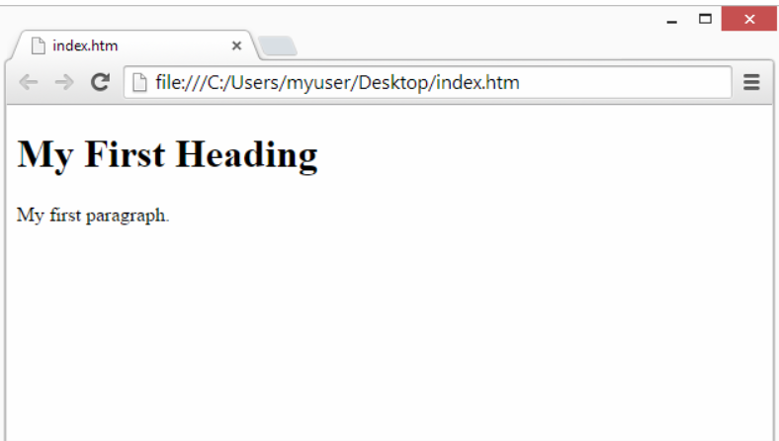

Slide 5
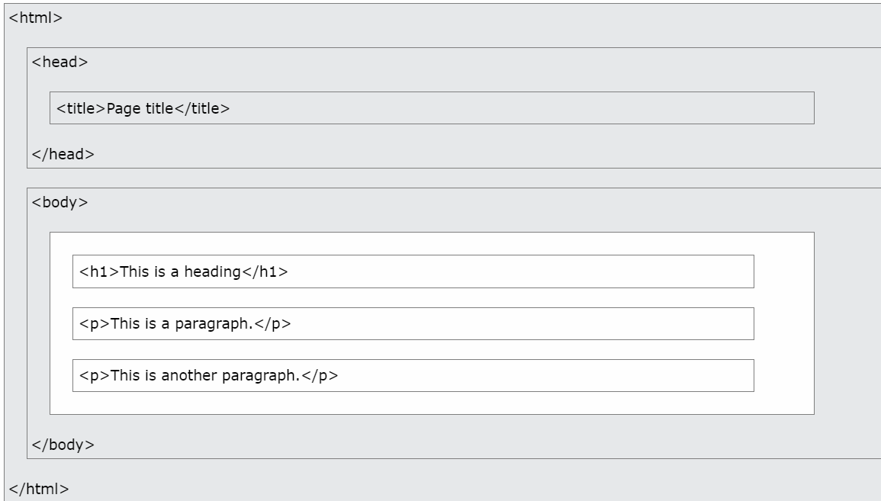
HTML Page Structure

Slide 6
HTML Headings
<h1>This is heading 1</h1>
<h2>This is heading 2</h2>
<h3>This is heading 3</h3>

Slide 7
HTML Paragraphs
<p>This is a paragraph.</p>
<p>This is another paragraph.</p>

Slide 8
HTML Links
<a href="https://www.w3schools.com">This is a link</a>

Slide 9
HTML Images
<img src="w3schools.jpg" alt="W3Schools.com" width="104" height="142">

Slide 10
Nested HTML Elements
<!DOCTYPE html>
<html>
<body>
<h1>My First Heading</h1>
<p>My first paragraph.</p>
</body>
</html>

Slide 11
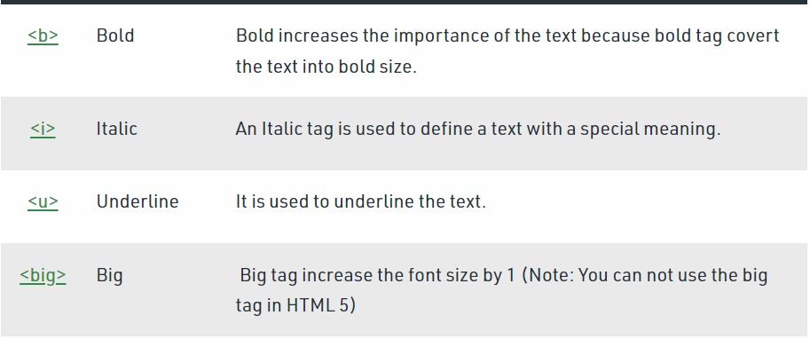
Physical style Tags

Slide 12
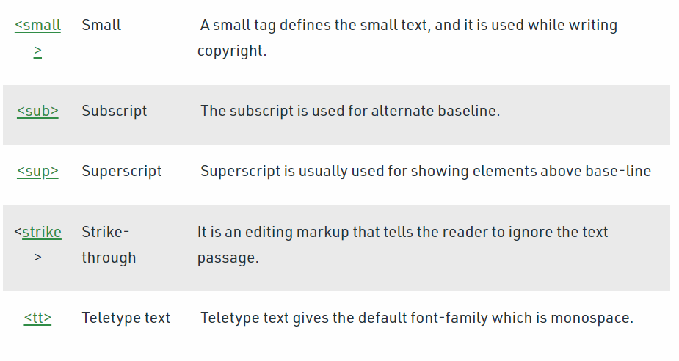

Slide 13
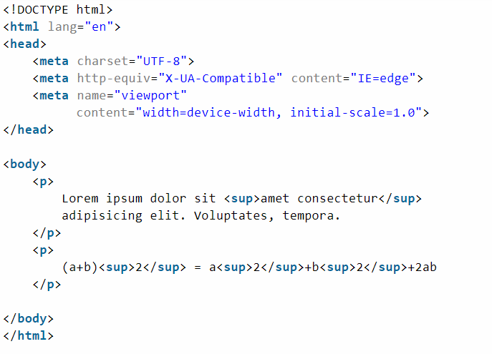
Program

Slide 14
Adding Images
<!DOCTYPE html>
<html>
<head>
<style>
img {
width: 100%;
}
</style>
</head>
<body>
<img src="html5.gif" alt="HTML5 Icon" width="128" height="128">
<img src="html5.gif" alt="HTML5 Icon" style="width:128px;height:128px;">
</body>
</html>

Slide 15
Image as link
<a href="default.asp">
<img src="smiley.gif" alt="HTML tutorial" style="width:42px;height:42px;">
</a>

Slide 16
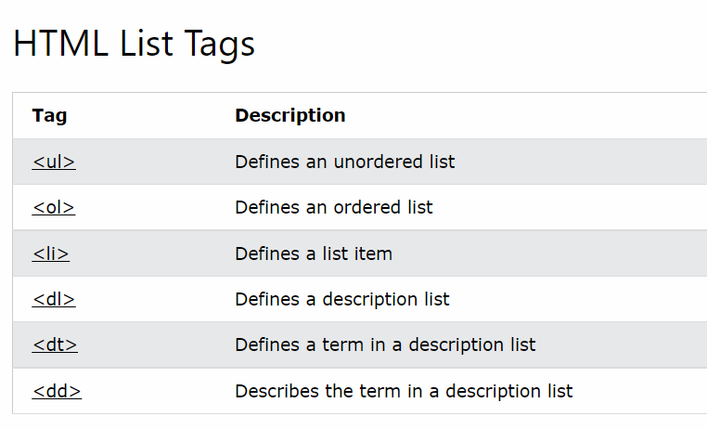
HTML list tags

Slide 17
Unordered List
<ul>
<li>Coffee</li>
<li>Tea</li>
<li>Milk</li>
</ul>

Slide 18
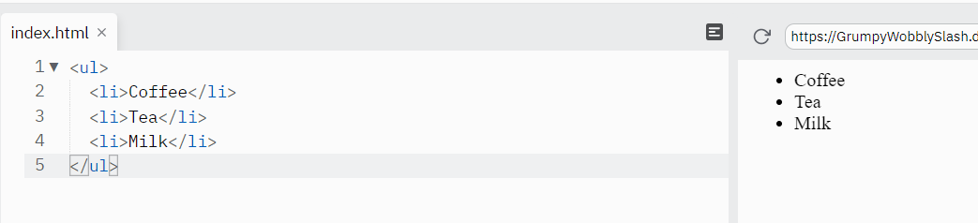
output

Slide 19
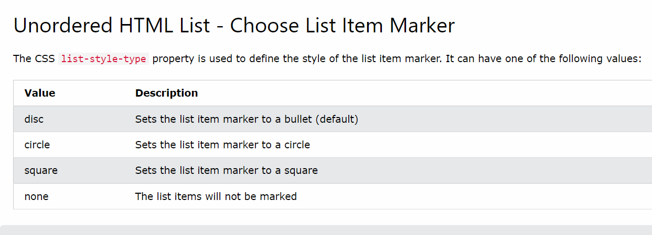

Slide 20
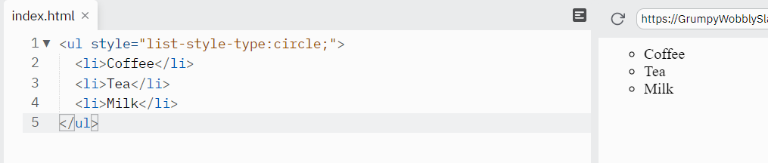

Slide 21
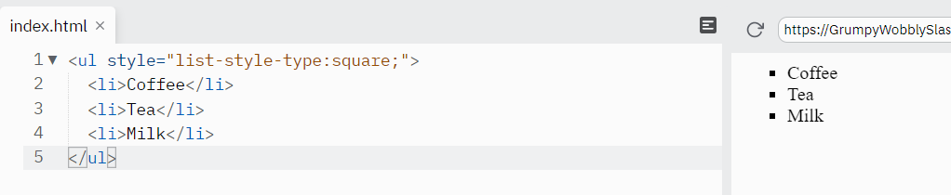

Slide 22
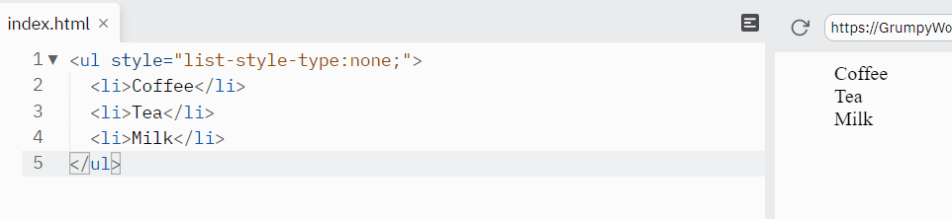

Slide 23
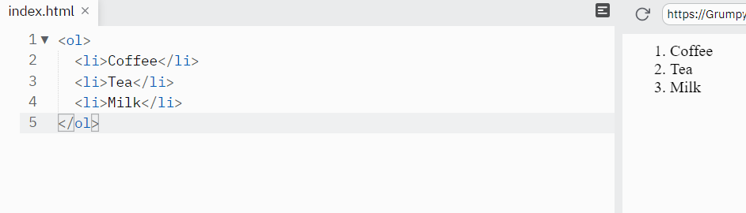
Ordered HTML List

Slide 24
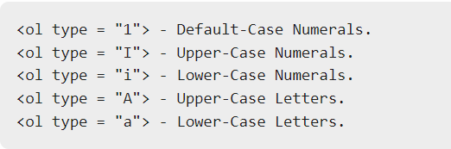
The type Attribute

Slide 25
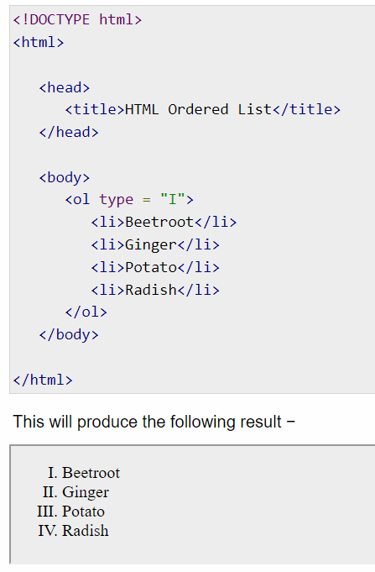

Slide 26
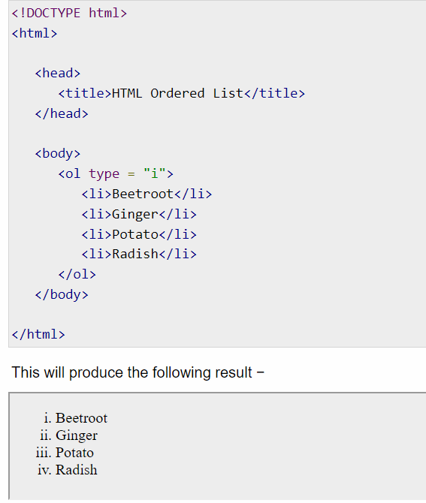

Slide 27
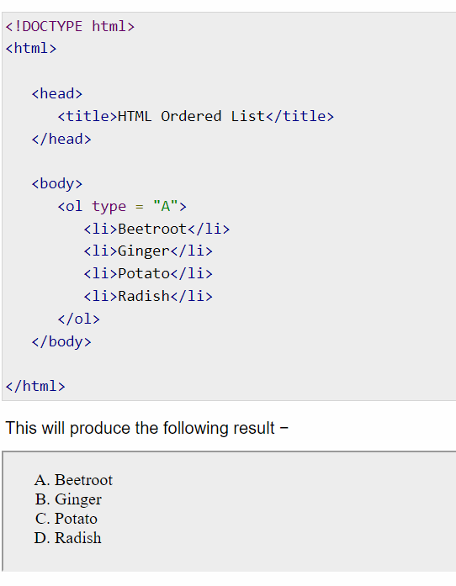

Slide 28
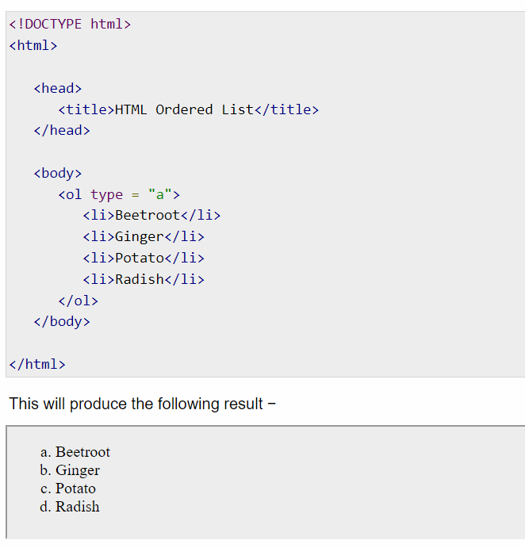

Slide 29
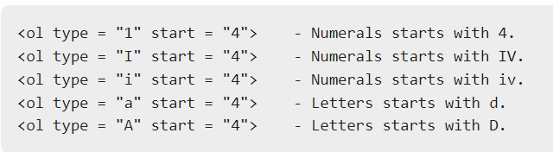

Slide 30
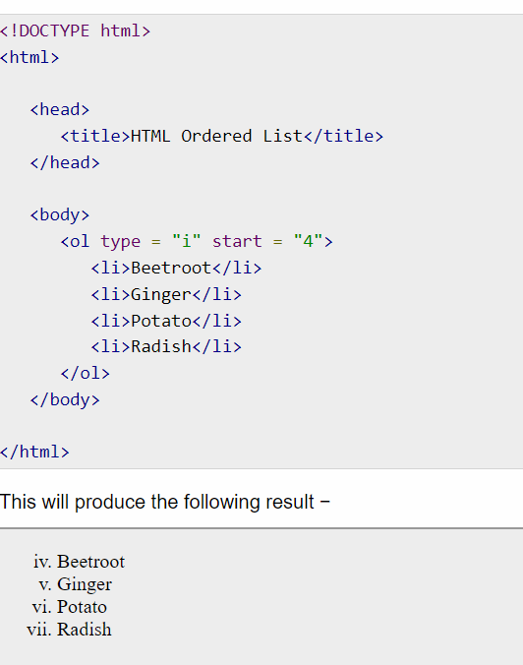

Slide 31
HTML Definition Lists
HTML and XHTML supports a list style which is called definition lists where entries are listed like in a dictionary or encyclopedia. The definition list is the ideal way to present a glossary, list of terms, or other name/value list.
Definition List makes use of following three tags.
<dl> − Defines the start of the list
<dt> − A term
<dd> − Term definition
</dl> − Defines the end of the list

Slide 32
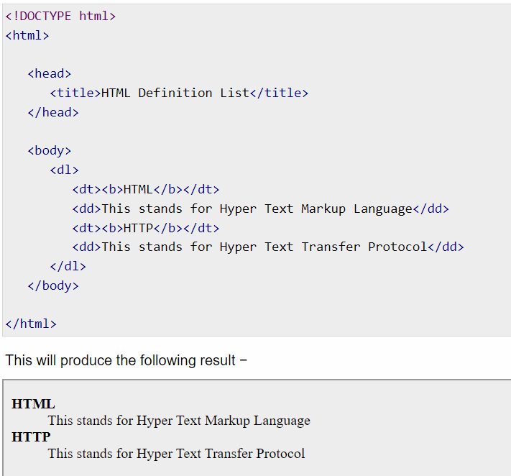

Slide 33
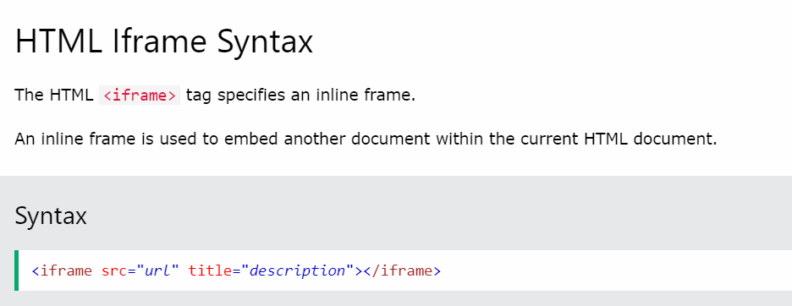
HTML Iframe Syntax

Slide 34
Iframe - Set Height and Width
<iframe src="demo_iframe.htm" height="200" width="300" title="Iframe Example"></iframe>

Slide 35
continue
<iframe src="demo_iframe.htm" style="height:200px;width:300px;" title="Iframe Example"></iframe>

Slide 36
Iframe - Remove the Border
<iframe src="demo_iframe.htm" style="border:none;" title="Iframe Example"></iframe>
With CSS, you can also change the size, style and color of the iframe's border:
<iframe src="demo_iframe.htm" style="border:2px solid red;" title="Iframe Example"></iframe>

Slide 37
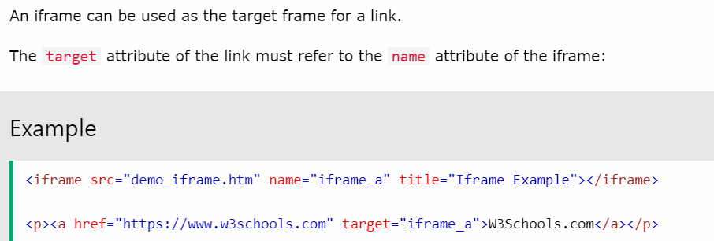
Iframe - Target for a Link

Slide 38
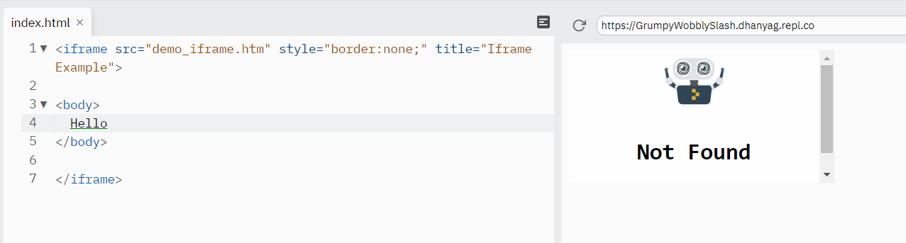

Slide 39
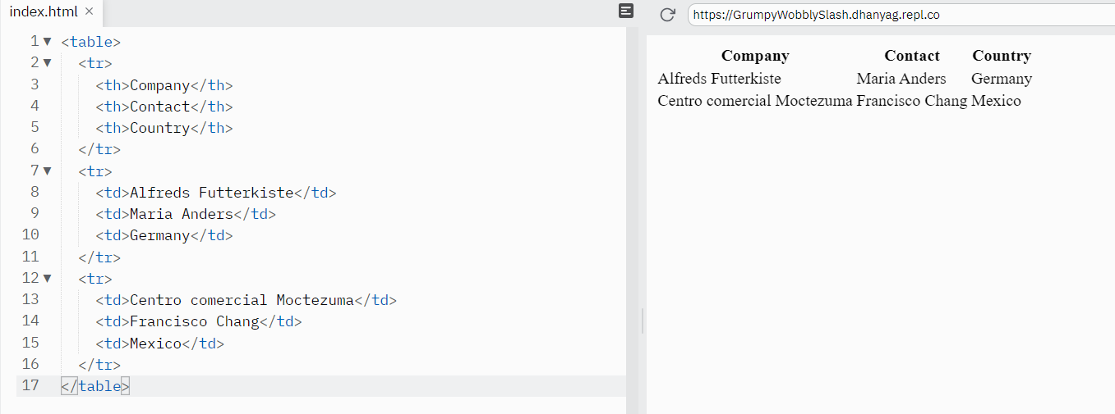
Creating Tables
HTML tables allow web developers to arrange data into rows and columns.

Slide 40
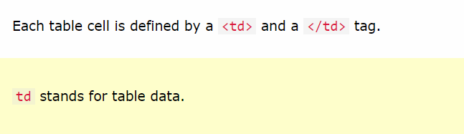
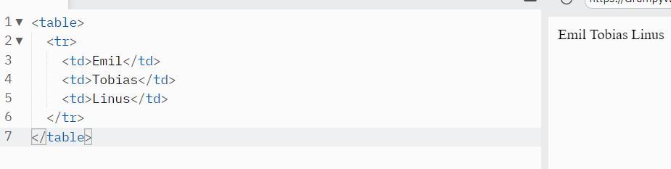
Table Cells

Slide 41
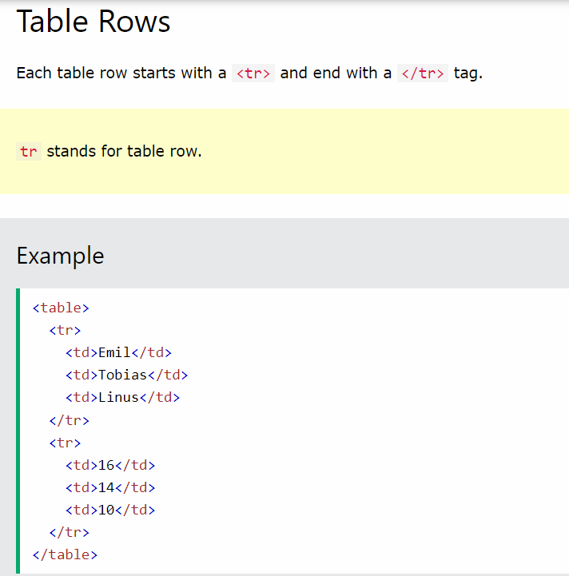

Slide 42
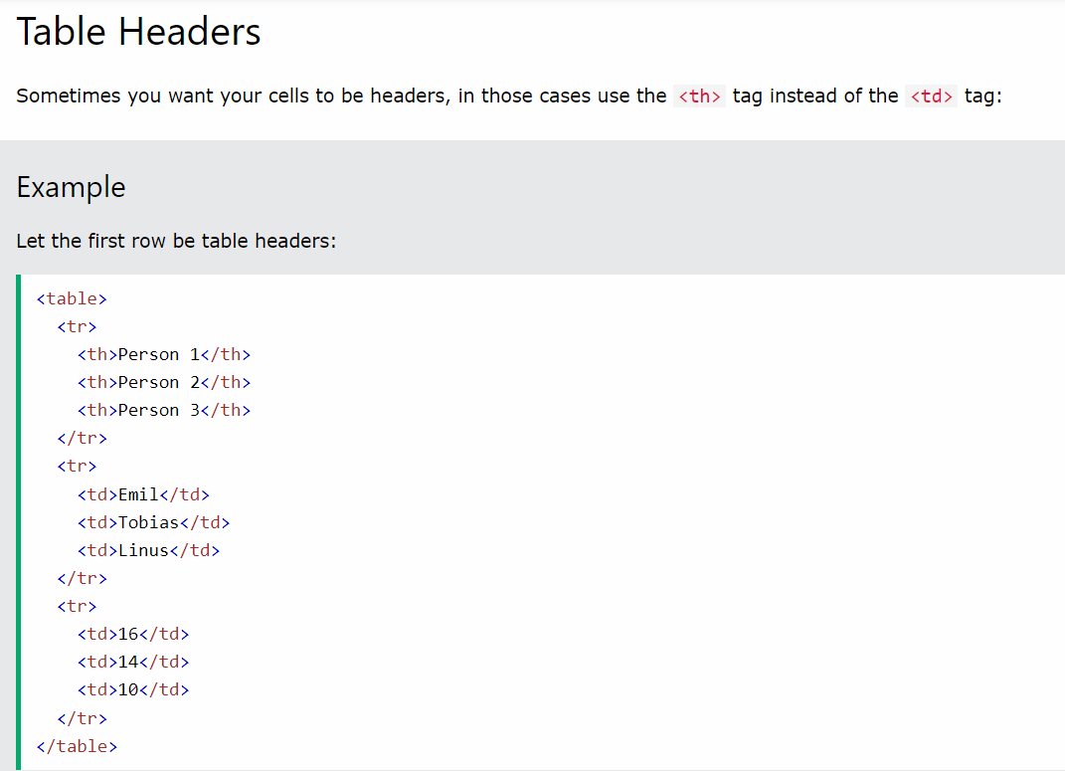

Slide 43
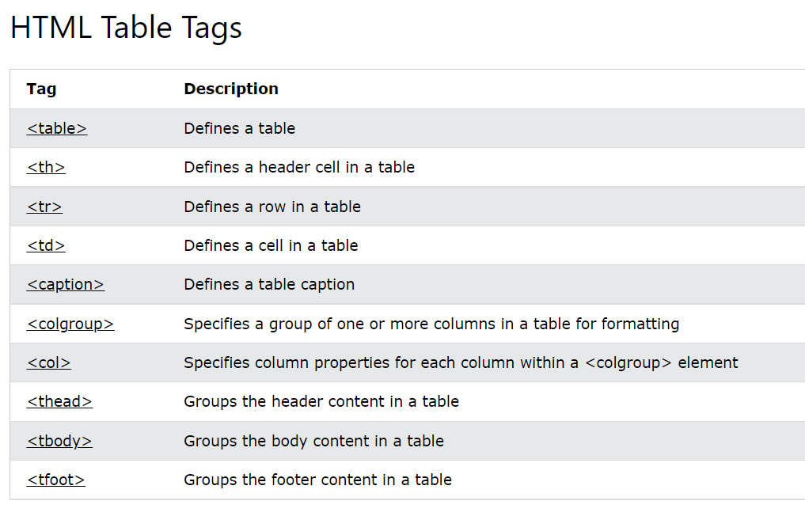

Slide 44
Here is an example of using background attribute. Here we will use an image available in /images directory.

Slide 45
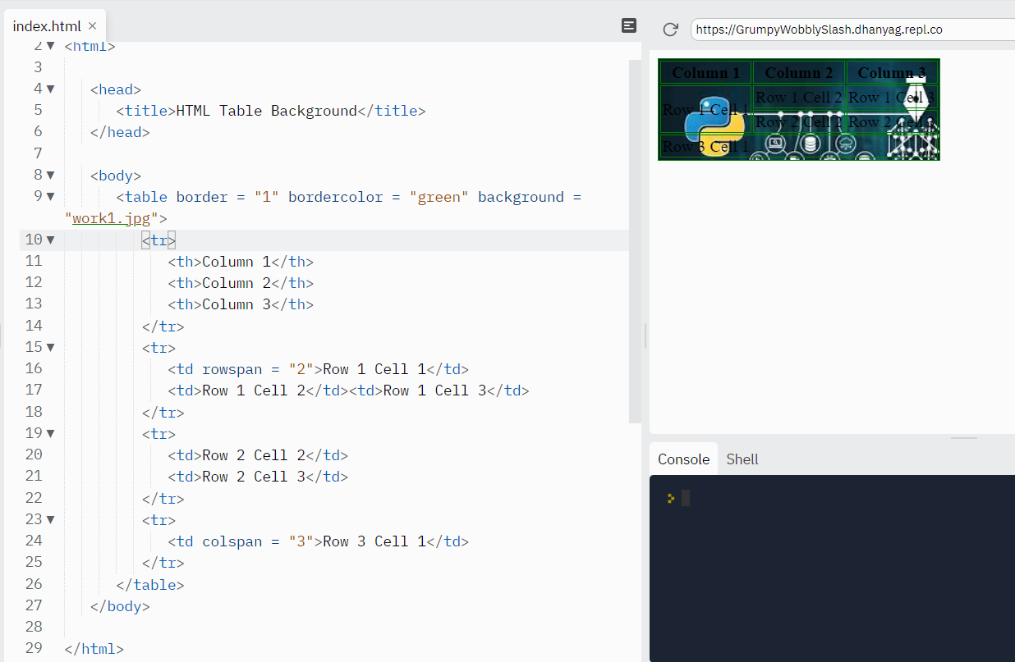

Slide 46
● Frames & Frameset.
HTML Frames are used to divide the web browser window into multiple sections where each section can be loaded separately. A frameset tag is the collection of frames in the browser window.
Creating Frames: Instead of using body tag, use frameset tag in HTML to use frames in web browser

Slide 47
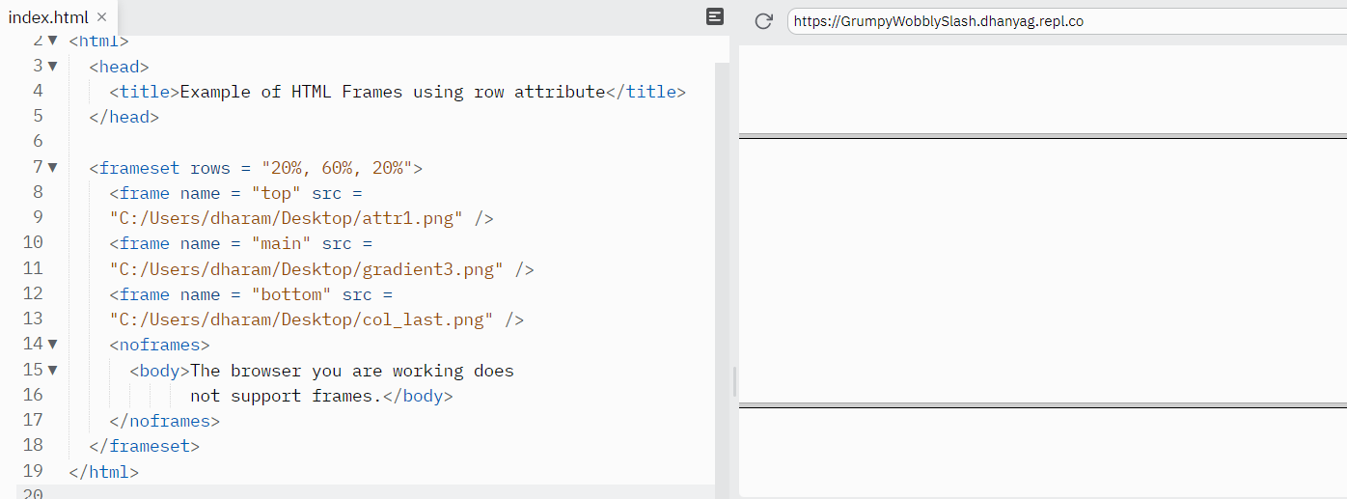
Frames

Slide 48
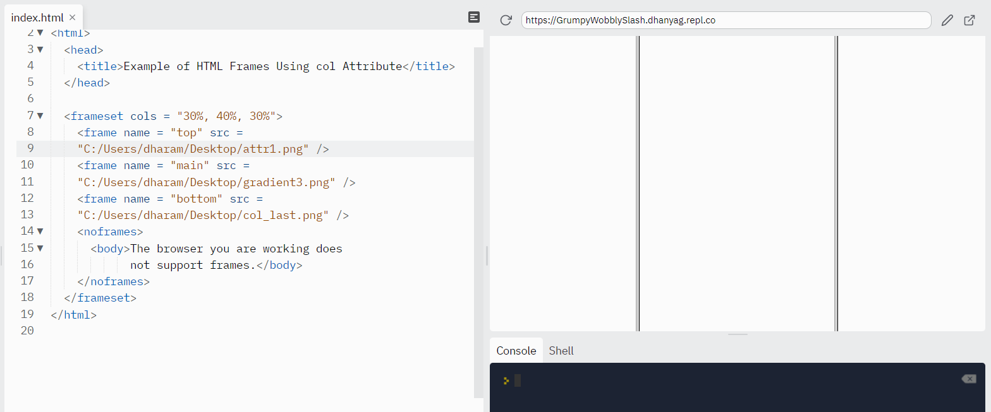
cols

Slide 49
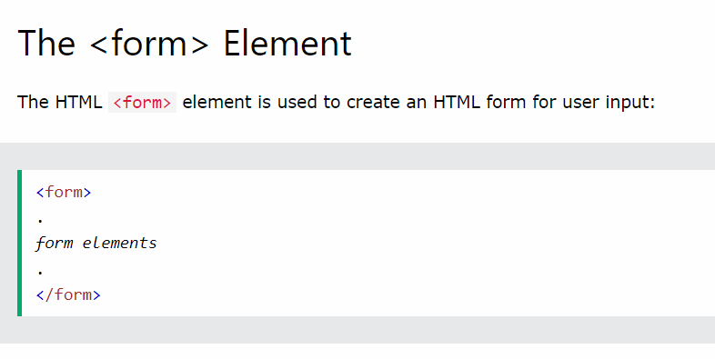
Forms

Slide 50
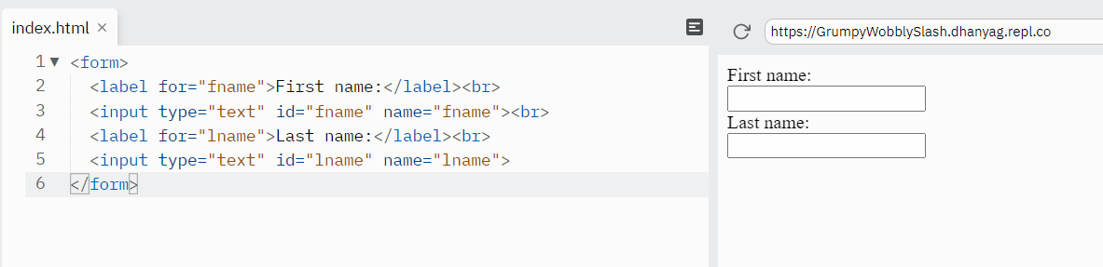
Text Fields

Slide 51
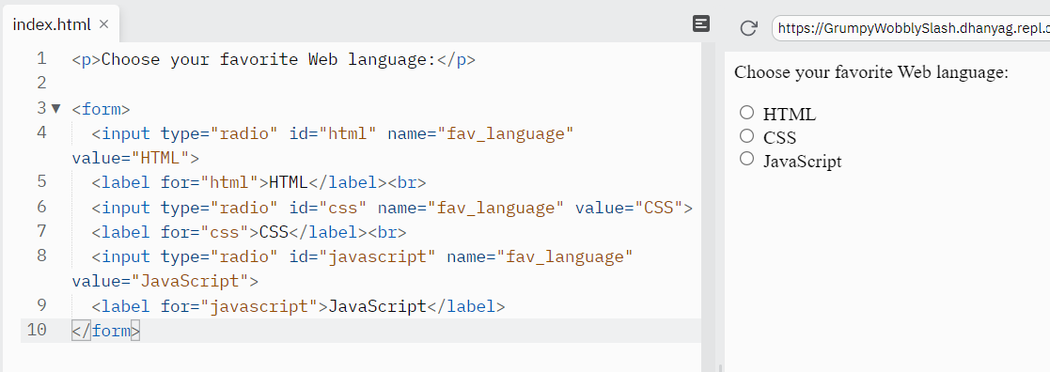
Radio Buttons

Slide 52
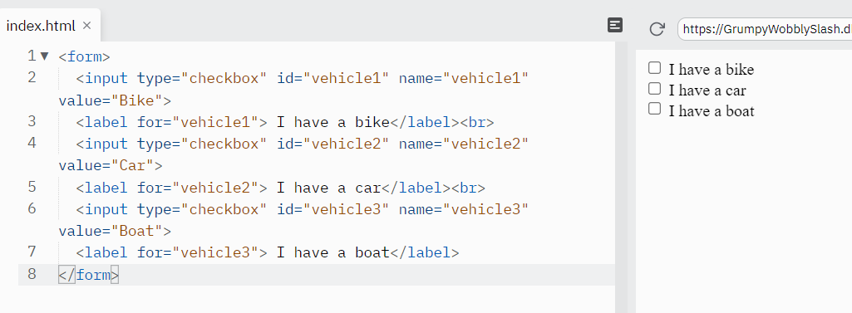
Checkboxes

Slide 53
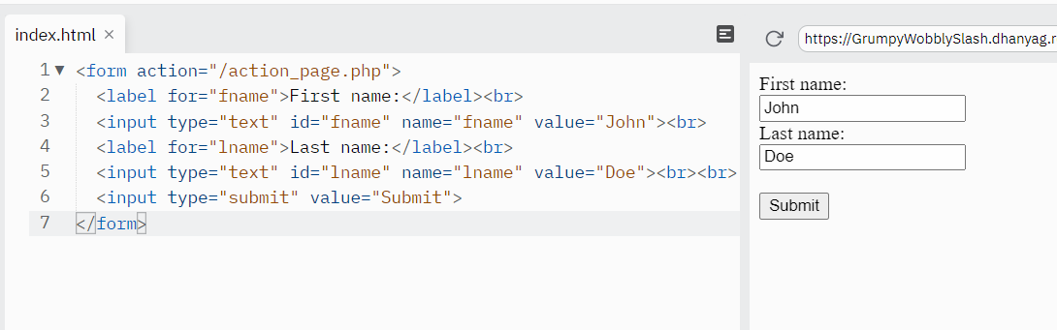
The Submit Button

Slide 54
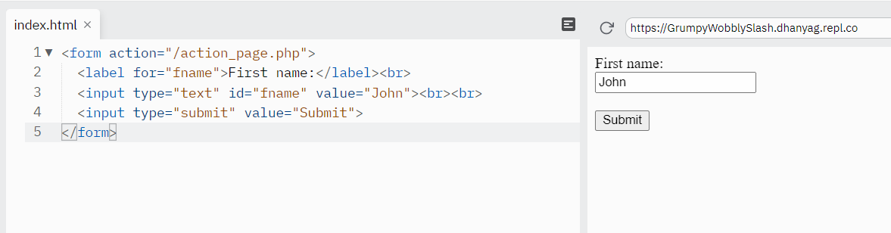
The Name Attribute for <input>

Slide 55
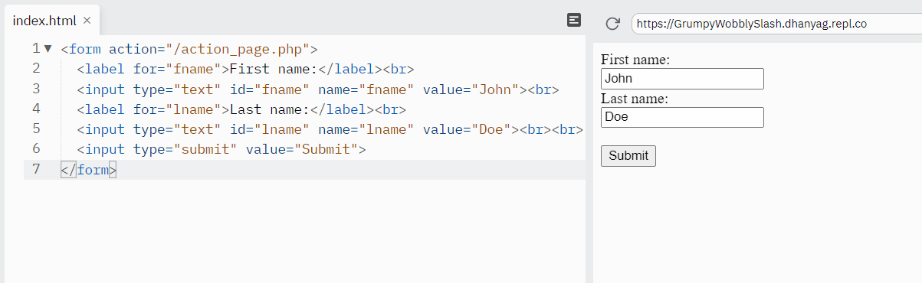
The Action Attribute

Slide 56
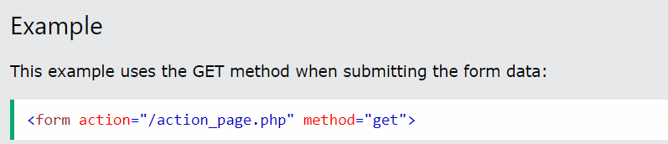
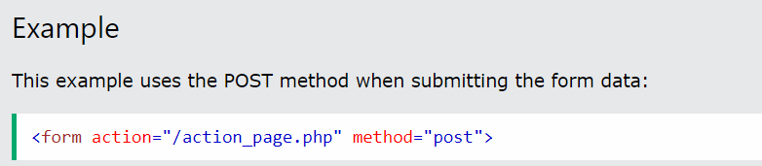
The Method Attribute

Slide 57
GET and POST
Notes on GET:
Appends the form data to the URL, in name/value pairs
NEVER use GET to send sensitive data! (the submitted form data is visible in the URL!)
The length of a URL is limited (2048 characters)
Useful for form submissions where a user wants to bookmark the result
GET is good for non-secure data, like query strings in Google
Notes on POST:
Appends the form data inside the body of the HTTP request (the submitted form data is not shown in the URL)
POST has no size limitations, and can be used to send large amounts of data.
Form submissions with POST cannot be bookmarked

