Slide 1
Javascript

Slide 2
Introduction
JavaScript is a lightweight, cross-platform, and interpreted scripting language. It is well-known for the development of web pages, many non-browser environments also use it.
JavaScript can be used for Client-side developments as well as Server-side developments. JavaScript contains a standard library of objects, like Array, Date, and Math, and a core set of language elements like operators, control structures, and statements.

Slide 3
JavaScript can be added to your HTML file in two ways:
Internal JS: We can add JavaScript directly to our HTML file by writing the code inside the <script> tag. The <script> tag can either be placed inside the <head> or the <body> tag according to the requirement.
External JS: We can write JavaScript code in other file having an extension .js and then link this file inside the <head> tag of the HTML file in which we want to add this code.

Slide 4
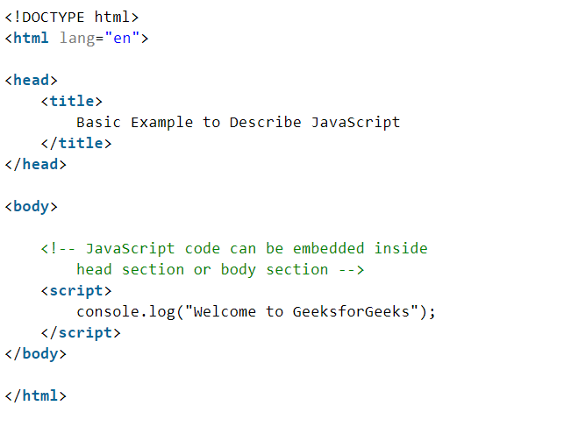

Slide 5
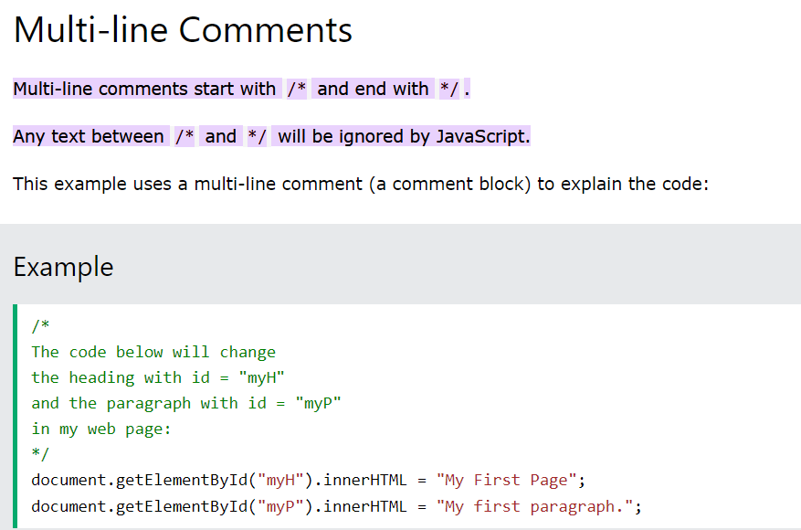
● Statements and Comments

Slide 6
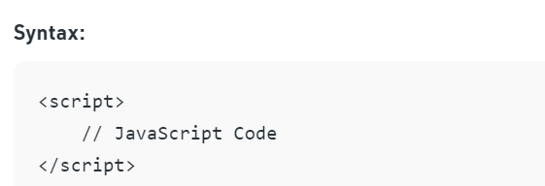
Syntax

Slide 7
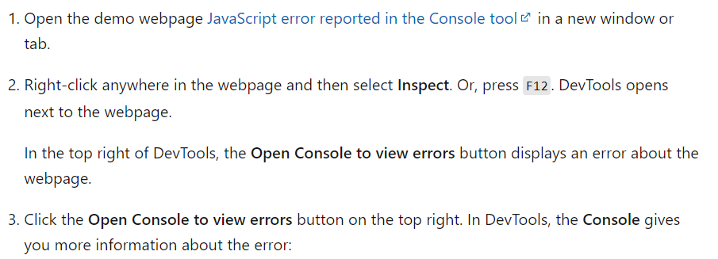
● Finding Errors

Slide 8
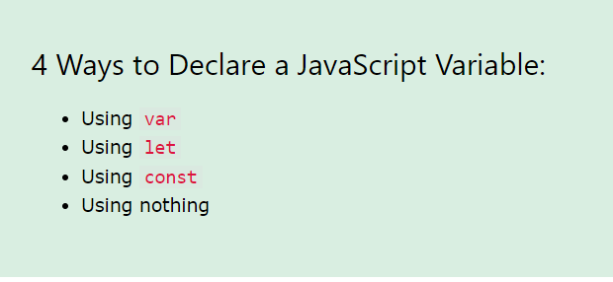
Variables

Slide 9
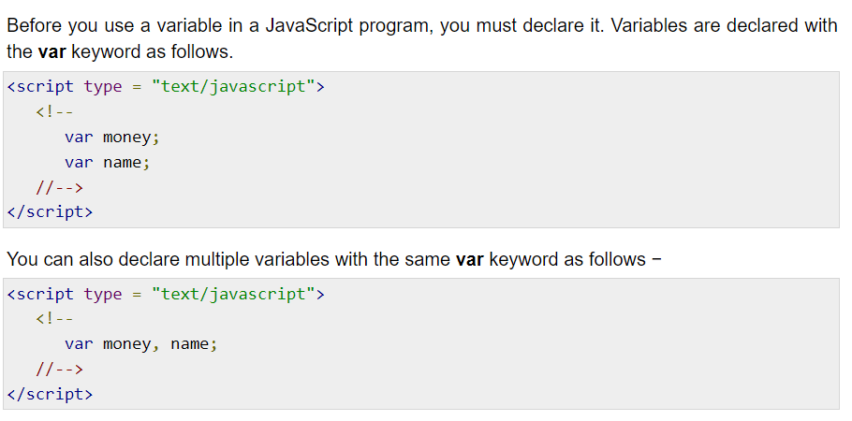

Slide 10
JavaScript Variable Scope
The scope of a variable is the region of your program in which it is defined. JavaScript variables have only two scopes.
Global Variables − A global variable has global scope which means it can be defined anywhere in your JavaScript code.
Local Variables − A local variable will be visible only within a function where it is defined. Function parameters are always local to that function.

Slide 11
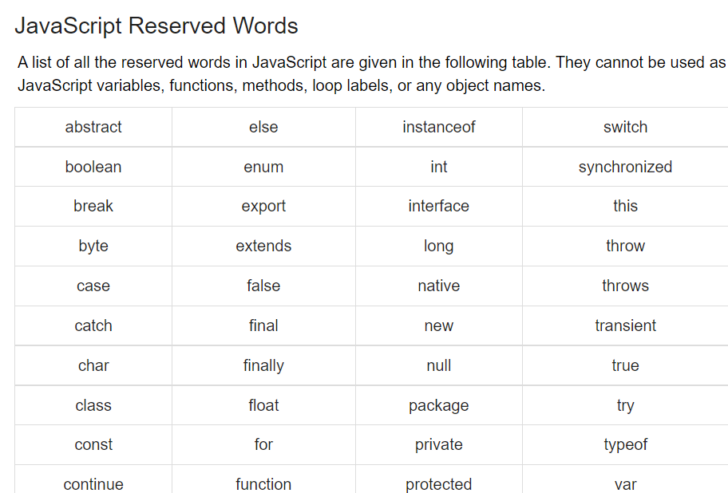
These cannot be variables

Slide 12
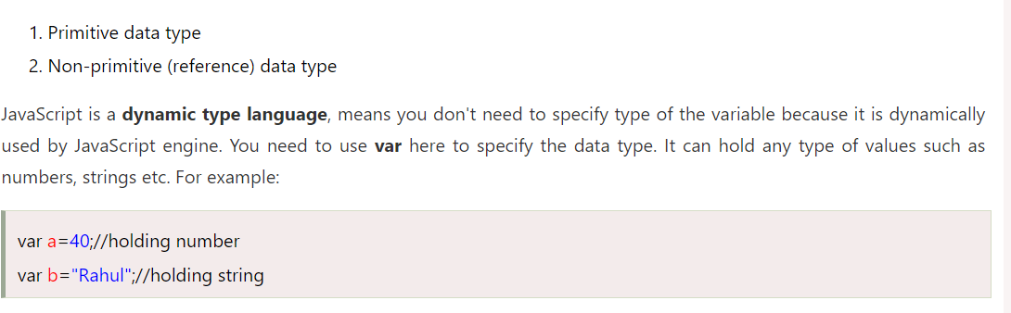
Javascript Data Types

Slide 13
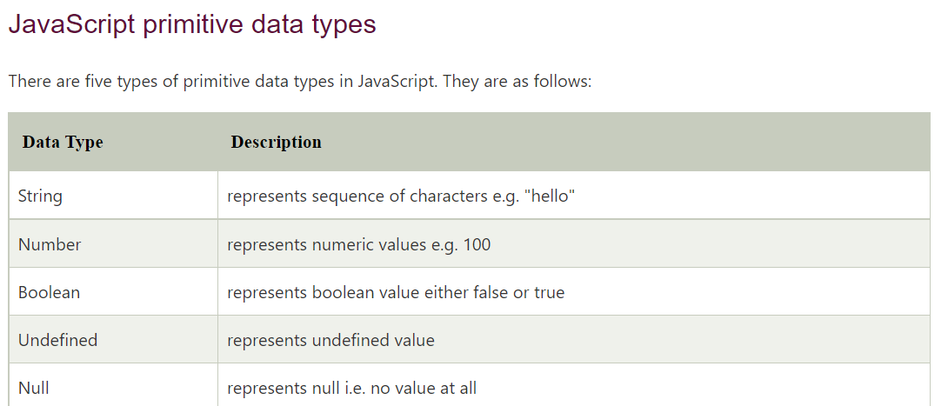

Slide 14
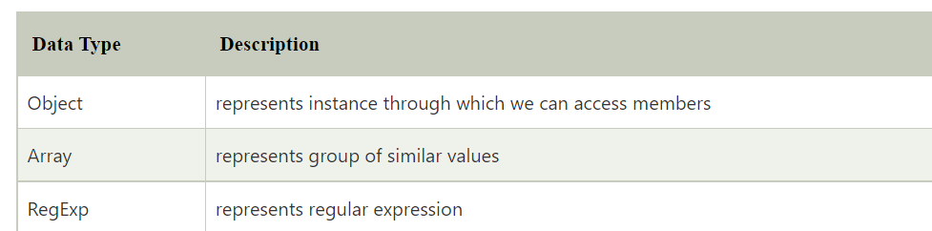

Slide 15
JavaScript Operators
Here, + is the arithmetic operator and = is the assignment operator.
There are following types of operators in JavaScript.
Arithmetic Operators
Comparison (Relational) Operators
Bitwise Operators
Logical Operators
Assignment Operators
Special Operators

Slide 16
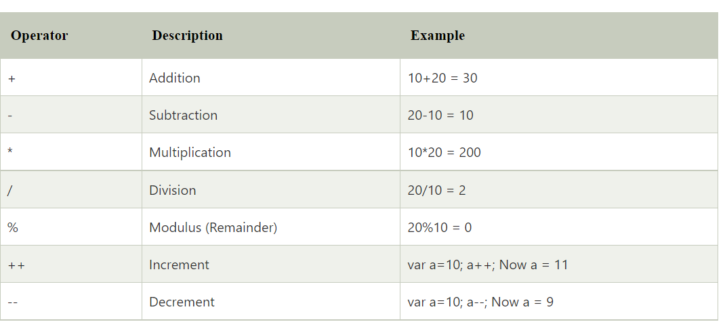
JavaScript Arithmetic Operators

Slide 17
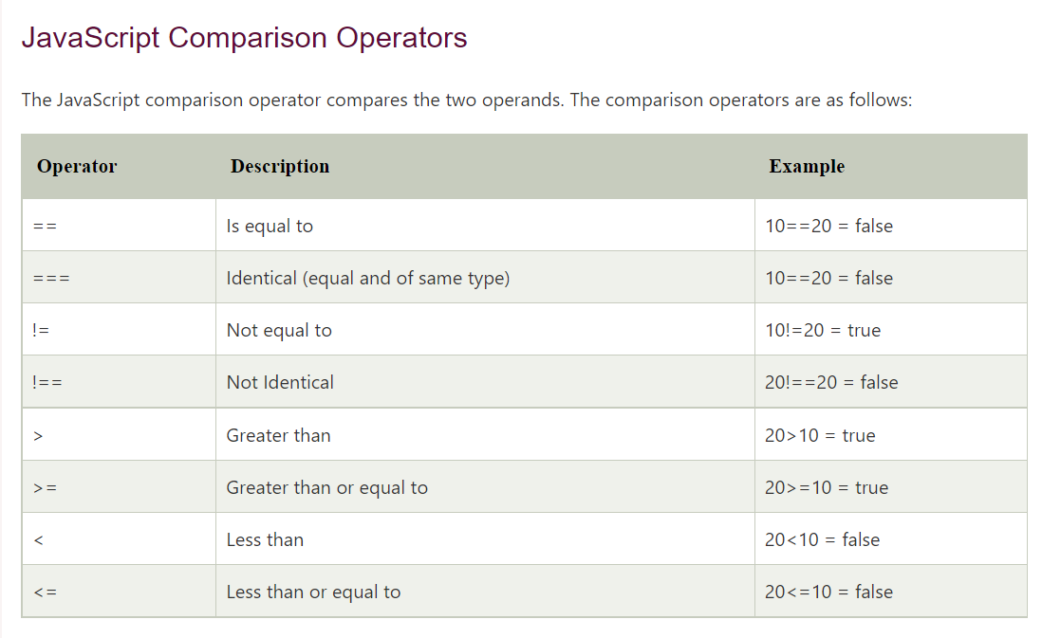

Slide 18
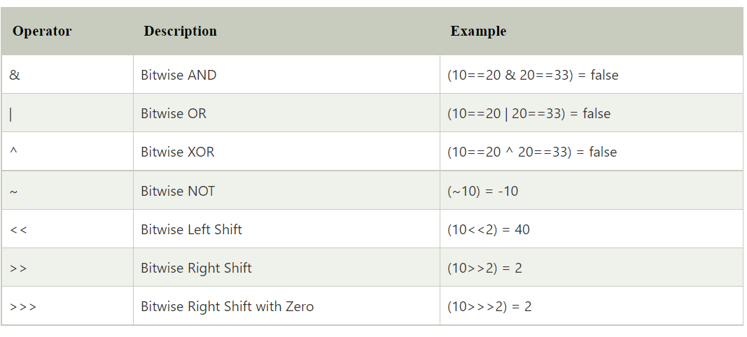
JavaScript Bitwise Operators

Slide 19
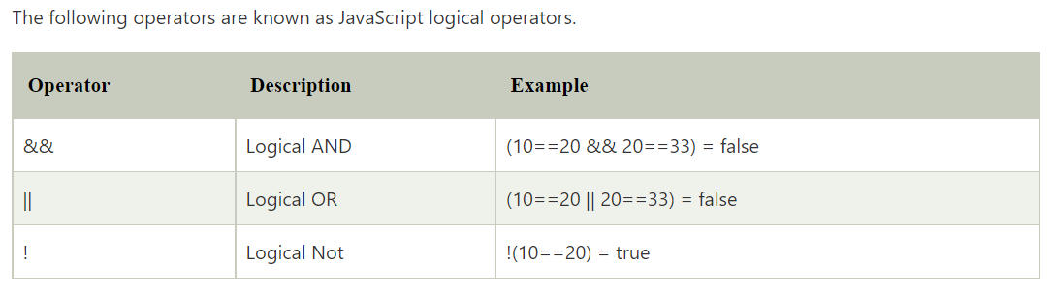
JavaScript Logical Operators

Slide 20
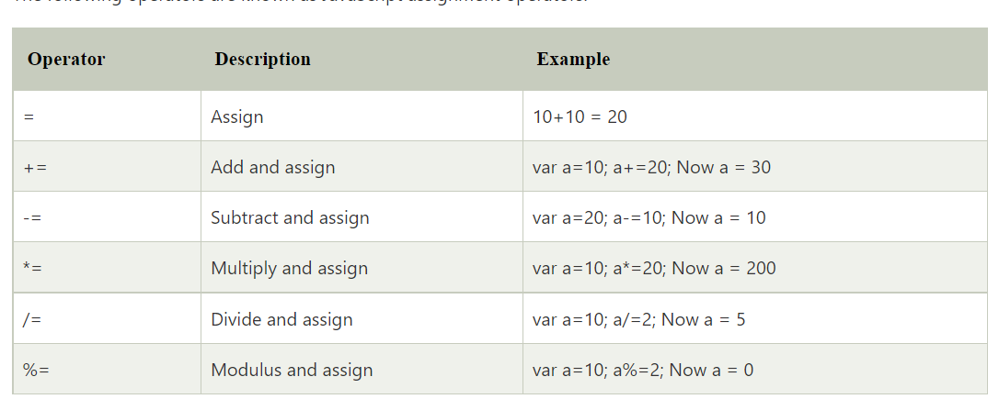
JavaScript Assignment Operators

Slide 21
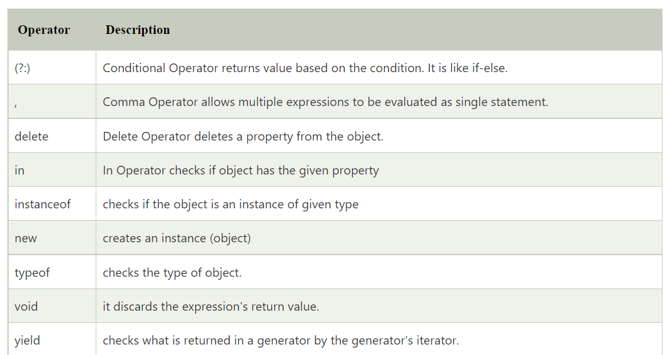
JavaScript Special Operators

Slide 22
JavaScript If-else
If Statement
If else statement
if else if statement

Slide 23
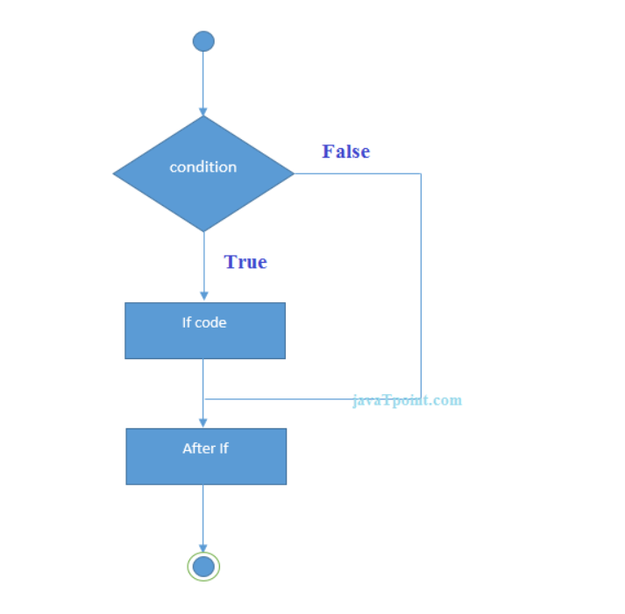
If statement

Slide 24
Let’s see the simple example of if statement in javascript.
<script>
var a=20;
if(a>10){
document.write("value of a is greater than 10");
}
</script>

Slide 25
JavaScript If...else Statement
if(expression){
//content to be evaluated if condition is true
}
else{
//content to be evaluated if condition is false
}

Slide 26
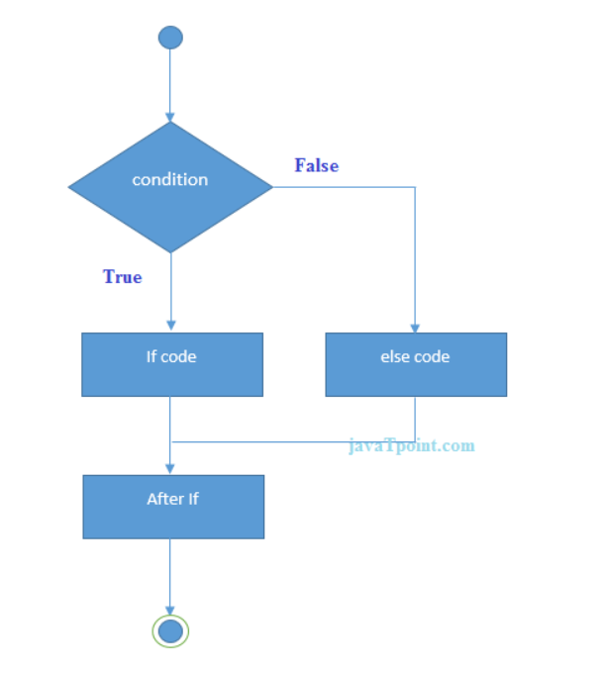

Slide 27
<script>
var a=20;
if(a%2==0){
document.write("a is even number");
}
else{
document.write("a is odd number");
}
</script>

Slide 28
JavaScript If...else if statement
if(expression1){
//content to be evaluated if expression1 is true
}
else if(expression2){
//content to be evaluated if expression2 is true
}
else if(expression3){
//content to be evaluated if expression3 is true
}
else{
//content to be evaluated if no expression is true
}

Slide 29
<script>
var a=20;
if(a==10){
document.write("a is equal to 10");
}
else if(a==15){
document.write("a is equal to 15");
}
else if(a==20){
document.write("a is equal to 20");
}
else{
document.write("a is not equal to 10, 15 or 20");
}
</script>

Slide 30
switch
<script>
var grade='B';
var result;
switch(grade){
case 'A':
result="A Grade";
break;
case 'B':

Slide 31
result="B Grade";
break;
case 'C':
result="C Grade";
break;
default:
result="No Grade";
}
document.write(result);
</script>

Slide 32
Strings
JavaScript String Length
let txt = "ABCDEFGHIJKLMNOPQRSTUVWXYZ";
let length = txt.length;

Slide 33
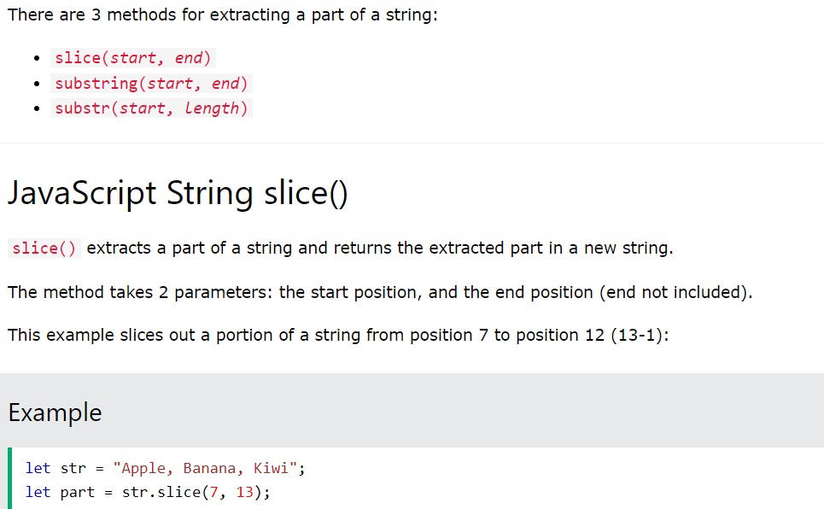
Extracting String Parts

Slide 34
Example
let str = "Apple, Banana, Kiwi";
let part = str.slice(-12, -6);
let part = str.slice(7)
let part = str.slice(-12);

Slide 35
let str = "Apple, Banana, Kiwi";
let part = str.substring(7, 13);
let str = "Apple, Banana, Kiwi";
let part = str.substr(7, 6);

Slide 36
let str = "Apple, Banana, Kiwi";
let part = str.substr(7);
let str = "Apple, Banana, Kiwi";
let part = str.substr(-4);

Slide 37
Replacing String Content
let text = "Please visit Microsoft!";
let newText = text.replace("Microsoft", "W3Schools");

Slide 38
The replace() method does not change the string it is called on.
The replace() method returns a new string.
The replace() method replaces only the first match

Slide 39
let text1 = "Hello World!";
let text2 = text1.toUpperCase();
let text1 = "Hello World!"; // String
let text2 = text1.toLowerCase(); // text2 is text1 converted to lower

Slide 40
let text1 = "Hello";
let text2 = "World";
let text3 = text1.concat(" ", text2);
let text1 = " Hello World! ";
let text2 = text1.trim();

Slide 41
let text = "5";
let padded = text.padStart(4,"x");
let text = "HELLO WORLD";
let char = text.charAt(0);

Slide 42
JavaScript Functions
A JavaScript function is a block of code designed to perform a particular task.
A JavaScript function is executed when "something" invokes it (calls it).

Slide 43
function myFunction(p1, p2) {
return p1 * p2; // The function returns the product of p1 and p2
}

Slide 44
JavaScript Function Syntax
function name(parameter1, parameter2, parameter3) {
// code to be executed
}

Slide 45
Function Invocation
The code inside the function will execute when "something" invokes (calls) the function:
When an event occurs (when a user clicks a button)
When it is invoked (called) from JavaScript code
Automatically (self invoked)

Slide 46
Function Return
let x = myFunction(4, 3); // Function is called, return value will end up in x
function myFunction(a, b) {
return a * b; // Function returns the product of a and b
}

Slide 47
Convert Fahrenheit to Celsius:
function toCelsius(fahrenheit) {
return (5/9) * (fahrenheit-32);
}
document.getElementById("demo").innerHTML = toCelsius(77);

Slide 48
Local Variables
// code here can NOT use carName
function myFunction() {
let carName = "Volvo";
// code here CAN use carName
}
// code here can NOT use carName

Slide 49
JavaScript while Loop
let text = "";
let i = 0;
while (i < 5) {
text += i + "<br>";
i++;
}

Slide 50
const cars = ["BMW", "Volvo", "Saab", "Ford"];
let text = "";
let i = 0;
while (i < cars.length) {
text += cars[i] + "<br>";
i++;
}

Slide 51
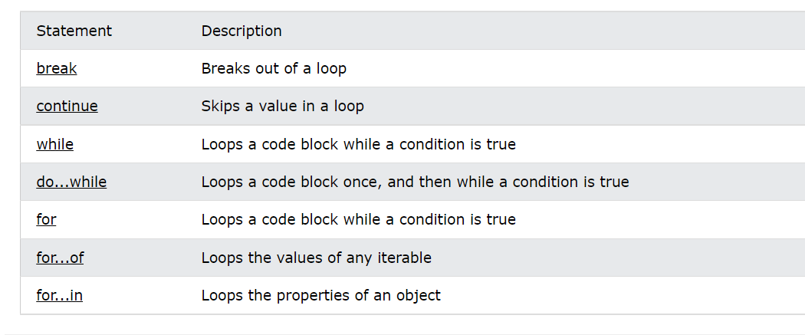

Slide 52
while
while (condition) {
code block to be executed
}
Example :
const cars = ["BMW", "Volvo", "Saab", "Ford"];
let text = "";
let len = cars.length;
while (len--) {
text += cars[len] + "<br>";
}

Slide 53
let text = "";
let i = 0;
while (i < 5) {
text += i + "<br>";
i++;
if (i == 3) break;
}

Slide 54
let text = "";
let i = 0;
while (i < 5) {
i++;
if (i == 3) continue;
text += i + "<br>";
}

Slide 55
Do while
let text = "";
let i = 0;
do {
text += i + "<br>";
i++;
}
while (i < 5);

Slide 56
The For In Loop
for (key in object) {
// code block to be executed
}
const person = {fname:"John", lname:"Doe", age:25};
let text = "";
for (let x in person) {
text += person[x];
}

Slide 57
JavaScript Forms
function validateForm() {
let x = document.forms["myForm"]["fname"].value;
if (x == "") {
alert("Name must be filled out");
return false;
}
}

Slide 58
HTML form
<form name="myForm" action="/action_page.php" onsubmit="return validateForm()" method="post">
Name: <input type="text" name="fname">
<input type="submit" value="Submit">
</form>

Slide 59
Automatic HTML Form Validation
<form action="/action_page.php" method="post">
<input type="text" name="fname" required>
<input type="submit" value="Submit">
</form>

Slide 60
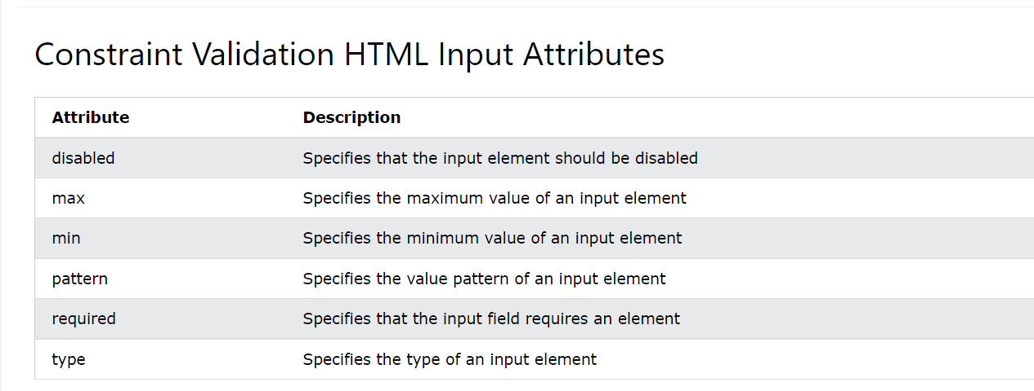

Slide 61
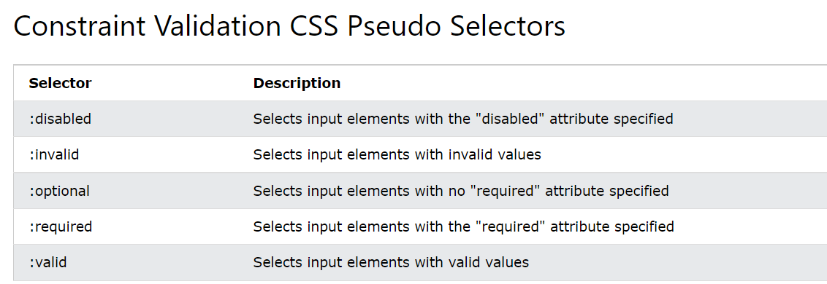

Slide 62
Form submission
<html>
<head>
<style>
input
{
border-radius:20px;}
</style>
</head>
<body>
<h1> onsubmit function </h1>
<form onsubmit="alert('edureka!');return false">
Enter the values <input type="text" value="text"><br>
<input type="submit" value="Submit">
</form>
</body>
</html>

Slide 63
JavaScript Form Validation
<script>
function validateform(){
var name=document.myform.name.value;
var password=document.myform.password.value;
if (name==null || name==""){
alert("Name can't be blank");
return false;
}else if(password.length<6){
alert("Password must be at least 6 characters long.");
return false;
}
}

Slide 64
</script>
<body>
<form name="myform" method="post" action="abc.jsp" onsubmit="return validateform()" >
Name: <input type="text" name="name"><br/>
Password: <input type="password" name="password"><br/>
<input type="submit" value="register">
</form>

Slide 65
JavaScript Retype Password Validation
<script type="text/javascript">
function matchpass(){
var firstpassword=document.f1.password.value;
var secondpassword=document.f1.password2.value;
if(firstpassword==secondpassword){
return true;
}
else{
alert("password must be same!");
return false;
}
}
</script>

Slide 66
<form name="f1" action="register.jsp" onsubmit="return matchpass()">
Password:<input type="password" name="password" /><br/>
Re-enter Password:<input type="password" name="password2"/><br/>
<input type="submit">
</form>

Slide 67
Radio button
<p> Choose your favroite season: </p>
<input type="radio" name="JTP" id="summer" value="summer">Summer<br>
<input type="radio" name="JTP" id="winter" value="winter">Winter<br>
<input type="radio" name="JTP" id="rainy" value="rainy">Rainy<br>
<input type="radio" name="JTP" id="autumn" value="autumn">Autumn<br>

Slide 68
if(document.getElementById('summer').checked == true) {
document.write("Summer radio button is selected");
} else {
document.write("Summer radio button is not selected");
}

Slide 69
checkbox
function check() {
document.getElementById("myCheck").checked = true;
}
function uncheck() {
document.getElementById("myCheck").checked = false;
}

Slide 70
Changing CSS
<script>
// Get the root element
var r = document.querySelector(':root');
// Create a function for getting a variable value
function myFunction_get() {
// Get the styles (properties and values) for the root
var rs = getComputedStyle(r);
// Alert the value of the --blue variable
alert("The value of --blue is: " + rs.getPropertyValue('--blue'));
}
// Create a function for setting a variable value
function myFunction_set() {
// Set the value of variable --blue to another value (in this case "lightblue")
r.style.setProperty('--blue', 'lightblue');
}
</script>

